Slide 1
Biological Safety Cabinets and
Chemical Fume Hoods
By Bukola Akinjobi, Carrie Beard, and Jennifer Roper

Slide 2
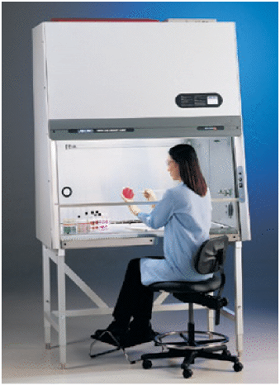
Biological Safety Cabinets
Biological Safety Cabinets (BSC):
  primary means of containment developed for working safely with infectious microorganisms

Slide 3
Why Use BSCs?
Biological Safety Cabinets are built for three types of protection:
Product protection: avoid contamination of the work, experiment, or process
2. Environment protection from contaminants within the cabinet
3. Personnel protection from harmful agents in the cabinet

Slide 4
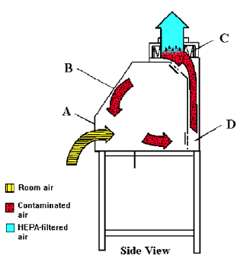
Class I BSCs
Provides personnel and environment protection only. No product protection.
Suitable for low to moderate risk (biosafety 1,2, and 3)
HEPA filter protects environment by filtering air before it is exhausted

Slide 5
Class II BSCs
Provides personnel, environment, and product protection
Widely used in clinical, hospital, life science, research and pharmaceutical laboratories.
Have 3 main features:
    A front opening with careful maintained inward airflow
    HEPA-filtered unidirectional airflow inside the work area
    HEPA-filtered exhaust air to the room or exhaust air to a facility exhaust system

Slide 6
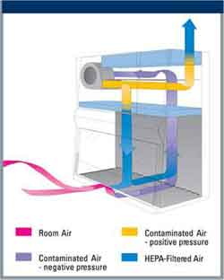
Class II BSCs
Type A1 and A2 HEPA filtered exhaust air may be recirculated into the room or released outside
70% of air is recirculated, 30% of air filtered through an exhaust and into the room

Slide 7
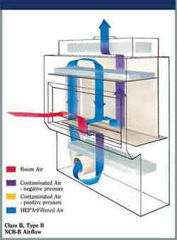
Class II BSCs
Type B1 offers more protection to the personnel if vapor source is at rear of work area
Exhausts 60% of circulated air through HEPA exhaust filter and 40% of air is recirculated to work area through HEPA supply filter

Slide 8
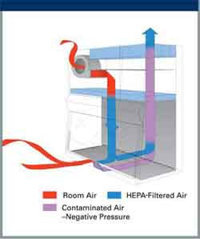
Class II BSCs
Type B2
0% air recirculated, 100% exhausted from cabinet
Widely used in toxicology labs and similar labs where clean air is essential

Slide 9
Class III
Used to work with microbiological agents assigned to biosafety level 4
Provides maximum protection to personnel and environment
Applications for Cabinet:
    Working with emerging diseases
    Working with diseases that are near eradication
    Weighing and diluting chemical carcinogens
    Working with highly infectious or hazardous experimental materials
    Working with low to moderate risk agents

Slide 10
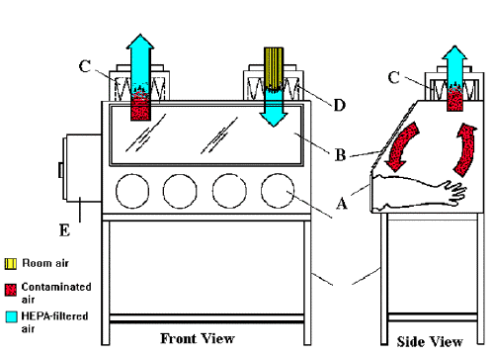
Class III

Slide 11
BSC Operating Procedures
Ready Work Area
  turn off UV lamp, turn on fluorescent
  check air grilles for obstructions, switch on blower
  allow air to purge work space five minutes
Pre-disinfect
  spray or swab all interior surfaces with appropriate disinfectant
  allow to air dry
Assemble material
  introduce only material required to perform procedure
  place material such that clean and contaminated items do not meet
  place contaminated material container at right rear
  ensure view screen is properly located and secured
Pre-purge cabinet
  allow air purge period with no activity inside (leave blower on!)
Prepare self don protective clothing, gloves, mask, etc. as appropriate

Slide 12
BSC Operating Procedure
Do the procedures DO NOT remove hands from work space until procedures are complete and all critical material is secured, remove gloves into contaminated material container
Post-purge cabinet allow air purge period with no activity inside (leave blower on!)
Finish personally
remove protective clothing, mask, and wash hands
Post-disinfect don gloves, remove materials to incubator, to biohazard bag, autoclave as appropriate, spray or swab all interior surfaces with appropriate disinfectant
Shutdown cabinet
turn off blower and fluorescent lamp, turn on UV lamp

Slide 13
Safe Work Practices for BSC Use
Do not use the top of the cabinet for storage. The HEPA filter could be damaged and the airflow disrupted.
Make sure the cabinet is level. If the cabinet base is uneven, airflow can be affected.
Never disengage the alarm. It indicates improper airflow and reduced performance which may endanger the researcher or the experiment.
Never completely close the window sash with the motor running as this condition may cause motor burnout.
Cabinets should be placed away from doors, windows, vents or high traffic areas to reduce air turbulence.

Slide 14
Safe Work Practices for BSC Use
For BSC without fixed exhaust, the cabinet exhaust should have a twelve inch clearance from the ceiling for proper exhaust air flow. Also, allow a twelve inch clearance on both sides of the cabinet for maintenance purposes.
Never operate a cabinet while a warning light or alarm is on.
The operator should be seated with shoulders level with the bottom of the sash.
Perform all work using a limited number of slow movements, as quick movements disrupt the air barrier. Try to minimize entering and exiting your arms from the cabinet, but if you need to, do it directly, straight out and slowly.
Keep all materials at least four inches inside the sash opening.
To avoid excessive movements in and out of the cabinet, discard pipettes into a tray, container or biohazard bag within the cabinet.

Slide 15
Safe Work Practices for BSC Use
If a bunsen burner must be used, place it at the rear of the work area where the air turbulence from the flame will have the least possible effect on the air stream. Often the use of a flame is redundant in what should be a germ free work space.
All equipment which has come in contact with the biological agent should be decontaminated. The cabinet should be allowed to run for at least three minutes with no activity so that the airborne contaminants will be purged from the work area before removing equipment.
After all items have been removed, wipe the interior surfaces with disinfectant.

Slide 16
Biological Safety Cabinet Certification
A cabinet must be certified when first installed and then annually. It must be recertified anytime it is moved even within the same room. Before certification personnel arrive, remove all items from the cabinet and wipe it down with a disinfectant. This will expedite the certification. Any decontaminations, certifications, repairs or adjustments are to be made by qualified personnel.

Slide 17
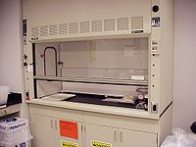
Fume Hoods
A fume hood or fume cupboard is a large piece of scientific equipment common to chemistry laboratories designed to limit a person's exposure to hazardous and/or unpleasant fumes.

Slide 18
Fume Hoods
For worker protection, the laboratory fume hood is the most useful piece of safety equipment found in the lab. When used appropriately, fume hoods not only provide protection from toxic gases and vapors but also provide protection from unanticipated fires and explosions. In short it could save one from serious injury or death.

Slide 19
When to use…
When handling chemicals with significant inhalation hazards such as toxic gases, toxic chemical vapors, volatile radioactive material, and respirable toxic powders
When carrying out experimental procedures with strong exothermic reactions
When handling chemicals with significant vapor pressure
When chemical vapors generated could cause a fire hazard
When working with compounds that have an offensive odor

Slide 20
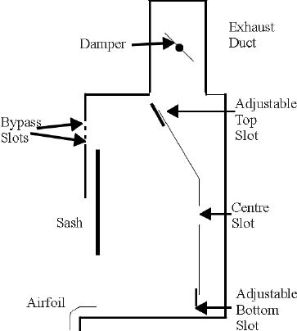
How it works…
The principle is the same for all units; air is drawn in from the front of the cabinet by a fan, and either expelled outside the building or made safe through filtration and fed back into the room.

Slide 21
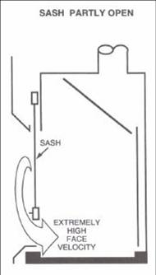
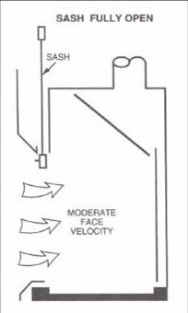
Standard Fume Hood
Constant air volume
Less elaborate
Used for general protection
the face velocity of a CAV hood is inversely proportional to the sash height
  The lower the sash, the higher the face velocity

Slide 22
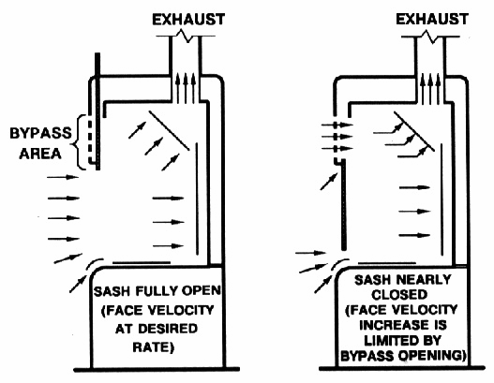
Bypass Fume Hood
Improved variation of the standard fume hood
The bypass is located above the sash face opening and protected by a grille which helps to direct air flow.
The bypass is intended to address the varying face velocities that create air turbulence leading to air spillage.
The bypass limits the increase in face velocity as the sash nears the fully closed position, maintaining a relatively constant volume of exhaust air regardless of sash position

Slide 23
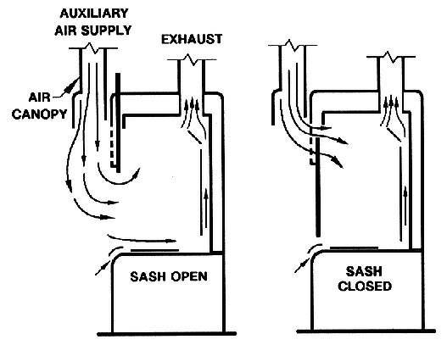
Auxiliary Air hood
Variation on the bypass fume hood and reduces the amount of conditioned room air that is consumed.
The auxiliary fume hood is a bypass hood with the addition of directly ducted auxiliary air to provide unconditioned or partially conditioned outside makeup air.
Auxiliary air hoods were designed to save heating and cooling energy costs, but increase the mechanical and operational costs due to the additional ductwork, fans, and air tempering facilities.
Unless the volume (and therefore velocity) of auxiliary air is carefully adjusted, the air curtain created will affect the hood operation and may pull vapors out of the hood interior.

Slide 24
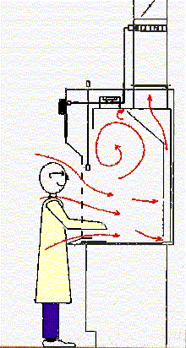
Optimal Performance
Should be located in an area of minimal traffic
Air flow indicators
  Should indicate inward movement
Face velocity should be around 100 fpm (feet per minute)
  At velocities greater than 125 fpm, studies have demonstrated that the creation of turbulence causes contaminants to flow out of the hood and into the user's breathing zone.

Slide 25
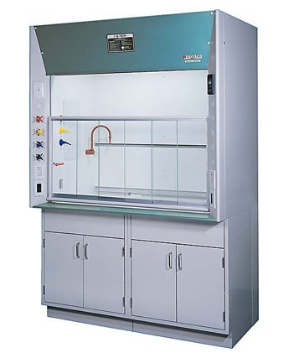
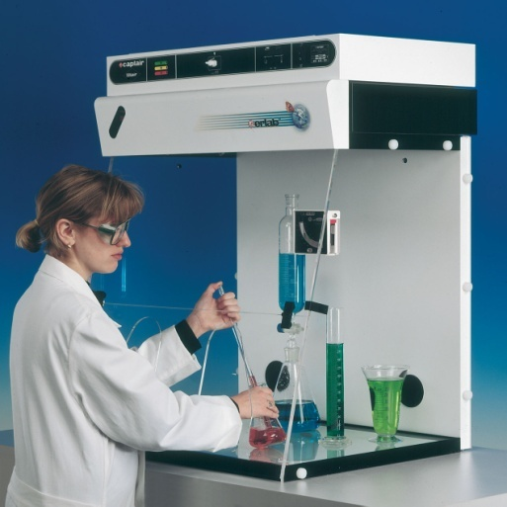
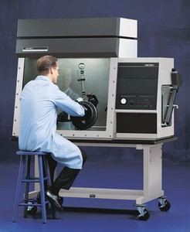
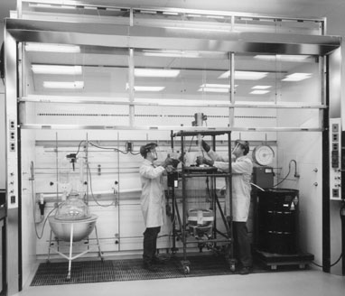
Different types

Slide 26
Safe Work Practices
Train and educate employees regarding specific hazards and include work methods that help reduce contaminant exposure
Never lean your head inside the fume hood when chemicals are present
Avoid cross drafts.
  Someone walking rapidly past the work opening can create a cross draft that may disturb the direction of airflow and cause turbulence
Keep exhaust fan on at all times
Keep the hood sash closed as much as possible at all times to ensure the optimum face velocity and to minimize energy usage.
Keep lab doors closed to ensure negative room pressure to the corridor and proper air flow into the hood.
Keep all work at least 6 inches inside the hood.
  The capture ability of a fume hood may not be 100% at the front of the hood

Slide 27
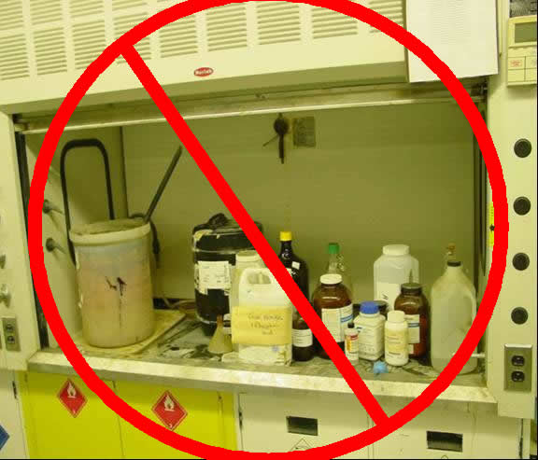
Maintenance
Keep the hood clean.
Remove old experimental glassware and clutter.
Wipe up spilled chemicals or residues.
Make sure you can see through the glass sash.
Minimize storage. Do not take up hood space and block ventilation by storing unused equipment or chemicals in hood
Prevent pollution.
  The chemical vapors generated in most hoods are exhausted into the atmosphere.
  To minimize pollution, seal all chemical containers not in use.
  Never use the hood to vent excess chemical waste.
  By law, all chemical containers must be capped when the hood is not operating.

Slide 28
Maintenance
Daily fume hood inspection
  Visually inspect the fume hood area for storage of material and other visible blockages.
  If hood function indicating devices are not a part of your fume hood, place a 1 inch by 6 inch piece of soft tissue paper at the hood opening and observe it for appropriate directional flow into the hood.
Periodic fume hood function inspection
  Capture or face velocity will be measured with a velometer or anemometer.
  Hoods for most common chemicals must have an average face velocity of 100 linear feet per minute at sash opening of 18 inches or higher.
  Face velocity readings should not vary by more than 20%. A minimum of six readings shall be used determine average face velocity.
  Other local exhaust devices shall be smoke tested to determine if the contaminants they are designed to remove are being adequately captured by the hood.
Annual maintenance
  Exhaust fan maintenance, (i.e.,lubrication, belt tension, fan blade deterioration and rpm), shall be in accordance with the manufacturer’s recommendation or as adjusted for appropriate hood function.

Slide 29
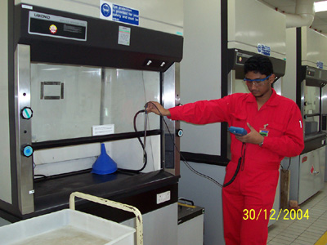
Inspection
American Society of Heating, Refrigerating and Air-Conditioning Engineers (ASHRAE) Issued standards for testing and certification
A random sample of chemical hoods can be tested for leakage and proper capture integrity.
  A tracer gas such as sulfur hexafluoride is delivered into the hood and measurements of concentration are collected around the hood to determine gas escape.
  A mannequin is placed at the face of a hood to simulate an operator's presence.

Slide 30
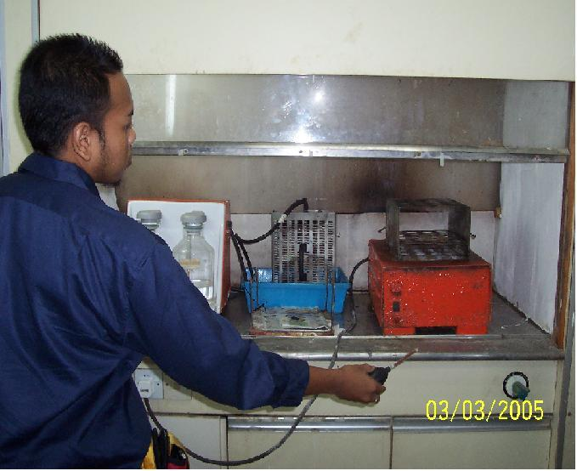
Face Velocity and Smoke Testing

Slide 31
Hired Specialist
Example
National Laboratory Specialists
  Identify the fume hood airflow requirements and ensures they operate in conjunction with the building HVAC system.
  When purchasing a new fume hood, will help ensure you have the right hood for your application.
  Verifies proper installation of your fume hood. Ensures proper fume containment, airflow and exhaust discharge.
  Ensures all of the above meet federal and state guidelines.
  Provides you with "ASHRAE 110-1995-All Test" results and certifies hoods in compliance with established test criteria

Slide 32
Refrences
Images and Infromation:
http://www.cdc.gov/od/ohs/biosfty/bsc/bsc.htm
http://www.bakerco.com/resources/intro.php
http://en.wikipedia.org/wiki/Fume_hood
http://www.research.northwestern.edu/ors/labsafe/hoods/index.htm#Introduction
http://www.ehs.berkeley.edu/pubs/factsheets/09fumehd.html
http://oregonstate.edu/ehs/vent/hood.php
http://www.labtech-midwest.com/testingvalidation/fumehood.asp

