Slide 1
Waste Management

Slide 2
What are Wastes?
  Waste (also known as rubbish, trash, refuse, garbage, junk, litter, and ort) is unwanted or useless materials. In biology, waste is any of the many unwanted substances or toxins that are expelled from living organisms, metabolic waste; such as urea and sweat.
Basel Convention Definition of Wastes
“substances or objects which are disposed of or are intended to be disposed of or are required to be disposed of by the provisions of the law”
Disposal means
“any operation which may lead to resource recovery, recycling, reclamation, direct re-use or alternative uses (Annex IVB of the Basel convention)”

Slide 3
Basel Convention
The Basel Convention on the Control of Transboundary Movements of Hazardous Wastes and Their Disposal, usually known simply as Basel Convention, is an international treaty that was designed to reduce the movements of hazardous waste between nations, specially to prevent transfer of hazardous waste from developed to less developed countries (LDCs). It does not, however, address the movement of radioactive waste. The convention is also intended to minimize the amount and toxicity of wastes generated, to ensure their environmentally sound management as closely as possible to the source of generation, and to assist LDCs in environmentally sound management of the hazardous and other wastes they generate.
The Convention was opened for signature on 22nd March 1989, and entered into force on 5 May 1992.

Slide 4
The definition…………
Produced by the United Nations Statistics Division (U.N.S.D.):
"Wastes are materials that are not prime products (that is products produced for the market) for which the generator has no further use in terms of his/her own purposes of production, transformation or consumption, and of which he/she wants to dispose. Wastes may be generated during the extraction of raw materials, the processing of raw materials into intermediate and final products, the consumption of final products, and other human activities. Residuals recycled or reused at the place of generation are excluded."

Slide 5
Kinds of Wastes
Solid wastes: wastes in solid forms, domestic, commercial and industrial wastes
Examples: plastics, styrofoam containers, bottles, cans, papers, scrap iron, and other trash
Liquid Wastes: wastes in liquid form
  Examples: domestic washings, chemicals, oils, waste water from ponds, manufacturing industries and other sources

Slide 6
According to EPA regulations, SOLID WASTE is
Any garbage or refuse (Municipal Solid Waste)
Sludge from a wastewater treatment plant, water supply treatment plant, or air pollution control facility
Other discarded material
Solid, liquid, semi-solid, or contained gaseous material from industrial, commercial, mining, and agricultural operations, and from community activities
http://www.epa.gov/epaoswer/osw/basifact.htm#solidwaste

Slide 7
Classification of Wastes according to their Properties
Bio-degradable
can be degraded (paper, wood, fruits and others)
Non-biodegradable
cannot be degraded (plastics, bottles, old machines,cans, styrofoam containers and others)

Slide 8
Classification of Wastes according to their Effects on Human Health and the Environment
Hazardous wastes
Substances unsafe to use commercially, industrially, agriculturally, or economically and have any of the following properties- ignitability, corrosivity, reactivity & toxicity.
Non-hazardous
Substances safe to use commercially, industrially, agriculturally, or economically and do not have any of those properties mentioned above. These substances usually create disposal problems.

Slide 9
Classification of wastes according to their origin and type
Municipal Solid wastes: Solid wastes that include household garbage, rubbish, construction & demolition debris, sanitation residues, packaging materials, trade refuges etc. are managed by any municipality.
Bio-medical wastes: Solid or liquid wastes including containers, intermediate or end products generated during diagnosis, treatment & research activities of medical sciences.
Industrial wastes: Liquid and solid wastes that are generated by manufacturing & processing units of various industries like chemical, petroleum, coal, metal gas, sanitary & paper etc.
Agricultural wastes: Wastes generated from farming activities. These substances are mostly biodegradable.
Fishery wastes: Wastes generated due to fishery activities. These are extensively found in coastal & estuarine areas.
Radioactive wastes: Waste containing radioactive materials. Usually these are byproducts of nuclear processes. Sometimes industries that are not directly involved in nuclear activities, may also produce some radioactive wastes, e.g. radio-isotopes, chemical sludge etc.
E-wastes: Electronic wastes generated from any modern establishments. They may be described as discarded electrical or electronic devices. Some electronic scrap components, such as CRTs, may contain contaminants such as Pb, Cd, Be or brominated flame retardants.

Slide 10
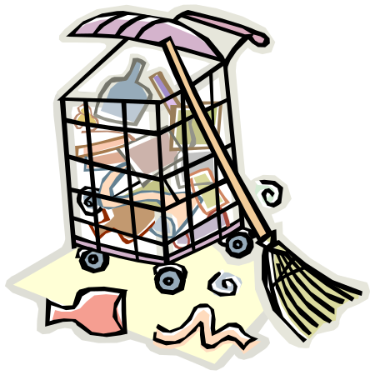
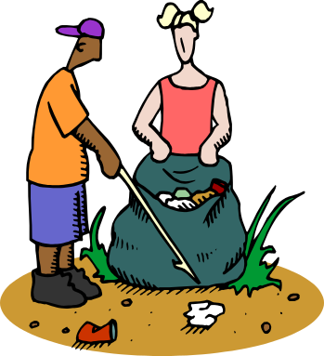


Sources of Wastes
Households
Commerce and Industry

Slide 11
IMPACTS OF WASTE IF NOT MANAGED WISELY
Affects our health
Affects our socio-economic conditions
Affects our coastal and marine environment
Affects our climate
GHGs are accumulating in Earth’s atmosphere as a result of human activities, causing global mean surface air temperature and subsurface ocean temperature to rise.
Rising global temperatures are expected to raise sea levels and change precipitation and other local climate conditions.
Changing regional climates could alter forests, crop yields, and water supplies.
This could also affect human health, animals, and many types of ecosystems.
Deserts might expand into existing rangelands, and features of some of our national parks might be permanently altered.

Slide 12
IMPACTS OF WASTE…
  - Some countries are expected to become warmer, although sulfates might limit warming in some areas.
  - Scientists are unable to determine which parts of those countries will become wetter or drier, but there is likely to be an overall trend toward increased precipitation and evaporation, more intense rainstorms, and drier soils.
  - Whether rainfall increases or decreases cannot be reliably projected for specific areas.

Slide 13
Impacts of waste….
Activities that have altered the chemical composition of the atmosphere:
Buildup of GHGs primarily carbon dioxide (CO₂) methane (CH₄), and nitrous oxide (N₂0).
C0₂ is released to the atmosphere by the burning of fossil fuels, wood and wood products, and solid waste.
CH₄ is emitted from the decomposition of organic wastes in landfills, the raising of livestock, and the production and transport of coal, natural gas, and oil.
N0₂ is emitted during agricultural and industrial activities, as well as during combustion of solid waste and fossil fuels. In 1977, the US emitted about one-fifth of total global GHGs.

Slide 14
SOURCES OF HUMAN EXPOSURES
Exposures occurs through
Ingestion of contaminated water or food
Contact with disease vectors
Inhalation
Dermal

Slide 15
Points of contact
Soil adsorption, storage and biodegrading
Plant uptake
Ventilation
Runoff
Leaching
Insects, birds, rats, flies and animals
Direct dumping of untreated waste in seas, rivers and lakes results in the plants and animals that feed on it

Slide 16
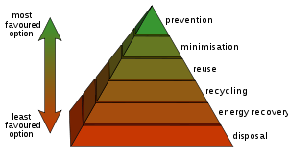
Waste hierarchy
Waste hierarchy refers to 3 Rs
Reduce, Reuse, Recycle

Slide 17
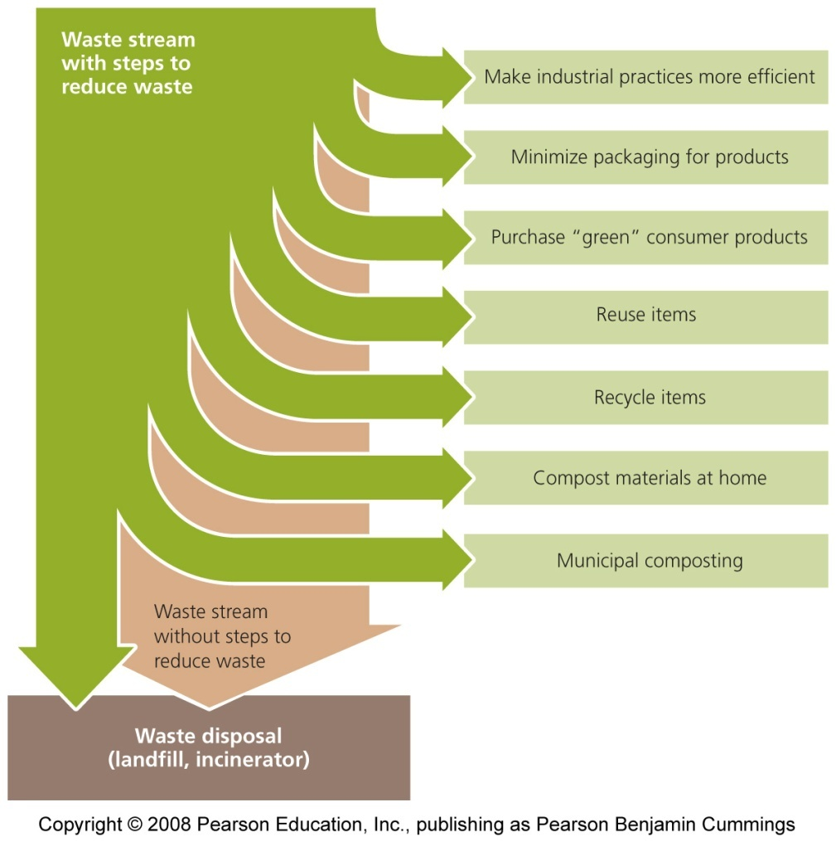
Waste
Minimizing solid waste
  Minimizing packaging
  Recycleable
    Paper, plastics, metals, glass, wood
  Reusable ?
    Textiles, leather, rubber, metals, wood
  Compostable
    Yard trimmings, food scraps (vegetable)

Slide 18
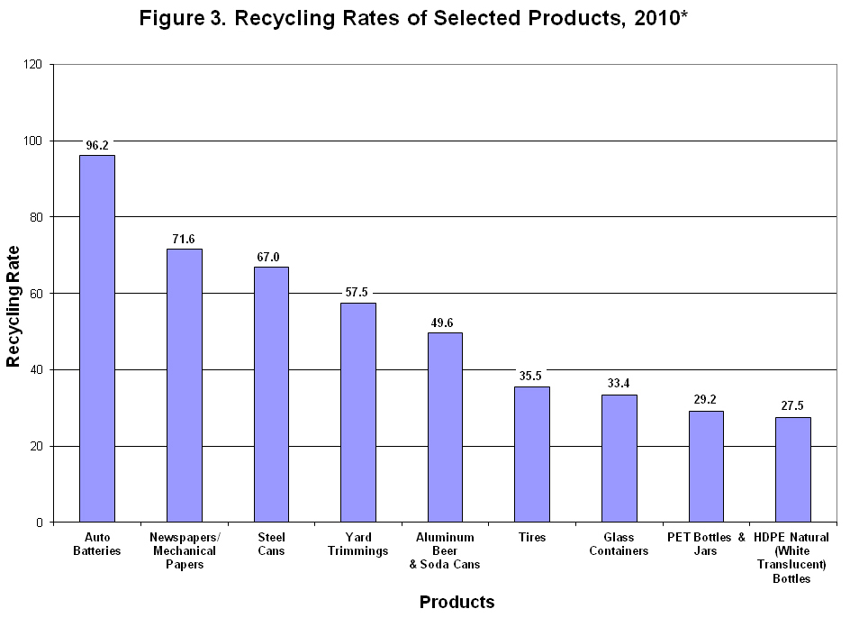
“By recycling almost 8 million tons of metals (which includes aluminum, steel, and mixed metals), we eliminated greenhouse gas (GHG) emissions totaling more than 26 million metric tons of carbon dioxide equivalent (MMTCO₂E). This is equivalent to removing more than 5 million cars from the road for one year.”

Slide 19
CATEGORIES OF WASTE DISPOSAL
DILUTE AND DISPERSE
(ATTENUATION)
Throw it in the river / lake / sea
Burn it
Basically this involves spreading trash thinly over a large area to minimize its impact
Works for sewage, some waste chemicals, when land-disposal is not available
Plastic in Pacific

Slide 20
CONCENTRATE AND CONTAIN
(ISOLATION)
Waste dumps, landfills
Historically, that’s how most of the solid waste gets treated

Slide 21
Useful options
Resource recovery
Composting
Vermicomposting
Energy recovery
Incineration
Pyrolysis
Gasification
Bio-methanation or anaerobic digestion

Slide 22
Impacts of waste on health
Chemical poisoning through chemical inhalation
Uncollected waste can obstruct the storm water runoff resulting in flood
Low birth weight
Cancer
Congenital malformations
Neurological disease
Notes:
Numerous epidemiology studies have been conducted to evaluate whether the health of people living near hazardous waste disposal sites is being adversely affected(Moeller, 20050.

Slide 23
Impacts of waste on health
Nausea and vomiting
Increase in hospitalization of diabetic residents living near hazard waste sites.
Mercury toxicity from eating fish with high levels of mercury.
Goorah, S., Esmyot, M., Boojhawon, R. (2009). The Health Impact of Nonhazardous Solid Waste Disposal in a Community: The case of the Mare Chicose Landfill in Mauritius. Journal of Environment Health, 72(1) 48-54
Kouznetsova, M., Hauang, X., Ma, J., Lessner, L. & Carpenter, D. (2007). Increased Rate of Hospitalization for Diabetes and Residential Proximity of Hazardous waste Sites. Environmental Health Perspectives, 115(1)75-75
Barlaz, M., Kaplan, P., Ranjithan, S. & Rynk, R. (2003) Evaluating Environmental Impacts of solid Waste Management Alternatives. BioCycle, 52-56.

Slide 24
Effects of waste on animals and aquatics life
Increase in mercury level in fish due to disposal of mercury in the rivers.
Plastic found in oceans ingested by birds.
Resulted in high algal population in rivers and sea.
Degrades water and soil quality.

Slide 25
Impacts of waste on Environment
Waste breaks down in landfills to form methane, a potent greenhouse gas
Change in climate and destruction of ozone layer due to waste biodegradable
Littering, due to waste pollutions, illegal dumping, Leaching: is a process by which solid waste enter soil and ground water and contaminating them.
U.S. Environment Protection Agency (2009)

Slide 26
It is estimated that food wasted by the US and Europe could feed the world three times over. Food waste contributes to excess consumption of freshwater and fossil fuels which, along with methane and CO2 emissions from decomposing food, impacts global climate change. Every tonne of food waste prevented has the potential to save 4.2 tonnes of CO2 equivalent. If we all stop wasting food that could have been eaten, the CO2 impact would be the equivalent of taking one in four cars off the road.

Slide 27
WHAT SHOULD BE DONE
Reduce Waste
  - Reduce office paper waste by implementing a formal policy to duplex all draft reports and by making training manuals and personnel information available electronically.
  - Improve product design to use less materials.
  - Redesign packaging to eliminate excess material while maintaining strength.
  - Work with customers to design and implement a packaging return program.
  - Switch to reusable transport containers.
  - Purchase products in bulk.

Slide 28
WHAT SHOULD BE DONE
Reuse
- Reuse corrugated moving boxes internally.
- Reuse office furniture and supplies, such as interoffice envelopes, file folders, and paper.
- Use durable towels, tablecloths, napkins, dishes, cups, and glasses.
- Use incoming packaging materials for outgoing shipments.
- Encourage employees to reuse office materials rather than purchase new ones.

Slide 29
WHAT SHOULD BE DONE
Donate/Exchange
- old books
- old clothes
- old computers
- excess building materials
- old equipment to local organizations

Slide 30
WHAT SHOULD BE DONE
Employee Education
- Develop an “office recycling procedures” packet.
- Send out recycling reminders to all employees including environmental articles.
- Train employees on recycling practices prior to implementing recycling programs.
- Conduct an ongoing training process as new technologies are introduced and new employees join the institution.

Slide 31
WHAT SHOULD BE DONE
Employee Education
- education campaign on waste management that includes an extensive internal web site, quarterly newsletters, daily bulletins, promotional signs and helpful reference labels within the campus of an institution.

Slide 32
WHAT SHOULD BE DONE
Conduct outreach program adopting an ecologically sound waste management system which includes:
    waste reduction
    segregation at source
    composting
    recycling and re-use
    more efficient collection
    more environmentally sound disposal

Slide 33
Residents may be organized into small groups to carry out the following:
construction of backyard compost pit
construction of storage bins where recyclable and reusable materials are stored by each household
construction of storage centers where recyclable and reusable materials collected by the street sweepers are stored prior to selling to junk dealers
maintenance of cleanliness in yards and streets
greening of their respective areas
encouraging others to join

