Slide 1
Waste management (Waste generation, Waste Segregation and collection and Waste Storage and Transportation)

Slide 2
Course Contents
Definition of health care waste
Rationale for managing health care waste
Classification of waste generated in a health care setting
Processes that generate health care waste and strategies to minimize it
  Practices that generate domestic/general health care waste
  Practices that generate hazardous waste related to health care
Strategies for minimizing waste generation
Steps in waste management cycle during
  Waste segregation and collection
  Waste storage
  Waste transportation
principles of health care waste management

Slide 3
Introduction
Safety, compliance, and community goodwill are best achieved when institutions demonstrate leadership in environmental stewardship.
Administrators must provide adequate resources, facilities, and authority to managers and staff who carry out institutional environmental programs, including waste management.
Work practice controls may also reduce worker risk, but they should supplement, and not substitute for, proper engineering controls, such as ventilation.

Slide 4
Introduction 2
Waste management program requires waste generation to be under the control of those generating the waste,
Segregation of different waste types into designated categories to allow for safest, most efficient, and most economical treatment or disposal options.
Separation of waste should be performed at the point of waste discard by personnel knowledgeable in the origin and hazard potential of the waste.

Slide 5
Introduction 3
Sharps should be discarded directly into containers that are readily accessible at laboratory stations to ensure utilization and to minimize the distance that used sharps must be carried for disposal.
Occupational Safety and Health Administration (OSHA) requires sharps collection containers to be closable, puncture-resistant, leakproof on the sides and bottom, and labeled or color-coded.
Sharps should not be handled directly; loose sharps should be handled with tongs or by some other mechanical means.
Needles should not be recapped, bent, or sheared, and they should be placed with syringes intact into the sharps containers.

Slide 6
Waste generation

Slide 7
Module I Outline
At the end of the module participants will be able to
Define health care waste
Discuss the rationale for proper health care waste management
Classify the different categories of waste generated in a health care setting
Understand waste generation practices and processes and apply strategies to minimize health care waste

Slide 8
definition
Definition of health care waste
Unwanted materials generated during health care delivery
Discarded Material is material that is “abandoned,”“recycled” or inherently “waste-like.”
  Waste (also known as rubbish, trash, refuse, garbage, junk, litter, and ort) is unwanted or useless materials. In biology, waste is any of the many unwanted substances or toxins that are expelled from living organisms, metabolic waste; such as urea and sweat.
Basel Convention Definition of Wastes
“substances or objects which are disposed of or are intended to be disposed of or are required to be disposed of by the provisions of the law”

Slide 9
Why should we manage health care waste?

Slide 10
The Rational for managing health care waste
The health care waste management is very important including the following:
To protect healthcare workers the community and environment (e.g. HIV/AIDS, hepatitis B and hepatitis C) and injuries caused by sharps
To optimize healthcare cost resulting from waste handling.
To comply with local and international regulations
To prevent risks and hazards to waste-handling staff.

Slide 11
The Rational for managing health care waste
To reduce the environmental impact caused by pollution resulting from improper disposal of waste, including contamination of grounds, water, and air.
To facilitate resource recovery of useful products (Reduce, Reuse, Recycle).
To prevent and control breeding of insects, rodents, and other pests.
To reduce nuisances (e.g., smell, unsightliness).
To prevent animal and human scavenging.
To improve on aesthetics; ensure the hospital is a beautiful environment.

Slide 12
Classification of waste generated in a health care setting

Slide 13
Categories of health care waste
HCW is broadly classified as hazardous and non-hazardous.
i). Hazardous HCW has the potential to cause harm to both humans and the environment if there is exposure or if it is improperly handled or disposed of.
ii) Non Hazardous (Domestic waste)
Dry/wet
Recyclable

Slide 14
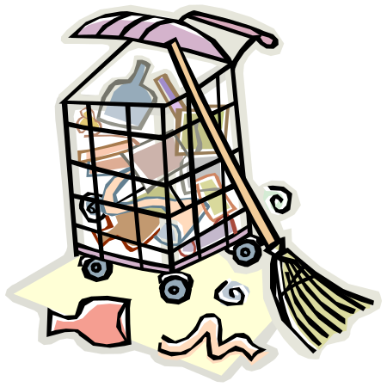
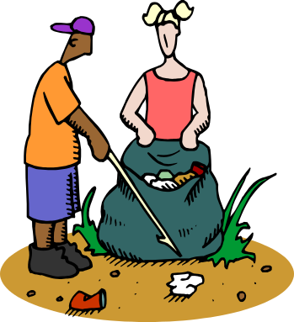


Sources of Wastes
Households
Commerce and Industry

Slide 15
Description of HCW generated in a health care setting
a) Non-infectious Waste/General Waste
This consists of waste generated from offices, kitchens, and packaging material, and from stores.
It is similar to domestic waste.
b) Infectious Waste
This category of waste is suspected to contain pathogenic micro-organisms. It includes:
Cultures and stocks of infectious agents from laboratory work.
Waste from surgery and autopsies (e.g., tissues and materials or equipment) that has been in contact with blood or other body fluids.
Waste from patients in isolation wards (e.g., excreta, dressings from infected or surgical wounds, disposable linen soiled with human blood or other body fluids).
Waste that has been in contact with patients undergoing haemodialysis (e.g. dialysis equipment such as tubing and filters, disposable towels, gowns, aprons, gloves, and laboratory coats).
Any other instruments or materials, including food remains that have been in contact with infected persons or animals (e.g., HIV/AIDS, diabetes home-based care, and intravenous drug use).

Slide 16
Description of HCW generated in a health care setting
Highly Infectious/Pathological Waste
Pathological waste consists of tissues, organs, body parts, human fetuses and animal carcasses, blood, infected animals from laboratories, and body fluids.
Within this category, recognizable human or animal body parts are also called anatomical waste.
This category should be considered as a subcategory of infectious waste, even though it may also include healthy body parts.

Slide 17
Sharps
Sharps are items that could cause cuts or puncture skin, and may include needles, hypodermic needles, scalpels and other blades, knives, infusion sets, saws, broken glass, and nails.
Whether or not they are infected, such items should be considered as highly hazardous HCW.
Pharmaceutical Waste
Pharmaceutical waste includes expired, spilled, and contaminated pharmaceutical products.
This includes drugs, vaccines, and sera that are no longer required.
The category also includes discarded items used in the handling of pharmaceuticals, such as bottles or boxes with residues, and drug vials.

Slide 18
Radioactive Waste
Radioactive waste includes solid, liquid, and gaseous materials contaminated with radionuclide.
It is produced as a result of procedures such as in vitro analysis of body tissue and fluid, in vivo organ imaging and tumor localization, and various investigative and therapeutic practices.
This waste is also produced from health care and research activities involving radionuclide, and related activities such as equipment maintenance and storage.
Genotoxic/Cytotoxic Waste
Genotoxic waste may include certain cytostatic drugs often used in cancer therapy; vomit, urine, or feces from patients treated with cytostatic drugs; chemicals; and radioactive material.
Genotoxic waste is highly hazardous and may have carcinogenic properties.
It raises serious safety problems, both inside hospitals and after disposal, and should be given special attention

Slide 19
Chemical Waste
Chemical waste consists of discarded solid, liquid, and gaseous chemicals (e.g., from diagnostic and experimental work and from cleaning, housekeeping, and disinfecting procedures).
Chemical waste from health care may be hazardous or non-hazardous
Non-hazardous chemical waste consists of chemicals with none of the above properties. These are commonly used in the maintenance of health facilities (e.g., disinfectants, detergents, insecticides, and engine oils for machinery and equipment).
Waste with Heavy Metal Content
This category includes waste containing mercury, cadmium, and lead, and drugs containing arsenic, among others.
Drugs containing arsenic should be treated as pharmaceutical waste.
Mercury waste is typically generated by spillage from broken clinical equipment (although equipment containing mercury is gradually being replaced with solid-state electronic sensing instruments, including thermometers, blood pressure gauges, etc.), residues from dentistry procedures, and fluorescent tubes. Whenever possible, spilled drops of mercury should be recovered.
Cadmium waste comes mainly from discarded batteries.
Certain “reinforced wood panels” used in radiation-proofing of x-ray and diagnostic departments may contain lead.

Slide 20
Hazardous waste: Summary of examples of hazardous waste
Pathological waste- | Human tissues or fluids e.g. body parts; blood and other body fluids; fetuses
Infectious waste- | Waste suspected to contain pathogens e.g. laboratory cultures; waste from isolation wards; tissues (swabs), materials, or equipment that have been in contact with infected patients; excreta
Sharps- | Wastes such as needles; infusion sets; scalpels; knives; blades; broken glass
Pharmaceutical waste- | Waste containing pharmaceuticals e.g. pharmaceuticals that are expired or no longer needed; items contaminated by or containing pharmaceuticals (bottles, boxes)
Genotoxic/Carcinogenic- | Waste containing substances with nucleic acid toxic properties e.g. waste containing cytotoxic drugs (often used in cancer therapy); DNA toxic chemicals
Chemical waste | (flammable, corrosive, volatile, toxic)
Pressurized containers- | Gas cylinders; gas cartridges; aerosol cans
Radioactive waste- | Substances that are radioactive at levels above the exempt limits (more than 0.05 mCi) established by the National Regulatory Commission

Slide 21
Processes that generates health care waste
What activities could generate domestic waste in a health care setting (15mins)?

Slide 22
Domestic activities related to health care
Office work, food remains, store management/packaging materials
Hazardous activities related to health care
These include all processes in a health care setting that will lead to generation of unwanted waste that is detrimental to environment, personnel and patients

Slide 23
Strategies to minimize waste generation
Approaches adopted by the health facility to reduce the amount of HCW generated during delivery of services.
It includes:
Adhering to policies that ensure appropriate processes and procedures are followed
Developing appropriate SOPs aligned to systematic practices that ensures reduced HCW
Orient staff on processes and procedure before commencement of work
Minimize unnecessary processes and procedures that could generate waste
Minimizing expiries (proper stock management)
Monitor consumption rates of reagents and consumables vis-a-vis the workload

Slide 24
The key steps in Health Care waste Management
The practice in HCWM should be adhered to as per the guidelines and locally designed procedures in the facility
Waste generation
Bench technologists are responsible for segregating and labeling all waste that requires special handling at the point of waste generation.
Employees must bring to management's attention unsafe working conditions and identify opportunities for hazardous waste reduction.

Slide 25
Minimizing waste generation
Source reduction, A method of avoiding waste generation through reduction in the amount or hazard of the waste generated
examples of source reduction include
  scaling down a process to generate less waste
  changing a process to eliminate waste generation
  substituting materials to reduce or eliminate the hazard of the waste.

Slide 26
Environment Protection Agency (EPA’s) Guidance for Waste Minimization
Effective waste minimization program include these elements:
  top management support, such as a statement from the institution’s head;
  characterization of waste generation to promote understanding of the amounts and types of waste generated and to identify where waste minimization efforts would be most efficient and effective;
  periodic waste minimization assessments;
  a cost allocation system in which individual departments and units are charged for disposal as a disincentive (Alternatively, every unit that generates hazardous waste should be notified of the disposal costs borne by the institution.);
  encouragement of technology transfer (Talk to other similar institutions. What waste minimization methods work best for them?);
  program evaluation.

Slide 27
Examples of Waste Minimization Activities
Method Example | Method Example
Source separation | The use of multiple waste collection containers to keep waste types separate, so that each waste type can be optimally managed. In offices, separate receptacles for recyclable paper.
Waste segregation | Keeping waste types segregated during collection, storage, transport, treatment, and disposal.
Source reduction | Keeping needle boxes out of red bags. Require purchases to be in small, manageable quantities. This reduces the potential for future disposal costs of used and, more importantly, unused hazardous materials. Use nonhazardous or less hazardous materials whenever possible. For example, there are substitutes available for xylene in the histology laboratory; formalin in histology and from surgical specimens; and mercuric chloride salts used in some fixation procedures. Use a scintillation cocktail that is not aromatic hydrocarbon-based. Each laboratory must determine if these products work satisfactorily
• Redistribution | Identify surplus or unwanted laboratory chemicals, and relocate them to laboratories that can use them.
Recycling | Solvents like xylene, xylene substitutes, and alcohols can be recycled and reused in the process from which they were generated. Formalin, a fixative, can also be recycled. Many facilities have set up recycling programs for aluminum cans, paper, and other solid waste items.
Process changes | Substitute non-chromium cleaners for chromic acid. Use miniaturized testing procedures to reduce the quantity of hazardous
Recovery | Silver recovery units. Heat recovery using waste solvents for fuel. This requires proper
Hazard reduction | A treatment or procedure that reduces the hazard of the waste, making it easier or less expensive to dispose of.

Slide 28
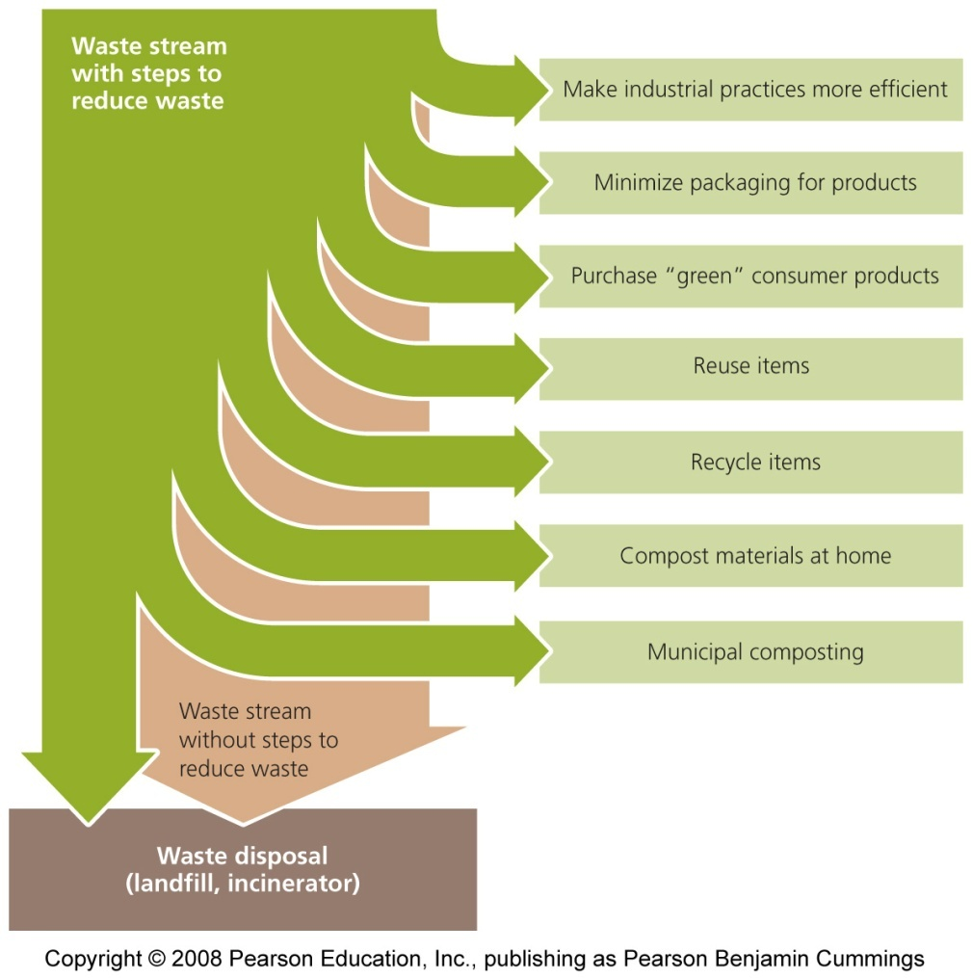
Minimizing solid waste
Minimizing solid waste
  Minimizing packaging
  Recycleable
    Paper, plastics, metals, glass, wood
  Reusable ?
    Textiles, leather, rubber, metals, wood
  Compostable
    Yard trimmings, food scraps (vegetable)

Slide 29
Module II content
At the end of the module participants will be able to
Outline the steps in waste management cycle
  waste generation
  Waste segregation and collection
  Waste storage and transportation
Apply the principles of health care waste management

Slide 30
Segregation of waste

Slide 31
Segregation of waste
Why should we segregate waste? (participants suggest using routine examples)
Segregation and collection involves;
Sorting HCW into separate containers according to type of category: non-infectious or
general waste, infectious, highly infectious, and sharps waste, with their respective collection

Slide 32
Segregation of waste
Segregation means the separation of waste according to type and defined waste categories at the point of generation.
Waste Segregation entails;
Collection of each category of waste in an appropriate labeled Colour coded container
Segregation of waste is the key to proper HCWM and has the following advantages:
  Facilitates safe handling of the waste.
  Separates recyclable waste from hazardous waste.
  Ensures that the waste will be treated according to its hazard.
  Reduces the overall costs of waste management, including transport, treatment, and disposal.

Slide 33
Waste segregation principles
Do not mix different waste types.
Dilution of regulated waste with normal trash does not remove it from regulation, even if the waste mixture no longer has hazardous characteristics.
Mixing incompatible wastes can cause additional hazards.
For recycling purposes, it is also advantageous to segregate certain nonhazardous wastes (e.g. newspapers, bottles, and aluminum cans).
it is highly desirable to keep different waste types separate—and well labeled—from the other waste from its point of generation to its final disposition.
Starting at the point of generation, each waste type should be collected separately and be kept segregated throughout storage, transportation, and disposal operations.
If precautions are taken to avoid incompatibility and commercial disposal problems, it is appropriate to combine different waste types by collecting them in one container.

Slide 34
Packaging and Labeling

Slide 35
Packaging and Labeling
The safety container should be designed to maintain its integrity throughout handling, storage, movement, and shipping.
If necessary, double bagging or placement of the bags in semirigid or rigid containers may be implemented.
Solid and semisolid wastes can usually be packaged in plastic bags.

Slide 36
Colour-Coding and Marking Health Care Waste
All infectious waste should be discarded directly into plastic bags or other containers that are clearly identifiable and distinguishable from the general waste stream.
All containers used for infectious waste, including sharps containers, must be red in color or labeled with the “Biohazard” symbol in accordance with OSHA regulations. (Red containers need not be labeled, because the color red is generally recognized as designating untreated infectious waste.)
The use of colour-coding and marking helps to easily segregate waste and identify the different categories of waste.
contributes to safer handling of waste by clearly associating a specific colour with a specific category and its associated hazard.
NOTE: waste containers should be compatible with the waste they are holding
Collection and storage containers should be inspected regularly for leaks, proper closures, and signs of deterioration

Slide 37
Sharps and Liquid waste
Safety Box for Sharps
The safety box MUST be a Puncture proof to minimize risk of pricks and cuts.
Sharps waste must be immediately contained after use to prevent injury.
The primary way to contain sharps is by using a safety box.
Infusion sets should be put in the clinical waste bin (yellow bin) and not in the safety box.
If not properly disposed of, scavengers may collect and reuse sharps waste.
Reusing syringes and needles results in high risk of infection or disease transmission.
Sharps can cut or puncture the skin and, if they are contaminated, they can cause infections like hepatitis B, hepatitis C, and HIV
Liquid waste
All liquid wastes from a laboratory that are not hazardous, biohazardous, radioactive, or multihazardous do not need any special type of handling.
They should be disposed of into a sink or drain that leads to the sanitary sewer system or, if that is not available, into a septic tank system.
Acidic and basic liquid wastes can be neutralized on-site before they are discharged into the sanitary sewer system.
Containers holding liquid wastes should be stored on trays or other devices providing secondary containment in the event of leakage or spills.
Absorbent liners should be placed under containers to protect the surfaces in the holding area from contamination.
Liquid infectious waste should be placed in leakproof, stoppered bottles/flasks, or containment tanks.

Slide 38
Storage and transportation of HCW

Slide 39
Storage and transportation of HCW
Storage of HCW
The waste generator ensures adoption of cleaner production principles, waste handling and transportation, waste treatment, and disposal, MUST be done according to the local and international regulations.
Documented systematic procedure on storage and transportation of HCW
Quantification of waste by weight and volume and routinely documenting
NOTE:
Personnel safety during handling of HCW
Provision of appropriate PPEs, training, immunization and medical surveillance

Slide 40
Safe Storage of Health Care Waste
Access controlled dry, vermin free storage location
Use adequately sized, leak proof, well covered collection and/or storage containers preferably with wheels
Waste bags must not be over-filled (fill to approximately three-quarters of capacity
The volume of a waste bag should not exceed 55 liters
Keep a written record of the amount of waste e.g weight brought into and taken away from storage and disposed of.
Promptly transport the waste from storage area to sites of destruction/ disposal based on the category/type of waste
  Putrifiable waste- transported within 24hrs
  Non-putrifiable waste transported regularly to avoid accumulation
Establish a schedule for waste transportation

Slide 41
Transport of Health Care Waste
When moving waste from one location to another (onsite or offsite):
Transportation of waste should be done according to the local and national guidelines/regulations
Keep safety waste containers upright to avoid spillage; avoid direct contact of safety boxes with other waste or medical supplies in the same vehicle/cart.
Safety boxes must be kept dry.
All health workers should be aware of the waste collection schedule.
Use designated vehicles/carts to transport waste
Transportation vehicles/carts should be well covered to avoid unsightly scenes, noxious smell and scattering during transportation
Waste collection points should be easily accessible to transporting personnel to avoid interference with work flow.
Routes of waste transportation should be well defined and should have as limited traffic as possible.
Transportation carts/vehicles should be routinely decontaminated with non corrosive agents.
Offsite transportation of waste should be accompanied by a completed waste tracking document that should be produced on demand to any law enforcement officer

Slide 42
Key messages
Various elements need to be instituted and implemented for proper HCWM including:
Duty of Care Principle
Any person handling or managing hazardous substances or related equipment is ethically responsible for using the utmost care in that task to minimize waste generation
Proximity Principle
Waste treatment and its disposal should be done closely to the area of waste generation in order to minimize risks linked to the transport of waste.
Precautionary Principle
Whenever the magnitude of a particular risk is uncertain, it should be assumed that this risk is significant, and measures to protect health and safety should be designed accordingly.
Polluter Pays Principle
All producers of waste are responsible for the safe and environmentally sound disposal of the waste they produce.

Slide 43
Acknowledgement
      Clinical Laboratory Waste Management; Approved Guideline—Second Edition volume 22 no 3
      Kenya - guide for training health workers on waste management Kenya
      ISO15190;2003 Safety Standard
      WB REVISED PUBLIC Environmental and Social Framework
      EAPHLNP-MOH
      Regional TCB

