Slide 1






MANAGEMENT OF CHEMICAL HAZARDS

Slide 2
Learning Outcomes
At the end of this learning session the participant will be able to:
Identify chemical hazards commonly encountered in health laboratories
Describe the importance of managing chemical hazards
Describe giving examples, physical and chemical characteristics of Chemical Hazards
Explain warning properties of various chemical hazards, evaluation procedures and control measures
Describe contents of spill kits and proper selection of disinfectants
Describe Material Safety Data Sheet / Material safety data base and its application in chemical management
Develop Chemical Hygiene Plan

Slide 3
Contents
Importance of chemical hazards,
Employee training and orientation
Recognition of chemical hazards
Physical classification of chemicals
Warning properties of chemical hazards
Chemical hazard evaluation
Chemical hygiene plan
Chemical grouping
Labelling and marking system for chemicals
Information on Material Safety Data Sheet
Spill control and spill prevention
Toxicity of chemicals
General hazard control practices
Selection of effective disinfectants
Factors to consider before choosing disinfectants
Disinfectants used in the laboratory

Slide 4
Why learn about chemical hazards
Most common & significant health hazards
Chemicals can combine with other chemicals = new hazards
All hazards must be taken in to account when using and storing chemicals

Slide 5

Before Lab Work, Get to Know:
Hazards of materials & agents and their prescribed safety procedures especially chemicals
Emergency spill procedures, use of absorbents and disinfectants
Designated escape route and alternate
Location of fire extinguisher, eye wash, shower, first aid, and spill kits

Slide 6
Employee must be informed
Chemical inventory list
Physical & chemical characteristics
The Right to Know Law
Chemicals in the Work Place
Location and Availability of Material Safety Data Sheets
Spill kits and choice of disinfectants
Monthly chemical inventory review

Slide 7
Employee Training
Within 1ST week of initial employment or assignment to a new job
Whenever new hazards or chemicals are introduced to the workplace
In case of an incident / exposure / accident
Annually

Slide 8
Chemical Hazard recognition
Degree of hazard associated with a specific
chemical will depend on:
Its physical & chemical properties
Its toxicity
The way it is used in the Lab
The environment in which it is encountered

Slide 9
Physical Classification
Chemicals may be found in different forms and the danger is determined by its form, characteristics & handling
Solid: Lead pipe (sanded & welded = lead dust/fumes)
  Nickel contact = dermatitis,
Liquid: Contact with skin- absorption, inhaled,
e.g. inhalation is the 1⁰ entry route of chemicals into the body.
Thus, vapor pressure in vital to determine the hazard (low vp=low airborne concentration= low toxicity)
Gases and vapors: At gas state molecules are unrestricted by cohesive forces.
Vapors are evaporation products of chemicals that are normally liquids at room T⁰
Routes of entry: inhalation, ingestion and eye/ skin contact.

Slide 10
Physical classification ---1
Aerosols: - Invisible/visible fine solid or liquid particulate matter in the air (dust, fumes, mist, fog, smoke, smog).
- Knowledge on how various aerosols are produced assists you anticipate where aerosol hazards may exist in the Lab.
- Are hazardous when in contact with: eye, skin, respiratory system and digestive system.

Slide 11
Physical Classification ---2
Some chemicals help other contaminants to penetrate the skin. e.g. Dimethyl sulfoxide is extremely well absorbed in the skin and is used in medicine to transport drugs in the body.
Liquids present a splash hazard; ( goggles, face shields, gloves coveralls) to prevent eye and /or skin contact
Some liquids combine with others = new hazards: house hold bleach and ammonia

Slide 12
Chemical Characteristics ---3
Understanding chemical characteristics you anticipate to use in Laboratory helps you identify the hazards & protect yourself.
This is obtained from MSDS / MSDB of a specific chemical.
MSDS must be available in the work place and easily accessible to every employee.
All should understand how to use it.

Slide 13
Information found on MSDS:
Solubility of a chemical
Explosive limits of a chemical
Melting point of a chemical
Specific gravity and density
Vapor density
Flash and boiling points
Vapor pressure and auto ignition temperature
First aid procedures

Slide 14
CHEMICAL Characteristics ---4
Chemical Flashpoint: The lowest Temperature at which a liquid gives off enough vapor to form an ignitable and produce a flame in the presence of heat source.
-Ignition continues infinitely so long as the T⁰ is above the flash point!
- Some liquids have low while other have high flash points.

Slide 15
Characteristics 4
Vapor pressure: Is the pressure exerted on the sides of the container, and is promotional to T⁰ (mm Hg).
The higher the vapor pressure the more volatile the liquid.
Explosive limits: Range of concentration of gases in air to support explosive process. Its measured by UEL/LEL

Slide 16
WARNING PROPERTIES
Alerts you on the presence of chemical in the air:-
Odor threshold (airborne concentration)
  This must be taken by caution due to ranges in individuals sense of smell.
  Sense of smell can be reduced by: allergies, head colds and olfactory fatigue.
Color product: Some chemical changes in color
  E.g. nitric acid = red, chlorine =blue
Other sensory signal:
  mild irritation of eyes, nose or throat.
  Some chemicals will produce a taste before or instead of odor or irritation.

Slide 17
Chemical hazard evaluation
Identify materials available & obtain knowledge on their hazardous status
Ensure employees are aware of them and are accessible to the hazards information
Take precaution if you are unsure that a hazard exists
Check for the presence of corrosives

Slide 18
Chemical grouping
Some chemicals have multiple hazards and therefore
require further segregation
MAJOR GROUPS (categories)
Flammables
Oxidizers: (Reactive, toxic, irritant)
pH Value: Acid, Neutral, Base (Corrosive)
Inorganic: Potassium, Sodium, Chlorine, (explosive)
Organic: Alcohol, ether, xylene (explosive, flammable, toxic)
Solid or Liquid; Store separately to avoid accidents in case
of chemical/liquid spill

Slide 19
Grouping - 2
Chemical Name Hazard
Sulfuric Acid Corrosive
Isopropanol Flammable
Acetic Acid Corrosive
Nitric Acid Corrosive
Ethyl Alcohol Flammable
Formalin Toxic

Slide 20
Chemical Hygiene Plan (CHP)
Outlines procedures to protect employees from health
hazards associated with chemicals
Follows International and National Safety and Health Safety guidelines
Controlled by the Safety Officer
Include occupational health surveillance
Job hazard analysis report
Annual CHP inspection
Chemical Inventory
Proper & adequate PPE
Consider the hazards associated with use of the chemicals.

Slide 21
Corrosives
Two categories of corrosives:
  acids
  alkalies.
Acids are corrosive in any form, and in high concentrations destroy body tissue and cause severe burns on contact with the skin and eyes.
Some acids are strong oxidizing agents and react destructively and violently with organic and other oxidizing agents.
Understand the general safety precautions necessary for the handling, storage, and disposal of corrosives.
Handling and disposal of corrosive chemicals should be done in accordance with lab protocol established by the Safety Officer

Slide 22
Handling of Corrosives ---2
Handle according to the protocol established at your lab
Aqueous solutions between pH 6.0 to 10.0 may be disposed of down the sink. Consider disposal limits ( avoid heavy metals& flammable organic solvents)
Mineral acids and alkalies that are within the pH range of 3.0-11.0 can be disposed via sanitary sewer drain followed by a water flash during and after disposal to flush the material from the traps and piping (avoid pesticides).
Recommended piping are glass or dura-iron piping for this pH. hydrofluoric acid and nitric acids are excluded from this type of disposal.
Cleanup and decontamination may require the use of neutralizing agents.

Slide 23
Flammable or Explosive Substances
Flammables (flash point less than 100F) or explosive at the time of disposal
Must not be disposed into a sink or drain as they will create unfavorable conditions during low flow

Slide 24
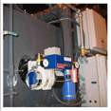
Oxidizers
All oxidizing chemicals and agents should be disposed in the thermal oxidizer evaporator.
The thermo oxidizer evaporator is designed to completely evaporate liquid waste, leaving only a non hazardous dry ash residue.
The evaporator atomizes the liquid waste stream into a fine non hazardous mist.
Flash evaporation reduces the entire water and organic volume in a waste stream leaving only a non hazardous dry residue to be removed.

Slide 25
Labeling and marking systems
There are three labeling and marking systems used to quickly identify hazards
National Fire Protection Association (NFPA)
Hazardous Materials Information System (HMIS)
Uniform Laboratory Hazard Signage (ULHS)
The first two systems rely on color codes and a numerical rating system to identify the hazard and its severity.

Slide 26
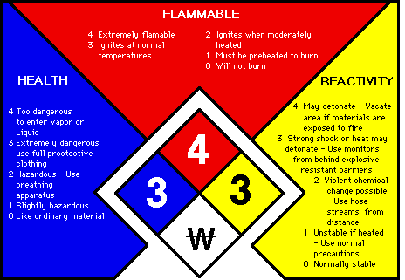
National Fire Protection Association (NFPA)
The diamond identification system
Uses four colors and a 0-4 numeral rating for hazards
Blue - Health
Red - Flammability
Yellow - Reactivity
White - Special information
Numerical rating begins at 0 and goes thorough to 4
0 least severity and 4 most severity in hazard

Slide 27
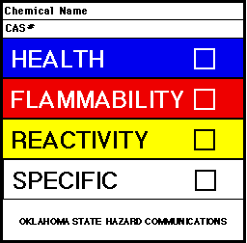
Hazardous Materials Information System (HMIS)
Rating of 0 in this system indicates the least severity:
  will not burn,
  stable,
  no hazard
Rating of 4 in this system indicates the most severity:
  deadly.
  Highly explosive
  Highly flammable

Slide 28

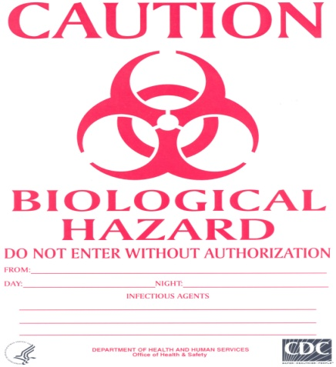
Uniform Laboratory Hazard Signage (ULHS)
Pictograph identification system
Symbols used to help identify hazards

Slide 29
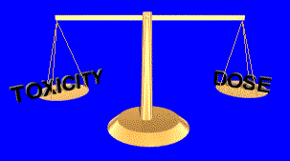
Toxicity vs. Dose
There is a balance between toxicity and dose.
Dose is the AMOUNT of something you are exposed to, or come in contact with.
The less the toxicity, the greater the dose you can tolerate without ill effects.
The greater the toxicity, the less dose you can tolerate without becoming sick

Slide 30
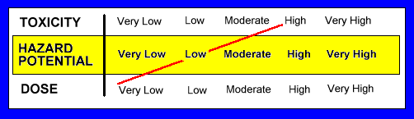
High Toxicity - Low Dose
For example, acetone is a highly toxic chemical. But you could work safely with it, if you were outside or in a well ventilated room where your dose would be very low.
As the chart below shows, your hazard potential for working with acetone in a well ventilated room would be low.

Slide 31
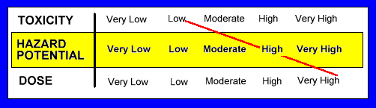
Low Toxicity - High Dose
Let's take another example. Nitrogen gas has a low toxic rating. It is found in great amounts in the air we breathe.
However, if you were in a confined space that had only nitrogen gas in it (a very high dose), you would soon die because of the lack of oxygen.
As the chart below indicates, your hazard potential for working in a room filled with nitrogen would be high.

Slide 32
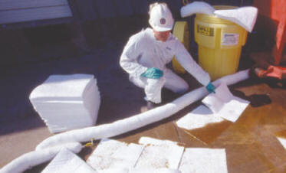
SPILL CONTROL & SPILL PREVENTION
Comply with OSHA 29CFR 1910.120 Hazardous Waste Operations and Emergency Response
Individuals should be familiar with the properties and hazards of the materials with which they work with.
Improper clean-up of a chemical spill may result in injury, illness, fire, a release to the environment, or property damage.

Slide 33
SPILL CONTROL & SPILL PREVENTION---2
Planning for chemical spills is essential.
Before beginning work with chemicals, one should be sure that he or she has adequate training for cleaning up small spills, and that the appropriate types and amounts of spill clean-up materials and personal protective equipment are immediately available.
Each chemical user should consult the Material Safety Data Sheet (MSDS) for the specific chemical that he/she plans to work with and consider response options in case of a spill or release beforehand.
Pre-planning is essential to safely and properly handling a spill.

Slide 34
SPILL KIT (CONTENTS)
Universal spill boom ( 5’X 17’)
Universal spill pads (17’ x 19’)
Universal pillow ( 17’X17’)
Red Z solidifier
Green Z solidifier
Acid Lock solidifier
Alky solidifier
Petro Lock absorbent
Nitrile gloves
Scoop/scraper
9"x12" zip lock bag
Hazardous waste label
Non-Hazardous waste label

Slide 35
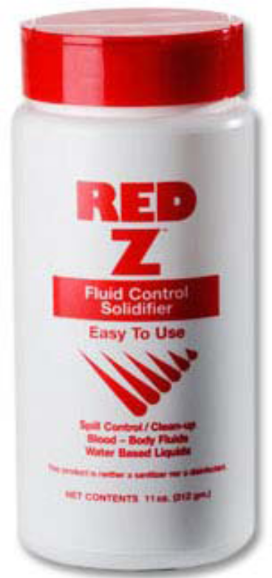
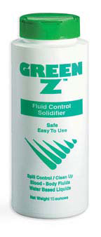
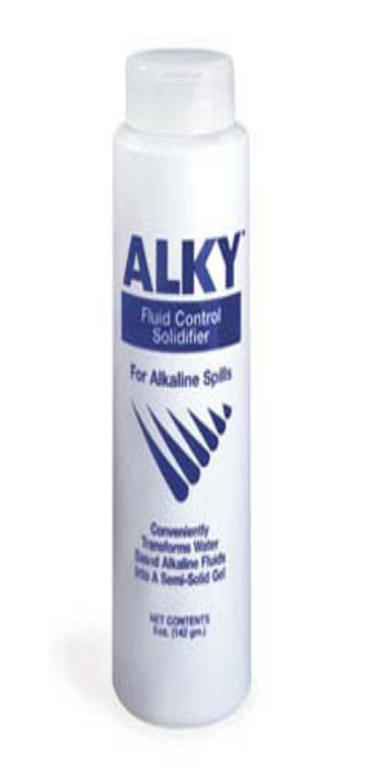
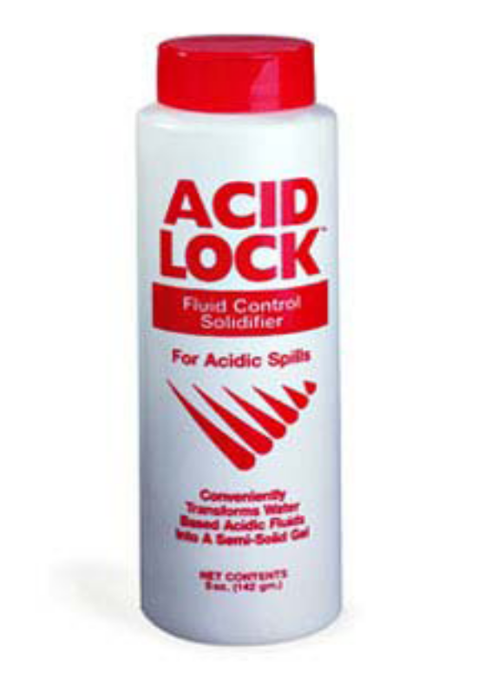
SPILL KITS

Slide 36
General hazard control practices
Avoid direct contact with the chemical
Limit exposure levels and time
Enforce good hygiene practice, PPE
Take appropriate fire prevention & control measures
Use equipment not affected by material being handled
Ensure the chemical is not mixed with others
Use engineering controls & good common sense
Ensure you have proper disinfectants.

Slide 37
SELECTION OF DISINFECTANTS
Definition:
Disinfectants are chemicals used to kill micro-organisms on infected instruments.
Disinfectants are not meant to be used on the skin or mucous membranes (used on inanimate).

Slide 38
The Effectiveness of Disinfectants
To be effective, the chosen disinfectant must:
Kill or inhibit the growth of the undesirable micro-organisms.
Not be harmful to the instrument/equipment on
which it is used.
Be used only on clean, rinsed and dried instruments/equipment. Protein material.
Be used in the proper concentration.
Be used within the stipulated lifetime after dilution
Note: Detergent and soap will inhibit some disinfectants.

Slide 39
Factors to consider before choosing disinfectants
Nature of the item to be disinfected
The rougher the surface, the longer the contact time required for disinfection (crevices, hinges, lumen).
Number of micro-organisms present
The number of micro-organisms present will lengthen the time for effective disinfection to take place. In general, higher bio-burden requires more time for disinfection.
Resistance of micro-organisms
Some micro-organisms are more resistant to disinfection than others.
The generally accepted order from the most resistant to the least resistant is: bacterial spores, mycobacteria, hydrophilic viruses, fungi, vegetative bacteria, lipid viruses.

Slide 40
Factors to consider---2
Type and concentration of disinfectant used.
Resistance of micro-organisms depends on the type of disinfectant used. A particular micro-organism may be more resistant to one type of disinfectant than another. For instance, alcohol (isopropyl or ethyl) is effective against vegetative bacteria and most lipophilic viruses, but is not effective against bacterial spores or most hydrophilic viruses.
Many disinfectants are broad spectrum; that is, effective against all or most forms of microbial life.
Presence of organic material
-The presence of organic soiling matter will compromise disinfection: Blood, blood products, body fluids, and faeces contain significant amounts of proteins
- Protein will bind and inactivate some disinfectants or slow their action. ( require high concentrations)

Slide 41
Factors to consider---3
Duration of exposure and temperature
Duration of exposure and temperature influences the disinfection process.
The longer the duration of exposure, the higher the degree of disinfection achieved.
Some disinfectants require a longer contact time to achieve killing, and some microorganisms need longer exposures to be killed.
Higher temperatures increase the killing power of most disinfectants, whereas lower temperatures may slow the killing power of most disinfectants.

Slide 42
Factors to consider---4
Choice of Disinfection Methods
When compatible with other requirements, disinfectants used should be bactericidal rather than bacteristatic; active against a wide range of micro-organisms and should not be readily inactivated.
Personnel
The disinfectants are diluted by a qualified staff in manageable quantities

Slide 43
Types of disinfectants
High-level disinfectants ( Glutaraldehydes, Formaldehyde, paracetic acid)
  -Kill bacteria, viruses, fungi, Mycobacterium tuberculosis and some, but not necessarily all bacterial endospores.
Intermediate-level disinfectants (Alcohols & chlorines)
  Kill mycobacteria, most viruses, and bacteria.
  Recommended for use on blood and other potentially infectious materials
  Small, non-lipid viruses, (e.g. enteroviruses) may be resistant.
  Used for some non-critical items, or devices, or environmental surfaces.

Slide 44
Types of disinfectants-2
Low-level disinfectants ( Phenolics &3%H₂O₂₎
  Kill some bacteria and some viruses and fungi, and tuberculosis-causing micro-organisms
  Not effective for bacterial endospores.
  Are used for cleaning surfaces, such as floors and counter tops.
* They should not be used for processing instruments and other items.

Slide 45
EXAMPLES
Alcohols:- 60%- 70% isopropanol
Have relatively poor efficiency and susceptible to interference)
Aldehydes: Formaldehyde and Glutaraldehyde --Don’t use for general disinfection: - fumigation)
Hypochlorite: ( Bleach& chloros)
Phenolics: Effective particularly for Mycobacterium. It is toxic & cause skin burns, damage plastics.

Slide 46
Dilutions of Household Bleach
Volume of Bleach | Volume of Water | Dilution Ratio | Sodium Hypochlorite(%) | Available Chlorine (PPM)
Undiluted 1 1 | 0 9 99 | 1:1 1:10 1:100 | 3.00 0.3 0.03 | 30, 000 3,000 300

Slide 47
Key Messages
Methods to reduce risks associated with chemicals hazards :-
Recognition of chemical hazards are dependent on physical properties, toxicity, use and environmental conditions present.
Its important to familiarize yourself with chemical and physical characteristics as well as the warning properties of chemical hazards you may encounter during the course of your work .
Awareness of effects environmental factors may have on a potential hazard is vital to manage chemical hazards
Knowing of hazard control and evaluation methods for potential hazards is vital to manage chemical hazards
Always consult MSDSs or other ref. sources for the available hazards in your environment
Familiarize yourself with hazard classes to manage chemical hazards

