Slide 1



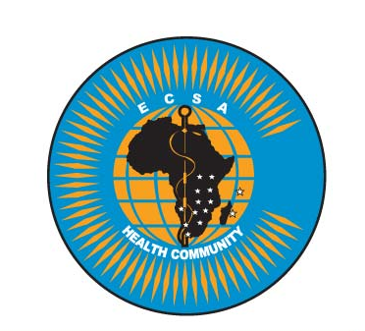


Biorisk Assessment

Slide 2
Learning outcomes
At the end of this topic, you should be able to:
Describe the types of hazards found in the clinical laboratory
Discuss the concepts of risk assessment
Outline the basic steps of the risk assessment process

Slide 3
Content
Definition of risk, threat, hazard and consequences in relation to Biorisk management
Assessment of biological agents, laboratory procedures, laboratory hazards and controls and external environmental conditions
Prioritization of risks

Slide 4
Definitions
A risk assessment is a procedure that analyses a particular process or situation in order to determine the likelihood and consequences of a certain adverse event.

Slide 5
Definitions
A hazard or threat is an agent or object that can cause harm
The term threat is used in the biosecurity context (i.e. malicious intent by a person to cause harm)
The term hazard is used in a biosafety context (i.e. unintentional exposure to the agent or object)
Risk is the likelihood of an undesirable event happening, that involves a specific hazard or threat and has consequences.

Slide 6
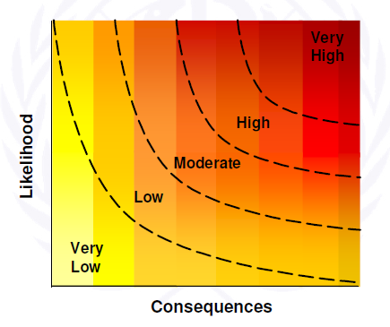

Risk assessment
Risk is a function of:
  Likelihood of the event
  Consequences of the occurrence
The higher the likelihood and the graver the consequences, the higher the risk

Slide 7
Risk assessment
Risk assessment is the procedure that analyses a particular process or situation in order to determine the likelihood and consequences of a certain adverse event

Slide 8
Risk
Question: What is the risk of being attacked by a tiger?
What would you need to know to answer this question?
Slide <number>
Notes:
This is the beginning of the “tiger” exercise. As we have introduced students to “likelihood” and “consequences”, the hope is that students will begin to think of different factors that will affect the risk of being attacked by a tiger in terms of these two concepts.

Slide 9
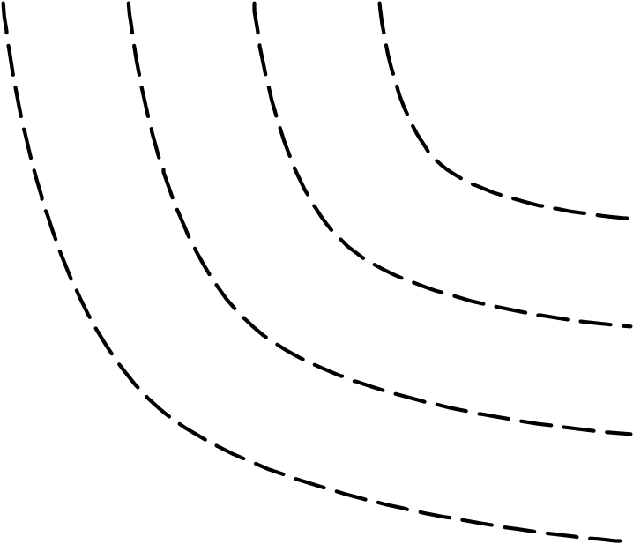
Risk
RISK
Consider the question in terms of Likelihood and Consequences, and the graph on the right.
R = f(L, C)
Where L is the Likelihood and C are the Consequences
Very
High
High
Likelihood
Moderate
Low
Very
Low
Consequences
Slide <number>

Slide 10
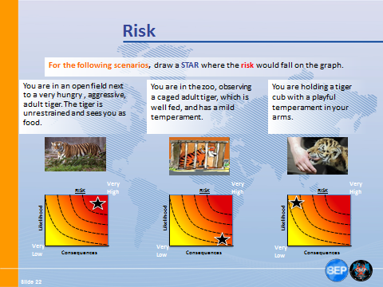

Slide 11
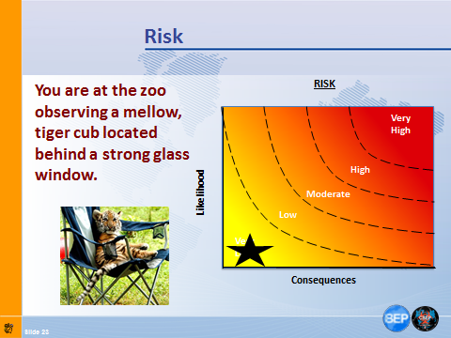

Slide 12
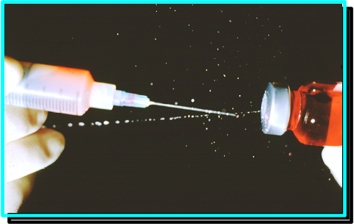
Risk Assessment
A risk assessment assigns values for likelihood and consequences, which allows us to represent the risk of a particular adverse event on a graph.
RISK
Very
High
Likelihood
High
Moderate
Low
Very
Low
Consequences
Slide <number>
Notes:
This slide connects the previous definition of risk assessment, in terms of likelihood and consequences, with the graphs we had been using for the tiger “assessment”, and with biological risks (image with needle and syringe).

Slide 13
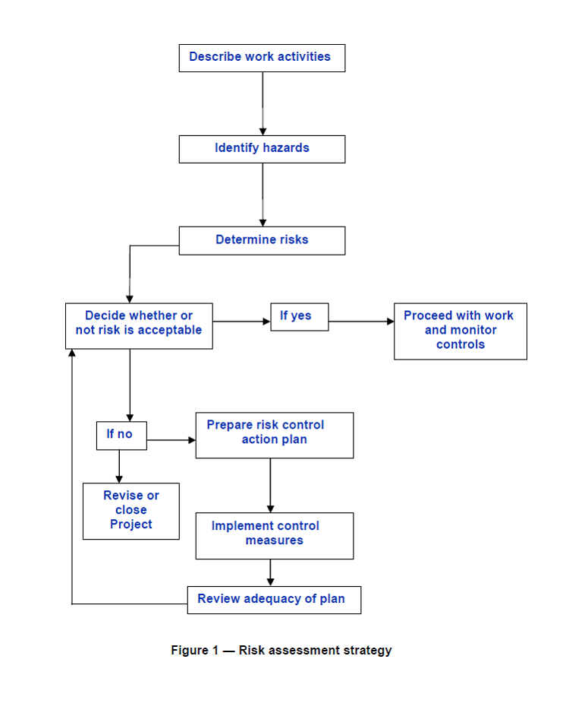

Risk Assessment Strategy
Risk Assessment Strategy:
Biorisk Management =
Assessment, Mitigation, Performance
Source: CWA 15793:2011
Slide <number>
Notes:
This slide is the first on risk characterization and is meant as a rhetorical question.

Slide 14


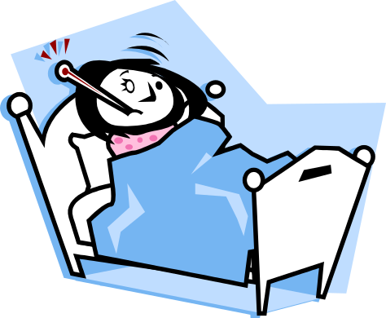
What is the aim of risk assessment
Risk assessment informs the selection of appropriate laboratory biosafety and laboratory biosecurity risk mitigation measures to reduce likelihood and consequences of the risk.
Slide <number>
Notes:
NEW SLIDE

Slide 15
Risk Characterization
Risk Characterization is the actual process of determining the likelihood and consequences of a particular risk within a Risk Assessment.
Please recall that risk is associated with a particular adverse event. We can only determine the likelihood and consequences of a very clearly defined risk.
Slide <number>
Notes:
The important point here is we can only characterize risk by characterizing likelihood and consequences, and we can only do that one specific risk at a time.

Slide 16

Risk Characterization
For a Biosafety Risk, the hazard is the biological material worked with in the lab.
Characterizing the material allows one to determine important parameters for likelihood and consequences, such as route of exposure, infectious dose, incubation time, morbidity, mortality, communicability, and others.
Slide <number>
Notes:
This slide identifies the hazard of biosafety risk as the biological material worked with in the lab. Then it moves on to discuss agent / biological material / hazard characterization part of what informs likelihood and consequences.

Slide 17

Risk Characterization
For Biosecurity Risk, the threat is the potential adversary who is interested in the biological materials.
Characterizing potential adversaries allows one to determine important parameters for likelihood and consequences, such as means, motives, and opportunity.
Slide <number>
Notes:
For biosecurity risk, this slide makes the link to likelihood and consequences through threat / adversary characterization.

Slide 18
Risk Characterization
Scenario:
A lab worker has just prepared a culture of Mycobacterium tuberculosis in order to conduct a drug sensitivity test. He is wearing gloves, a surgical mask, and lab coat, and is using a Biosafety Cabinet which has not been certified in three years.
What is the hazard in this scenario?
What is the likelihood of exposure?
What are the consequences of exposure?
What are some factors that should be considered?
RISK
Very
High
High
Likelihood
Moderate
Low
Very
Low
Consequences
Slide <number>

Slide 19
Risk Characterization
Scenario:
The lab worker discovers his culture of Mycobacterium tuberculosis is Extremely Drug Resistant (XDR). Meanwhile, a local animal rights group has threatened to disrupt laboratory operations and generate publicity by breaking in and stealing agents. They believe taking samples of XDR will generate the most publicity.
What is the threat in this scenario?
What is the likelihood of a theft?
What are the consequences of a theft?
What are some factors that should be considered?
RISK
Very
High
High
Likelihood
Moderate
Low
Very
Low
Consequences
Slide <number>

Slide 20
Risk Characterization
A hazard or threat cannot in itself pose a risk without a specific situation.
Conversely, a situation also does not represent a risk without a hazard or threat.
Both a changing hazard or threat, and a changing situation will independently alter the scenario being assessed, and thus change the risk.
Slide <number>

Slide 21
Risk Characterization
Discussion:
Consider the biosafety Mycobacterium tuberculosis scenario.
How would the risk change if the laboratory worker wore a respirator instead of a surgical mask, and was working in a biosafety cabinet that had been certified in the last six months?
OR
If there were strict physical security measures in place at the laboratory to keep unauthorized people out?
Slide <number>
Notes:
This slide is meant to change the situation to help visualize how risk changes when situational details change.

Slide 22
Risk Characterization
Whereas the hazard or threat can affect both the likelihood and consequences of a risk, the situation will usually affect only likelihood.
Discussion: Why?
Slide <number>
Notes:
Please allow for some discussion on this question, as the students will, hopefully, be able to discover the answer on their own. Essentially, the consequences of exposure or theft depend on the agent itself… not really how one was exposed or how it was stolen. So when we think of consequences, we are thinking of the aftermath of the event, nothing related with the details of the event per se.

Slide 23
Risk Characterization example 1
Consider a situation which involves;
A biological agent is highly infectious through the aerosol route (hazard characteristic), and
A procedure is being implemented where large-volume aerosols are being generated in close proximity to the laboratory worker, and
Protective equipment such as respirators or biosafety cabinets are unavailable (all situation characteristics),
Then we can say likelihood of exposure is high.
Slide <number>
Notes:
This slide is complex, and should be discussed slowly. Essentially, hazard characteristics and situation characteristics are brought together to determine likelihood of exposure.

Slide 24
Risk Characterization example 2
Consider a situation in which;
That same biological agent does not produce serious disease (hazard characteristic), and
An effective vaccine has been administered to all personnel (situation characteristic)
Then we can say the consequences of exposure are low.
Slide <number>
Notes:
In this slide, hazard characteristics and situation characteristics are brought together to determine the consequences of exposure.

Slide 25
Risk Characterization
Another consideration in characterizing risk is the concept of relative risk.
Relative risk is the value of one particular risk (in terms of likelihood and consequences) in the context of another risk. It helps give meaning to risk.
For example: Dependent on certain situation, or the PPE used, the risk of aerosol exposure may be higher than the risk of percutaneous exposure.
Risk is relative because it will change depending on the situation and the factors that go into determining the risk, themselves, are not absolute.
Slide <number>
Notes:
This slide discusses relative risk. Whether a risk is high or low, with high or low likelihood and high or low consequences, is interesting… but knowing where to place the risk on the graph allows us to visualize how risk would change if we were to reduce either likelihood or consequences. That visualization can help us understand in an intuitive way how our mitigation measures have reduced our risk, to our benefit.
This is the first review question. These questions are meant to exercise the students’ brains and ensure that they have understood the key concepts and messages of the course. For this particular question, one answer could be: relative risk is the value of one particular risk (in terms of likelihood and consequences) in the context of another risk. It may help us give meaning to risk, like: the risk of aerosol exposure is higher than the risk of percutaneous exposure.

Slide 26
Risk Characterization
To demonstrate the concept of relative risk, lets consider different biosafety and biosecurity risk mitigation efforts and their effects on likelihood and consequences.
Slide <number>
Notes:
This slide discusses relative risk. Whether a risk is high or low, with high or low likelihood and high or low consequences, is interesting… but knowing where to place the risk on the graph allows us to visualize how risk would change if we were to reduce either likelihood or consequences. That visualization can help us understand in an intuitive way how our mitigation measures have reduced our risk, to our benefit.

Slide 27
Risk Characterization
Biosafety
The use of personal protective equipment lowers the
likelihood of exposure.
A vaccine lowers the
consequences of exposure.
RISK
RISK
Very
High
Very
High
Likelihood
High
Likelihood
High
Moderate
Moderate
Low
Low
Very
Low
Very
Low
Consequences
Consequences
Slide <number>
Notes:
This graph demonstrates the reduction in risk by using PPE, which reduces the likelihood of exposure.

Slide 28
Risk Characterization
Biosecurity
The use of physical barriers lowers the likelihood of threat.
Availability of therapeutics lowers the consequences of threat.
RISK
RISK
Very
High
Very
High
Likelihood
High
Likelihood
High
Moderate
Moderate
Low
Low
Very
Low
Very
Low
Consequences
Consequences
Slide <number>
Notes:
This graph demonstrates the reduction in risk by using PPE, which reduces the likelihood of exposure.

Slide 29

Risk Characterization
Understanding the relative risk associated with different situations or by implementing different risk mitigation strategies is important for the overall process of characterizing risk.
Slide <number>
Notes:
This slide is to remind students that each risk characterization will be different for each facility, laboratory, and situation (procedure for biosafety). This is because the factors or details will all be different.

Slide 30
Risk Characterization
Naturally, each facility, laboratory, and situation will have its own unique set of factors that will be particularly relevant to fully characterize risk.
Slide <number>
Notes:
This slide is to remind students that each risk characterization will be different for each facility, laboratory, and situation (procedure for biosafety). This is because the factors or details will all be different.

Slide 31
Risk Characterization
The Risk Characterization process should be as robust as possible to enable:
Comparability: the ability trust the accuracy of differences between assessments, due to similarities in their bases, assumptions, procedures and protocols
Repeatability: the ability to conduct the same process in the same way for the same hazard or threat and situation over a period of time, or for different hazards, threats, and situations at the same time.
Slide <number>
Notes:
It is important that the process of Risk Characterization be as robust as possible.
In this case, robust refers to the ability of a process to be comparable and repeatable.
This is the final section of risk characterization, which discusses how the process must be as robust as possible. Discuss with the students what they think robustness might mean… this is a concept that may have different meanings to different people, so it will be important for students to air their opinions.
Emphasize that for this course, what we mean by “robust” is a that a process is “comparable” and “repeatable”. Robust may mean or suggest other things as well, but these are the aspects we will focus on. Definitions of these follow in the next slide. These terms are from the BioRAM presentation of late 2011.

Slide 32
Risk Characterization
A robust risk characterization process will generate similar results when assessing similar hazards or threats in similar situations, no matter who is following the methodology, where the characterization is being conducted, and when it’s occurring.
A robust risk characterization makes a risk assessment robust.
Slide <number>
Notes:
This is true because risk characterization is the part of risk assessment that CAN be robust. Risk evaluation, on the other hand, is more subject to opinion and will vary from institution to institution for a variety of reasons (to be discussed later in the course).

Slide 33

Risk Evaluation
Risk Evaluation is a crucial intermediary step between Risk Characterization and taking active steps towards mitigating risk.
Risk Evaluation is the process of determining, subjectively, whether a risk is high or low, and whether it’s acceptable or not.
Slide <number>
Notes:
Risk evaluation is the final section of the course. It is an intermediary step between risk characterization and mitigation because it allows for the interpretation of characterized risks based on the uniqueness of each laboratory or institution’s preferences. Risk evaluation is the final section of the course. It is an intermediary step between risk characterization and mitigation because it allows for the interpretation of characterized risks based on the uniqueness of each laboratory or institution’s preferences.

Slide 34
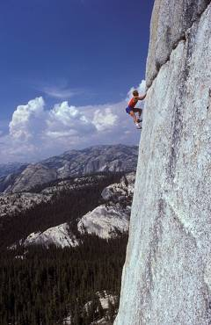
Risk Evaluation
What is “acceptable” risk?
Slide <number>
Notes:
Risk evaluation is the final section of the course. It is an intermediary step between risk characterization and mitigation because it allows for the interpretation of characterized risks based on the uniqueness of each laboratory or institution’s preferences. Risk evaluation is the final section of the course. It is an intermediary step between risk characterization and mitigation because it allows for the interpretation of characterized risks based on the uniqueness of each laboratory or institution’s preferences.
Slide from SAND No. 2011-2499C

Slide 35

Risk Evaluation
The evaluation of risk is
often related to the
concept of Risk Acceptance.
Risk evaluation and
acceptance can vary with
culture, experience,
resources, management,
and even current events.
Slide <number>
Notes:
This slide introduces the concept of risk acceptance. This slide emphasizes the point that neither risk evaluation or acceptance can be determined through a formula, nor can either be determined in a robust. If you have time, discuss this point with the students. What do they think?

Slide 36



Risk Evaluation
Unfortunately, there is no systematic way of evaluating risk and determining risk acceptability. This will depend on the perceptions of individuals, institutions, and the community.
Slide <number>

Slide 37
Risk Evaluation
Question:
What factors might drive differences in risk acceptability between individuals, institutions, and communities?
Slide <number>
Notes:
The objective of this slide is to get students to think about what acceptability is in the real world, and to focus on the potential differences between individuals, institutions, and communities. The results of their table discussions should be aired to the entire class as time permits.

Slide 38

Risk Evaluation
If an institution finds a particular risk unacceptable, it will either cease the work resulting in that unacceptable risk, or it will find ways to mitigate that risk to a
more acceptable level.
Slide <number>
Notes:
Acceptability describes what risk is acceptable or not for an institution to work with. While evaluation gives a value, high or low, acceptability drives action. Even if two institutions value risk in the same way (x risk is high), they may have different levels of acceptability (x risk is high but we’ll do our work anyway, or x risk is too high and we have to mitigate). Though they don’t have to be connected explicitly, institutions will often define risk values (high to low) in terms of what is acceptable or not (high is not acceptable, medium is acceptable).

Slide 39
Risk Evaluation
Question: What could happen if an institution finds a particular risk resulting from its work acceptable, but the surrounding community does not?
Slide <number>
Notes:
This question introduces the variable of community interactions. If an institution finds a risk acceptable, it may decide to continue its work without mitigation… but if the community finds it unacceptable, they may force the institute to implement mitigation measures or cease work altogether. The purpose of this question is to emphasize that different stakeholders may have different levels of acceptability of risk, even of the same risk in a single institution.

Slide 40

Risk Evaluation
The community’s risk acceptability level is still important for the institution because an institution in conflict with the community may not be able to operate normally.
Slide <number>
Notes:
This slide discusses the previous question in more detail.
Institutions operate in a context, and whether it’s the community immediately surrounding the installation, or the regional or national government, or even an international organization, the perception of risk, and the acceptability of risk, by others may place certain constraints on your risk mitigation decisions.

Slide 41

Risk Evaluation
Only an institution can determine
whether a particular risk is
Very High, High, Moderate,
Low, or Very Low.
Question: So how can risk evaluation be depicted on the likelihood consequences graph of risk?
Slide <number>
Notes:
Thus, the graph itself does not provide any value to risk aside from, perhaps, a numerical one with little meaning. The graph will be able to say that one risk is HIGHER than another, but not that it’s HIGH per se. The graph itself can only say that as either likelihood or consequences grows, so does risk.

Slide 42
Risk Evaluation
The curves on the graph, called “isoquants”, show the different levels of risk, from Very Low to Very High.
It is important to recognize that the precise locations of these isoquants on the graph are in fact arbitrary. This is the essence of Risk Evaluation.
RISK
Very
High
High
Likelihood
Moderate
Low
Very
Low
Consequences
Slide <number>
Notes:
This describes the risk curves on the graphs we have seen before. The risk curves can also be referred to as “isoquants”. An isoquant has the same (iso-) value (-quant) on every point of its line. Previously, when characterizing risk, we used a graph with risk curves, or “isoquants”, showing the different levels of risk, from Very High to Very Low

Slide 43


Risk Evaluation
Different institutions will have different definitions for what is high or low, or even what the shapes of the curves are.
Slide <number>
Notes:
Thus, the locations AND the shapes of the curves will be different for every person conducting a risk assessment.

Slide 44
Risk Evaluation
Think through these questions:
What is the difference between Risk Averse and Risk Tolerant?
How might these two characteristics be depicted using Isoquants on the likelihood consequences graph?
Please spend some time to write in the isoquants on the following two graphs depicting a Risk Averse and a Risk Tolerant evaluation
Slide <number>
Notes:
The purpose of this exercise is to allow students the chance to think through the meaning of the word risk. Since this word is used in common parlance, it is important for students to begin thinking about it more analytically.

Slide 45
Risk Evaluation
What is the difference between Risk Averse and Risk Tolerant?
How might these two characteristics be depicted using the Isoquants on the graph?
RISK - Default
RISK Averse
RISK Tolerant
Very
High
High
Likelihood
Likelihood
Likelihood
Moderate
Low
Very
Low
Consequences
Consequences
Consequences
Slide <number>

Slide 46
Risk Evaluation
What is the difference between Risk Averse and Risk Tolerant?
How might these two characteristics be depicted using the Isoquants on the graph?
RISK - Default
RISK Averse
RISK Tolerant
Very
High
Moderate
Very
High
Low
High
Likelihood
Likelihood
Likelihood
Moderate
High
Very
Low
Low
Moderate
Low
Very
Low
Very
Low
Consequences
Consequences
Consequences
Slide <number>

Slide 47
Risk Evaluation
Risk Evaluation drives investment decisions in an institution. If an institution is particularly risk-averse, it will spend more resources attempting to reduce the risks it faces. If a similar institution faces the same risks but is risk-tolerant, it might proceed with procedures others may find too “dangerous”.
Slide <number>

Slide 48
Risk Evaluation
Discussion:
What might the isoquants of an institution that is Likelihood Averse or Consequence Averse look like?
RISK
Likelihood Averse
RISK
Consequence Averse
RISK - Default
Very
High
High
Likelihood
Likelihood
Likelihood
Moderate
Low
Very
Low
Consequences
Consequences
Consequences
Slide <number>

Slide 49
Risk Evaluation
Discussion:
What might the isoquants of an institution that is Likelihood Averse or Consequence Averse look like?
RISK
Likelihood Averse
RISK
Consequence Averse
RISK - Default
Very
High
Very
High
Very
High
High
High
High
Likelihood
Likelihood
Likelihood
Moderate
Moderate
Moderate
Low
Low
Low
Very
Low
Very
Low
Very
Low
Consequences
Consequences
Consequences
Slide <number>

Slide 50
Risk Evaluation
An institution that considers a certain risk high might be motivated to spend a large amount of resources mitigating that risk.
Another institution that considers the same risk to be moderate might decide to spend a small amount of resources in mitigation instead.
Slide <number>
Notes:
Delete?
This slide makes the connection between risk evaluation and risk mitigation decisions.

Slide 51
Possible sources of information for risk assessment
Scientific literature
MSDS
Other scientists
Your colleagues

Slide 52
Key Messages
A biosafety and biosecurity risk assessment allows a laboratory to determine the relative level of risk its different activities pose, and helps guide risk mitigation decisions so these are targeted to the most important risk.
Risk Characterization is the process of identifying the factors that contribute to risk and determining the likelihood and consequences that contribute to risk.
Complete and thorough analysis of the different hazards, threats and situations that can affect risk will increase the robustness of the risk characterization process.
Risk Evaluation is a crucial intermediary step between Risk Characterization and taking active steps towards mitigating risk and is the process of determining whether a particular risk is in fact acceptable or not to a facility or institution.
Slide <number>

