Slide 1



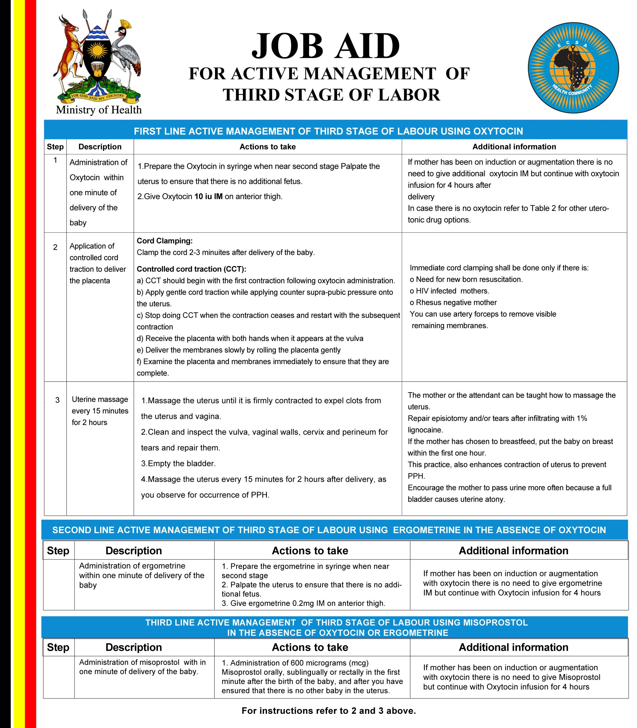


BIORISK MITIGATION

Slide 2
Learning Outcomes
By the end of this topic you should be able to
Describe Biorisk mitigation
Describe the different measures of biorisk mitigation processes
Determine the order of biorisk mitigation hierarchy
Select appropriate mitigation measures

Slide 3
Contents
Definition of Biorisk mitigation
Elimination and substitution in Biorisk management
Risk mitigation approaches
Relative efficacy and pros and cons of each of the approaches
Hierarchy of the controls approaches

Slide 4
BIORISK MITIGATION
  Actions and control measures that are put into place to reduce or eliminate the risks associated with biological agents and toxins

Slide 5
Mitigation Control Measures
There are five major categories of measures for controlling biological risks in the laboratory.
Elimination or Substitution
Engineering Controls
Administrative Controls
Practices and Procedures
Personal Protective Equipment

Slide 6
Mitigation Control Measures
Elimination or Substitution: Removing the hazard, not working with the agent or replacing the hazard with something less dangerous
Engineering Controls: Physical changes to work stations, equipment, materials, production facilities, or any other relevant aspect of the work environment that reduce or prevent exposure to hazards

Slide 7
Mitigation Control Measures
Administrative Controls: Policies, standards and guidelines used to control risks
Practices and Procedures: Processes and activities that have been shown in practice to be effective in reducing risks
Personal Protective Equipment: Devices worn by the worker to protect against hazards in the laboratory e.g laboratory coats, gloves, face masks

Slide 8
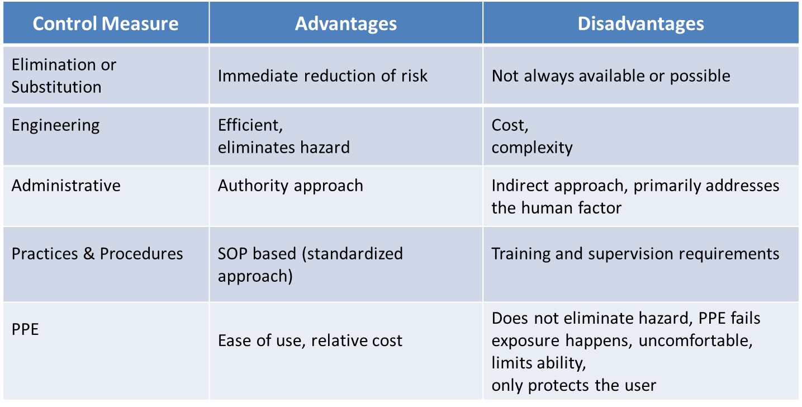
Advantages and Disadvantages

Slide 9
Hierarchy of Controls
Elimination or Substitution
Engineering Controls
Administrative Controls
Practices and Procedures
Personal Protective Equipment
Control methods at the top of the list are, in general, more effective and protective than those at the bottom.

Slide 10
Key Messages
Mitigation is most effective when based on a thorough risk assessment.
There are five generally recognized categories of control measures; each with various advantages and disadvantages.
Elimination or substitution is the most effective means of mitigating risk; generally followed by engineering controls; administrative controls; practices and procedure; and finally PPE.
It takes a combination of mitigation measures; in addition to the risk assessment, the effectiveness of mitigation also must be judged on your ability to implement them.

