Slide 1
CASE STUDY
A qualitative study design

Slide 2
A Case Study is an empirical inquiry that:
investigates a contemporary phenomenon within its real-life context, especially when
the boundaries between phenomenon and context are not clearly evident

Slide 3
Epistemology?
Case studies are very suitable to answer ‘how’ and ‘why’ questions

Slide 4
When Use the Case Study Method?
The case study is preferred in examining contemporary events, but when the relevant behaviors cannot be manipulated.
Case studies rely on direct observation, and systematic interviewing.
Case studies do not permit experimental manipulations and controls are very hard to enact

Slide 5
Criticisms of the Method
Insufficient rigour
  Compared to experimental research
    But actually experiments are not automatically precise or unbiased
Inadequate basis for generalisation
    Which is why multiple cases are conducted
    The results of a case study investigation can be generalised to theory and can inform theory development

Slide 6
Key Components
Research questions - how and why
Research propositions (if any) but not hypotheses
  That reflect an important theoretical issue and indicate where to look for relevant evidence
Unit(s) of analysis
  What are we studying? Units, people, individuals?
  What does the data describe?
Logic that links the data to the propositions
The criteria for interpreting the findings.

Slide 7
Single Case Design
The focal case is used to test a well-formulated theory
  The case meets all the criteria for testing the theory
The case represents an extreme or unique case
The revelatory case
  A situation that occurs when the investigator has an opportunity to observe and analyze a phenomenon previously inaccessible to scientific investigation.
A single case may have multiple units of analysis

Slide 8
Multiple Case Design
This means that the same study has two or more cases
The evidence from multiple cases is often considered more compelling, which makes the overall study more robust.
Undertaking a multiple case study can require extensive resources and time beyond the means of a single researcher.
Each case must be chosen carefully and specifically
The cases should have similar results (a literal replication) or contrary results (a theoretical replication) predicted explicitly at the outset of the investigation.

Slide 9
Multiple Case Design
It is important in a replication process to develop a rich, theoretical framework.
The framework needs to state the conditions under which a particular phenomenon is likely to be found (literal replication) and the conditions under when it is not likely to be found (theoretical replication).
The individual cases within a multiple-case study design may be either holistic or embedded.
When an embedded design is used each individual case study may in fact include the collection and analysis of highly quantitative data, e.g. surveys.

Slide 10

COMPARATIVE ANALYSIS
Why Compare?
The Comparable Cases Strategy

Slide 11
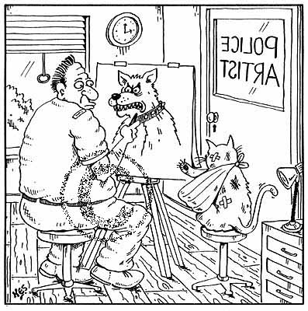
FOUR REASONS WHY COMPARISON IS USEFUL
Description
Classification and Typology

Slide 12
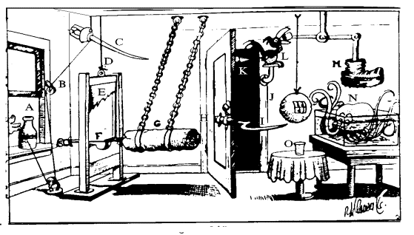
FOUR REASONS WHY COMPARISON IS USEFUL (con’t)
3. Hypothesis-Testing
Hypothesis = A statement about a possible causal relationship between two or more concepts.

Slide 13
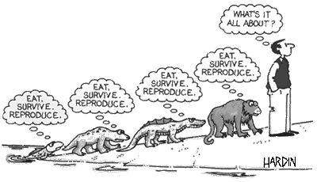
4. Theory formulation = A definitive and logical statement(s) about how the world, or some key aspect of it, works.

Slide 14





TYPES OF CASE STUDIES
Descriptive (Configurative-Ideographic)
Plausibility Probes
Most Likely Case Studies (MLCS)
Least Likely Case Studies (LLCS)
Deviant Case Studies (“commission of inquiry”)

Slide 15
Single-Case Studies
Illustrations – often complementary with statistical methodologies
Plausibility Probes – similar to pilot projects to see if more extensive/intensive studies would be useful and feasible. Yin calls these “exploratory.”
Deviant Cases – Seek explanation for anomalies, which may lead to new theory development.
Critical cases or other TESTS -- controversial

Slide 16
Pilot Case Study
It may be sensible to conduct a small-scale pilot case study first so as to test procedures and protocols
  The pilot can be more convenient so as to train research team members and even act as a "laboratory"
  The research questions can be broader and less focused than the ultimate data collection plan.
  The pilot reports can provide lessons for both research design and field procedures

Slide 17
Single Case studies and Variation
How can a single case study be used for inferences? If it remains a single observation (N=1), it can not.
The trick is to produce multiple N by breaking into subunits or time units.
  Studying multiple sites
  Studying policy changes across time.

Slide 18
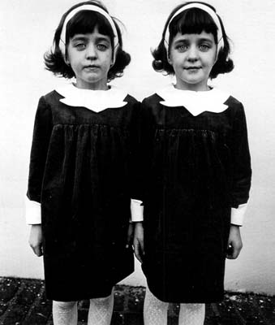
TYPES OF COMPARABLE CASE STRATEGIES
1. Most Similar Systems Design (MSSD)
Key is to identify what factor leads to dissimilar outcomes of Y when the cases appear rather similar in most regards.

Slide 19
Using MSSD to explain the emergence of guerrilla movements
Case | Cuba | Venz | Guate | Colo | Peru | Boli
Key Peasant Groups | Squat-ters | Share-cropper | Tennant | Share-cropper | Serfdom | Small-holders
Outcome: Guerrilla Support | Yes | Yes | Yes | Yes | Yes | No
Source: Adopted from Timothy Wickham-Crowley. Guerrillas and Revolution in Latin America. Princeton: Princeton University Press, 1993.

Slide 20
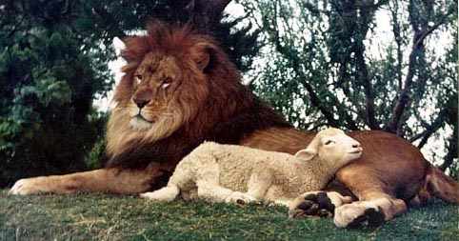
TYPES OF COMPARABLE CASE STRATEGIES (con’t)
2. Most Different Systems Design (MDSD)

Slide 21
Most Different System Designs
The key to this type of design is to understand that very different units/cases have the same outcome (Y variable). The search is then for a key explanatory variable common to the cases that all appear very different from each other.

Slide 22
Using MDSD to explain high levels of charitable giving.
 | Israel | Iran | U.S.
Features
Major Religion | A | D | G
GNP/capita | B | E | H
Tax codes | C | F | I
Key explanatory factor: religiosity | X | X | X
Outcome to be explained: level of giving | High | High | High

