Slide 1
Choosing a study design
Research In Practice
Achilles Katamba, Department of Medicine, Makerere University College of Health Sciences
Arusha - November 21st 2012

Slide 2
Learning objectives
Define the unique features of the major epidemiological study designs
Select and discuss the most appropriate study design to answer a certain research question

Slide 3
Goal of research studies is to generate knowledge on
  Causes – how to identify cause so that we can prevent it
  People/ populations at risk – how to identify them? risk
  Prevention - how to prevent disease best
  Therapy - how to treat a patient best
  Diagnostic tools – which are best diagnostic tools
  Prognostic tools - how to predict prognosis of disease
  For example:
  To identify the “causal effect” of Effect on Disease

Slide 4

From health problem to research question to study design
Topic
Research question
Determining the study design
Objectives
(Hypothesis)
What do we already know about the problem?

Slide 5


Slide 6
In which stage are we?
Descriptive stage
  Is the problem already well described?
Analytical Stage
  Is the problem already well analyzed?
Application Stage –Intervention and Evaluation
  Is a worthwhile intervention already evaluated?

Slide 7
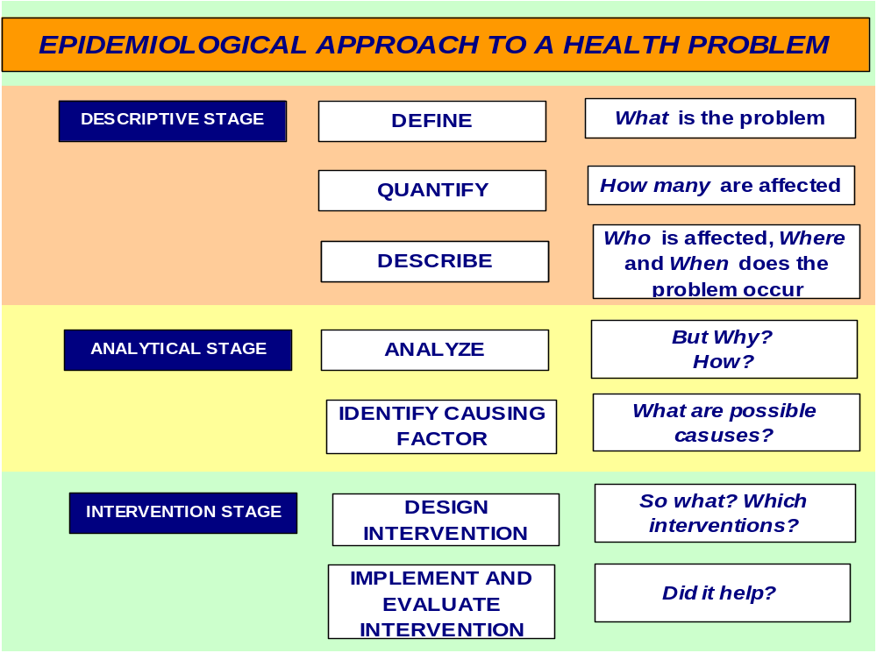

Slide 8
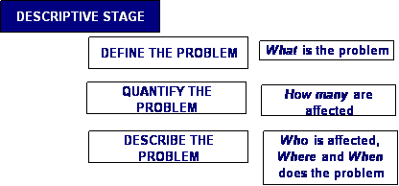
First Stage: Descriptive Stage
Knowledge about the problem limited

Slide 9
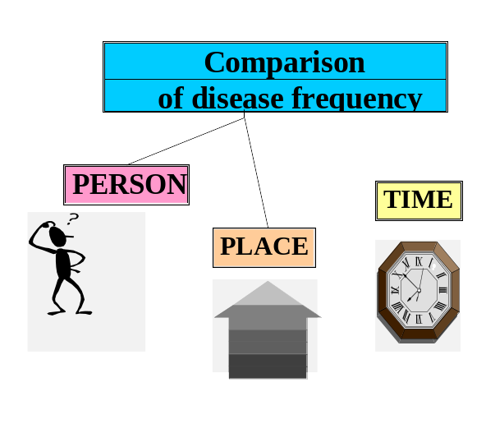
Analytical Stage
Epidemiological reasoning
1. Disease does not occur at random
2. Comparison of groups in the population can identify underlying causes of the occurrence of disease
Purpose of Comparison: to identify association between exposures and disease

Slide 10
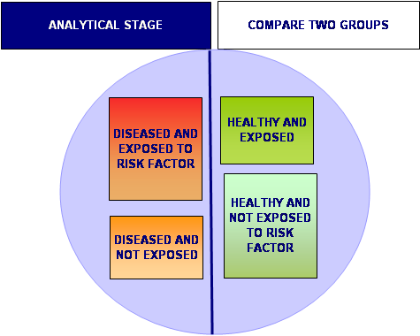
Are disease and exposure linked to each other?

Slide 11
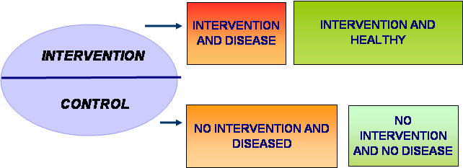
INTERVENTION STAGE
Expectation: Disease will occur less in group with intervention

Slide 12
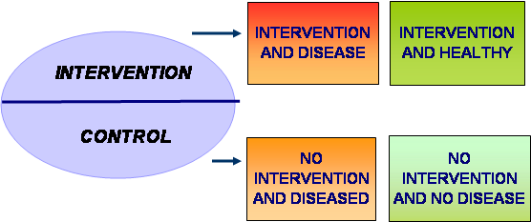
Any effect of intervention?
No, occurrence of disease similar in groups with and without intervention

Slide 13
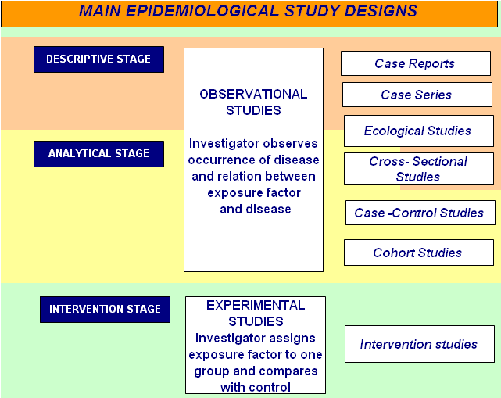

Slide 14
Descriptive studies

Slide 15
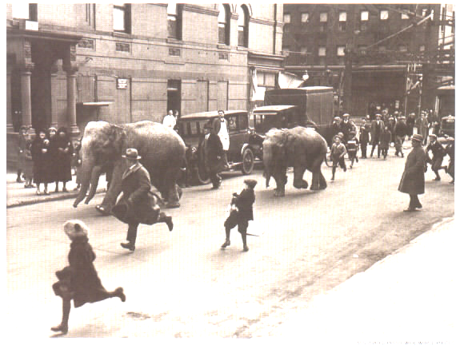
Start of research:
Observation of an unusual event

Slide 16
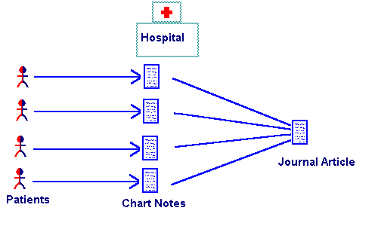
Case Report /Case Series
1 patient: Case Report
More patients: Case Series

Slide 17

Case study
One patient infected with two different strains of Mycobacterium tuberculosis

Slide 18
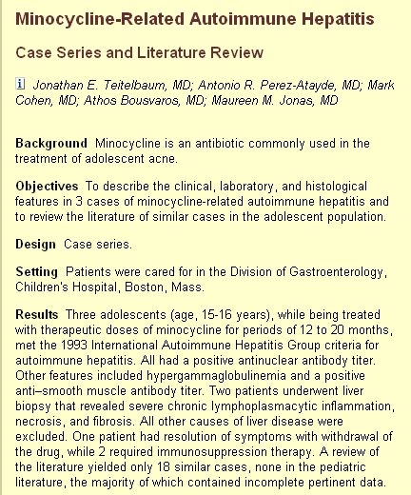
Case series
Description of three patients reacting to treatment,
they developed auto-immune hepatitis following minocycliine treatment

Slide 19
Ecological Studies
1. Description
Describes disease occurrence on population level
2.Analytical component - explorative
Evaluates an association using the population -not the individual -as the unit of analysis.
  The rates of disease are examined in relation to factors described on the population level

Slide 20
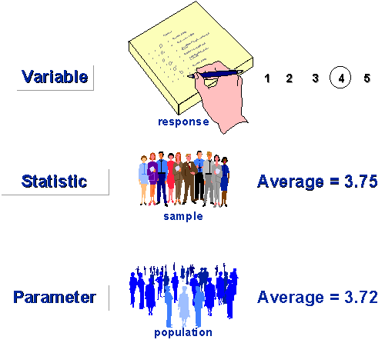
Association between cancer and fat intake?
National Cancer Rate
High
Low
High
Low
National Diet Fat-Intake
Ecological fallacy: We do not know if the individuals who have cancer were also the individuals with the high fat intake

Slide 21
Correlation between per capita daily meat consumption-grams and colon cancer
•UK
•Den
•Net
Colon cancer rate •Pol
•Yug
• Jap •Nig
Per capita meat intake-grams

Slide 22
Cross-Sectional Studies
1. Description
Describes disease occurrence on individual level
2. Analytical component - explorative
Examines the relationship between a disease and an exposure among individuals in a defined population at a point in time.
  Thus, it takes a snapshot of a population and measures the exposure prevalence in relation to the disease prevalence

Slide 23

Cross-sectional studies
Exposure and disease are determined simultaneously for each person → a snapshot of the population at one point in time
This can only indicate association, but cannot give a time-sequence.

Slide 24

Descriptive studies: summary
Case reports Case series | Selective by nature, providing little information May help identify potential health problems
Routine data Prevalence surveys Cross-sectional study | Show trends, raise questions Aid in health planning Descriptive or analytic?

Slide 25
Descriptive study ; e.g. survey
Select a sample of the population – source population
In study population we examine Disease and Exposure (Risk factors) at the same time

Slide 26


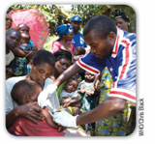
Example descriptive study -survey
Bull World Health Organ 2009;87:6–7 |

Slide 27
Analytical Observational Studies
Case-Control Studies
Cohort Studies

Slide 28
Case-Control study
In a case-control study the investigator compares one group among whom the problem is present (the cases) with another group where the problem is absent (the controls), in order to find out what factors are associated and could possibly have contributed to the problem

Slide 29
Case-Control Studies
Purpose
To study risk factors for a given condition- establishing an association between disease and exposure/risk factor
To do an outbreak investigation identifying cause of outbreak

Slide 30
Case-Control study
Quick assessment of possible association between exposure/risk factor and disease
If there is an association of an exposure and disease, than in the group of persons who have the disease more people have the exposure compared to the group that do not have the disease

Slide 31
Case-Control study V
Features
Starts with the outcome, looks back at the exposures
Always retrospective
Records vs. ‘life data’
Can often be done in a short time.
Exposure Outcome

Slide 32
Case-Control study
Past
Present
Exposed
Cases
(with disease)
Non-Exposed
?
Population
Exposed
Controls
(Without disease)
Non-Exposed
Start: Cases and Control
Direction of inquiry

Slide 33
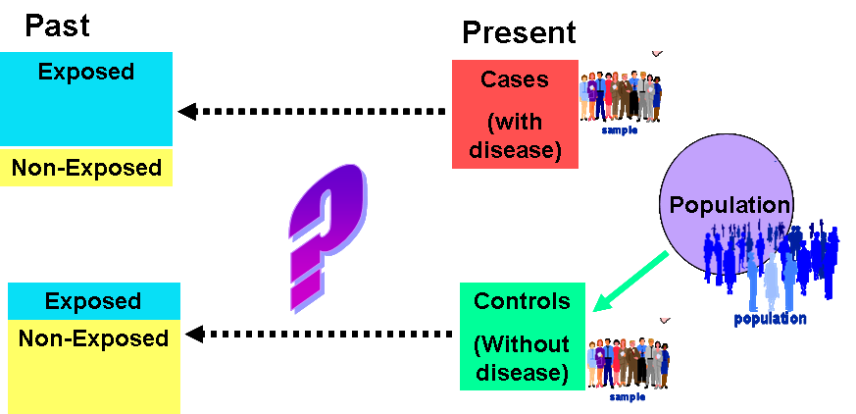
Is there an association between TB and smoking?
Design a case-control study to answer this question
define study groups
define all measurements

Slide 34
The Cohort study

Slide 35


Cohort
“Cohort” was the Roman term for
a group of soldiers that marched together
A cohort is a group that has something in common at the start
In clinical research “cohort” is a group of subjects that are followed over time starting at a specified point in time

Slide 36
Cohort study
In a cohort study a group of individuals that is exposed to a risk factor (study group) is compared to a group that is not exposed (the control group).
The researcher follows both groups over time and compares the occurrence of the problem under study in both groups

Slide 37
Purpose of Comparison
Features
Starts with measuring exposure, looks forward to the outcome
Can be prospective or retrospective
Exposed group can be specifically chosen
Design of choice to measure incidence.
Exposure Outcome

Slide 38
Cohort studies
More in-depth assessment of possible association between exposure/risk factor and disease
If there is an association of an exposure and disease, the incidence of disease should be higher in persons who are exposed than in those who are not

Slide 39
Cohort study
Purpose:
To study incidence of disease or other conditions
To study associations between exposures and outcomes (risk factors, determinants).

Slide 40
Cohort study - Prospective
Present
Future
Exposed
Diseased
Healthy
?
Population
Diseased
Healthy
Non-Exposed
Start: Exposed and non-exposed
Direction of inquiry

Slide 41
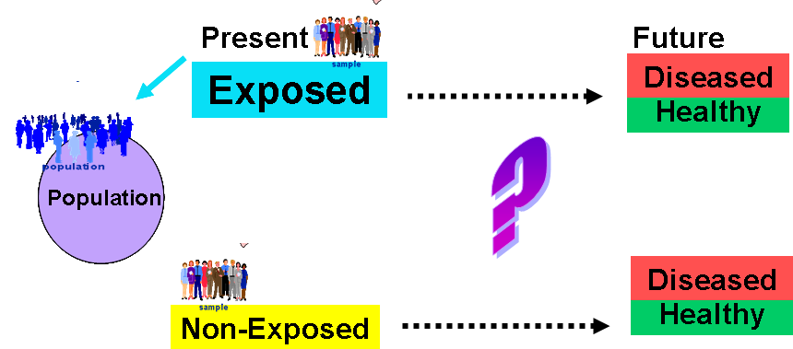
Is there an association between TB and smoking?
Design a cohort study to answer this question
define study groups
define all measurements

Slide 42
Quiz
Which study type do you prefer to answer this question?
Why?

Slide 43
Is there an association between in-house cooking and lung disease?
Design a case-control study to answer this question
Design a cohort study to answer this question
Which study design would you prefer for this question? Explain.

Slide 44
Interpretation of observational studies can be difficult
BIAS – systematic error
and CONFOUNDING – is there an alternative explanation for the results?

Slide 45
Prevention of mortality in meningococcal cases?
OBJECTIVE--To determine whether parenteral penicillin given before admission to hospital reduces the case fatality rate in patients with meningococcal disease.
DESIGN--Retrospective analysis of 46 consecutive patients admitted to hospital with meningococcal disease from January 1986 to March 1991.
RESULTS--None of the 13 patients given parenteral penicillin by the referring doctor before admission died, compared with eight deaths (24%) in 33 patients admitted without such treatment.
CONCLUSION--Parenteral penicillin given before admission probably contributed to a reduction in the case fatality rate from meningococcal disease, and primary care physicians should be encouraged to give such treatment immediately on suspicion of the diagnosis before transferring the patient to hospital.

Slide 46
OBJECTIVE: To explore the impact on mortality and morbidity of parenteral penicillin given to children before admission to hospital with suspected meningococcal disease.
DESIGN: Retrospective comparison of fatal (cases) and non-fatal cases (controls).
RESULTS: Administration of parenteral penicillin by general practitioners was associated with increased odds ratios for death and complications in survivors
Children who received penicillin had more severe disease on admission. Severity on admission did not differ significantly with time taken to reach hospital.
CONCLUSIONS: Children who were given parenteral penicillin by a general practitioner had more severe disease on reaching hospital than those who were not given penicillin before admission.

Slide 47
BIAS- systematic error
Authors concluded: “The association with poor outcome may be because children who are more severely ill are being given penicillin before admission”.
Selection bias: children in group with exposure are not comparable to the children in group without exposure

Slide 48
Study Designs and Bias
Despite all preventive efforts, bias should always be considered among alternative explanations of a finding.
It has to be remembered that bias may mask an association or cause a spurious one; and it may cause over or underestimation of the effect size.
A study that suffers from bias lacks internal validity.

Slide 49
Randomized Controlled Trial (RCT)
The gold standard

Slide 50
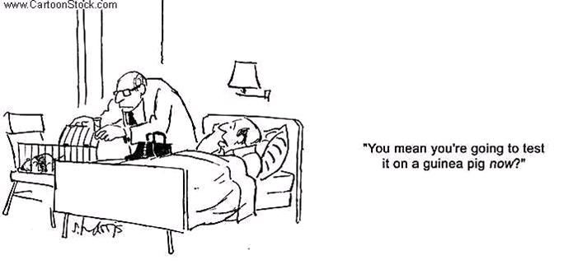
Experimental Designs

Slide 51
Experimental studies
Intervention studies have the advantage over observational studies in that they have the ability to demonstrate causality
Randomly assigning the intervention can eliminate the influence of confounding variables
  Blinding the administration of the intervention can reduce bias

Slide 52
Randomised Controlled Trial
FINISH
START
E+
D?
A special type of cohort study : experimental
Because chance has allocated exposure, groups are comparable
Ethical considerations
RCT gives us best answer about causal effect of E on D.
Randomization
E-
D?

Slide 53
Randomised Controlled Trial
Present
Future
Exposed
Diseased
Healthy
?
Population
Randomisation
Diseased
Non-Exposed
Healthy
Start: Randomisation of exposure
Direction of inquiry
Notes:
Cave confusion: in RCTs the group that is exposed to the intervention under study is called the intervention arm, the groups that does not get the intervention (non-exposed group) is often referred to as the Control arm. Cf with case-control (and sometimes also cohort) studies where “Controls” denote people who don’t have the outcome under study, i.e. the non-diseased group.

Slide 54
Example RCT
Does drug X improve cure rates for extra-pulmonary TB?
Does intensified contact tracing reduce the risk of transmission of MDR-TB?
To what extent does vaccine Y prevent all forms of TB in an adult high-risk population?

Slide 55

Practicals

Slide 56
Question 1
Case scenario You want to study whether heavy smoking is a risk factor for active TB.
Q1 : could you use a cross-sectional design? If not, why not?

Slide 57
Question 2
Case scenario You want to study whether heavy smoking is a risk factor for active TB.
Q2 : could you use a case-control design? If not, why not?

Slide 58
Question 3
Case scenario You want to study whether heavy smoking is a risk factor for active TB.
Q3: could you use a cohort design? If not, why not?

Slide 59
Question 4
Case scenario You want to study whether heavy smoking is a risk factor for active TB.
Q4 : could you use an RCT design? If not, why not?

Slide 60
Answer Q1
No, because smoking is an exposure that may change over time. You will not know what was there first: TB or heavy smoking

Slide 61
Answer Q2
Q2 : Yes, this is the design of choice if you have to start from scratch.

Slide 62
Answer Q3
Q3 : It is possible, but not ideal because active TB may not become apparent until after many years and because TB is a relatively rare disease. It may happen that in your entire cohort, no-one will develop TB. The exception is when you would have access to the exposure data anyway in a large cohort that already exists, e.g. the Framingham study or the Doctors health study.@ In that case it would be a historic cohort study, because you start by looking at exposure data from the past and then follow up patients through time (by looking in the study register) to see who develops active TB. This design would then be preferable to a case control design because it has less problems with bias [do not elaborate on this now]

Slide 63
Answer 4
No, that is not ethical, because you are investigating a harmful effect of an exposure. Also, the exposure would be difficult to impose on people (“you are assigned to the intervention group, you now have to smoke 40 sigarettes a day for the next 5 years”). And all the problems with a cohort design would also apply here.

Slide 64
Question 5
The main objective is to compare the efficacy and safety of 2 artemisinin-based combination therapies (ACT), artemether-lumefantrine (AL) and dihydroartemisinin – piperaquine (DP) for treatment of uncomplicated malaria in children in Uganda
Which study design would you use and why?

Slide 65
Question 6
To determine the prevalence of the major enteric pathogens associated with diarrhea in 5 hospitals in Uganda and describe the antimicrobial susceptibility patterns of the bacterial pathogens.
Which study design would you use and why?

Slide 66
Question 7
To determine the optimal TB diagnostic algorithm based on sputum smear-microscopy, OSSM, Gene Xpert and MGIT
Which study design would you use and why?

Slide 67
Questions/Comments
Thank you for Listening

