Slide 1

Student Dropout
Risk Prediction
Using Machine Learning
Course: Machine Learning Capstone Project
Author: Kenneth Paul Cortez
Date: March 2026
2026
A Data-Driven Approach to Student Success

Slide 2



The Problem
Student dropout is a growing challenge facing universities worldwide
32%
1 in 3
$12k+
of students drop out
before graduation
students leaves without
the degree they enrolled for
in tuition revenue lost
per dropout student annually
Student Success
Institutional Reputation
Financial Stability
Students who leave without a degree face long-term financial setbacks, often carrying debt without the qualification that was meant to improve their prospects.
High dropout rates lower graduation statistics, directly affecting university rankings and making it harder to attract quality students and secure future funding.
Every dropout represents lost tuition income and undermines the financial planning that universities rely on to sustain programmes, staff, and facilities.

Slide 3
Why This Problem
Matters
Institutional Consequences
Revenue Shortfall
The cost of inaction extends far beyond
each individual student who leaves.
Unplanned dropouts create budget gaps, forcing programme cuts and staffing freezes that affect every remaining student.
£50,000+
Rankings Decline
National and global rankings weigh graduation rates heavily. A declining rate can take years to reverse.
average debt load for
students who drop out
15–20%
Reputational Damage
Prospective students research completion rates. A poor reputation spreads quickly through word-of-mouth.
ranking drop per
5% rise in dropout rate
~3 years
Wasted Resources
Advisor time, scholarships, and infrastructure investment is lost when students leave before benefiting from the support.
to recover rankings
after reputation damage

Slide 4


Proposed Solution
An AI-powered early warning system that identifies students at risk before it is too late
Predictive Analytics for Student Retention
Collect
Analyse
Identify
Intervene
Gather student academic, enrolment, demographic, and financial data from institutional systems automatically.
Machine learning finds hidden patterns across thousands of student records patterns humans cannot spot alone.
Students most likely to drop out are flagged early weeks before the risk becomes a reality.
Advisors receive a prioritised list and focus energy where targeted support will have the greatest impact.

Slide 5
How the System Works
A straightforward four-step process no technical knowledge required
01
02
03
04
Data Collection
Pattern Recognition
Risk Score Generated
Advisor Takes Action
Academic grades, enrolment details, family background, and financial status are pulled automatically from university records.
The system analyses thousands of data points to identify student profiles that historically correlate with dropout risk.
Every student receives a risk assessment. High-risk students are clearly flagged for immediate advisor attention.
Advisors review flagged students and initiate targeted support — counselling, financial guidance, or academic referrals.
›
›
›
Result: Fewer dropouts · Better outcomes · Smarter use of support resources

Slide 6
Key Insights from the Data
What patterns reveal about students most likely to drop out
Student Outcome Distribution
87%
Tuition Fees Unpaid
Students with overdue tuition fees drop out at a rate of 87% the single strongest predictor of risk.
2.5×
Low First-Semester Grades
Students performing below average in their first semester are 2.5× more likely to leave before graduating.
#1
Age at Enrolment
Older enrolment age is the highest correlated demographic factor with dropout risk across the full dataset.
1 in 3 students does not complete their degree

Slide 7
Model Performance Results
The predictive system was rigorously tested on real student data
Accuracy Comparison All Models Tested
88.2%
Accuracy
9 out of 10 students correctly identified
86.6%
Precision
High confidence in genuine risk flags
XGBoost
Best Model
Top performance across all approaches tested
In plain terms: the system correctly identifies at-risk students roughly 9 times out of 10

Slide 8


Business Value for Your Institution
Predictive analytics translates into measurable, real-world institutional gains
Proactive Intervention
Improved Retention
Smarter Resource Use
Identify at-risk students weeks before dropout. Advisors engage early with meaningful support, not last-minute damage control.
Even a 5% improvement in retention can generate significant additional tuition revenue and improve institutional sustainability.
Focus academic support budgets precisely on students who need them most, rather than spreading resources too thinly.
Higher Graduation Rates
Competitive Advantage
Risk Management
Higher completion rates improve national rankings, attracting stronger students and unlocking additional funding streams.
Institutions using data-driven retention tools outperform peers in student satisfaction and graduate employment outcomes.
Predictable student retention allows more confident long-term financial planning and reduces exposure to revenue volatility.

Slide 9
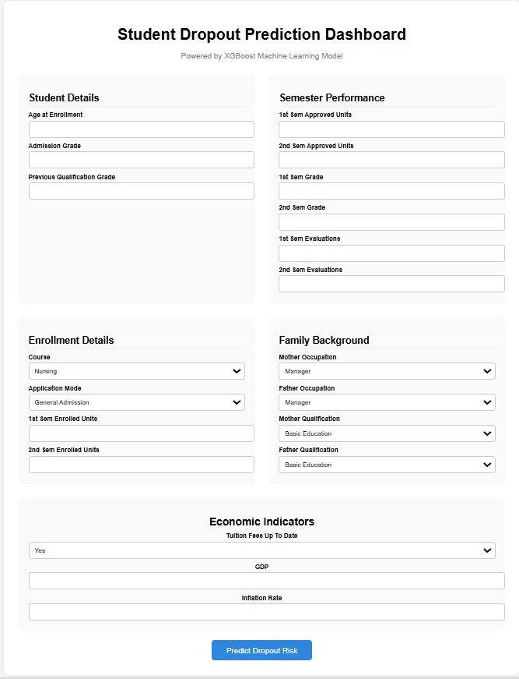

Web Application Interface
A user-friendly tool that puts predictive power directly in advisors' hands
About the Dashboard
Powered by XGBoost Machine Learning
Student Information Inputs
Simple form fields capture academic grades, enrolment details, family background, and economic indicators.
One-Click Prediction
A single button submits the data for analysis. Results appear in seconds no waiting or technical steps.
Instant Risk Result
The system displays a clear risk classification showing at a glance whether the student needs immediate attention.
Accessible in any browser · No installation · Results in seconds

Slide 10
Implementation Strategy
A phased rollout designed to minimise disruption and maximise impact
Phase 1
Phase 2
Phase 3
Phase 4
Data Integration
Pilot Programme
Full Deployment
Continuous Improvement
Months 1–3
Months 4–6
Months 7–12
Ongoing
Connect the prediction system to existing Student Information Systems. Set up automated data feeds covering academic, financial, and enrolment records.
Launch in one faculty or department. Train academic advisors on the dashboard. Validate prediction accuracy and gather feedback from early users.
Expand institution-wide. Establish a prediction cycle aligned to semester milestones. Integrate automated alerts into existing advisor workflows.
Retrain the model each semester with updated outcomes. Refine intervention strategies based on measured results. Add new data sources as available.
Designed to work alongside existing systems with minimal disruption to current operations

Slide 11

Responsible AI Usage
Ethical deployment and student trust are fundamental to this system's design
Data Privacy
Fairness & Bias Prevention
All student data is processed securely in full compliance with GDPR and applicable data protection regulations. No personal data leaves institutional servers.
The model was tested across demographic groups — gender, age, and nationality — to ensure no student population is unfairly targeted or disadvantaged.
Human-Led Decisions
Full Transparency
The AI provides a recommendation only. Academic advisors review every flagged case. Final decisions are always made by qualified humans, never automated.
The system explains why a student is flagged — not just whether they are. Advisors see the contributing factors, making conversations more informed.
The system is a decision-support tool it empowers advisors, it does not replace them

Slide 12


Future Opportunities
Expanding the system's reach, accuracy, and institutional impact over time
Richer Data Sources
Real-Time Monitoring
Expanded Web Tools
Personalised Interventions
Incorporate learning management data — assignment completion rates, login frequency, and forum activity — to detect disengagement even earlier.
Move from semester-based snapshots to continuous monitoring, generating updated risk scores week-by-week as student behaviour evolves.
Develop richer advisor dashboards, mobile-friendly interfaces, and automated email alerts that push high-risk notifications directly to advisors.
Tailor support recommendations to each student's specific risk factors — financial, academic, or personal — rather than one-size-fits-all responses.
Vision: A fully integrated student success platform that prevents dropout before it becomes inevitable

Slide 13
Conclusion
88.2%
Prediction Accuracy
32%
Current Dropout Rate
The XGBoost model correctly identifies 9 in 10 at-risk students before dropout occurs.
Nearly 1 in 3 students does not graduate — this system is built to change that trajectory.
Early
Weeks of Warning
Zero
Technical Expertise Needed
Advance alerts give advisors time to engage students with genuine, targeted support.
The web application is designed for everyday use by any advisor or administrator.
Predictive analytics is no longer a luxury it is a strategic necessity for any institution committed to student success.
Dataset: UCI ML Repository · Model: XGBoost · Deployment: Flask Web Application
Thank you — Questions welcome

