Slide 1

Student Dropout
Risk Prediction
Using Machine Learning
4,424
37
5
Records
Features
Models
Machine Learning Capstone Project
Kenneth Paul Cortez
Dataset: UCI ML Repository Realinho et al. (2022)
04 March 2026

Slide 2
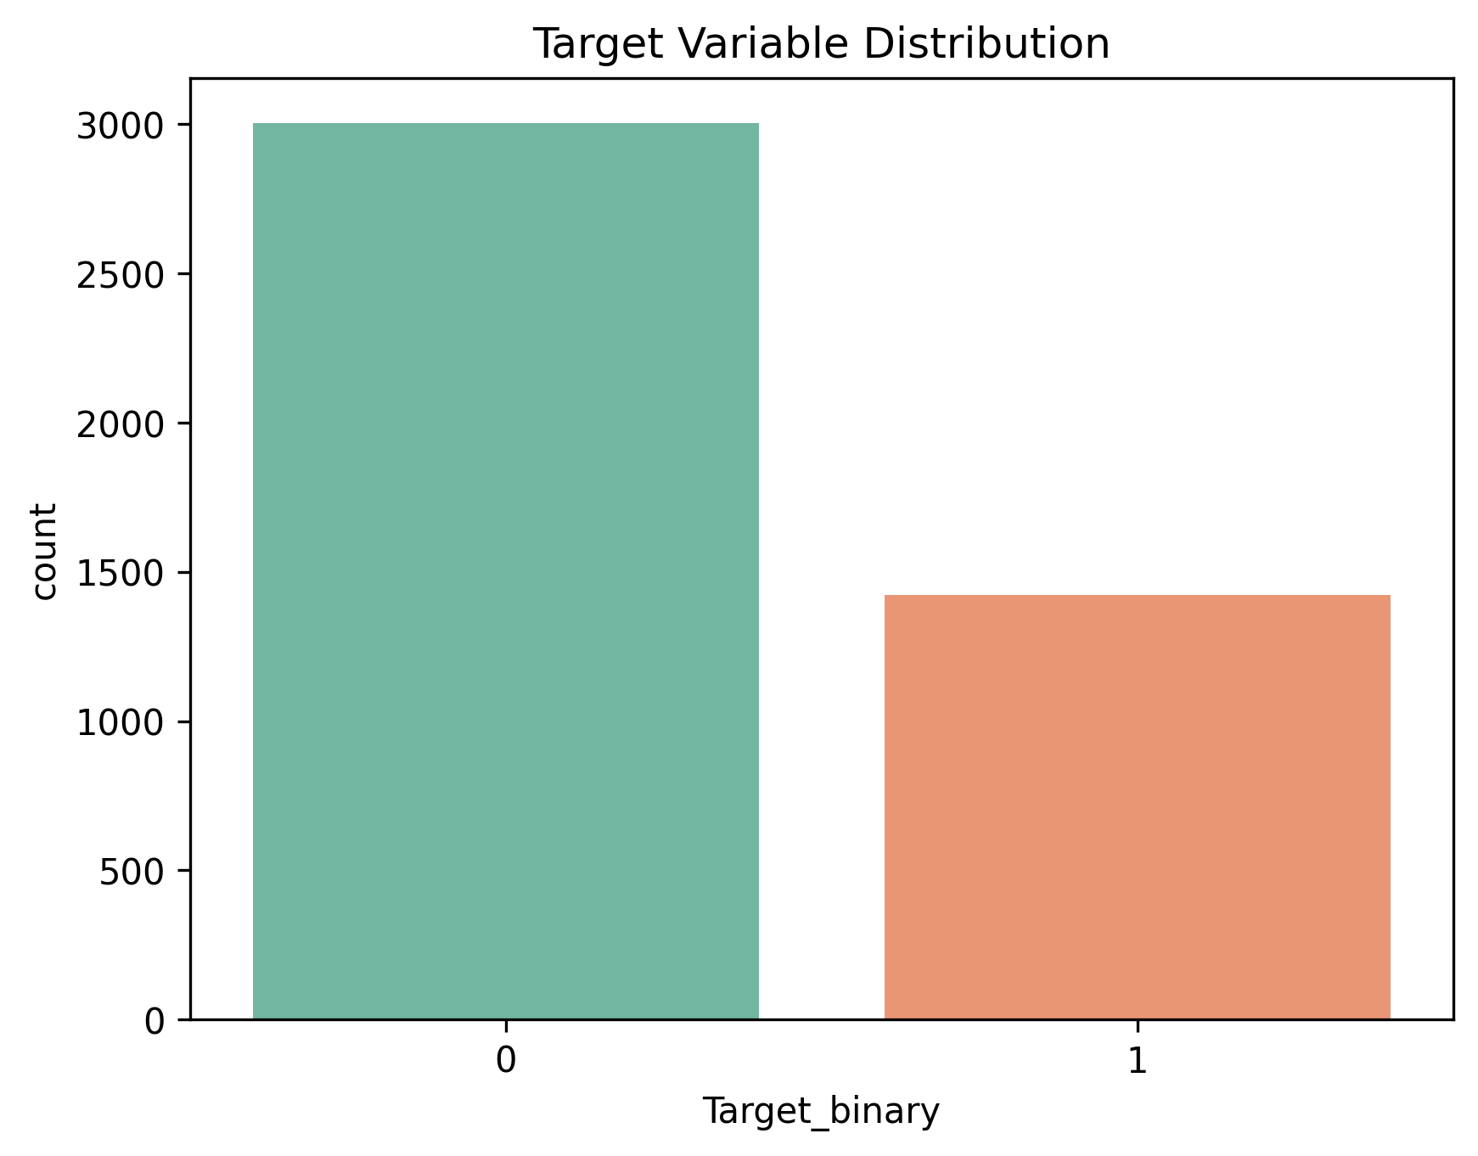
Problem Overview
Why predicting student dropout matters for higher education institutions
Silent Accumulation
32%
Dropout rate in dataset
Dropout rarely happens overnight. Declining grades, unpaid tuition, and disengagement compound quietly — the institution detects the pattern only after the student has already mentally checked out.
1,421
Dropout cases (class 1)
Institutional Cost
3,003
High attrition erodes tuition revenue, weakens ranking metrics, and signals gaps in student support infrastructure. In Portugal, dropout rates in higher education have drawn sustained policy attention.
Non-dropout cases (class 0)
The ML Opportunity
A predictive model trained on prior cohort data can surface at-risk students weeks before a critical outcome, giving advisors a concrete, prioritised list for outreach.
Fig 1: Binary target distribution after 3-class → binary transformation

Slide 3
Machine Learning Problem Definition
Task Type: Supervised Binary Classification
Target Variable
Input Features
Evaluation Goal
Original: 3 classes
Dropout / Enrolled / Graduate
Demographic
(age, gender, marital status, nationality)
Primary metric: F1-Score
(penalises missed at-risk students equally with false alarms)
Binarised:
1 = Dropout
0 = Enrolled + Graduate
Academic
(semester grades, approved units, evaluations)
Secondary: ROC-AUC
Accuracy · Precision · Recall
Socioeconomic
(fees, debt, scholarship, parental occupation)
F1-Score is chosen as primary metric because a missed dropout case (false negative) carries higher institutional cost than a false alarm.

Slide 4
Dataset Description UCI ML Repository (Realinho et al., 2022)
4,424
37
0
~32%
Total Records
Features
Missing Values
Dropout Rate
Demographic Features
Academic Features
Socioeconomic Features
Gender
Age at enrollment
Nationality
Marital status
International student flag
Displacement status
Admission grade
Previous qualification & grade
1st & 2nd semester grades
Curricular units approved
Units without evaluations
Daytime / evening attendance
Tuition fees up to date
Scholarship holder
Debtor status
Mother's & Father's occupation
Unemployment rate
Inflation rate · GDP
Realinho V. et al. (2022). Predicting Student Dropout and Academic Success. Data, 7(11), 146. https://doi.org/10.3390/data7110146

Slide 5
Data Preprocessing
Pipeline steps applied before model training
Missing Value Audit
Outlier Analysis
01
All 37 features inspected zero null entries found across 4,424 records. No imputation was required.
04
Boxplot analysis flagged high admission grades and older enrollment ages. All were verified as genuine student profiles retained to preserve predictive signal.
Duplicate Detection
Stratified 80/20 Split
02
Row-level deduplication confirmed every record is unique. No removal necessary.
05
Train and test sets produced with stratification to preserve the 32:68 class ratio in both partitions.
Target Binarisation
StandardScaler
03
Original 3-class label (Dropout / Enrolled / Graduate) collapsed to binary: 1 = Dropout, 0 = Non-Dropout.
06
Zero-mean, unit-variance scaling applied post-split. Critical for Logistic Regression and SVM; applied uniformly across all models.

Slide 6
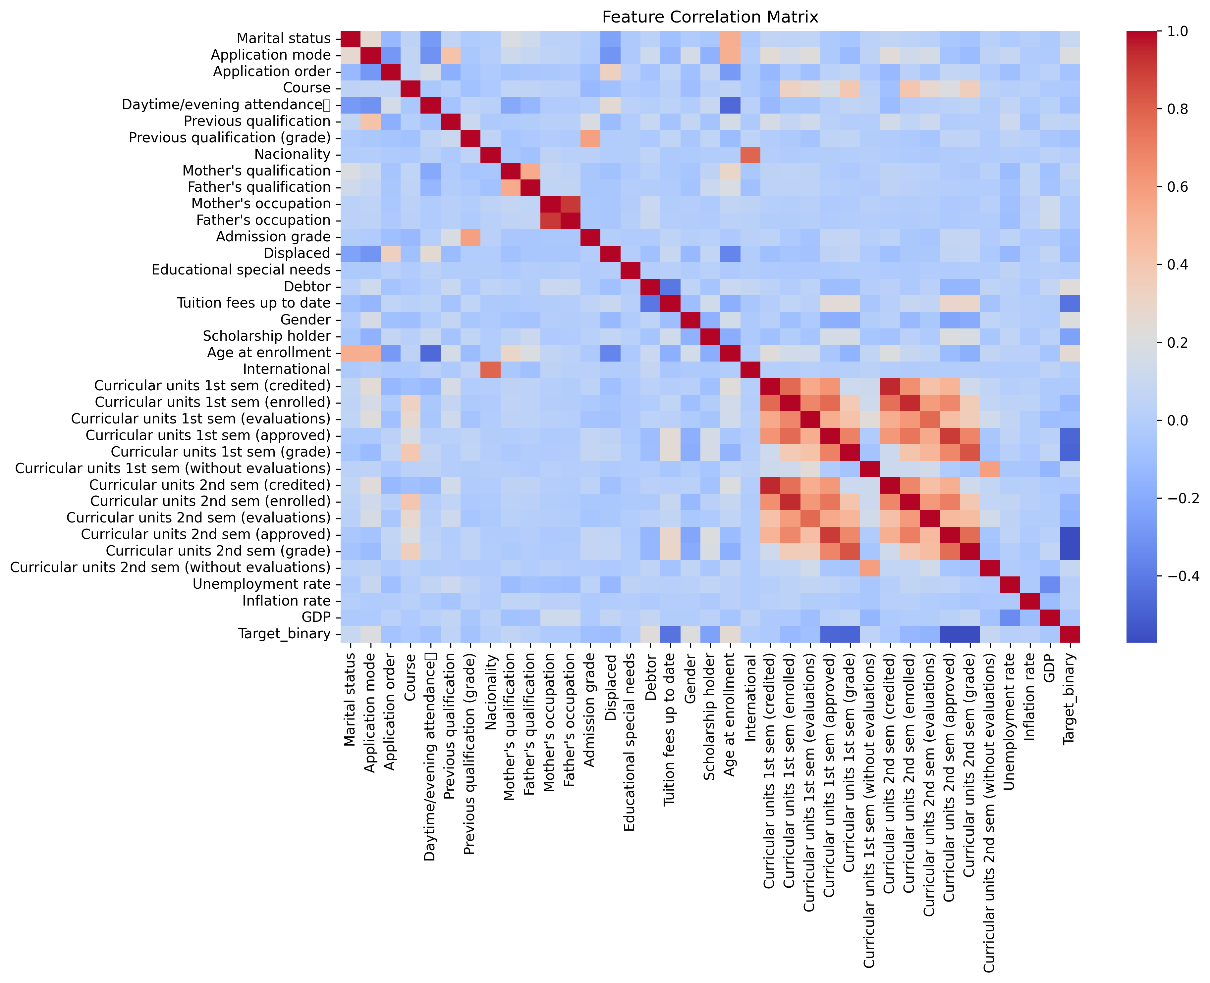
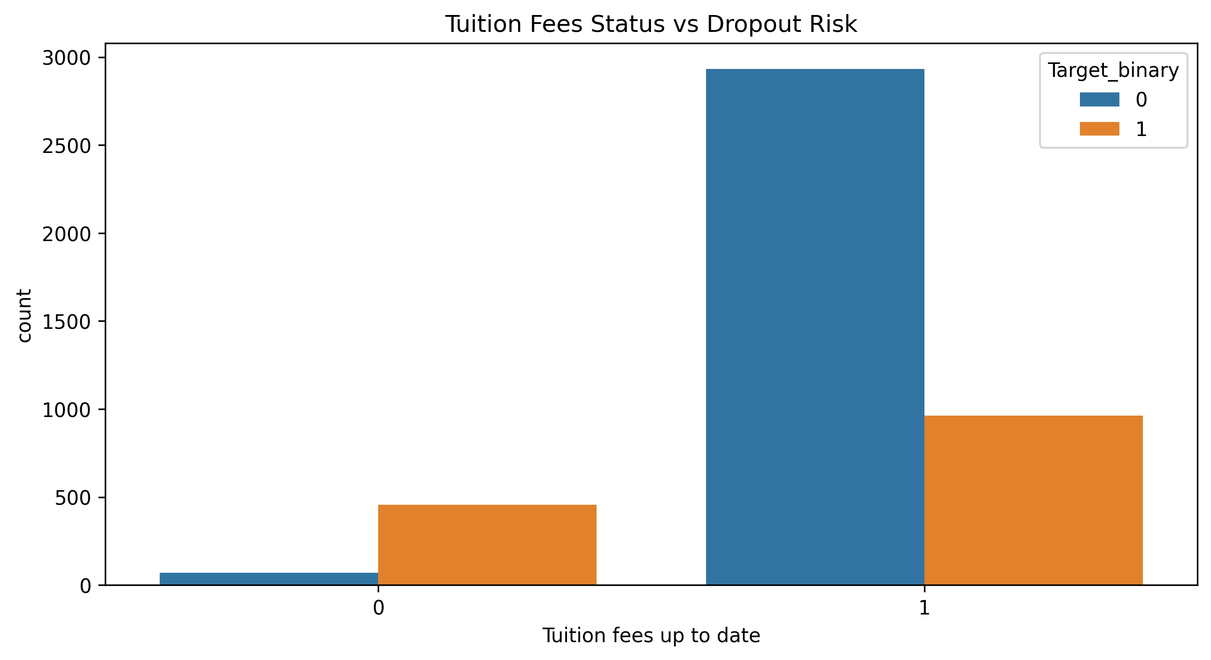
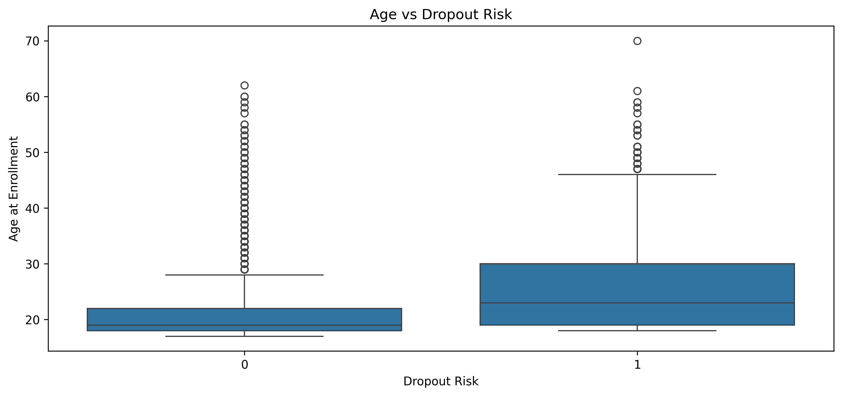
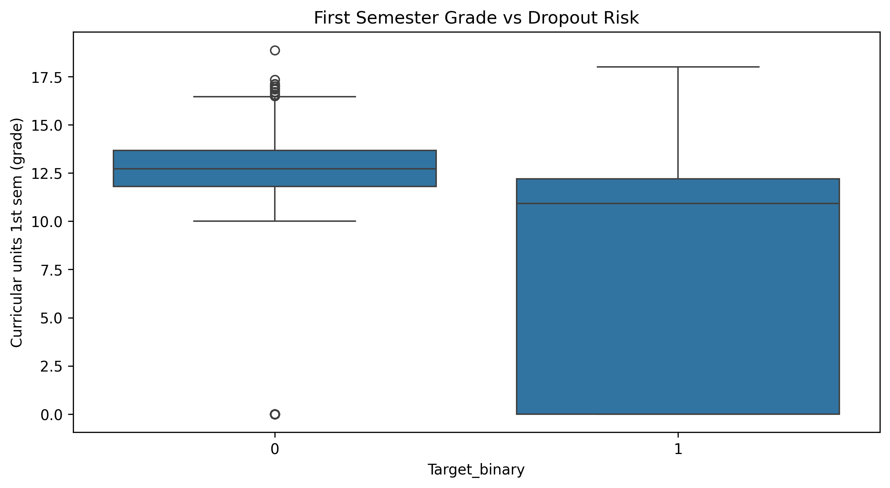
Exploratory Data Analysis Key Patterns Before Modelling
Fig 2: Correlation heatmap semester-grade variables are tightly intercorrelated; tuition fees show strong negative correlation with dropout target.
Fig 3: Tuition fee status vs dropout 87% of students with unpaid fees eventually drop out; a near-binary signal.
Fig 4: Age at enrollment vs dropout dropout students have a wider, higher-centred age distribution; median ~3 years older.
Fig 5: 1st semester grade vs dropout dropout group shows markedly lower grades and far greater variance across the IQR.

Slide 7
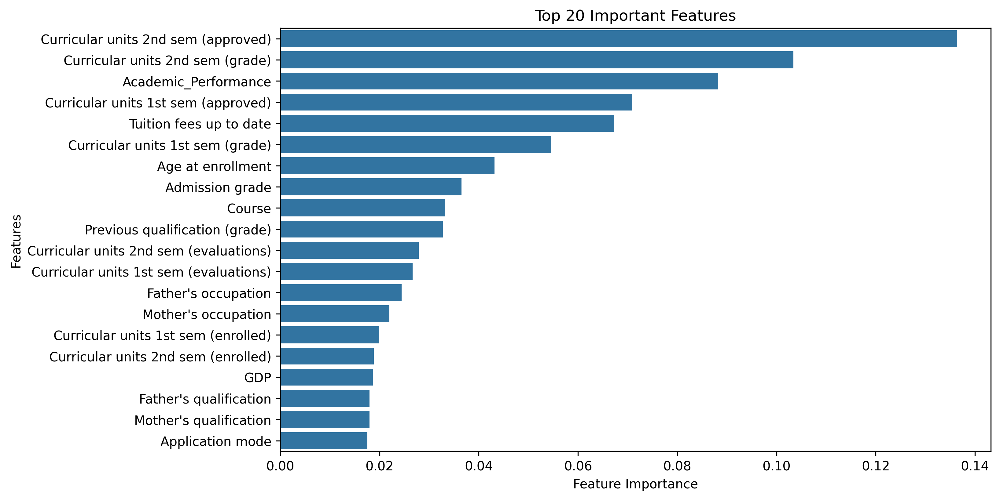
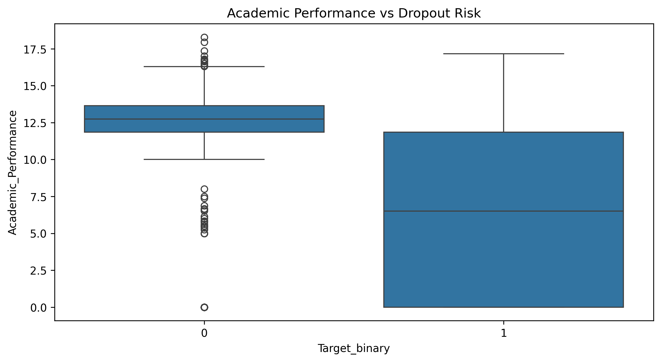
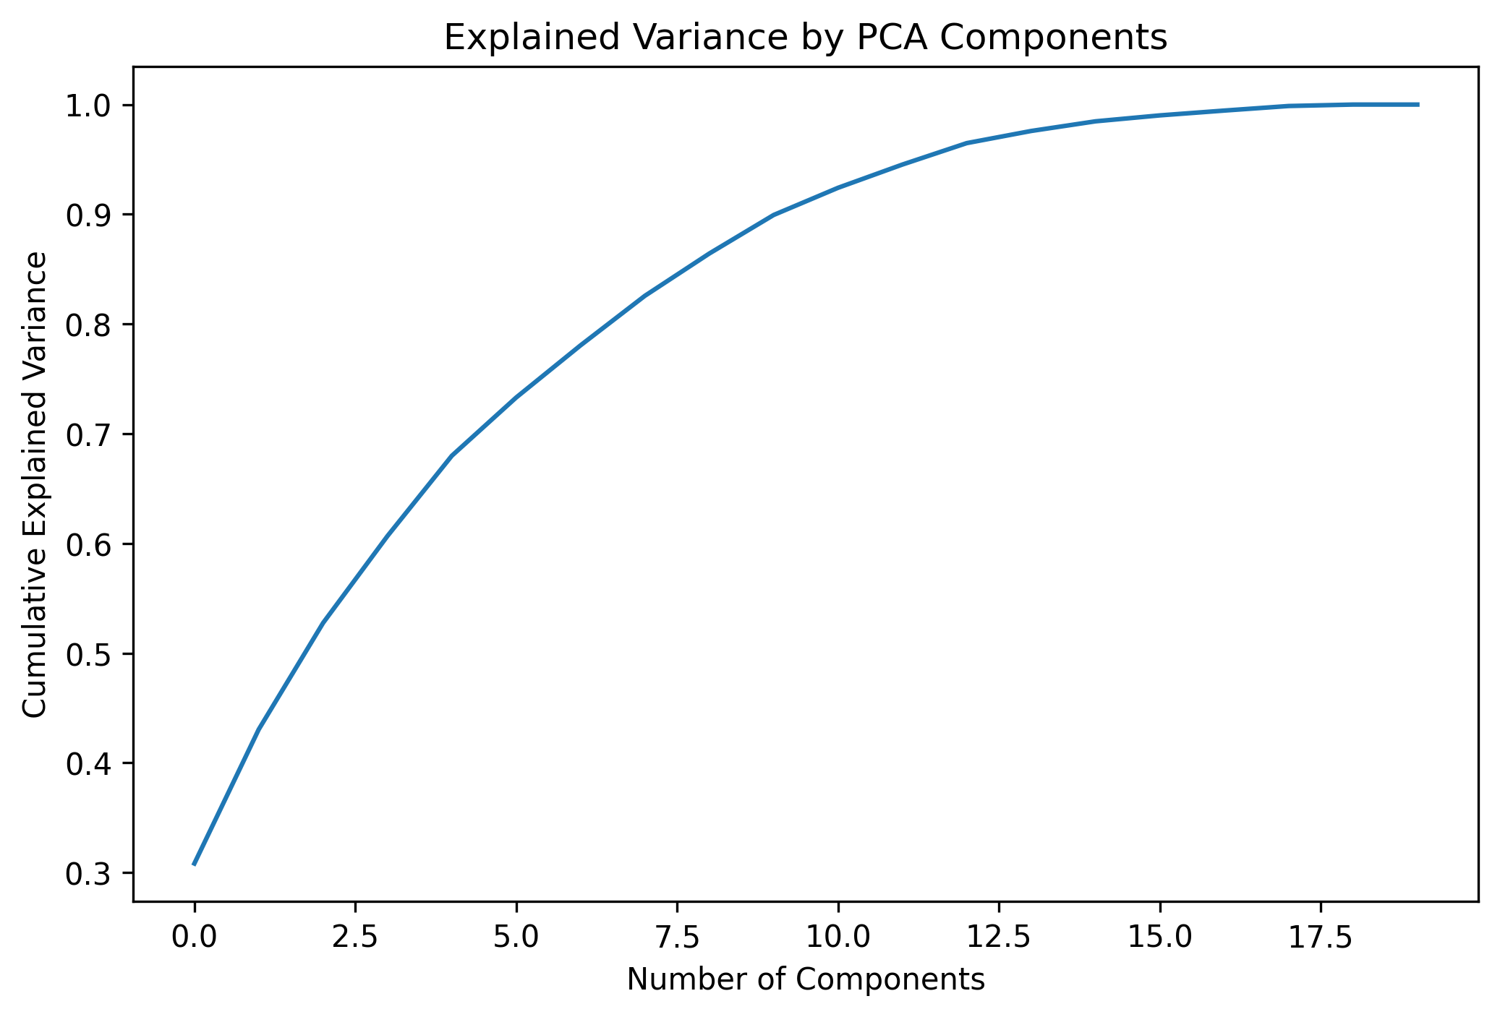
Feature Engineering & Selection Signals, Importances & Dimensionality
Engineered: Academic_Performance
Top-20 Feature Importances — Random Forest
Average of 1st and 2nd semester grades combined into a single composite score. Captures sustained academic trajectory more faithfully than either semester alone as confirmed by the sharper class separation below.
Fig 6: Academic_Performance vs Dropout Risk
Fig 8: PCA Cumulative Explained Variance
Fig 7: Approved 2nd-sem units lead (0.14 importance), followed by 2nd-sem grade and the composite Academic_Performance feature.
5 components capture ~75% variance; 10 reach ~90% — confirming moderate redundancy in the raw 37-feature set.

Slide 8
Model Implementation
Five classifiers trained on a consistent 80/20 stratified split with StandardScaler
Logistic Regression
Baseline
Linear decision boundary with L2 regularisation. Provides an interpretable lower-bound reference for ensemble gains.
Decision Tree
Interpretable
Recursive feature splitting to minimise impurity. High interpretability but prone to overfitting without pruning.
Random Forest
Ensemble
Bootstrapped ensemble of trees. Reduces prediction variance and produces the feature importance rankings used in Slide 7.
SVM (RBF Kernel)
Margin-Based
Maximum-margin classifier in kernel-projected space. Sensitive to feature scale StandardScaler is mandatory here.
XGBoost
Best Model
Sequential gradient-boosted trees with L1/L2 regularisation. Captures nonlinear feature interactions; highest F1 score.

Slide 9
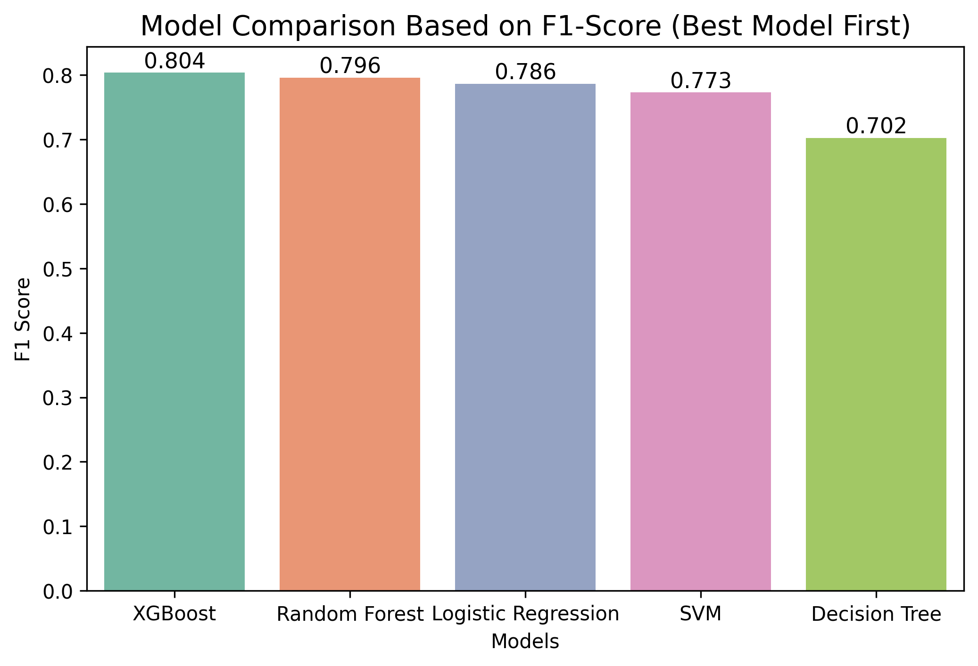
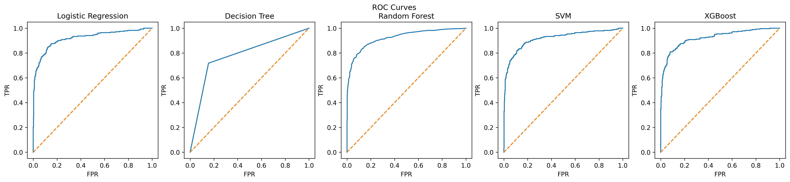
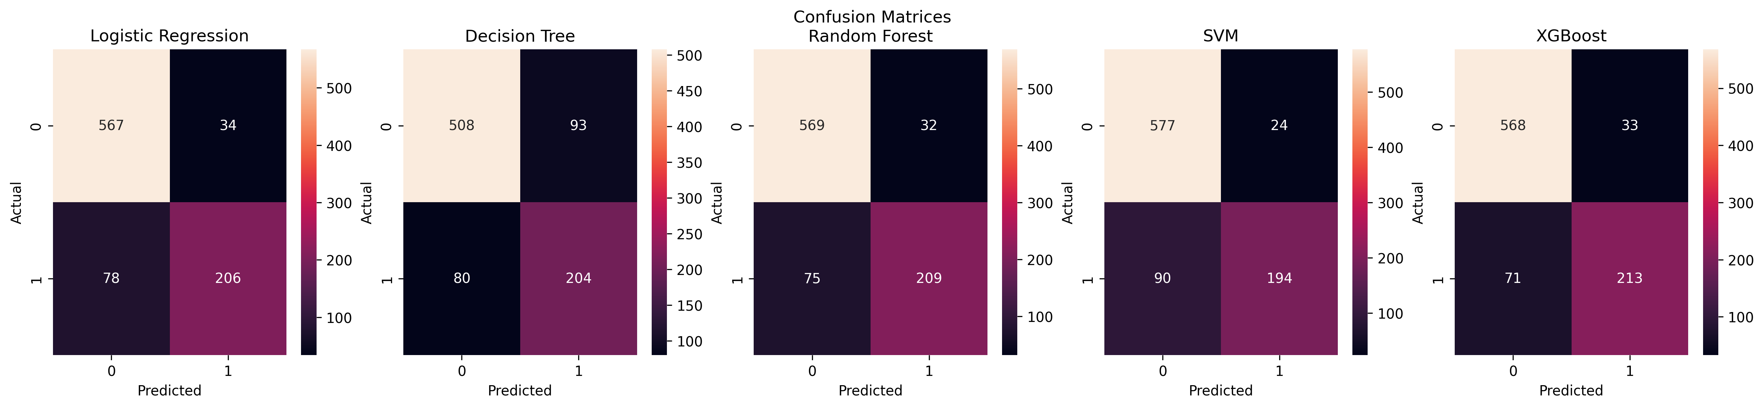
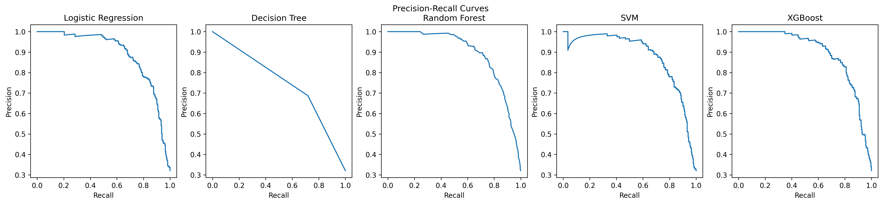
Model Evaluation & Performance Comparison
Model | Accuracy | Precision | Recall | F1-Score | ROC-AUC
XGBoost | 0.882 | 0.866 | 0.750 | 0.804 | 0.923
Random Forest | 0.879 | 0.867 | 0.736 | 0.796 | 0.924
Logistic Regression | 0.873 | 0.858 | 0.725 | 0.786 | 0.920
SVM | 0.871 | 0.890 | 0.683 | 0.773 | 0.917
Decision Tree | 0.805 | 0.687 | 0.718 | 0.702 | 0.782
F1-Score Comparison
ROC Curves (AUC: RF 0.924, XGB 0.923, LR 0.920)
Confusion Matrices — All Five Models
Precision-Recall Curves

Slide 10
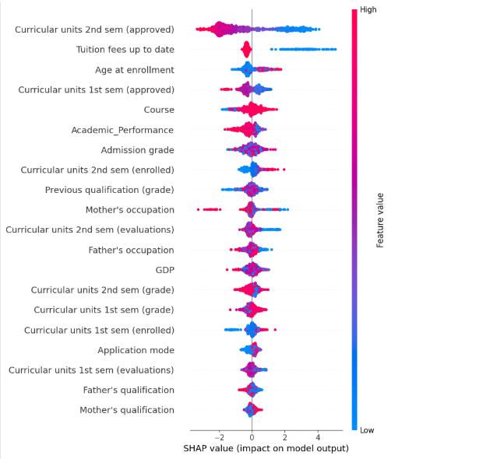
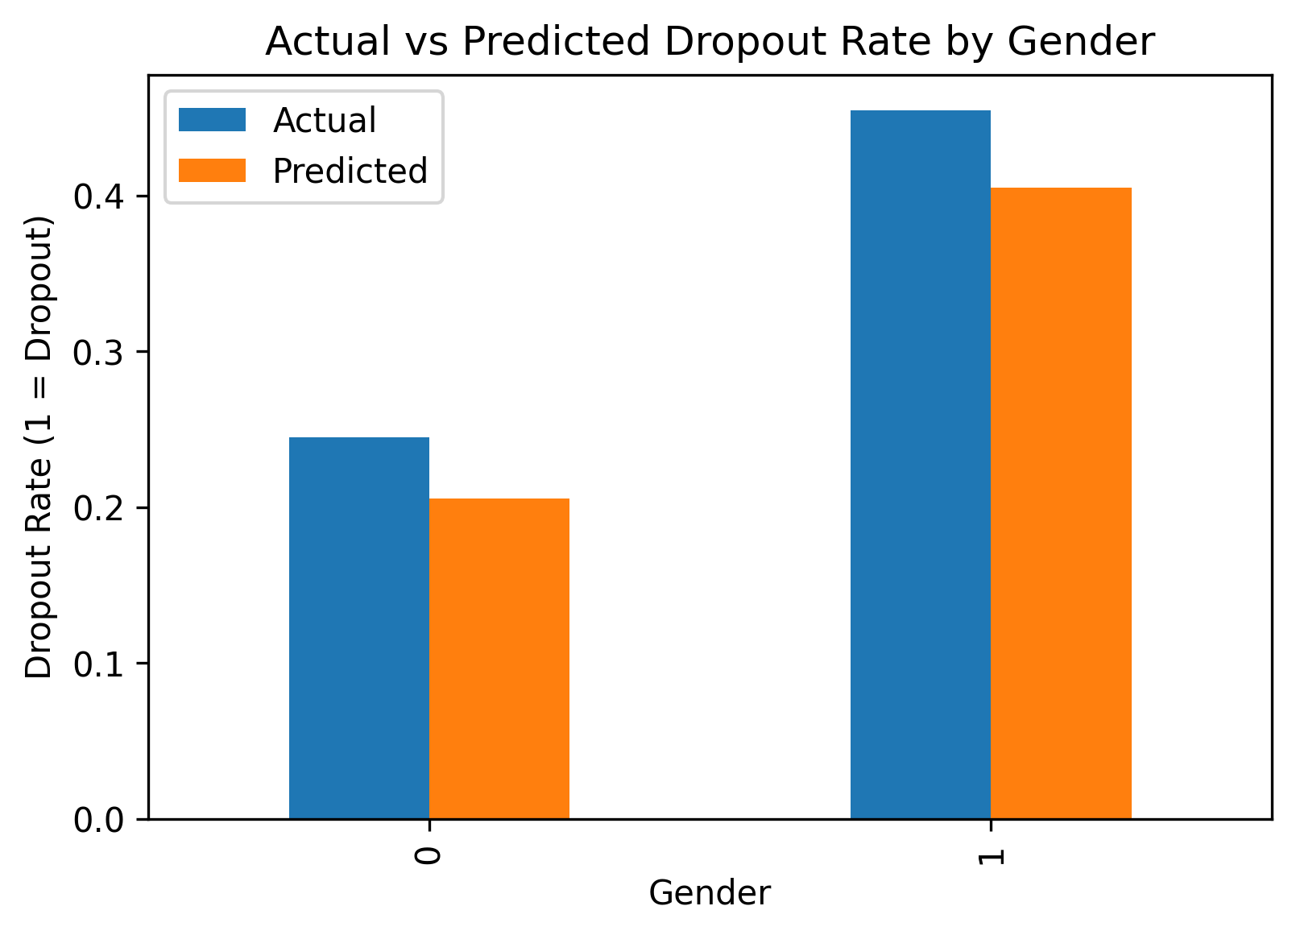
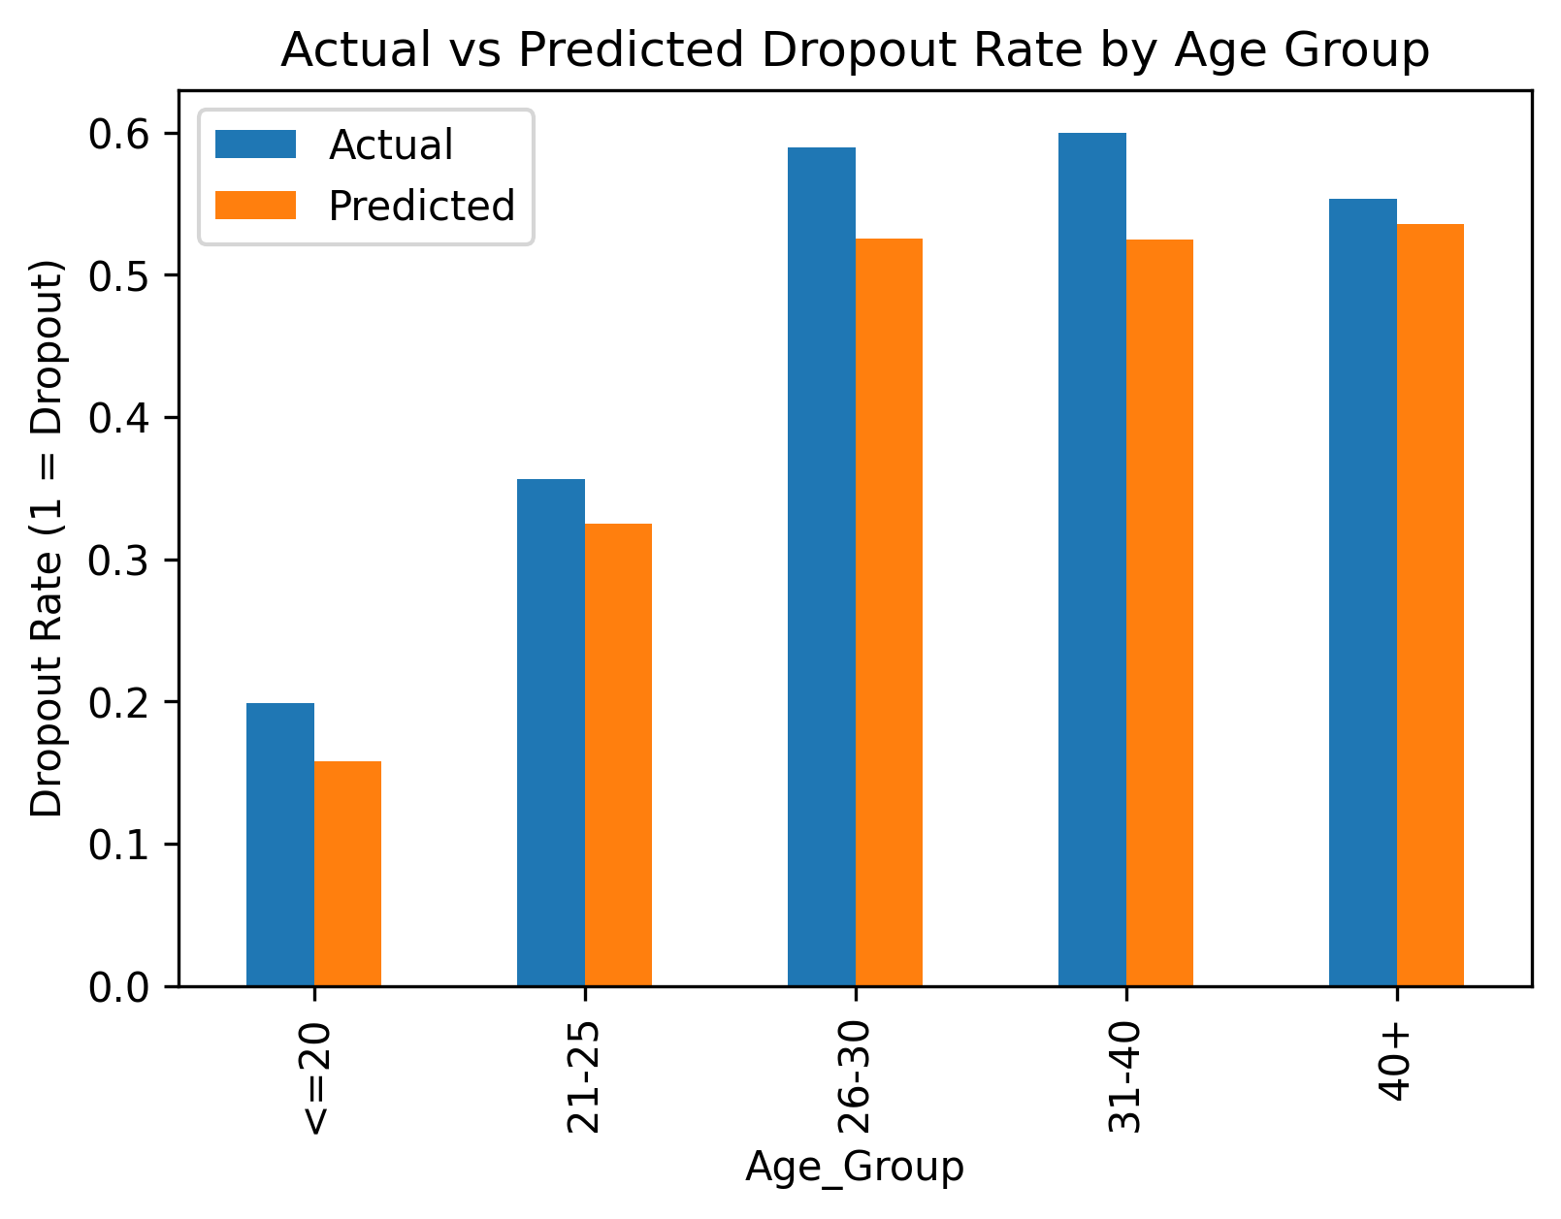
Bias & Fairness Analysis SHAP Explainability & Demographic Parity
SHAP Summary Plot — XGBoost
Gender: Actual vs Predicted Dropout Rate
Age Group: Actual vs Predicted Dropout Rate
Red = high feature value → non-dropout signal. Blue = low value → dropout risk. Approved 2nd-sem units is the dominant driver.
Predicted rates track actual rates closely across all demographic groups — no amplification of existing disparities detected.

Slide 11
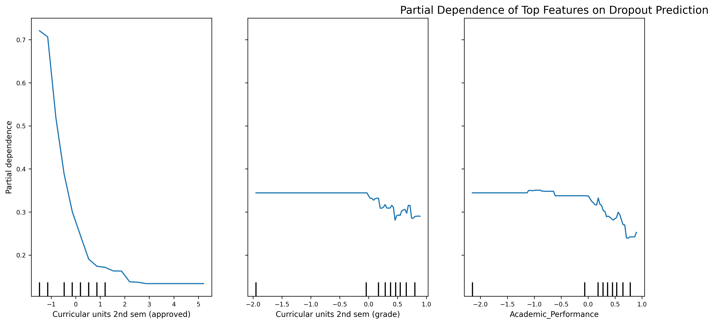
Results & Key Findings XGBoost Selected as Final Deployment Model
Best Model: XGBoost | Accuracy 88.2% | F1-Score 0.804 | ROC-AUC 0.923
Partial Dependence Top 3 Features
Why XGBoost Outperforms
Nonlinear interactions
Low grades + unpaid fees together predict dropout more strongly than either feature alone — something linear models miss.
Sequential error correction
Each boosting iteration targets the residual errors of the previous ensemble, converging on hard-to-classify boundary cases.
L1/L2 regularisation
Penalises model complexity, reducing overfitting to the training cohort and improving generalisability.
Fig 9: Dropout probability drops from 0.72 to below 0.20 as approved 2nd-sem units rise from 0 to 5+. Monotonic relationships confirm coherent model behaviour.
All ensemble models cluster between 0.871–0.882 accuracy; Decision Tree lags at 0.805, confirming that ensemble diversity adds real value over individual trees.

Slide 12
Model Deployment Using Flask
Serving the trained XGBoost model through a lightweight web application for institutional use
Trained Model Integration
Model Load
The serialised XGBoost pipeline (model + StandardScaler) is loaded into Flask at server startup, eliminating per-request initialisation overhead and ensuring consistent preprocessing.
Web Form Data Collection
Input
The HTML interface captures 20 student attributes across four domains. Form data is submitted as an HTTP POST request to the Flask route handler for processing.
Model Inference and Prediction
Inference
Flask passes the parsed feature vector to the loaded XGBoost pipeline. The model applies the stored StandardScaler transform before generating a binary dropout prediction and probability score.
Result Returned to Interface
Output
The predicted risk label (Dropout / No Risk) and associated probability are rendered dynamically on the results page and surfaced to the end user without page reload.
User Input → Flask Web Application → Trained XGBoost Model → Prediction Output

Slide 13
Web Application Interface
A structured HTML form enabling advisors to submit student profiles and receive real-time dropout risk predictions
Input Fields
Flask Web App Homepage
Grouped into four sections: Student Details (age, grades, prior qualification), Semester Performance (units, grades, evaluations), Enrollment Details (course, application mode), and Family Background (parental occupation and qualification).
Student Details Age, admission grade, prior qualification
Semester Performance Grades, approved units, evaluations
Economic Indicators
Enrollment Details Course, application mode, enrolled units
Tuition fee status, GDP, and inflation rate fields allow the model to incorporate macroeconomic context that correlates with dropout risk in the training dataset.
Family Background Parental occupation and qualification
Prediction Trigger
Economic Indicators Tuition status, GDP, inflation rate
A single submit button triggers an HTTP POST to /predict. All form fields are validated client-side before dispatch. The result page renders the dropout risk classification and confidence score.
Predict Dropout Risk
Predicted Risk Output
The result page returns a binary classification label alongside a dropout probability score, giving advisors both a categorical decision and an underlying confidence metric.
Submits form data via POST to /predict. The result page displays the binary risk classification and probability score returned by the XGBoost backend.

Slide 14
System Architecture
Three-layer design connecting the browser-rendered UI to the Flask routing layer and the serialised ML pipeline
Layer 1 Frontend Interface (HTML / CSS)
Browser-rendered HTML template structured into four input sections. Jinja2 templating dynamically populates dropdown options. Form submission triggers an HTTP POST request. The results page receives and renders the model response via template variable injection.
Layer 2 Flask Backend Server (Python)
Flask route handler parses the POST payload, validates field types, and assembles the feature vector in the column order expected by the trained pipeline. It then invokes the model and packages the prediction response for template rendering.
Layer 3 ML Prediction Model (XGBoost)
The serialised sklearn Pipeline (StandardScaler + XGBoostClassifier) applies stored scaling parameters to the input vector before inference. It returns a class label (0/1) and a probability score, both passed back to the Flask layer.

Slide 15
Practical Use Case
Translating model predictions into structured early-intervention workflows for academic institutions
01
Data Entry by Academic Advisor
An academic advisor logs into the Flask web application and enters a student’s academic, demographic, enrollment, and economic features into the structured input form.
02
System Generates Risk Prediction
The Flask backend processes the submission, scales the input vector, and invokes the trained XGBoost classifier. Within milliseconds, a risk label and dropout probability are returned to the interface.
03
Advisor Reviews Result
The advisor receives a risk classification and associated probability. High-risk predictions are prioritised for outreach, while low-risk results allow advisors to allocate time to higher-need students.
04
Early Intervention Action Taken
At-risk students are contacted before the dropout event occurs. Interventions include academic counselling, fee negotiation, or learning support referrals guided by the model’s top contributing features.
The deployed system shifts institutional response from reactive case management to proactive, data-informed student support weeks before a dropout event would otherwise be detected.

Slide 16

Future Directions
LMS Engagement Data
Incorporate assignment submission rates and login frequency for detection in the first 2–3 weeks of term before academic grades are available.
Conclusion
Hyperparameter Tuning
Bayesian optimisation of XGBoost learning rate, tree depth, and subsampling ratio to close the remaining performance gap.
& Future Work
XGBoost achieved the best F1 (0.804) and 88.2% accuracy across all five models
Approved 2nd-semester units and tuition fee status are the strongest early-warning signals
Fairness audit across gender, age, debt, and fees shows no demographic amplification
SHAP explanations produce actionable, human-readable output for academic advisors
Longitudinal Validation
Retrain on subsequent student cohorts to verify that learned feature-dropout relationships remain temporally stable.
Fairness Constraints
Test in-training fairness objectives that directly penalise demographic disparity during the optimisation step.
Realinho et al. (2022). Data, 7(11), 146. | Chen & Guestrin (2016). XGBoost. KDD '16. | Lundberg & Lee (2017). SHAP. NeurIPS.

