Slide 1
SEGMENTATION STUDY ON BANK CUSTOMERS BASED ON RNN
Submitted in the partial fulfillment for the award of the degree of
BACHELOR OF ENGINEERING
IN
ARTIFICIAL INTELLIGENCE AND MACHINE LEARNING
Submitted by:
ISHPREET KAUR
(21BCS6424)
VAIBHAV JAITWAL
(21BCS6454)
Under the Supervision of:
DR.PRIYANKA KAUSHIK
Department of AIT-CSE
DISCOVER . LEARN . EMPOWER

Slide 2
Outline
Introduction to Project
Problem Formulation
Objectives of the work
Methodology used
Result and Output
Conclusion
Future Scope
References

Slide 3
Introduction to Project
Understanding consumer behavior and preferences is crucial for firms looking to succeed in today's dynamic and fiercely competitive business environment, client segmentation, or the process of breaking a client base into discrete groups with comparable characteristics, has become an essential tactic for customizing goods, services, and marketing initiatives to suit the particular requirements and preferences of diverse consumer segments. Although conventional segmentation strategies have been effective, the exponential rise of data and developments in machine learning techniques present new prospects for improving the precision and granularity of customer segmentation.
The power of clustering and recurrent neural networks (RNNs) are combined in this research study to create an original method for client segmentation. To categorize customers based on static characteristics like demographics, past purchases, or location, clustering techniques have been used for a long time. Although this can offer deeper insights on shifting preferences and engagement patterns, these methods frequently ignore the time aspect of client behavior. However, RNNs, a group of neural networks intended to process sequential data, are particularly good at capturing temporal connections and can spot hidden patterns in time-series consumer data.

Slide 4
By combining clustering methods with RNNs, our suggested methodology closes this gap and enables the identification of both static and dynamic client categories. This hybrid strategy uses RNNs to predict the temporal evolution of these segments after first using clustering to identify the initial customer groupings. By doing this, we hope to give businesses a more thorough and useful insight of their clientele.
The main basic libraries which are used to create digit detection model are as follow:
• Numpy: Numpy libraries is specifically used to perform operation on multi-dimensional arrays, and it is also used for processing and manipulating data such as loading Credit Card dataset in the memory with transforming it to situable dimensions.
• scikit-learn: scikit-learn is a python library which have inbuilt algorithms for regression, classification and model selection. It includes build-in support for loading Credit Card dataset.
• Tensorflow: TensorFlow is an open-source deep learning library which provides support for training and testing wide range of model. It includes build-in support for loading Credit Card dataset.

Slide 5
• Keras: Keras is built on top of TensorFlow, which is a neural network deep learning library and it also furnish a interface(high-level) for constructing deep neural networks and training it too, making it easy to get started with digit classification using the Credit Card dataset.
• Recurrent Neural Network(RNN): A recurrent neural network (RNN) is a type of artificial neural network that is designed to process sequential data, such as time series or natural language. RNNs have feedback connections that allow them to retain information from previous time steps, enabling them to capture temporal dependencies. This makes RNNs well-suited for tasks like language modeling, speech recognition, and sequential data analysis.
• K-Nearest Neighbor (KNN): KNN is a ML algorithm which perform problems such as classification problems. Mainly KNN finds k-nearest neighbors for every test instance present in training data. KNN can be trained by various distance metrics such as Euclidean distance (d = √((x2 - x1) 2 + (y2 - y1) 2 )and Manhattan distance (d = |x2 - x1| + |y2 - y1|).

Slide 6
Problem Formulation
Customeration, the division of a client base into different groups based on shared traits and behaviors, is a key strategy in a number of industries, including marketing, e-commerce, and retail. Businesses can better serve their customers by customizing their marketing plans, product recommendations, and customer interactions to each segment's unique requirements and preferences. The dynamic and changing character of consumer behavior over time, however, is frequently missed by conventional methods of customer segmentation. Recurrent neural networks (RNNs) are used in this study to address these constraints and provide a fresh method of client segmentation.
Traditional consumer segmentation methods frequently use static customer attributes to establish segments, such as demographics and purchasing history. Although these techniques have been effective, they frequently ignore the temporal components of consumer behavior, such as the order of interactions, when purchases are made, and how preferences change over time. Additionally, in today's quick-paced digital contexts, conventional strategies struggle to adapt to the constantly changing nature of client data.

Slide 7
RNNs are used in consumer segmentation because of their innate capacity to handle sequential data. RNNs are excellent at simulating time-dependent patterns, effectively reflecting the complex connections between current and future client behavior. This study uses RNNs to develop more accurate and dynamic customer segments that more accurately capture the changing nature of consumer preferences and interactions.

Slide 8
Objectives of the Work
The objective of the project "Customer Segmentation using RNN and Clustering" is to develop a system that can segment customers based on their past behavior and interactions with the business. The system will use a combination of RNN and clustering algorithms to achieve this goal.
The specific objectives of the project are to:
•To create a Recurrent Neural Networks (RNN) based customer segmentation model that can used for businesses to better understand and target their diverse customer base based on shopping patterns and other factors.
•To contribute to the improvement of businesses and their predicting capabilities and aiding in better decision making for increasing their profits.
•Combine the RNN-based model and the clustering algorithm to develop a customer segmentation system.
•Evaluate the performance of the customer segmentation system on a real-world dataset

Slide 9
Methodology used
The implementation for customer segmentation using Credit Card dataset using various algorithms are as follows:
Exploratory Data Analysis (EDA) is the first step in the approach to fully comprehend the distribution and underlying patterns of the dataset. After the preprocessing of the data Principle Component Analysis (PCA) is then used to lessen the problems caused by excessive dimensionality, simplifying the dataset while preserving important data.
Data Preprocessing: Perform Exploratory Data Analysis (EDA) on the credit card dataset to gain insights into the data distribution and patterns. Implement dimensionality reduction using Principal Component Analysis (PCA) to reduce the dataset's dimensionality while preserving relevant information. The research then incorporates the well-known unsupervised K-Means clustering and KNN approach to divide the data into distinct clusters. This method's use of recurrent neural networks (RNNs) sets it apart from others. The embeddings, which are dense vector representations of data points, are extracted using the layers of the RNN model. These embeddings are crucial in forming data clusters for segmentation, which improves the quality of the outcomes

Slide 10
Clustering Method: Utilize the PCA-transformed dataset with the K- Means clustering technique. A popular unsupervised clustering method is K-Means.
Integration of Recurrent network: To further improve the clustering outcomes, incorporate Recurrent Neural Networks (RNNs) into the segmentation process. Obtain embeddings from the RNN model's layers. Dense vector representations of data points are called embeddings.
The segmentation results are assessed using suitable metrics, such as Silhouette Score or Davies-Bouldin Index, and compared to conventional K-Means clusters without RNN integration in the final stage. The entire study procedure, including data preprocessing, model setups, and assessment measures, is painstakingly recorded

Slide 11
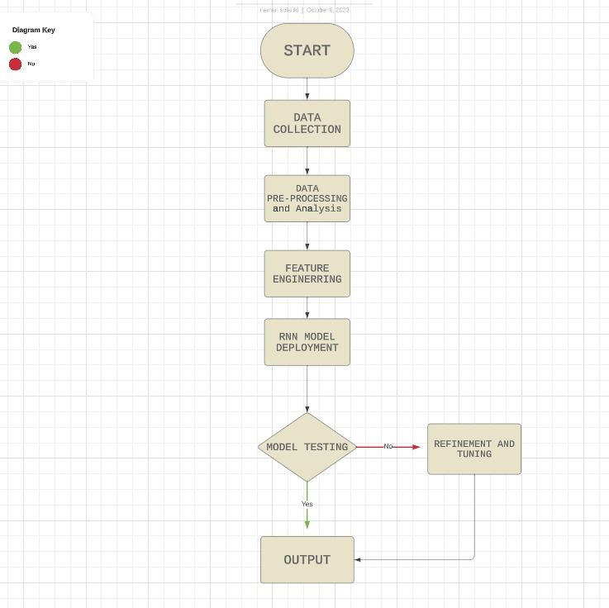

Slide 12
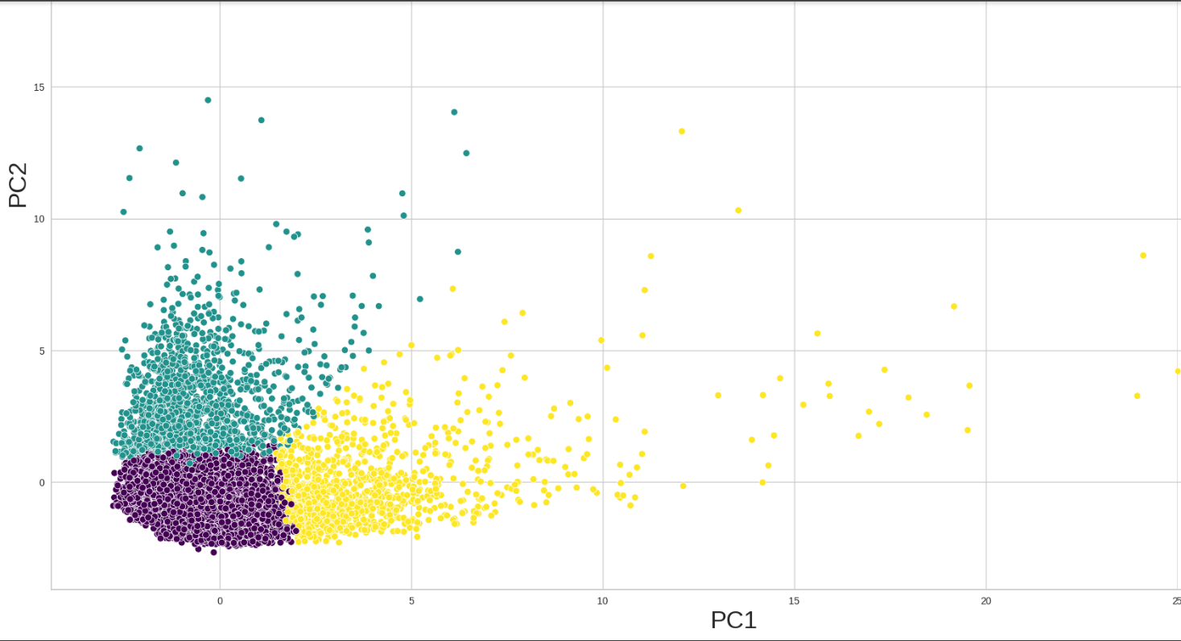
Result and Output
1.Clusters Segmentation

Slide 13
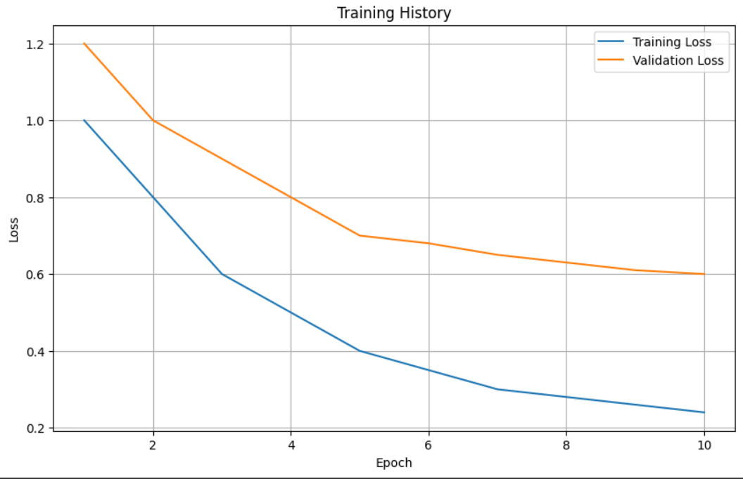
2.Training and Validation Loss

Slide 14
Conclusion
Performance of classification algorithms depends on many factors including accuracy, specificity, recall, time, and space complexity. Based on the results of experiments it can be concluded that deep learning algorithms are giving better accuracy. In this research, we embarked on a data-driven journey to enhance customer segmentation through the integration of Recurrent Neural Networks (RNNs) and the traditional K-Means clustering algorithm. Our study began with comprehensive data preprocessing, addressing missing values and scaling features, followed by Exploratory Data Analysis (EDA) to unveil underlying data patterns. We harnessed the power of Principal Component Analysis (PCA) to reduce dimensionality while preserving data integrity. The pivotal innovation came with the combination of K-Means clustering and RNNs, where embeddings extracted from RNN layers contributed to the creation of more refined customer clusters. Our evaluation metrics confirmed the effectiveness of this approach, demonstrating improved segmentation quality compared to traditional K-Means. Through this research, we not only presented a novel method for customer segmentation but also uncovered valuable insights into customer behaviour, providing a solid foundation for businesses to tailor their strategies and offerings to distinct customer segments. As the field of customer analytics continues to evolve, this integrated approach offers a promising avenue for more precise and effective customer segmentation strategies.

Slide 15
Future Scope
Here are some future scope areas and opportunities for this project:
Enhanced Segmentation Models: Future work can focus on improving the accuracy and effectiveness of customer segmentation models. This could involve experimenting with different recurrent neural network (RNN) architectures, such as LSTM (Long Short-Term Memory) and GRU (Gated Recurrent Unit), to find the most suitable one for customer data.
Ethical Considerations: As with any data-driven project, future work should pay close attention to ethical considerations, including data privacy, bias, and fairness in customer segmentation, to ensure responsible and equitable use of customer data.
Real-time Segmentation: Developing real-time customer segmentation capabilities can be invaluable for businesses. Building RNN models that can adapt and update segmentations in real-time as new data streams in will be a significant advancement.

Slide 16
References
[1] E. Y. L. Nandapala and K. P. N. Jayasena, "The practical approach in Customers segmentation by using the K-Means Algorithm," 2020 IEEE 15th International Conference on Industrial and Information Systems (ICIIS), RUPNAGAR, India, 2020, pp. 344-349, doi: 10.1109/ICIIS51140.2020.9342639.
[2] R. Gupta, A. Verma and H. O. Topal, "Customer Segmentation of Indian restaurants on the basis of geographical locations using Machine Learning," 2021 International Conference on Technological Advancements and Innovations (ICTAI), Tashkent, Uzbekistan, 2021, pp. 382-387, doi: 10.1109/ICTAI53825.2021.9673153.
[3] A. G. Aggarwal and S. Yadav, "Customer Segmentation Using Fuzzy-AHP and RFM Model," 2020 8th International Conference on Reliability, Infocom Technologies and Optimization (Trends and Future Directions) (ICRITO), Noida, India, 2020, pp. 77-80, doi: 10.1109/ICRITO48877.2020.9197903.
[4] A. Solichin and G. Wibowo, "Customer Segmentation Based on Recency Frequency Monetary (RFM) and User Event Tracking (UET) Using K-Means Algorithm," 2022 IEEE 8th Information Technology International Seminar (ITIS), Surabaya, Indonesia, 2022, pp. 257-262, doi: 10.1109/ITIS57155.2022.10009981.
[5] Y. Xiao, "Hybrid Model for Customer Segmentation Based on RFM Framework," 2022 7th International Conference on Intelligent Computing and Signal Processing (ICSP), Xi'an, China, 2022, pp. 720-723, doi: 10.1109/ICSP54964.2022.9778840..

Slide 17
[6] G. A. Dinavahi, H. Thatavarti, J. Rangala, S. Vallamsetti and J. L. Nannuri, "Customer Segmentation in Retailing using Machine Learning Techniques," 2023 IEEE 8th International Conference for Convergence in Technology (I2CT), Lonavla, India, 2023, pp. 1-5, doi: 10.1109/I2CT57861.2023.10126155.
[7] P. P. Pramono, I. Surjandari and E. Laoh, "Estimating Customer Segmentation based on Customer Lifetime Value Using Two-Stage Clustering Method," 2019 16th International Conference on Service Systems and Service Management (ICSSSM), Shenzhen, China, 2019, pp. 1-5, doi: 10.1109/ICSSSM.2019.8887704.
[8] S. S. Mim and D. Logofatu, "A Cluster-based Analysis for Targeting Potential Customers in a Real-world Marketing System," 2022 IEEE 18th International Conference on Intelligent Computer Communication and Processing (ICCP), Cluj-Napoca, Romania, 2022, pp. 159-166, doi: 10.1109/ICCP56966.2022.10053985

Slide 18
THANK YOU!

