Slide 1
DIGITAL ADDICTION PREDICTION USING ML & XAI
By:
Veydant Katyal 22BCE3476
Vinayak Trivedi 22BCE0521
Vrinda Bajaj 22BCE2251
Akshita Gupta 22BCE0248

Slide 2
Table of contents
01
02
03
06
07
08
04
05
Introduction
Why?
Methodology
Architecture
Web App
09
Results
Future Work
Conclusion
Challenges
Faced

Slide 3
INTRODUCTION
With the increasing integration of technology into everyday life, digital and social media addiction has become a growing concern, particularly among adolescents and young adults. This project aims to build an intelligent system that can accurately detect digital addiction using machine learning techniques applied to psychometric and behavioral data.
We trained a robust classification model on a curated and scaled dataset containing 13 features such as FoMO (Fear of Missing Out), happiness levels, neuroticism, honesty, social media usage habits, and online behavior patterns. These features were derived from validated psychological assessments and digital behavior studies.
The model is deployed through an intuitive Gradio web interface that allows users to interact with the system by adjusting input sliders representing their behavioral traits. Upon submission, the model returns a prediction indicating whether the individual shows signs of digital addiction.
This solution has applications in mental health screening, behavioral research, and early intervention systems, and it sets the foundation for building explainable AI tools in the domain of digital wellbeing.

Slide 4
WHY?
To address the growing concern of digital and social media addiction, especially among youth and adolescents.
To enable early detection and intervention using data-driven, AI-powered tools.
To bridge the gap between psychological traits and real-world behavioral data for mental health insights.
To provide a scalable and interactive solution that can support researchers, psychologists, and digital wellbeing platforms.

Slide 5
Methodology
DATA COLLECTION AND PREPROCESSING
EXPLORATORY DATA ANALYSIS (EDA)
STATISTICAL ANALYSIS
MODEL TRAINING & EVALUATION
EXPLAINABLE AI
DEPLOYMENT

Slide 6
DATA COLLECTION & PRE-PROCESSING
Collect data from https://data.mendeley.com/datasets/6hhdxszm56/2, load and verify.
Data cleaning using null value check and data summary report.
Rename features to english, since it’s a turkish dataset for easy understanding.
Plot data distribution plots to identify skewness:
Right skewness-apply log transformation.
Scale features using standardisation to prepare data for ML models.

Slide 7
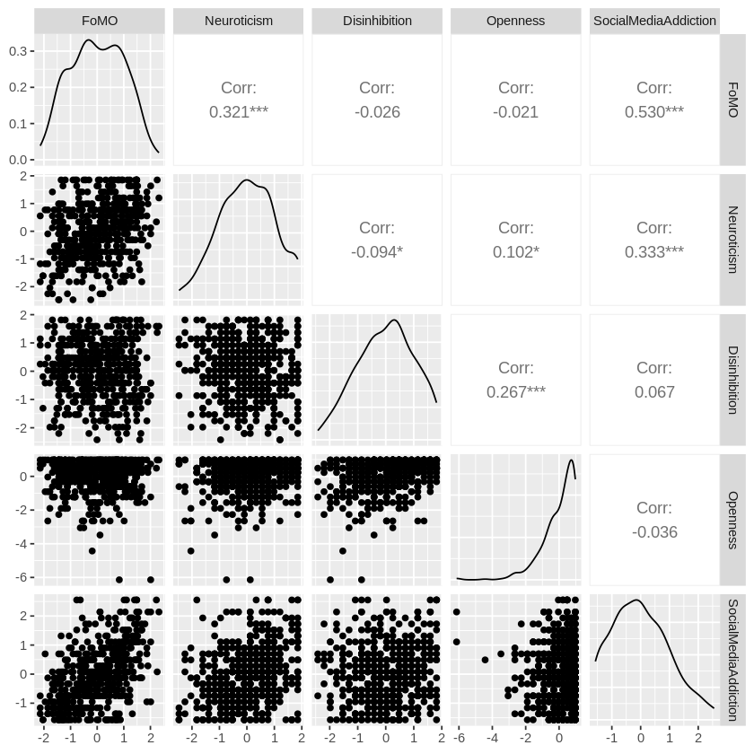
EXPLORATORY DATA ANALYSIS
HISTOGRAM
BOXPLOTS
CORRELATION MATRIX
PAIRWISE RELATIONSHIP
TARGET DISTRIBUTION
BOXPLOTS: PREDICTORS VS TARGET
DENSITY PLOTS
PCA
t-SNE
T & ANOVA TEST

Slide 8
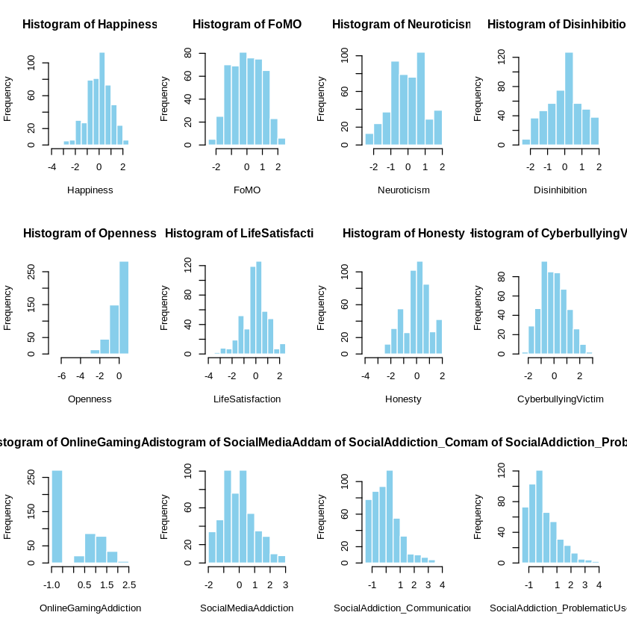
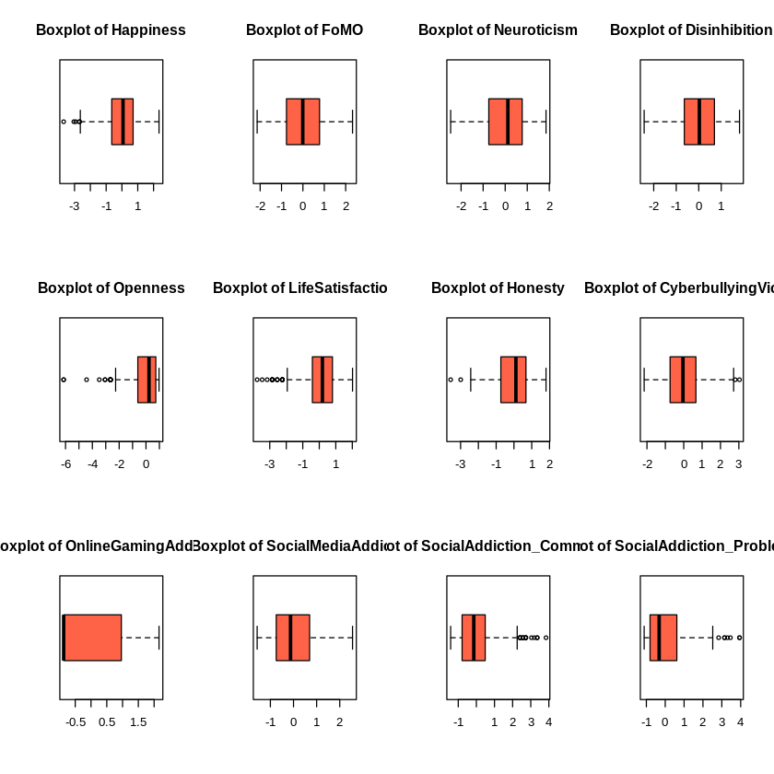
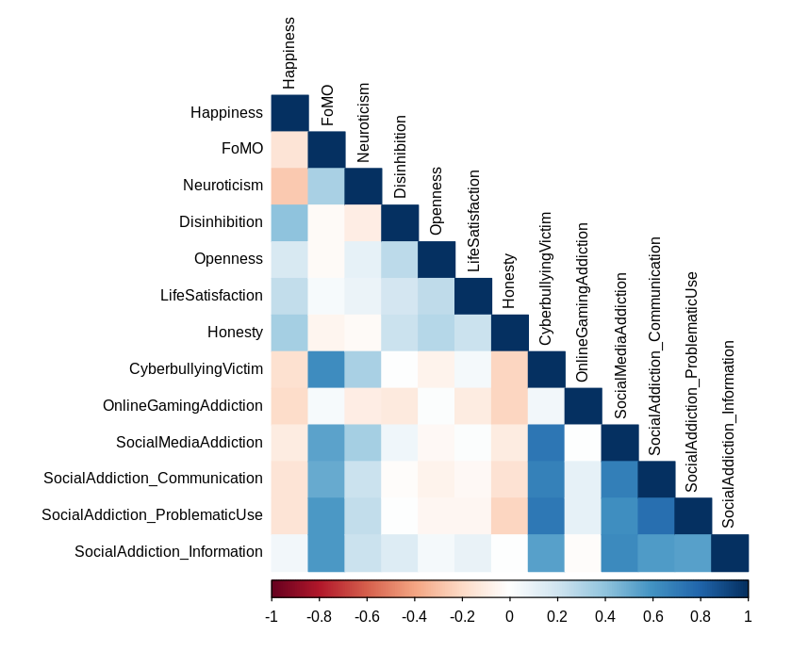
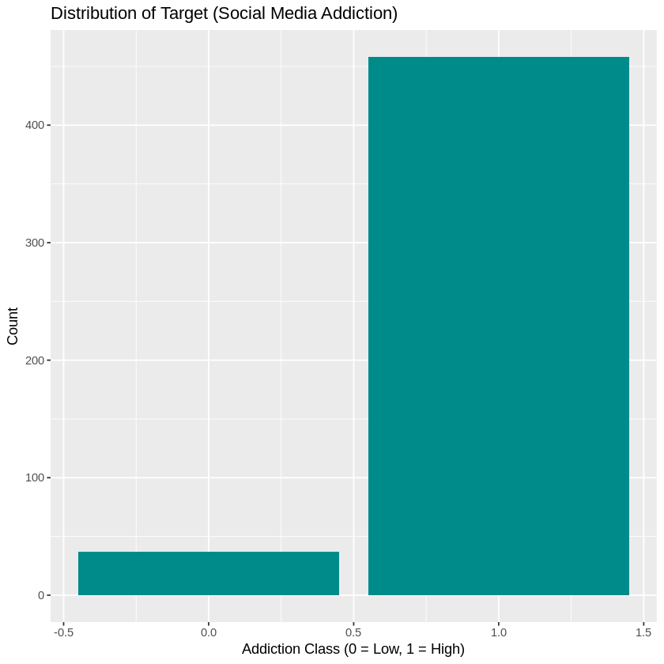
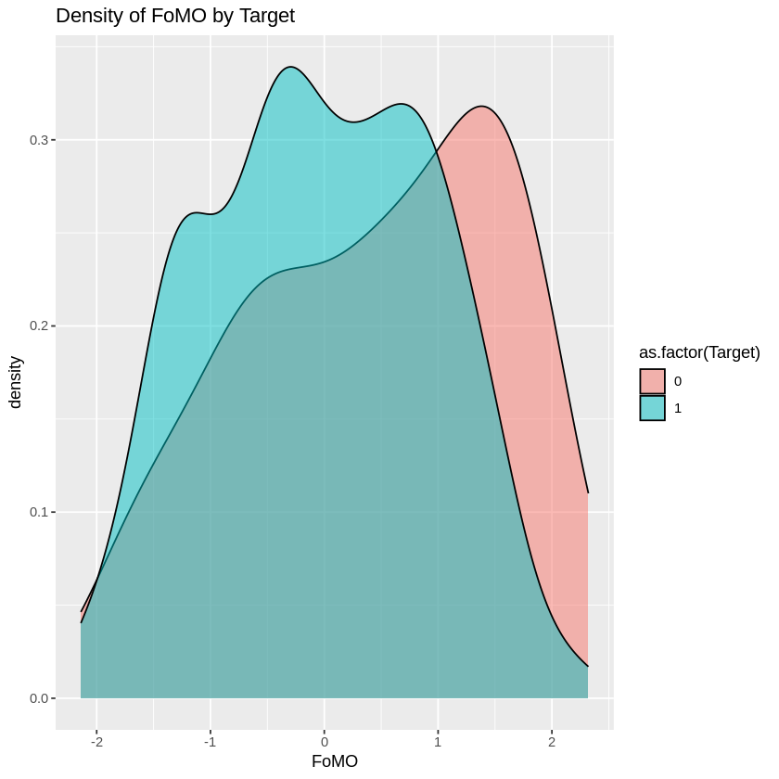
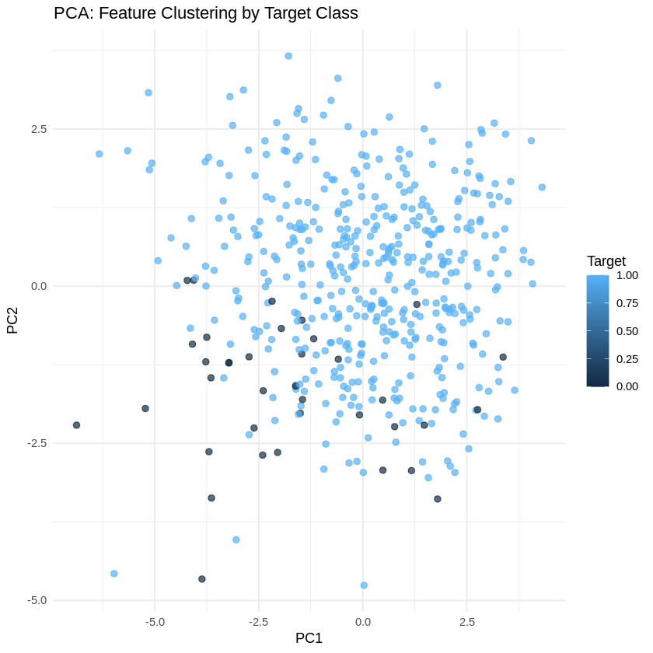
EDA GRAPHS

Slide 9
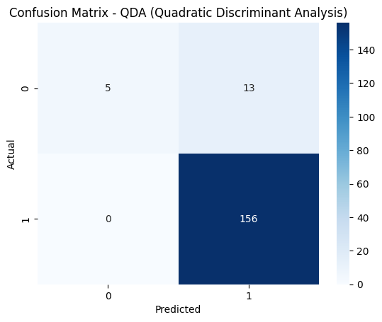
MODEL TRAINING
Modelled data using train-test split(65/35 due to less sample size of dataset).
Used scikit learn library to run the following ML models:
DECISION TREES
RANDOM FOREST
XGBOOST
SVM
LOGISTIC REGRESSION
LINEAR REGRESSION
QDA
DUMMY CLASSIFIER
Save all ML models using joblib.
Built evaluation functions to test model performance in terms of accuracy, precision, recall and F1 along with confusion matrix

Slide 10
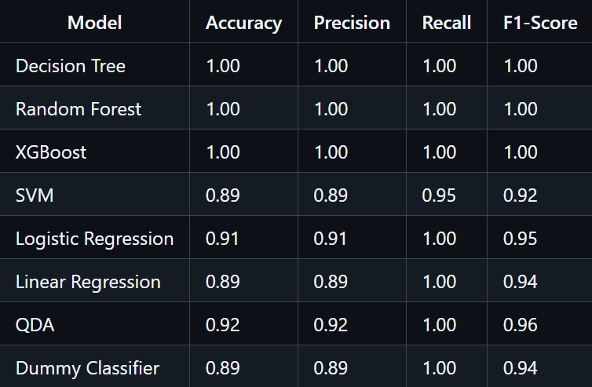
MODEL COMPARISONS
Due to small testing and huge class imbalance in small dataset, this was the best which could be accounted for.
This in no way is a good way to test prediction in real-time, it was done just for learning and academic purposes.

Slide 11
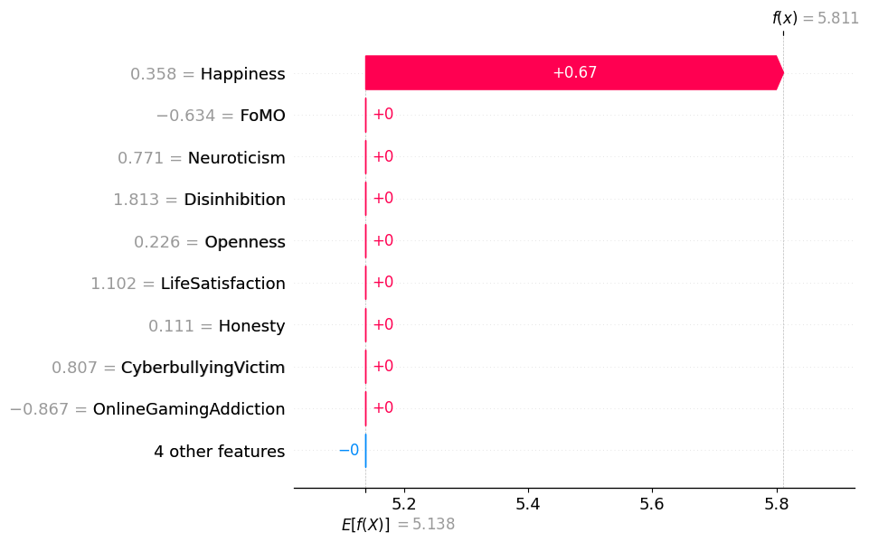
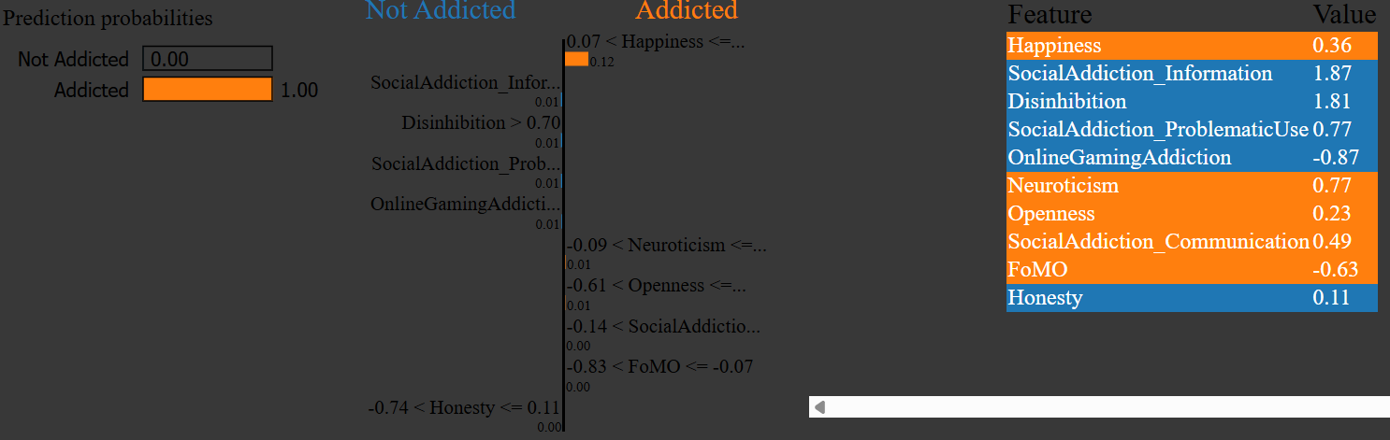
EXPLAINABLE AI (XAI)
SHAP: SHAP (SHapley Additive exPlanations) was used to interpret the model's predictions by quantifying the contribution of each feature (like FoMO or Neuroticism) toward the final addiction risk score.
LIME: LIME (Local Interpretable Model-agnostic Explanations) helped explain individual predictions by approximating the model locally and highlighting the most influential features for each user input.

Slide 12
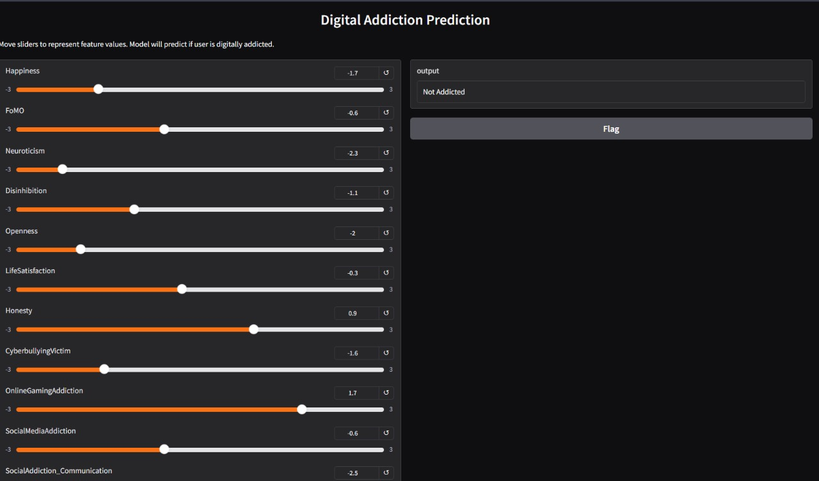
DEPLOYMENT
Gradio interface is used for building UI and is deployed on huggingface spaces.
Live link: https://veydant1811-digital-addiction-detector.hf.space/?__theme=system&deep_link=EeDcnUVrgbo

Slide 13
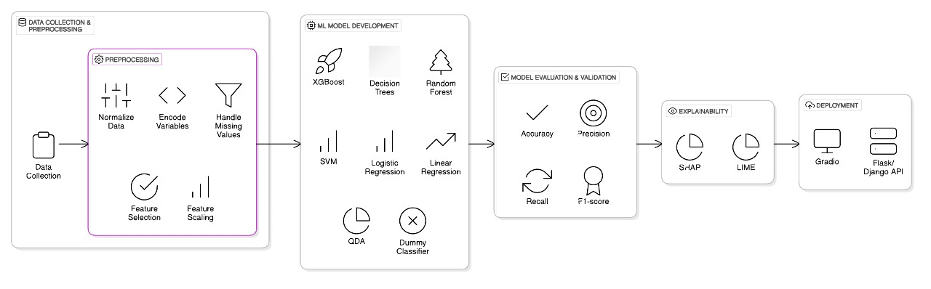
Architecture diagram

Slide 14
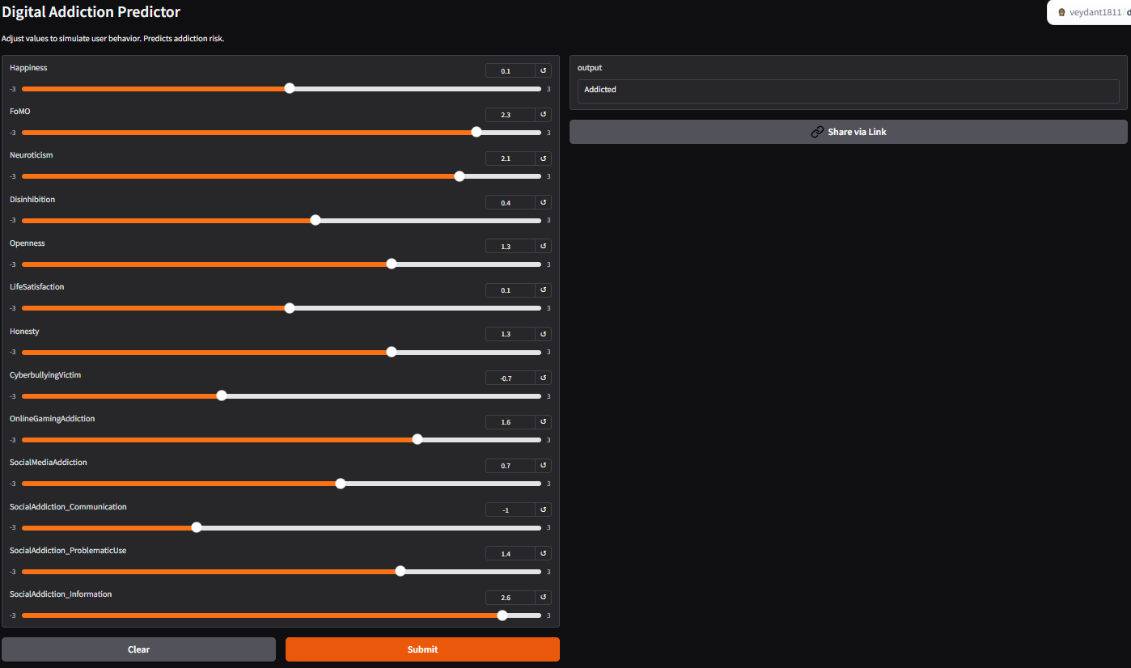
WEB APP DESIGN

Slide 15
CHALLENGES FACED
Lack of publicly available, large-scale datasets specifically focused on digital addiction, requiring reliance on limited or manually cleaned data.
Aligning psychometric and behavioral features with model expectations while ensuring they remained interpretable and relevant to addiction detection.
Balancing the dataset to handle potential class imbalance between addicted and non-addicted labels for better model generalization.
Integrating SHAP and LIME for explainability in a meaningful way without overloading the user interface or compromising performance.
Designing an intuitive yet accurate Gradio interface, ensuring that all 13 features could be easily tested by end users without overwhelming them.

Slide 16
RESULTS
Successfully designed a complete end-to-end data science lifecycle and trained various machine learning models on 13 psychological and behavioral features to detect digital addiction.
Achieved high prediction accuracy on the validation set using models like Random Forest.
Deployed a fully functional Gradio interface allowing real-time prediction based on user input.
Integrated SHAP and LIME to provide transparent and explainable model predictions.
Enabled personalized risk assessment for digital addiction through an interactive, user-friendly tool.

Slide 17
FUTURE WORK
Integrate deep learning models (like neural networks or transformers) for improved prediction accuracy and handling of larger datasets.
Collect and incorporate real-time user data from mobile apps or browser extensions to enhance behavioral analysis.
Add multilingual support and region-specific customization to make the tool more accessible and inclusive.
Extend the system with recommendation modules for digital detox strategies based on individual risk levels.
Conduct clinical validation by collaborating with mental health professionals to enhance model reliability.

Slide 18
CONCLUSION
This project showcases the effective use of machine learning to detect digital addiction based on a combination of psychological and behavioral indicators. By training a robust classification model on a cleaned and scaled dataset containing traits like FoMO, happiness, neuroticism, and social media usage patterns, we were able to achieve accurate and interpretable predictions. The integration of SHAP and LIME further added transparency, helping us understand the contribution of each feature to the model's output.
To make the solution interactive and accessible, we deployed the model using a Gradio-based web interface, allowing users to test real-time addiction risk by adjusting key behavioral traits. This project not only bridges the gap between AI and digital wellbeing but also lays the foundation for scalable mental health tools that can assist individuals, researchers, and practitioners in identifying early signs of digital overuse and taking informed actions.

Slide 19

Thank You

