Slide 1

Lightweight HIGHT Block Cipher
TASLAK

Slide 2
OUTLINE
Introduction
HIGHT General Process
HIGHT Encryption

Slide 3

INTRODUCTION
HIGH is 32 round block cipher with 64 – bit block size and 128 bit user key that makes use of an unbalanced Feistel Network.

Slide 4
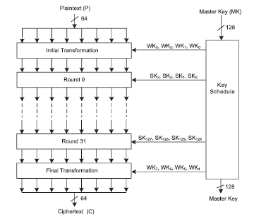
HIGHT General Process
HIGHT, 32 adım olarak 64 bit metin ve 128 bitlik anahtar ile çalışmaktadır.
Kriptoloji işlemi key Schedule, initial transformation, round fuction ve final transformation adımlarından oluşmaktadır.
Şifreleme fonksiyonu Initial Transformation adımının plaintext ve WK(Whitening Keys) kullanması ile başlamaktadır.
32 round sonunda ciphertext ‘in elde edilmesi için Final Transformation işlemi gerçekleştirilir.

Slide 5
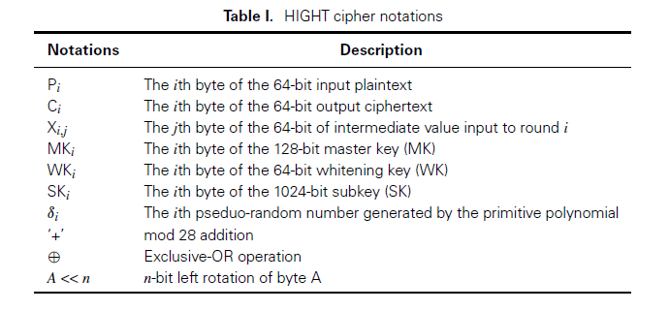

Slide 6
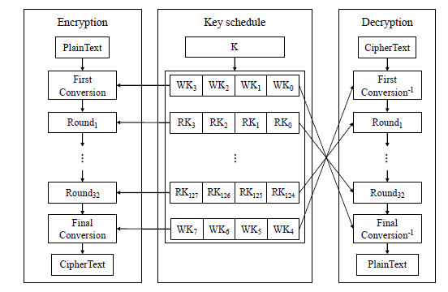
HIGHT Encryption
HIGHT, First Conversion, Round ve Final Conversion adımlarından oluşmaktadır.
First Conversion’da Whittening key’in ilk 4 byte larını kullanıyor.
Round adımlarında elde edilmiş olan 128 tane Subkey bytelarını kullanıyor.
Final Conversion’da Whittening key’in son 4 byte larını kullanıyor.

Slide 7
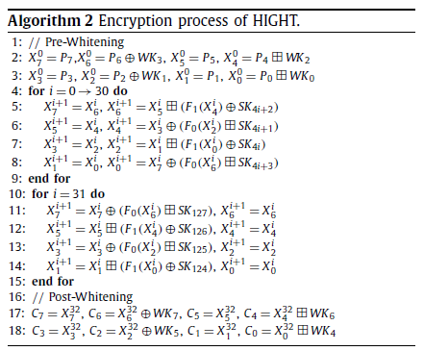
HIGHT Encryption

Slide 8

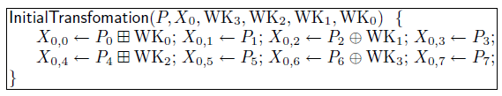
Initial Transformation
Initial Transformation transforms a plaintext P into the input of the first RoundFunction X0 = X0,7||X0,6||X0,5|… |X0,1||X0,0|| by using the four whittening-key bytes, WK0, WK1, WK2, WK3.

Slide 9
Initial Transformation MATLAB Code
%%%%
%% Initial transformations
%%%%
function x=initialTransformation(P, wk)
x(1)=mod(P(1)+wk(1), 256);
x(2)=P(2);
x(3)=bitxor(P(3), wk(2));
x(4)=P(4);
x(5)=mod(P(5)+wk(3), 256);
x(6)=P(6);
x(7)=bitxor(P(7), wk(4));
x(8)=P(8);
end

Slide 10
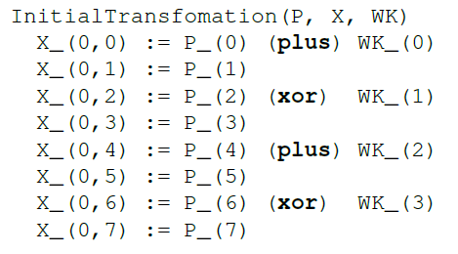
Initial Transformation Pseudo Code

Slide 11
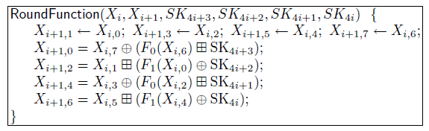

Round Function
Round Function uses two auxiliary functions F0 and F1:
For i = 0, …. , 31, Round Function transforms Xi =Xi,7||Xi,6||Xi,5|… |Xi,1||Xi,0|| into Xi+1 =Xi+1,7||Xi+1,6||Xi+1,5|… |Xi+1,1||Xi+1,0|| as follows.

Slide 12
Round Function MATLAB Code
function res=rotl(bin, d) %% Left rotation of d bits
if d>1
res=rotl([bin(2:end) bin(1)], d-1);
else
res=[bin(2:end) bin(1)];
end
end
function x=f0(s) %% Function f0 of the round
bin=dec2bin(s,8);
x=bitxor(bitxor(bin2dec(rotl(bin,1)), bin2dec(rotl(bin,2))), bin2dec(rotl(bin,7)));
end
function x=f1(s) %% Function f1 of the round
bin=dec2bin(s,8);
x=bitxor(bitxor(bin2dec(rotl(bin,3)), bin2dec(rotl(bin,4))), bin2dec(rotl(bin,6)));
end

Slide 13
Round Function MATLAB Code
function x=Round(state, sk, i) %% Encryption
x(1)=bitxor(state(8), mod(f0(state(7))+sk(4*i+4), 256));
x(2)=state(1);
x(3)=mod(state(2)+bitxor(f1(state(1)),sk(4*i+1)), 256);
x(4)=state(3);
x(5)=bitxor(state(4), mod(f0(state(3))+sk(4*i+2), 256));
x(6)=state(5);
x(7)=mod(state(6)+bitxor(f1(state(5)),sk(4*i+3)), 256);
x(8)=state(7);
end

Slide 14
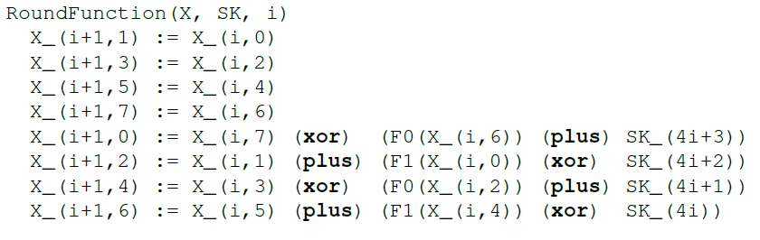
Round Function Pseudo Code

Slide 15
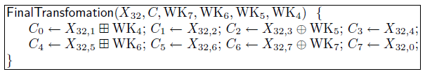
Final Transformation
Final Transformation untwists the swap of the last round function and transforms transforms X32 =X32,7||X32,6||X32,5|… |X32,1||X32,0|| into the cipher text C by using the four Whittening Key bytes WK4, WK5, WK6, WK7.

Slide 16
Final Transformation MATLAB Code
%%%%
%% Final transformations
%%%%
function c=FinalTransformation(x, wk) %% Encryption
c(1)=mod(x(2)+wk(5), 256);
c(2)=x(3);
c(3)=bitxor(x(4), wk(6));
c(4)=x(5);
c(5)=mod(x(6)+wk(7), 256);
c(6)=x(7);
c(7)=bitxor(x(8), wk(8));
c(8)=x(1);
end

Slide 17
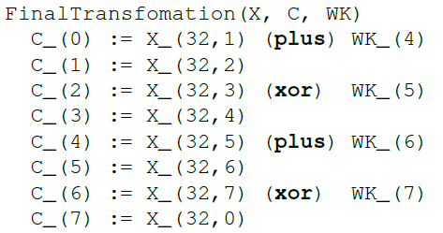
Final Transformation Pseudo Code

Slide 18
REFERENCES
[1] Jang, Kyoungbae, et al. "Grover on Korean Block Ciphers." Applied Sciences 10.18 (2020): 6407.
[2] Wen, Long, et al. "Multidimensional zero-correlation attacks on lightweight block cipher HIGHT: improved cryptanalysis of an ISO standard." Information Processing Letters 114.6 (2014): 322-330.
[3] Nascimento, Fernando Melo, Fernando Messias dos Santos, and Edward David Moreno. "A VHDL implementation of the Lightweight Cryptographic Algorithm HIGHT." algorithms 2.4 (2015): 5.
[4] Mohd, Bassam Jamil, et al. "Modeling and optimization of the lightweight HIGHT block cipher design with FPGA implementation." Security and Communication Networks 9.13 (2016): 2200-2216.
[5] Özen, Onur, et al. "Lightweight block ciphers revisited: Cryptanalysis of reduced round PRESENT and HIGHT." Australasian Conference on Information Security and Privacy. Springer, Berlin, Heidelberg, 2009.
[6] Kim, Bohun, et al. "Compact implementations of HIGHT block cipher on IoT platforms." Security and Communication Networks 2019 (2019).
[7] Hong, Deukjo, et al. "HIGHT: A new block cipher suitable for low-resource device." International Workshop on Cryptographic Hardware and Embedded Systems. Springer, Berlin, Heidelberg, 2006.

Slide 19


