Slide 1

Lightweight HIGHT Block Cipher
TASLAK

Slide 2
OUTLINE
Introduction
Where is HIGHT used?
HIGHT General Process
HIGHT Key Schedule
Project Management

Slide 3

RSA, ECC ve AES gibi kriptolojik algoritmalar her cihaz için uygun değildir.
RFID sistemleri ve sensör ağları gibi hassas uygulamalarda ortaya çıkan ihtiyaçlarla birlikte hafif sitoloji(lightweight) çok önemli hale geldi.
Bu kapsamda HIGHT algoritması hem güvenirlik odağını kaybetmeden hemde basit özellikte hafif sitoloji(lightweight) kriptolojisine sahiptir.
INTRODUCTION

Slide 4

Where is HIGHT used?
HIGHT,
IoT,
radio frequency identification,
akıllı kartlar,
kablosus vücut alan ağları(wireless body area network),
kablosus sensör ağlarında
kullanılıyor.

Slide 5
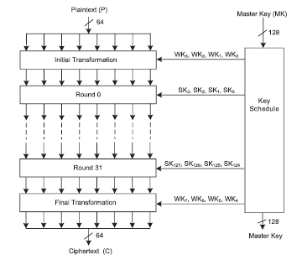
HIGHT General Process
HIGHT, 32 adım olarak 64 bit metin ve 128 bitlik anahtar ile çalışmaktadır.
Kriptoloji işlemi key Schedule, initial transformation, round fuction ve final transformation adımlarından oluşmaktadır.
Şifreleme fonksiyonu Initial Transformation adımının plaintext ve WK(Whitening Keys) kullanması ile başlamaktadır.
32 round sonunda ciphertext ‘in elde edilmesi için Final Transformation işlemi gerçekleştirilir.

Slide 6
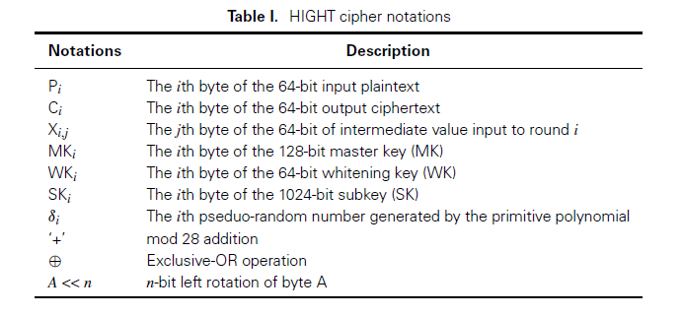

Slide 7
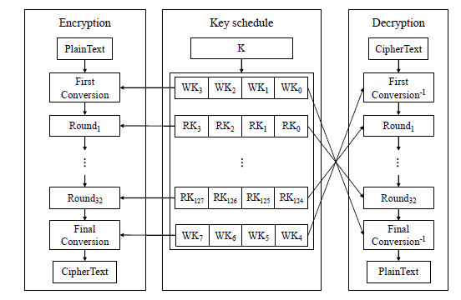
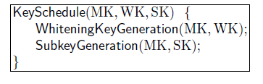
HIGHT Key Schedule
KeySchedule iki algoritmadan oluşmaktadır.
1- Whitening Key Generation
2- Subkey Generation
Whitening Key Generation 8 tane whitening key byte ları oluşturur. (WK0, WK1, … , WK7)
Subkey Generation 128 tane subkey oluşturur. (SK0, SK1, … , SK127)

Slide 8

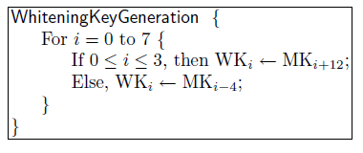
Whitening Key Generation

Slide 9
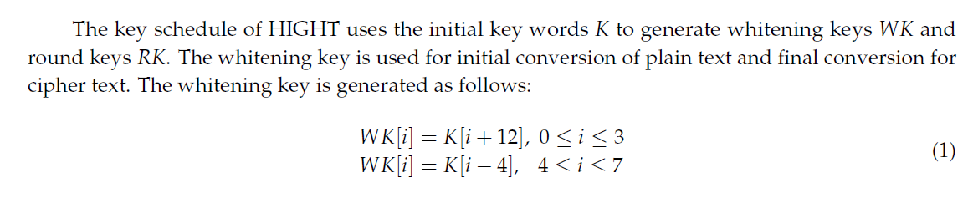
Whitening Key

Slide 10
Whitening Key MATLAB Code
{% create the whitening key that is used before the first round and after the last round %}
function wk=whiteningKey(K)
for i=1:8
if i<=4
wk(i)=K(i+12);
else
wk(i)=K(i-4);
end
end
end

Slide 11

Whitening Key Pseudo Code

Slide 12
Subkey Generation
128 bit subkeys ler 1 HIGHT şifrelemesinde kullanılıyor.
Her bir raundda 4 subkey kullanılır.
Subkey üretim algoritması ConstantGeneration alt algoritmasını kullanır.
7 bit sabitliğinde olan 128 bitlik δ0, δ1, … , δ127 üretilir ve bu sabitler ile SK0, SK1, … SK127 üretilir.
δ0, 2 tabanında 1011010 ile sabitlenmiştir. Bu 7 bitlik LSFR h ‘in başlangıç state idir.
H ‘ın iletim polinomu x^7 + x^3 +1 dir.
Constant Generation δ0 dan δ0, δ1, … , δ127 üretmek için LFSR h ı kullanır.

Slide 13
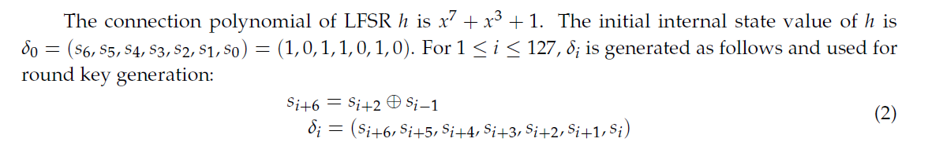
Subkey MATLAB Code

Slide 14
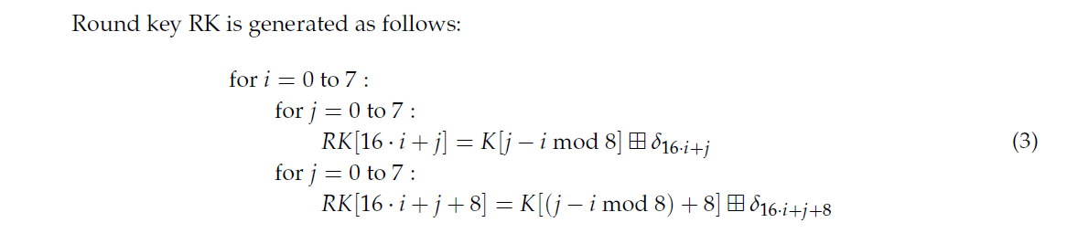
Subkey MATLAB Code

Slide 15
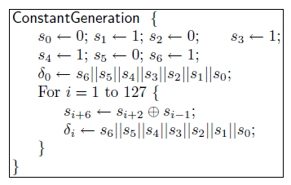
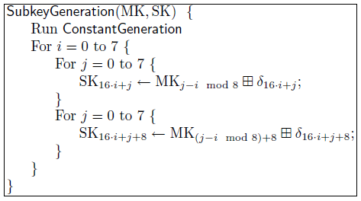
Subkey MATLAB Code
function cst=constantGen()
%% Generate constants used for the round
cst='0101101';
for i=1:127
cst(7+i)=dec2bin(bitxor(bin2dec(cst(i+3)), bin2dec(cst(i))), 1);
end
end
function c=extract_const(cst, i)
%% Extract the correct constant for the round i from the vector cst generated by the function constantGen
c=‘ ';
for j=i : i+6
c=[cst(j+1) c];
end
end
function sk=subkey(K, cst)
%% Generated the subkey used during the round
for i=0:7
for j=0:7
c=extract_const(cst, 16*i+j);
sk(16*i+j+1)=mod(K(mod(j-i, 8)+1)+ bin2dec(c), 256);
c=extract_const(cst, 16*i+j+8);
sk(16*i+j+9)=mod(K(mod(j-i, 8)+9)+ bin2dec(c), 256);
end
end
end

Slide 16
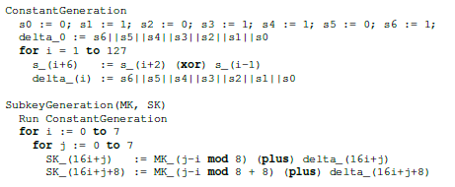
Subkey Pseudo Code

Slide 17
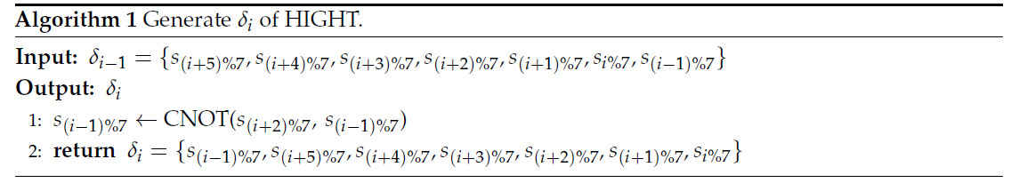
Algorithm

Slide 18
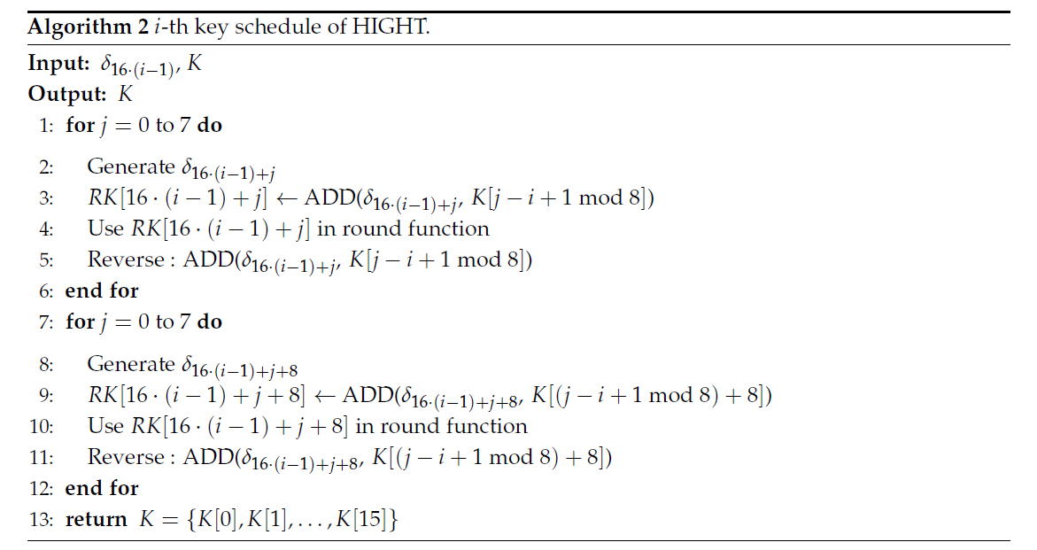
Algorithm

Slide 19


Slide 20
Work Packages
Preparing Software for Key Schedule in C
Designing Key Schedule in VHDL
Designing Key Schedule Test Bench
Preparing Software for Encryption in C
Designing Encryption Process in VHDL
Designing General Test Bench

Slide 21

1. Preparing Software for Key Schedule in C:
In this work package, the design of the HIGHT cryptology algorithm will be written in C programming language.
2. Designing Key Schedule in VHDL:
In this work package, the design of the HIGHT cryptology algorithm will be written in the VHDL design language.
3. Designing Key Schedule Test Bench:
Our aim in this work package is the tracking and verification of signals written in VHDL language. With the text bench, it will be progressed with more determined steps.
4. Preparing Software for Encryption in C:
In this work package, the entire design of the HIGHT cryptology algorithm will be written in C programming language. The link will be provided with the key schedule part and the results will be saved with a filing process.
5. Designing Encryption Process in VHDL:
In this work package, the entire design of the HIGHT cryptology algorithm will be written in VHDL design language. The key schedule part will be provided with the main program part and the results will be saved in a filing process.
6. Designing General Test Bench:
In this work package, a text bench will be written to evaluate all the results and the results will be written in the txt file. The results of VHDL and C programming will be compared and the accuracy of the system will be decided.

Slide 22
Gant Diagram
Task | Start Date | End Date | Duration
Preparing Software for Key Schedule in C | 16.03 | 17.03.2021 | 2
Designing Key Schedule in VHDL | 23.03 | 24.03.2021 | 2
Designing Key Schedule Test Bench | 30.03 | 31.03.2021 | 2
Preparing Software for Encryption in C | 06.04 | 7.04.2021 | 2
Designing Encryption Process in VHDL | 13.04 | 14.04.2021 | 2
Designing General Test Bench | 20.04 | 21.02.2021 | 2

Slide 23
REFERENCES
[1] Jang, Kyoungbae, et al. "Grover on Korean Block Ciphers." Applied Sciences 10.18 (2020): 6407.
[2] Wen, Long, et al. "Multidimensional zero-correlation attacks on lightweight block cipher HIGHT: improved cryptanalysis of an ISO standard." Information Processing Letters 114.6 (2014): 322-330.
[3] Nascimento, Fernando Melo, Fernando Messias dos Santos, and Edward David Moreno. "A VHDL implementation of the Lightweight Cryptographic Algorithm HIGHT." algorithms 2.4 (2015): 5.
[4] Mohd, Bassam Jamil, et al. "Modeling and optimization of the lightweight HIGHT block cipher design with FPGA implementation." Security and Communication Networks 9.13 (2016): 2200-2216.
[5] Özen, Onur, et al. "Lightweight block ciphers revisited: Cryptanalysis of reduced round PRESENT and HIGHT." Australasian Conference on Information Security and Privacy. Springer, Berlin, Heidelberg, 2009.
[6] Kim, Bohun, et al. "Compact implementations of HIGHT block cipher on IoT platforms." Security and Communication Networks 2019 (2019).
[7] Hong, Deukjo, et al. "HIGHT: A new block cipher suitable for low-resource device." International Workshop on Cryptographic Hardware and Embedded Systems. Springer, Berlin, Heidelberg, 2006.

Slide 24


