Slide 1
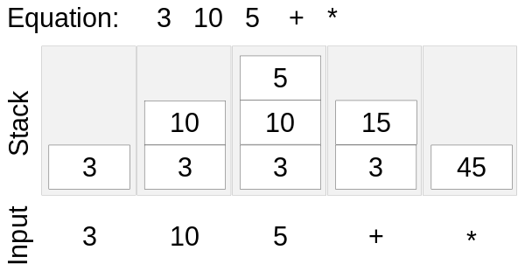
RFN Module VHDL Design Work

Slide 2
In this notation, operands come first and operator follows them.
Example: 18 5 +
Incoming operands are pushed to stack. Then the operator uses the latest two operands.
Example: 18 5 3 24 +
After + operator comes, 3 and 24 are popped from stack and the result is pushed back.
Stack after operation: 18 5 27
Example: 18 5 3 24 + x
Stack after operations: 18 135
3 + 24 = 27
Pop
+
Pushed Back
24
3
27
5
5
5
18
18
18

Slide 3
Data comes serially (1-bit).
After reset, when the signal is initially 0, there is no data or operator incoming.
If 1 and 0 come consecutively, it means that an 8-bit number will follow.
Most significant bit (MSB) comes first.
Example: ...1011111101...
The dots must be zero.
These are input bits on the timeline and incoming data is 253, which follows "10".
253 must be pushed to stack.
Data
System
dIn
1011111101
Pushed Back
Command(Number)
253

Slide 4
clear stack
multiplication
If two 1s come consecutively, it means that an operator is incoming.
Operator codes are in 2-bit.
00 -> clear stack
01 -> addition
10 -> multiplication
11 -> check
Examples:
clear -> ...1100...
add -> ...1101...
multiply -> ...1110...
check -> ...1111...
addition
check
System
dIn
1100110111101111
Command(Operator)
253

Slide 5
check
System
dIn
After check comes, latest data is read (not popped) from stack and sent to output.
Again 1 and 0 must be sent before the 8-bit number.
Example: Stack = {1, 3, 5}
If check comes, 5 is popped to output as follows.
...1000000101...
5 stays in stack.
1111
5
dOut
3
1
1000000101
Command(Number)

Slide 6
BRAM_Adress_cnt-1 /= 0
10 -> Number
1100 -> clear
1101 -> add
1110 -> multiply
1111 -> check
dIn = ‘0’
Clear
First_Operator
Addition_cnt < 5
dIn = ‘1’
Addition
BRAM_Adress_cnt-1 = 0
dIn = ‘0’
Multiply_cnt < 5
dIn = ‘0’
Addition_cnt = 5
Multiply
or
BRAM_Adress_cnt = 1
Second_Operator
dIn = ‘1’
Operator
dIn = ‘1’
dIn = ‘1’
Check
Multiply_cnt = 5
or
BRAM_Adress_cnt = 1
dIn = ‘1’
Number_or_Operator
Check_cnt = 9
Number_cnt < 7
dIn = ‘0’
Number
S_IDLE
Check_cnt = 9
dIn = ‘0’
Number_cnt = 7
S_Write

Slide 7
STATE: NUMBER
Number_cnt !=7
Number_register <= Number_register(6 downto 0) & dIn;
Number_cnt - 1

Slide 8
STATE: CLEAR
BRAM_Adress_cnt !=0
addra <= std_logic_vector(to_unsigned(BRAM_Adress_cnt, addra'length))
dina <= x’00000000’
BRAM_Adress_cnt - 1

Slide 9
STATE: Addition
Take First Number and POP it from BRAM
Take Second Number and POP it from BRAM
Add First and Second Number
Push Result to BRAM

Slide 10
STATE: Multiplication
Take First Number and POP it from BRAM
Take Second Number and POP it from BRAM
Multiply First and Second Number
Push Result to BRAM

Slide 11
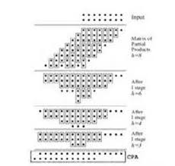
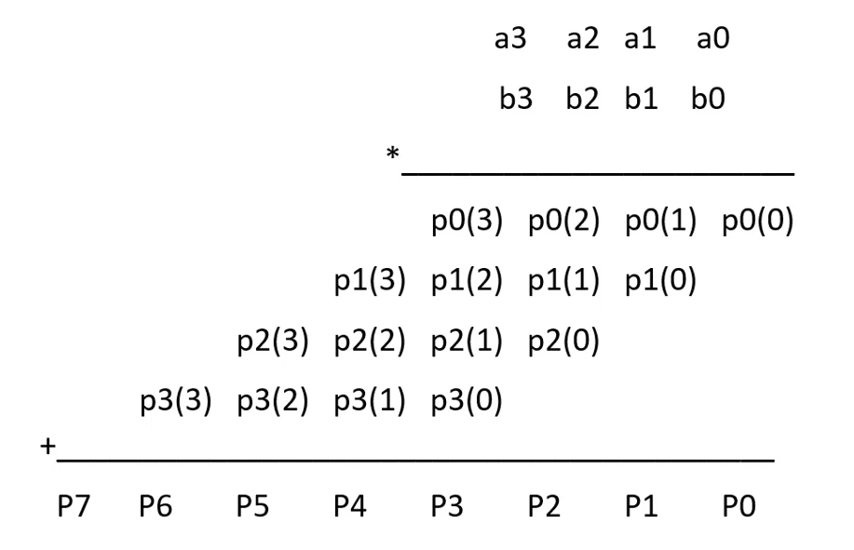
Multiply 8 bit Two Number
4 bit Wallace Tree

Slide 12
Multiply 8 bit Two Number
a7 a6 a5 a4 a3 a2 a1 a0
b7 b6 b5 b4 b3 b2 b1 b0
p0(7) p0(6) p0(5) p0(4) p0(3) p0(2) p0(1) p0(0)
p1(7) p1(6) p1(5) p1(4) p1(3) p1(2) p1(1) p1(0)
p2(7) p2(6) p2(5) p2(4) p2(3) p2(2) p2(1) p2(0)
p3(7) p3(6) p3(5) p3(4) p3(3) p3(2) p3(1) p3(0)
p4(7) p4(6) p4(5) p4(4) p4(3) p4(2) p4(1) p4(0)
p5(7) p5(6) p5(5) p5(4) p5(3) p5(2) p5(1) p5(0)
p6(7) p6(6) p6(5) p6(4) p6(3) p6(2) p6(1) p6(0)
p7(7) p7(6) p7(5) p7(4) p7(3) p7(2) p7(1) p7(0)
p7(7) s113 s112 s111 s110 s19 s18 s17 s16 s15 s14 s13 s12 s11 p0(0)
c113 c112 c111 c110 c19 c18 c17 c16 c15 c14 c13 c12 c11
P7(4) P6(4) S118 S117 S116 S115 S114 P3(1) P3(0)
c118 c117 c116 c115 c114 P4(0)
P7(3) P7(1) P6(1) P6(0)
P7(0)

Slide 13
p7(7) s113 s112 s111 s110 s19 s18 s17 s16 s15 s14 s13 s12 s11 p0(0)
c113 c112 c111 c110 c19 c18 c17 c16 c15 c14 c13 c12 c11
P7(4) P6(4) S118 S117 S116 S115 S114 P3(1) P3(0)
c118 c117 c116 c115 c114 P4(0)
P7(3) P7(1) P6(1) P6(0)
P7(0)
S213 s212 s211 s210 s29 s28 s27 s26 s25 s24 s23 s22 s21 s11 p0(0)
C213 c212 c211 c210 c29 c28 c27 c26 c25 c24 c23 c22 c21
p7(4) S217 c117 S216 S215 S214 p4(0)
C217 C216 C215 c214
C213 S312 s311 s310 s39 s38 s37 s36 s35 s34 s33 s32 s31 s21 s11 p0(0)
C312 c311 c310 c39 c38 c37 c36 c35 c34 c33 c32 c31
C217 C216 C215 c214
S412 S411 s410 s49 s48 s47 s46 s45 s44 s43 s42 s41 s31 s21 s11 p0(0)
C412 C411 C410 C49 C48 C47 C46 C45 C44 C43 C42 c41

Slide 14
STATE: Check
Take Latest Data from BRAM
After check comes, latest data is read (not popped) from stack and sent to output.
Again 1 and 0 must be sent before the 8-bit number.
Example: Stack = {1, 3, 5}
If check comes, 5 is popped to output as follows.
...1000000101...
5 stays in stack.
Concatenate ’10’ and Latest Data
Sent Data to Output one by one

Slide 15
RPN Module
There are four ports. Clock, reset, 1-bit input data and 1-bit output data.
module reversePolishNotation
(
input clk,
input rst,
input dIn,
output dOut
);
1
dIn
1
dOut
rst
rst
50 MHz

Slide 16
RPN Module
8x16 BRAM
1
dIn
Addra
douta
dina
1
dOut
rst
rst
wea
50 MHz
clka

