Slide 1
DB a.k.a Database

Slide 2
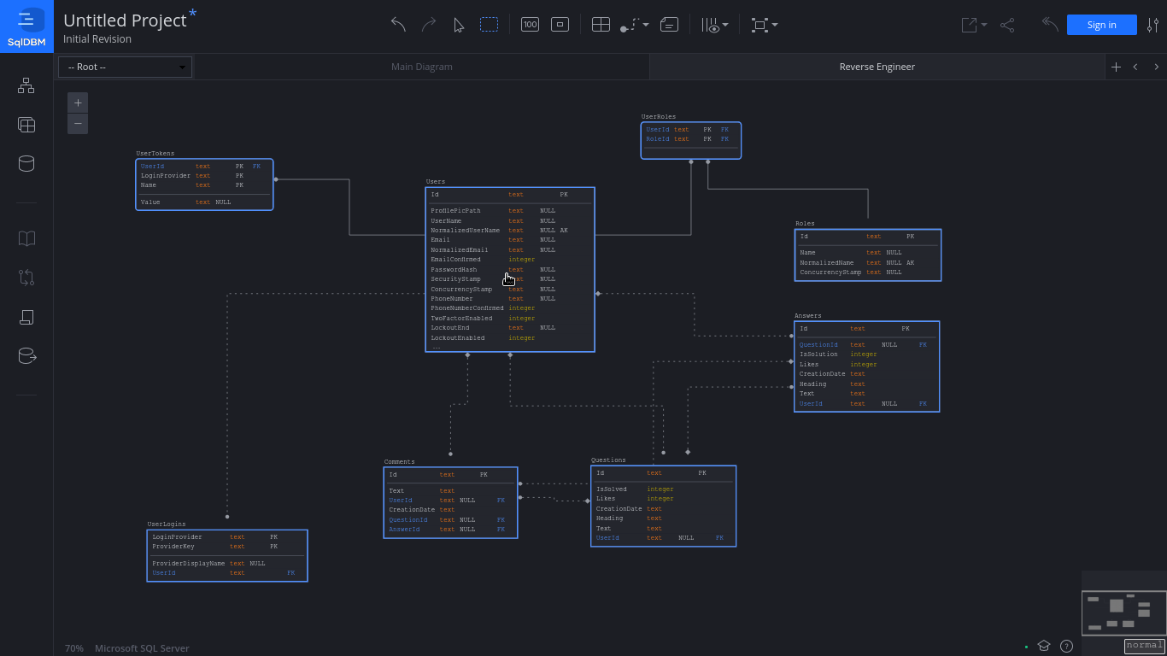

Slide 3
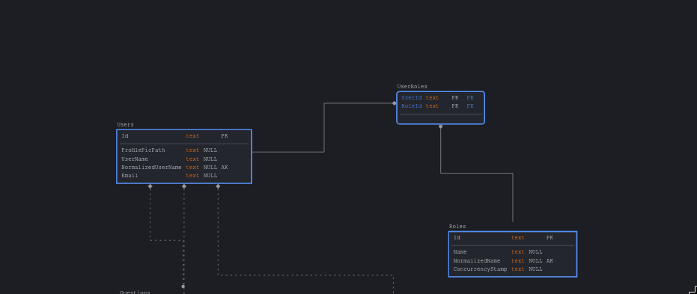
Notes:
User has roles: Admin, Moderator, User;
ProfilePicPath is where the profile picture is stored.

Slide 4
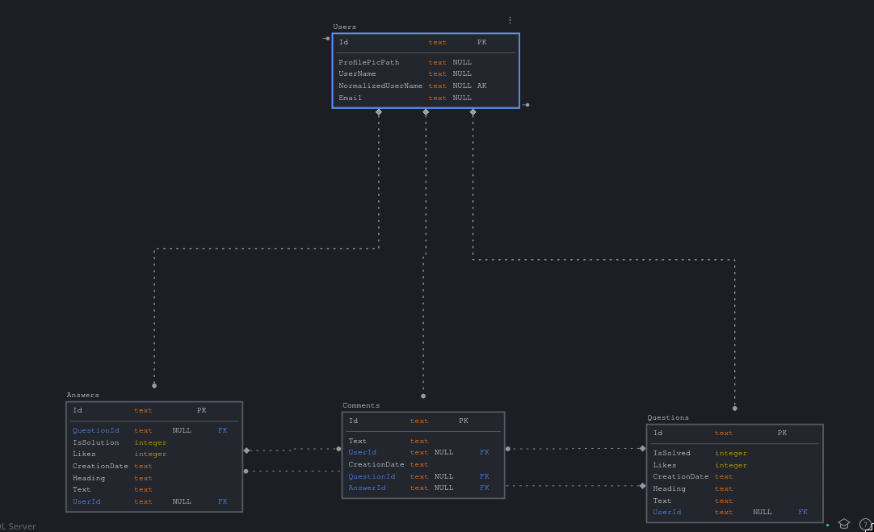
Notes:
A User can have Questions that he asked.
Answers that he gave.
Comments that he made.

Slide 5
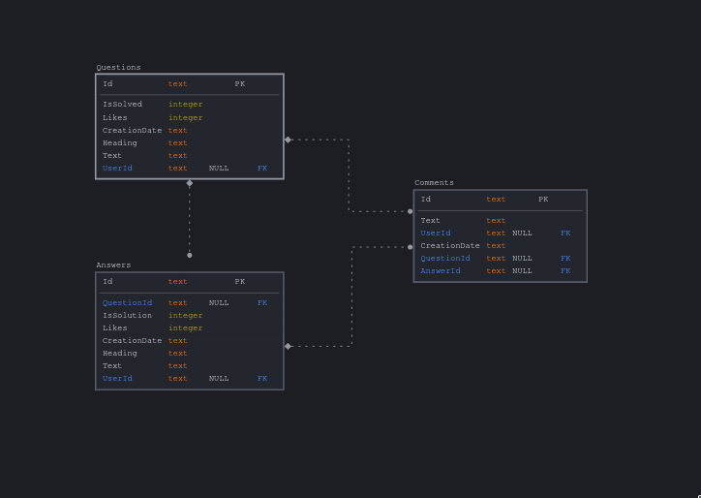
Notes:
Answer is a child of a question.
Both questions and answrers gave comments.

Slide 6
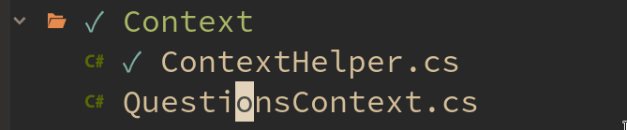

Slide 7
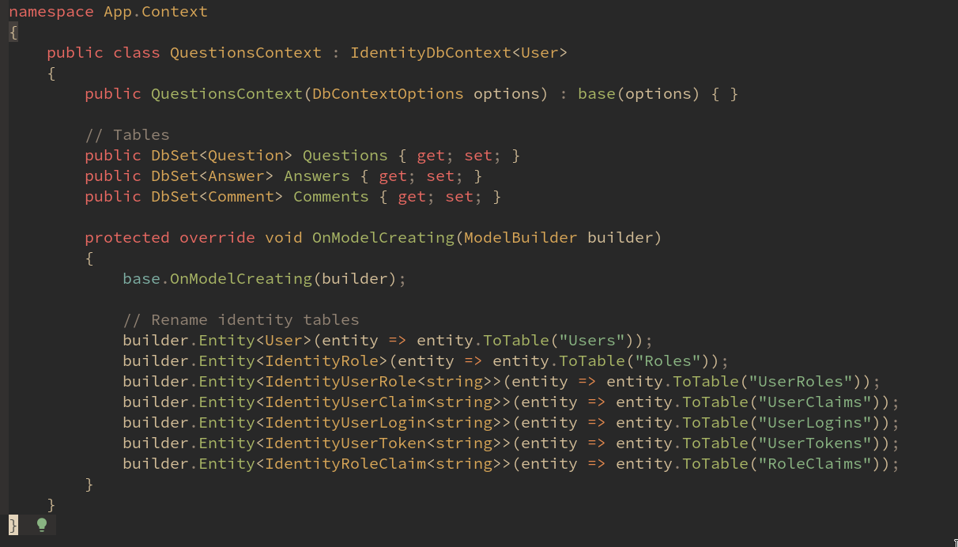
Database Context
Notes:
Here I renamed the default identity tables.

Slide 8
Database Context
Notes:
These are tables that are related to the user

Slide 9
Notes:
Here they are :)

Slide 10
Program and Startup

Slide 11
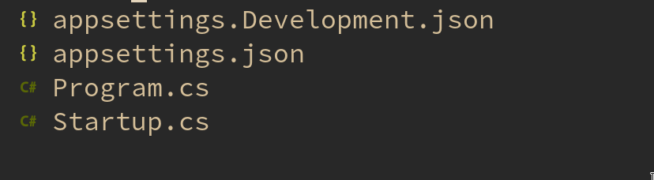

Slide 12
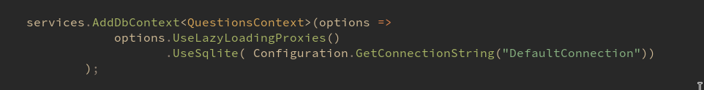

Slide 13
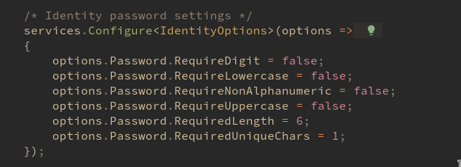

Slide 14
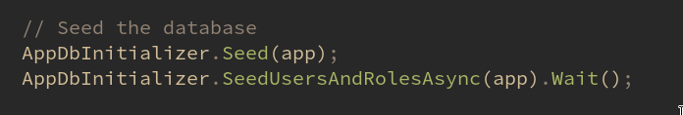

Slide 16
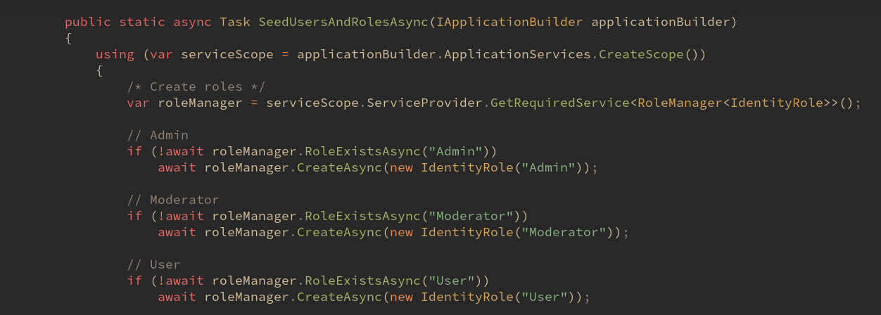

Slide 19
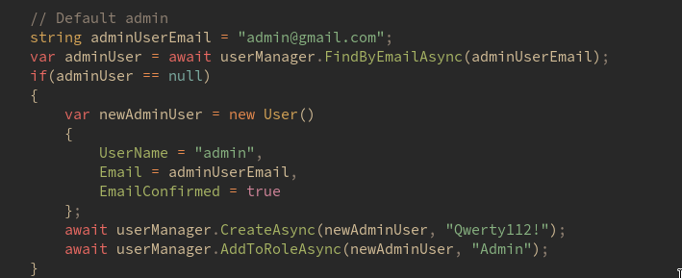

Slide 20
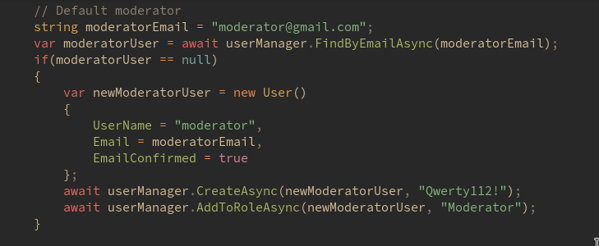

Slide 21
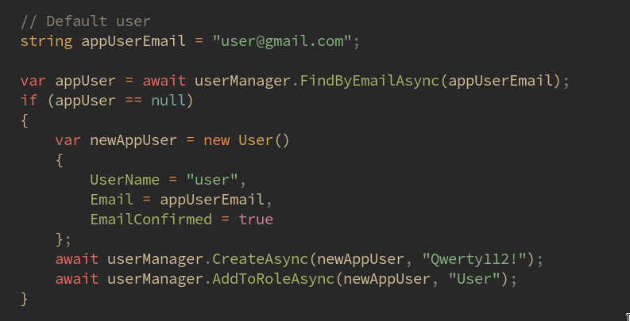

Slide 22
