Slide 1
CASE STUDY: Cyclistic bike-share
PRESENTED BY: VEZZANI FILIPPO
LAST UPDATED: FEBRUARY 2022

Slide 2
TABLE OF CONTENENTS
ABOUT THE COMPANY (INTRODUCTION)
DATABASE AND MAIN QUESTION
INSIGHT (CONCLUSION)

Slide 3
About the company

Slide 4
About the company
In 2016, Cyclistic launched a successful bike-share offering. Since then, the program has grown to a fleet of 5,824 bicycles that are geotracked and locked into a network of 692 stations across Chicago. The bikes can be unlocked from one station and returned to any other station in the system anytime.
Until now, Cyclistic’s marketing strategy relied on building general awareness and appealing to broad consumer segments. One approach that helped make these things possible was the flexibility of its pricing plans: single-ride passes, full-day passes, and annual memberships. Customers who purchase single-ride or full-day passes are referred to as casual riders. Customers who purchase annual memberships are Cyclistic members.

Slide 5
About the company
Cyclistic’s finance analysts have concluded that annual members are much more profitable than casual riders. Although the pricing flexibility helps Cyclistic attract more customers, the director of marketing believes that maximizing the number of annual members will be key to future growth. Rather than creating a marketing campaign that targets all-new customers, the director of marketing believes there is a very good chance to convert casual riders into members. She notes that casual riders are already aware of the Cyclistic program and have chosen Cyclistic for their mobility needs.
The director of marketing has set a clear goal: Design marketing strategies aimed at converting casual riders into annual members. In order to do that, however, the marketing analyst team needs to better understand how annual members and casual riders differ, why casual riders would buy a membership, and how digital media could affect their marketing tactics. The director of marketing and his team are interested in analyzing the Cyclistic historical bike trip data to identify trends.

Slide 6
DATABASE & MAIN QUESTION

Slide 7
DATABASE
The data of this analysis are the last quarter of 2021. This data is free and available at the following link: https://divvy-tripdata.s3.amazonaws.com/index.html

Slide 8
MAIN QUESTION
How do annual members and casual riders use Cyclistic bikes differently?

Slide 9
INSIGHT

Slide 10
Determine the credibility of the data
Make columns consistent
Check the data for errors
Stack individual month’s data frames into one big data frame

Slide 11
Useful statistic for the ride lenght of the users (in seconds)
 | Casual | Member
Mean | 1.590 | 708
Median | 756 | 485
Max | 2.442.301 | 93.595

Slide 12
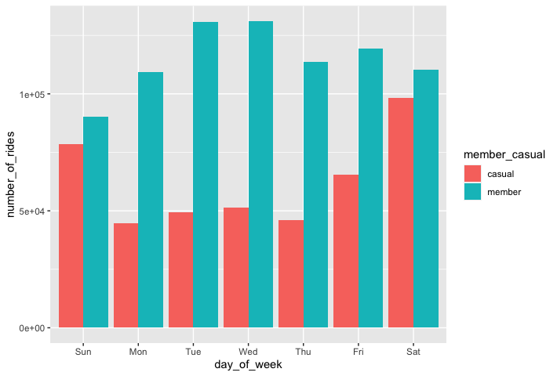
NUMBER OF RIDE BY EACH DAY

Slide 13
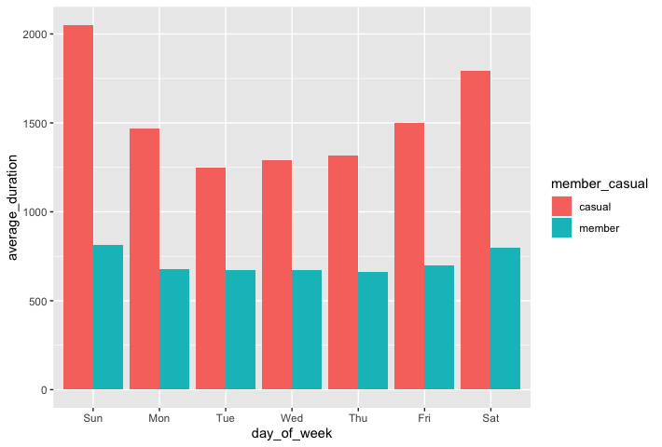
AVERAGE RIDE TIME BY EACH DAY

Slide 14
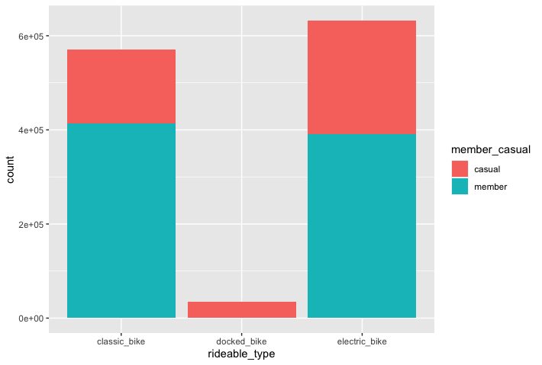
Type of vehicle

Slide 15
SUMMARY
In conclusion the casual consumers have greater statistic than ordinary members. However, the number of their ride is very low. There are two possible strategies:
Increase the awareness of the brand and in addiction of this the number of casual consumers
Increase the conversion rate provide a more efficient and competitive product

