Slide 2
Overview
Session 1: Introduced Kaizen iOS template.
Session 2: iOS automation test – XCUITest.
Session 3: Unit test – Quick & Nimble.

Slide 3
Session 1: Kaizen iOS template
Github link: https://github.com/vitalifyjp/Kaizen_IOS_Template

Slide 4
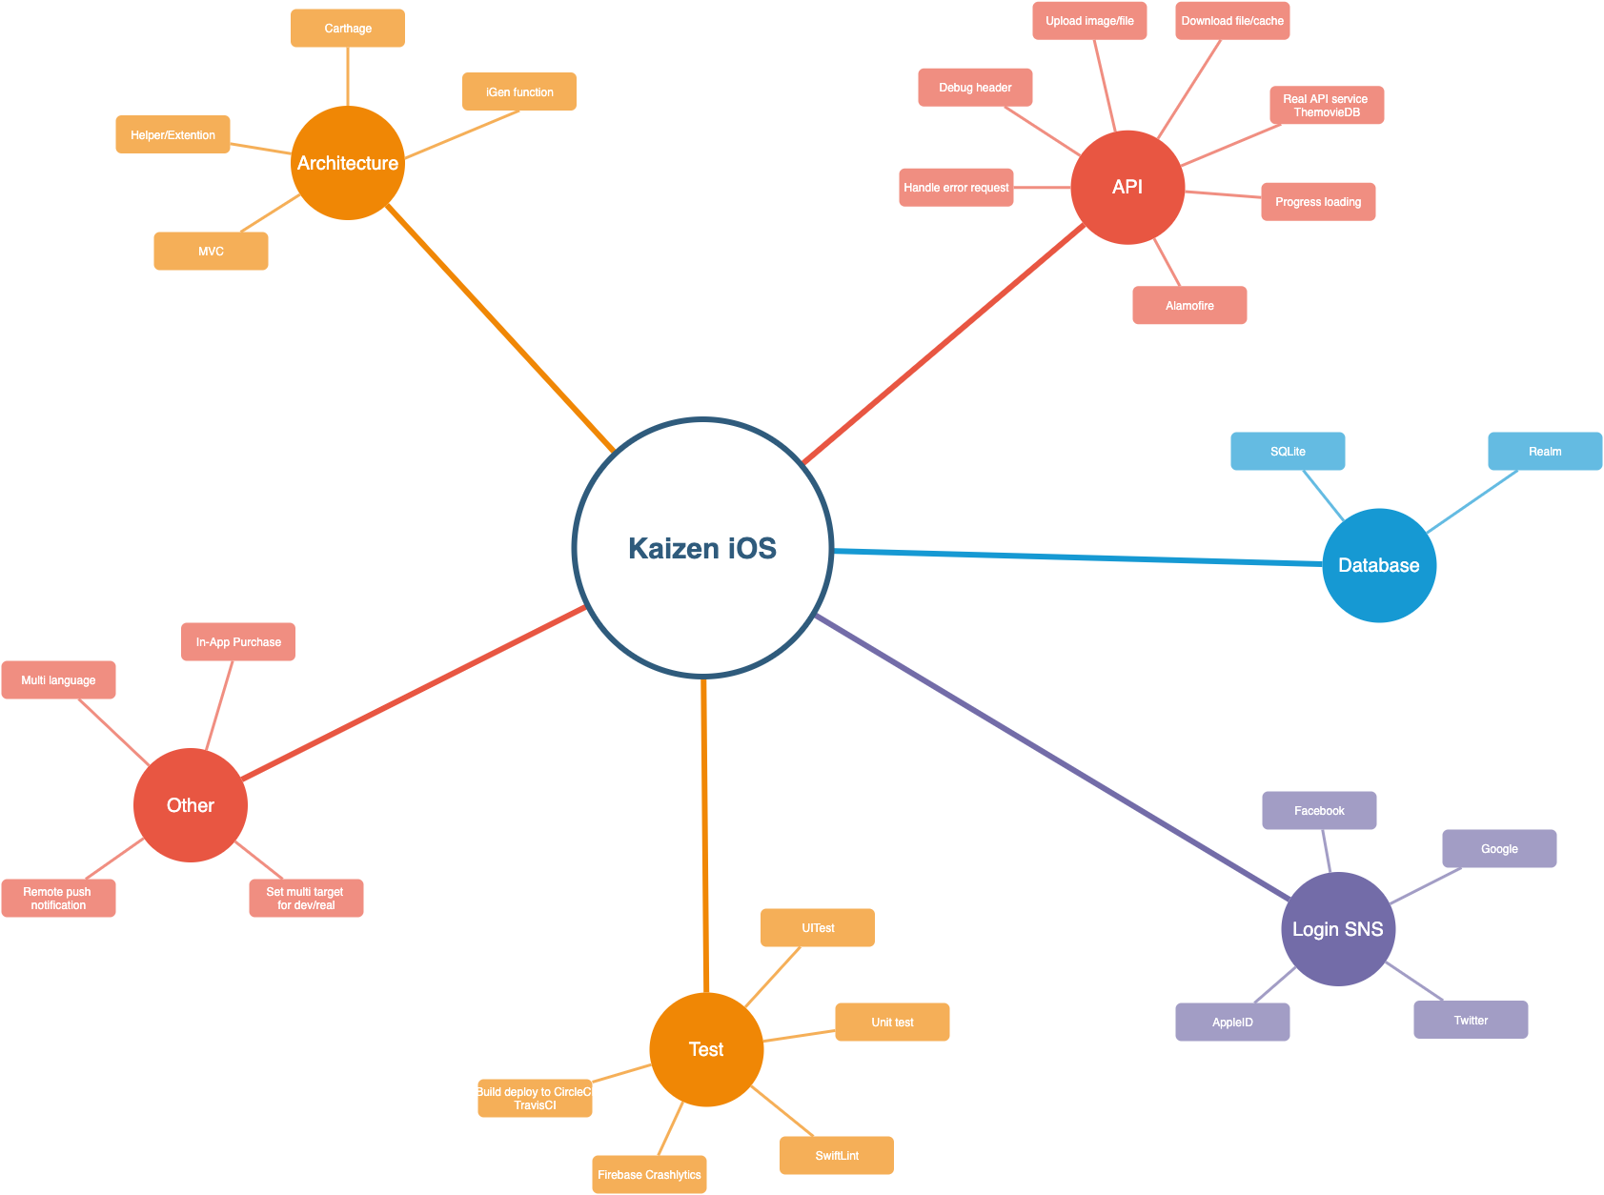
Functions

Slide 5
Session 2: iOS UI Testing in Xcode (iOS Automation)

Slide 6
Overview
Introduction XCUITest
Record and Playback
Demo

Slide 7
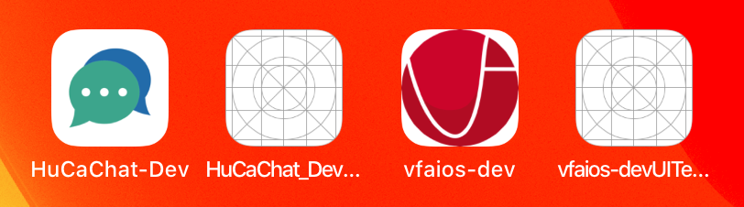
XCUITest
Introduced in Xcode 7 in 2015
xUnit Test cases (XCTestCase)
UITest targets can’t see production codes
Builds and tests are all executed using XCode (ObjC/Swift)
Record functionality

Slide 8
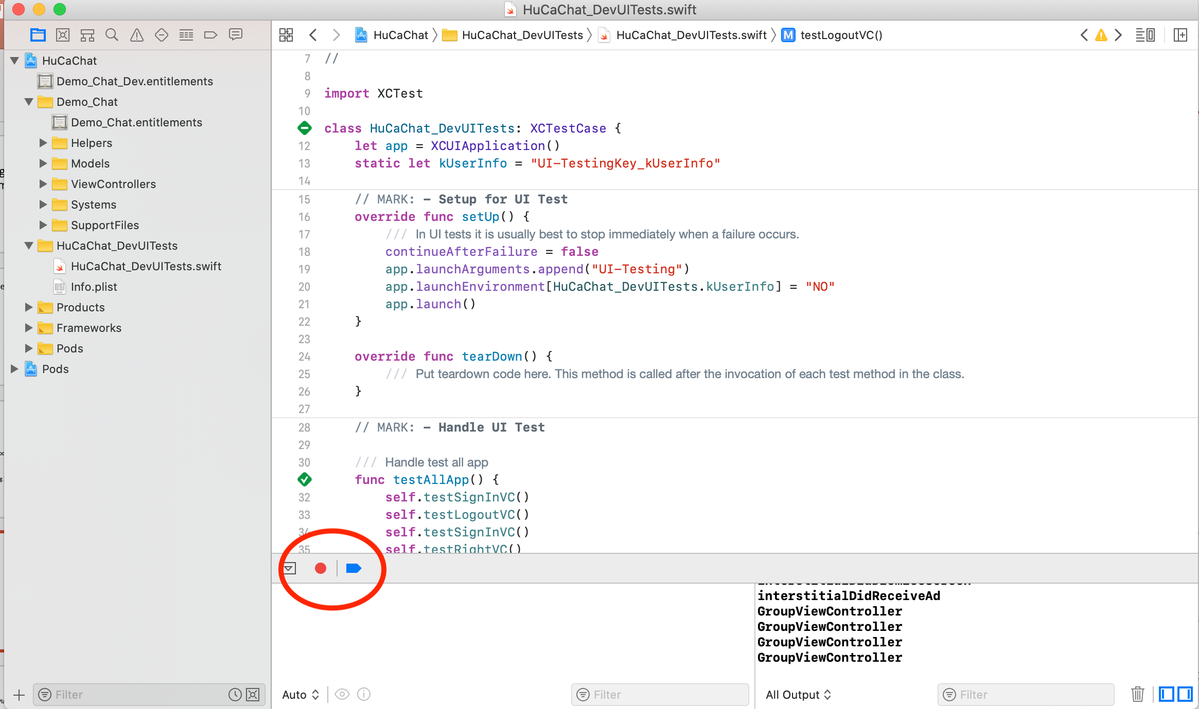
XCUITest – Recording and playback

Slide 9
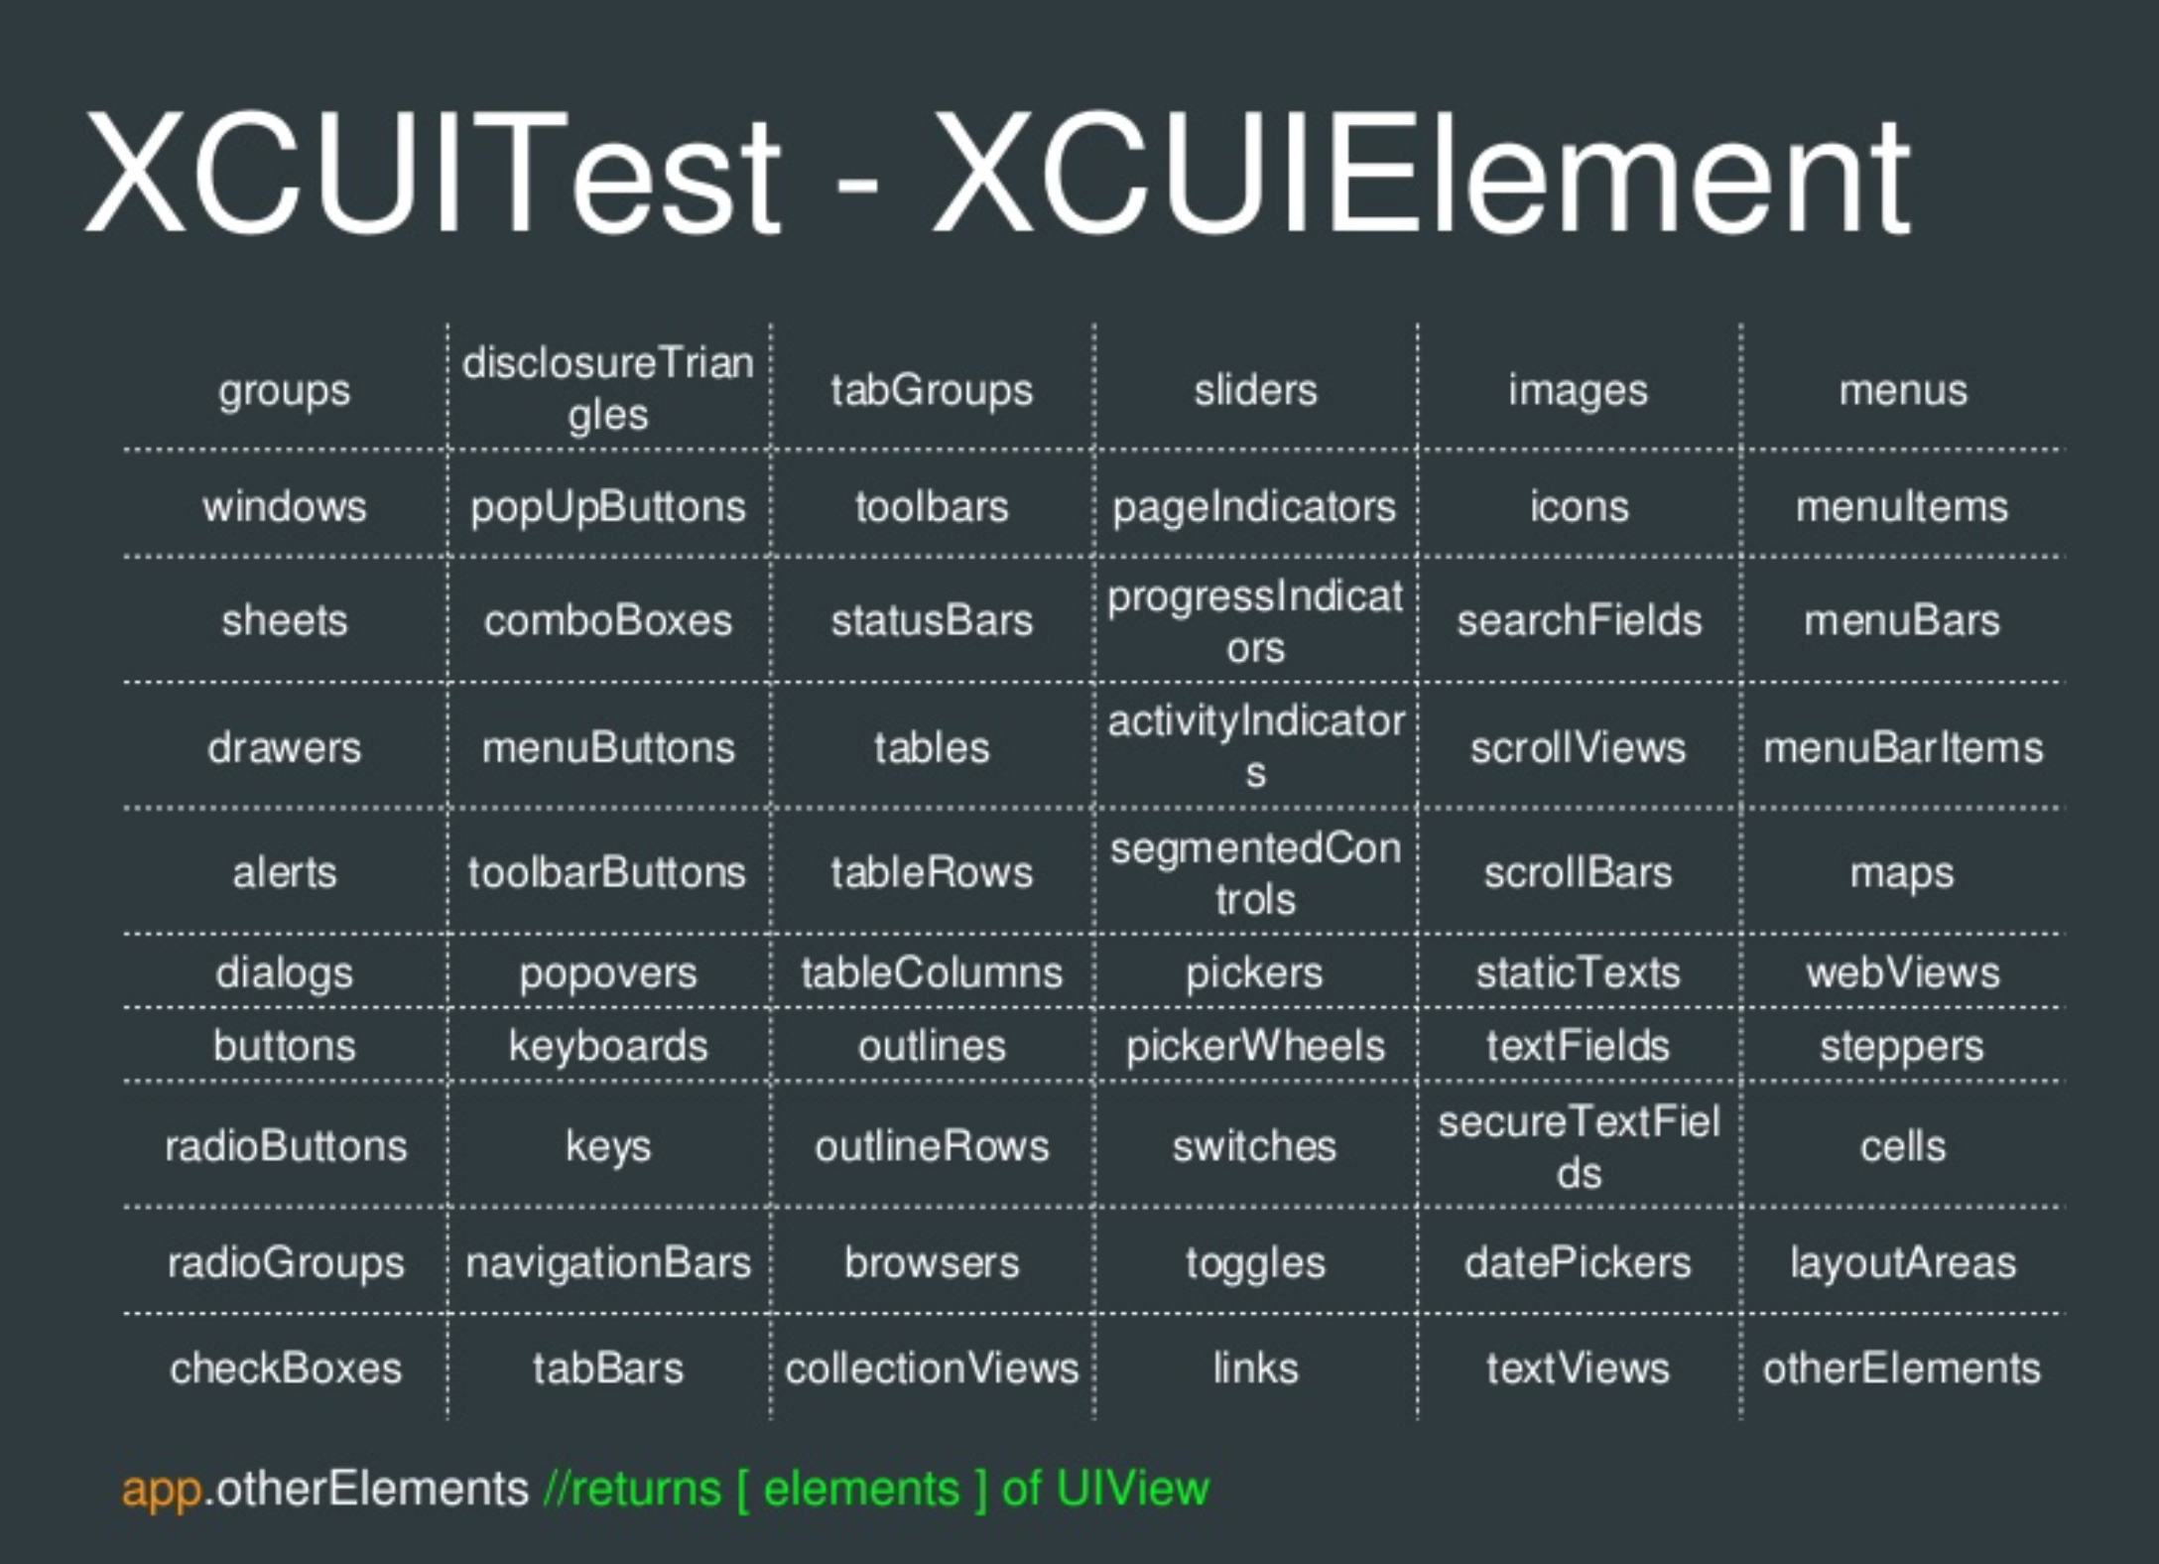

Slide 10
Demo
Demo 1: UI Recording – Record and Playback
YouTube link
Demo 2: How does iOS automation work?
Github: https://github.com/vfaHungnv/simpleapp/tree/develop

Slide 11
Session 3: Unit test – Quick & Nimble.

Slide 12
Referent
UITest call API: https://www.raywenderlich.com/960290-ios-unit-testing-and-ui-testing-tutorial
UITest: https://useyourloaf.com/blog/ui-testing-quick-guide/
UnitTest – Quick & Nimble: https://medium.com/inloopx/tdd-using-quick-nimble-244b14b09e3d

