Slide 1
Workshop: iOS Testing
HungNV
ChauNN

Slide 2
Overview
Session 1: Introduced Kaizen iOS template.
Session 2: iOS automation test – XCUITest.
Session 3: Unit test – Quick & Nimble.

Slide 3
Session 1: Kaizen iOS template
Github link: https://github.com/vitalifyjp/Kaizen_IOS_Template
Coding role: https://vitalifyjp.github.io/KaizenTeam/docs/ios/
Document: https://vfa-chaunn.gitbook.io/kaizen-ios-template-gui/

Slide 4
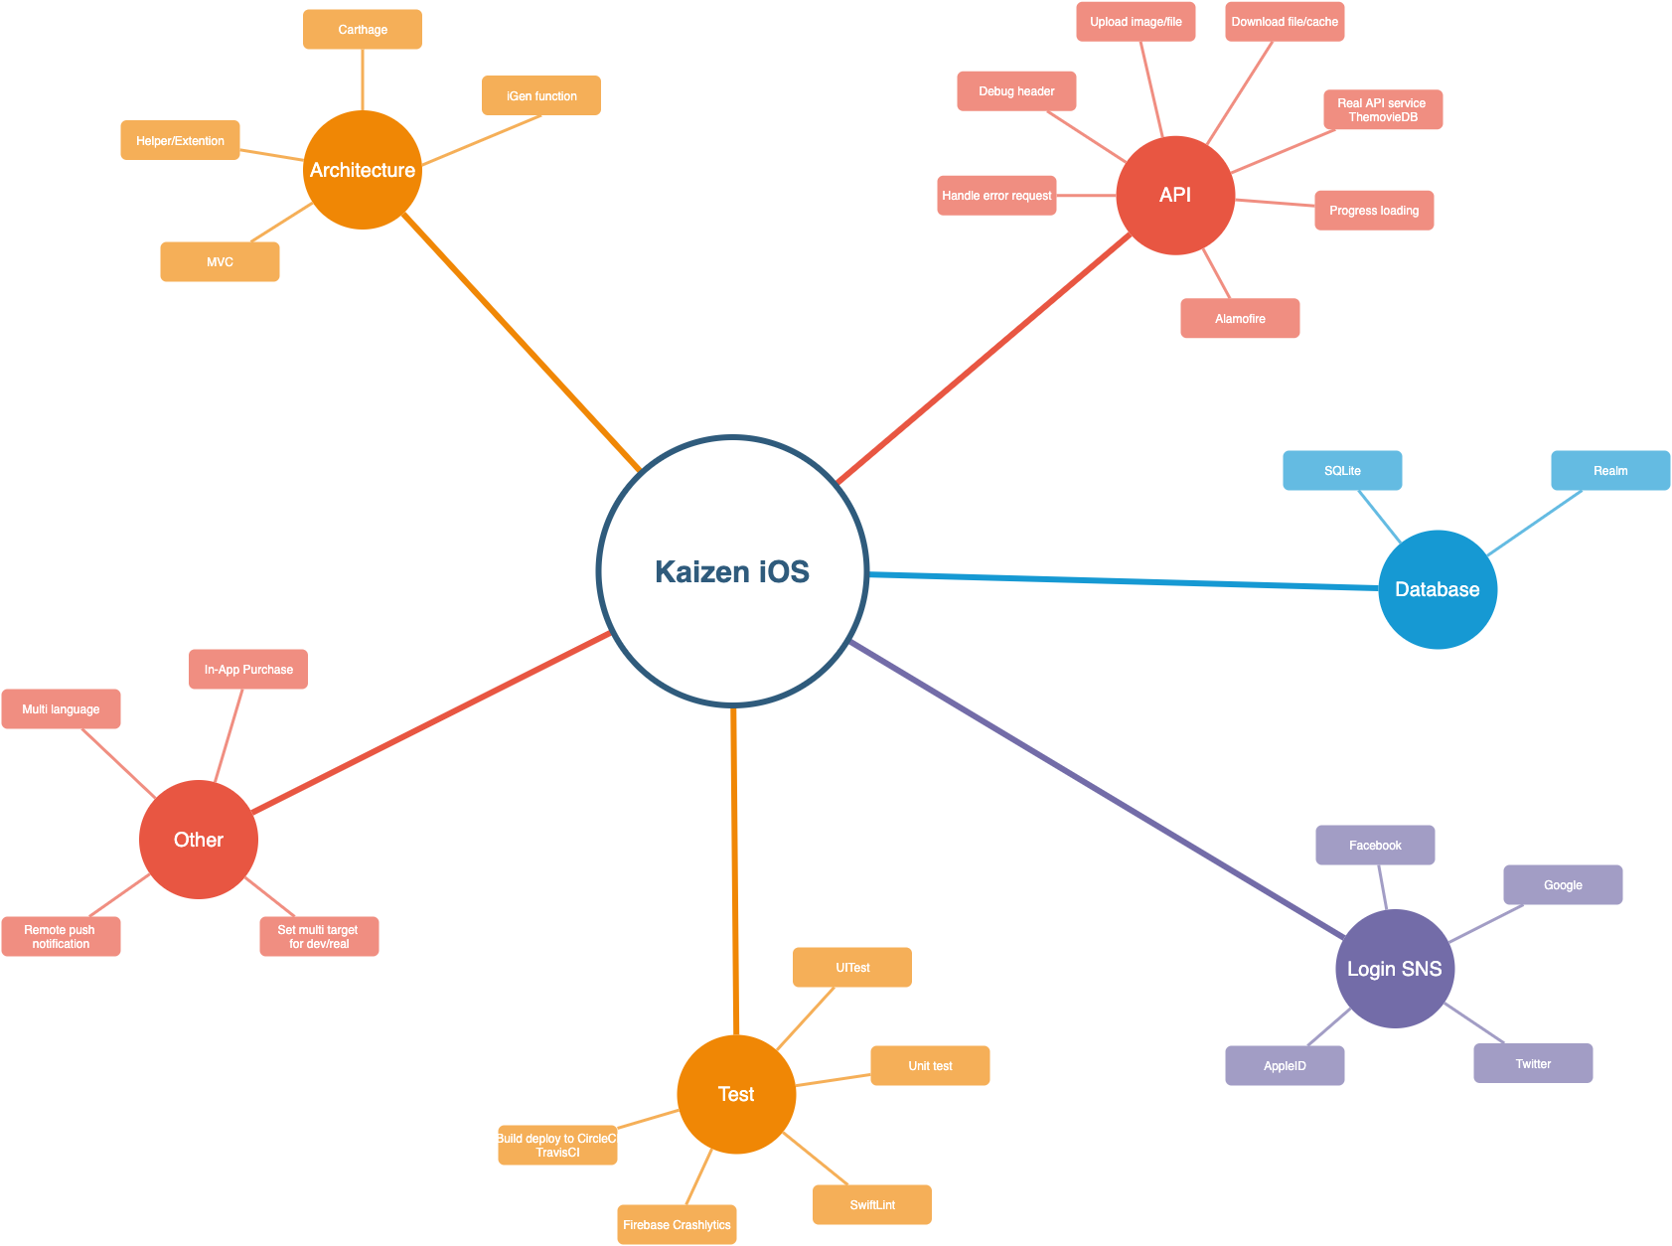
Functions

Slide 5
Session 2: iOS UI Testing in Xcode (iOS Automation)

Slide 6
Overview
Introduction XCUITest.
Record and Playback.
Demo.

Slide 7
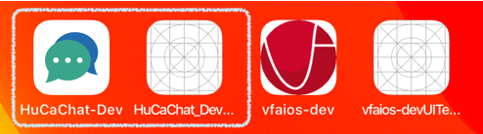
XCUITest
Introduced in Xcode 7 in 2015
xUnit Test cases (XCTestCase)
UITest targets can’t see production codes
Builds and tests are all executed using XCode (ObjC/Swift)
Record functionality

Slide 8
Requirements
UI testing depends on new OS features
iOS 9
OS X 10.11
Privacy protection
iOS devices
Enabled for development
Connected to a trusted host running Xcode
OS X must grant permission to Xcode Helper
Prompted on first run

Slide 9
Getting Started
Xcode target type APIs
UI recording

Slide 10
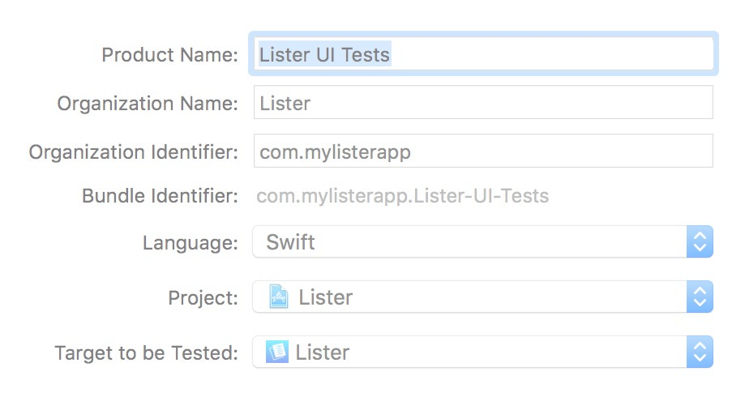
UI Testing Xcode Targets
UI tests have special requirements
Execute in a separate process
Permission to use Accessibility
New Xcode target templates
Cocoa Touch UI Testing Bundle (iOS)
Cocoa UI Testing Bundle (OS X)
“Target to be Tested” setting

Slide 11
APIs
Three new classes
XCUIApplication
XCUIElement
XCUIElementQuery

Slide 12
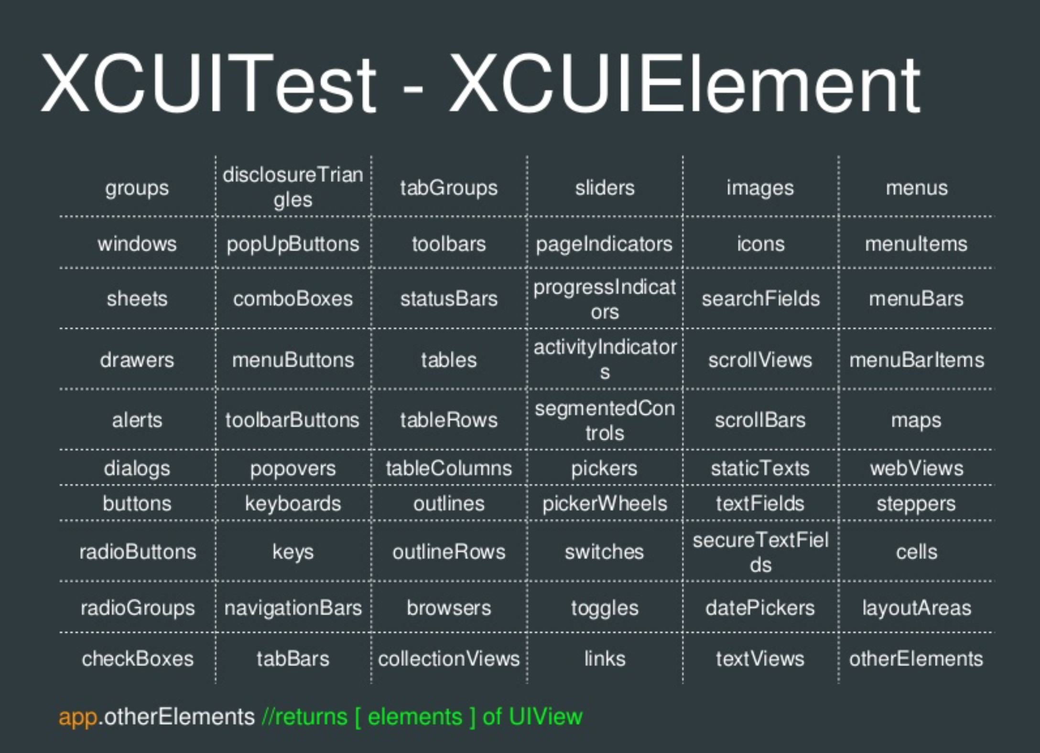

Slide 13
UI Recording
Interact with your app Recording generates the code
Create new tests
Expand existing tests

Slide 14
Example
Testing the Add button
// application:
let app = XCUIApplication() app.launch()
// element and query:
let addButton = app.buttons[“Add”] addButton.tap()
// assertion: XCTAssertEqual(app.tables.cells.count, 1)

Slide 15
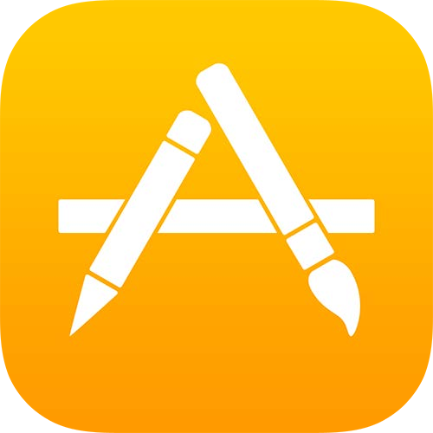
Example
Testing the Add button
// application:
let app = XCUIApplication()
app.launch()
// element and query:
let addButton = app.buttons[“Add”] addButton.tap()
// assertion: XCTAssertEqual(app.tables.cells.count, 1)

Slide 16
Example
Testing the Add button
// application:
let app = XCUIApplication()
app.launch()
// element and query:
let addButton = app.buttons[“Add”] addButton.tap()
// assertion: XCTAssertEqual(app.tables.cells.count, 1)

Slide 17
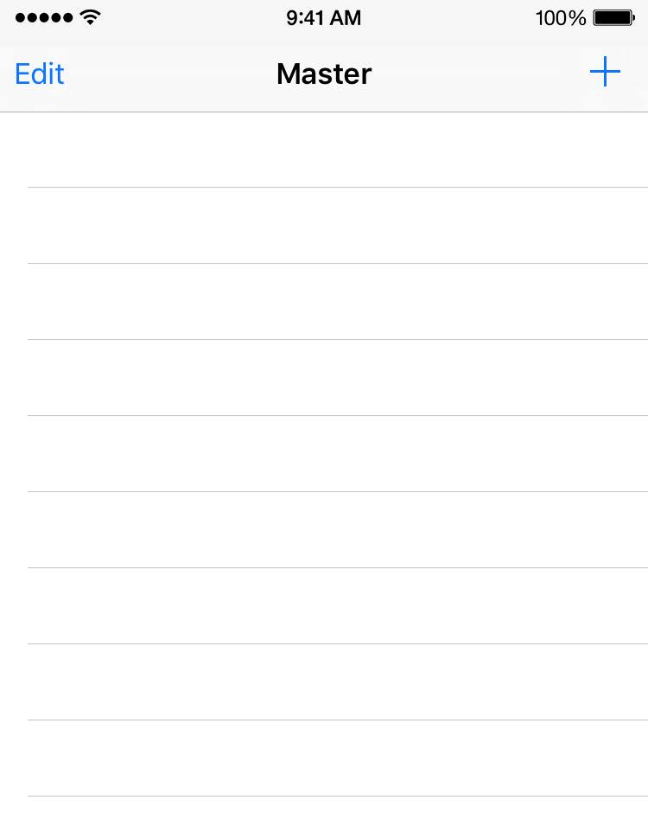
Example
Testing the Add button
// application:
let app = XCUIApplication()
app.launch()
// element and query:
let addButton = app.buttons[“Add”] addButton.tap()
// assertion: XCTAssertEqual(app.tables.cells.count, 1)

Slide 18
Example
Testing the Add button
// application:
let app = XCUIApplication() app.launch()
// element and query:
let addButton = app.buttons[“Add”]
addButton.tap()
// assertion: XCTAssertEqual(app.tables.cells.count, 1)

Slide 19


Example
Testing the Add button
// application:
let app = XCUIApplication() app.launch()
// element and query:
let addButton = app.buttons[“Add”]
addButton.tap()
// assertion: XCTAssertEqual(app.tables.cells.count, 1)

Slide 20
Example
Testing the Add button
// application:
let app = XCUIApplication() app.launch()
// element and query:
let addButton = app.buttons[“Add”]
addButton.tap()
// assertion: XCTAssertEqual(app.tables.cells.count, 1)

Slide 21

Example
Testing the Add button
// application:
let app = XCUIApplication() app.launch()
// element and query:
let addButton = app.buttons[“Add”]
addButton.tap()
// assertion: XCTAssertEqual(app.tables.cells.count, 1)

Slide 22
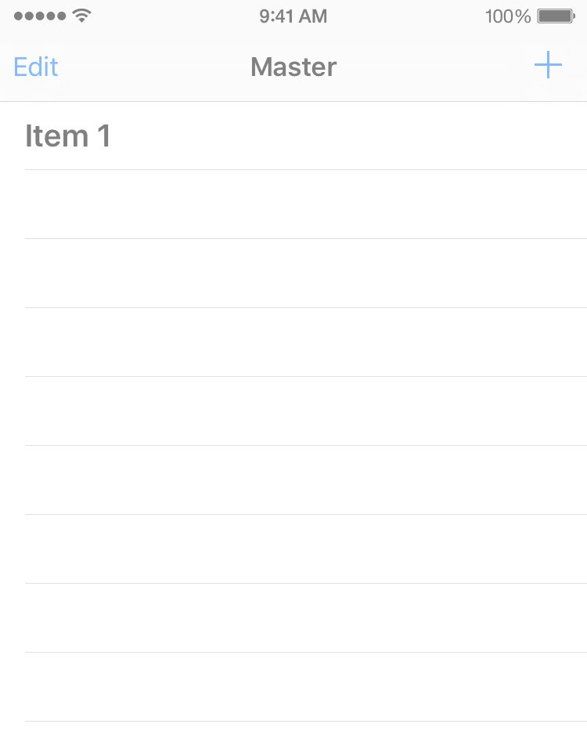
Example
Testing the Add button
// application:
let app = XCUIApplication() app.launch()
// element and query:
let addButton = app.buttons[“Add”] addButton.tap()
// assertion:
XCTAssertEqual(app.tables.cells.count, 1)

Slide 23
Demo
Demo 1: UI Recording – Record and Playback
YouTube link
Demo 2: How does iOS automation work?
Github: https://github.com/vfaHungnv/simpleapp/tree/develop

Slide 24
Session 3: Unit test – Testing with Quick & Nimble.

Slide 25
Overview
Introduced XCTest vs Quick and Nimble.
How to use Quick and Nimble.
Script for test case.
Demo.

Slide 26
Comparison between XCTest vs Quick and Nimble
XCTest is a testing framework provided by Apple. You need to be aware of setup() and tearDown() functions. XCTAssertions are also pretty inconvenient to use. Very long function names.
Quick is a testing framework which provides a convenient method to compose a unit test. It uses the single function spec() to define the whole test. The sections are describe, context and it. I will explain the purpose and benefits of such a setup later in this article.
Nimble is a matching framework which provides plenty of options how to fulfill your test expectations.

Slide 27
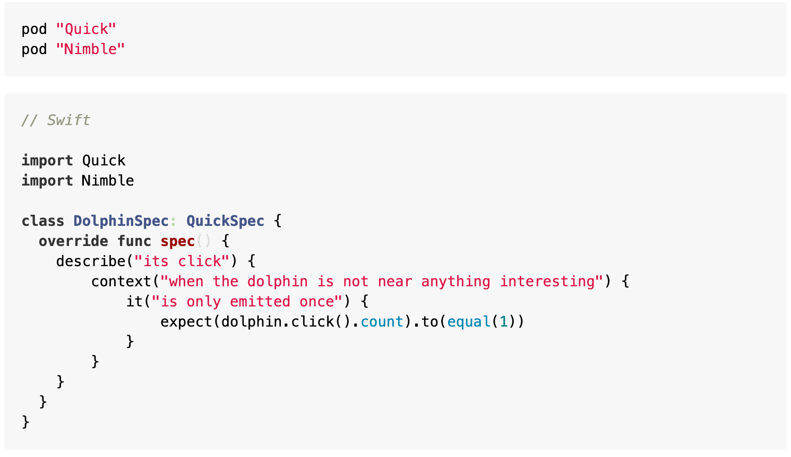
How to use Quick and Nimble
You can either use Cathage or Cocoa Pod.

Slide 28
Introduction Quick
describe: An arbitrary string describing the example group.
context: Defines an example group. Equivalent to `describe`.
it: Defines an example. Examples use assertions to demonstrate how code should behave. These are like "tests" in XCTest.

Slide 29
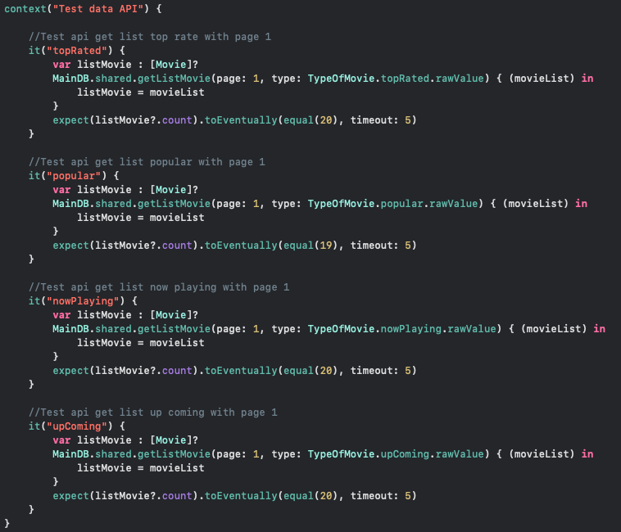
Script for test case.
1. Test number of element movie
into from API .

Slide 30
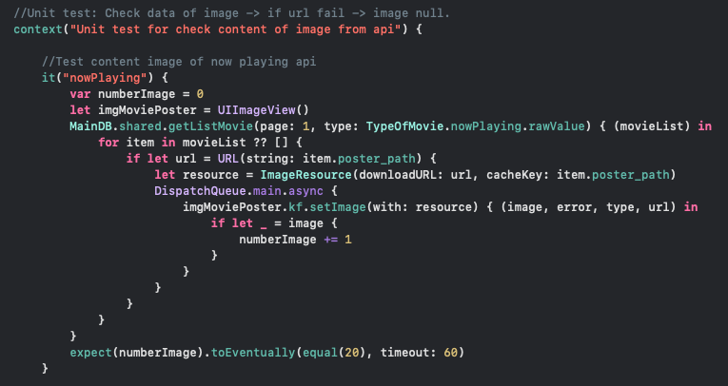
2. Test correct url thumbnail for each movie from API.

Slide 31
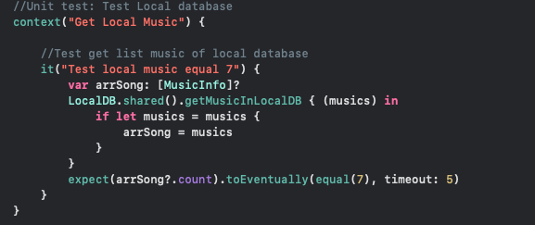
3. Test number of music into local DB.

Slide 32
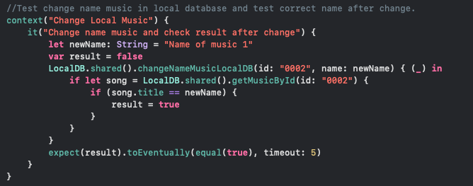
4. Test change data of music into local DB.

Slide 33
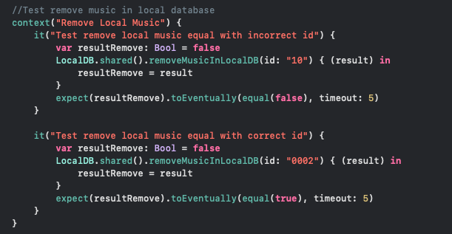
5. Test delete music into local DB.

Slide 34
Reference
Quick and Nimble: https://medium.com/inloopx/tdd-using-quick-nimble-244b14b09e3d
UITest call API: https://www.raywenderlich.com/960290-ios-unit-testing-and-ui-testing-tutorial
UITest: https://useyourloaf.com/blog/ui-testing-quick-guide/
WWDC: https://developer.apple.com/videos/developer-tools/testing
UnitTest – Quick & Nimble: https://medium.com/inloopx/tdd-using-quick-nimble-244b14b09e3d

Slide 35
Q.A – Thank you!!!

