Slide 1


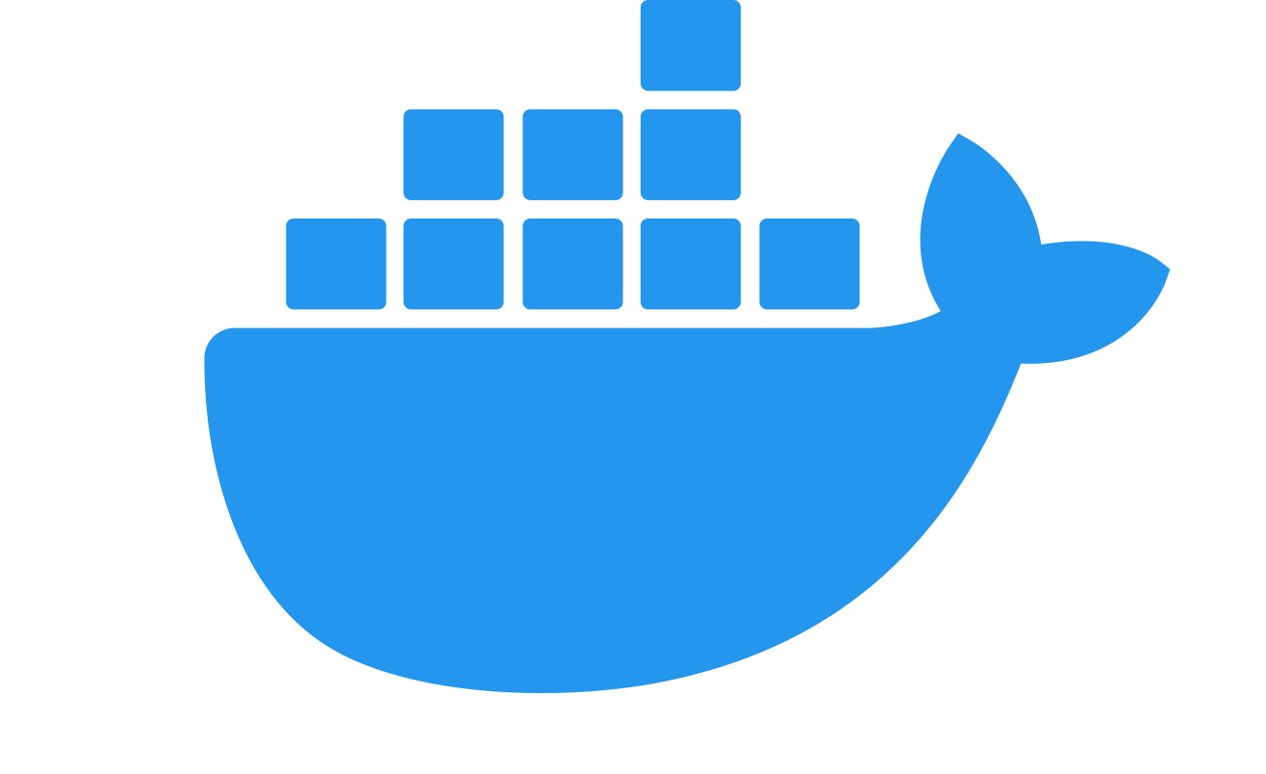

Azure DevOps Build agents hosted in Azure
Vivien FABING

Slide 2
Sprint Backlog
Presentation with demonstrations ~30 minutes
Q&A session

Slide 3

Thank you

Slide 4
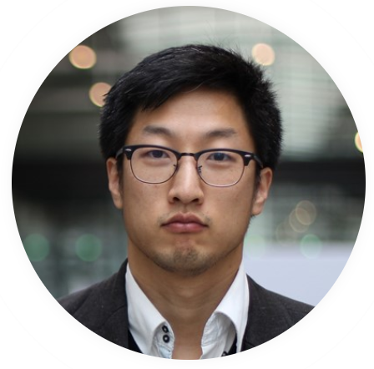
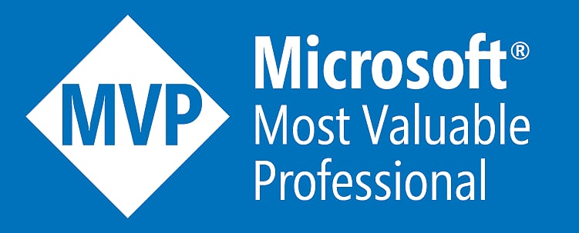


ALM Tech Lead @ Infinite Square
Working with Azure DevOps (previously Team Foundation Server) since 2011
Passionate about ALM, Clean Architecture and more recently #docker and #Blazor
@vivienfabing
@vivien-fabing
www.vivienfabing.com
blogs.infinitesquare.com/users/vfabing

Slide 5
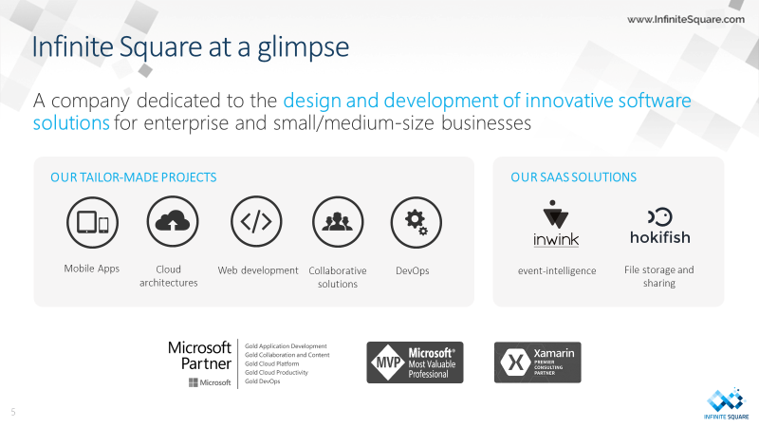

Slide 6
“88 years of free open source builds in 8 months with Azure Pipelines”
MARTIN WOODWARD
Group Principal Program Manager for Azure DevOps
May 6, 2019, 8 months after “Announcing Azure Pipelines with unlimited CI/CD minutes for open source”
https://cloudblogs.microsoft.com/opensource/2019/05/06/azure-pipelines-update-free-open-source-builds/

Slide 7
=
Microsoft-hosted agents
But…

Slide 8
“Sorry, but our pipeline takes 20 minutes to complete, and I am 5th in the queue. Can you come back in 2 hours ?”
A colleague waiting for its build to complete to merge its Pull Request
Not so long ago

Slide 9
Easy mode
+1
=
~40$/month
Or…
Microsoft-hosted agents

Slide 10
Ready for the next level?
+1
↑

Slide 11
Level up?
Manage our own build agent

Slide 12
Benefits
Faster build time with cache reuse
Easier debugging with “developer-like” build environment
More Azure credit optimization

Slide 13
Curious?

Slide 14



?

Slide 15
Azure Container Instances
Flexibility max
Easy to start

Slide 16
Pros
Get an additional build agent running in minutes!
Pay as you go
Isolation (1 agent per instance)

Slide 17
DEMO
ACI agents with standard (deprecated) images
ACI agents with custom image
ACI agents on demand
Azure Container Instances

Slide 18
Cons
No Docker in Docker
No Container density regarding performance for further cost optimization

Slide 19
Azure Virtual Machine
More control
Best performances

Slide 20
Pros
Best Cost/Performance for build docker containers
Container Density
Docker tools for easier debug

Slide 21
DEMO
Start in minutes using Docker Machine
Docker in Docker
Save cost with auto-start / auto-stop
Azure Virtual Machine + Docker Machine

Slide 22
Cons
More knowledge/maintenance required

Slide 23
Wrap up
Still alive?
Time to check the loot

Slide 24
Simple scenarii
Microsoft-hosted agents

Slide 25
Fine-tuned scenarii

Slide 26
Thank you for attending!
Keep in touch!
@vivienfabing
@vivien-fabing
Any question?
www.vivienfabing.com
blogs.infinitesquare.com/users/vfabing
To go further:
Azure Pipelines: How to add a build agent with Azure Container Instances
Azure Pipelines: How to add a build agent with Azure Container Instances - part 2 : Custom Agent
Azure Pipelines: How to add a build agent with Azure Container Instances - part 3 : Build agent on demand
Azure Pipelines: How to add a build agent with docker-machine

