Slide 1
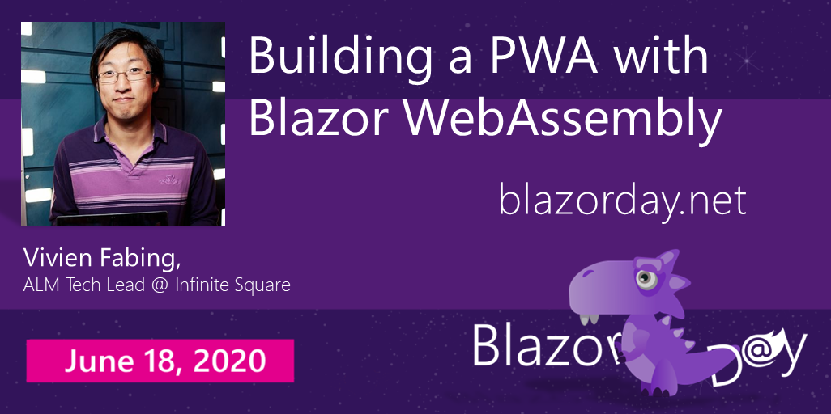

Slide 2


Slide 3
Objectives
Overview of (my point of view of) PWA
Overview of PWA with Blazor
Key points to get started (installable, offline)
Pitfalls and points worth of attention

Slide 4


Slide 5


Slide 6
+
?

Slide 7
PWA
Angular Universal app
React service worker
Svelte.js / Sapper

Slide 8


Workbox

Slide 9

+
PWA

Slide 10
.NET Core SDK 3.1.300

Slide 11
Demo
Make it installable with manifest.json file
Add offline support using service-worker.js
Update your app…
Adding manually PWA support to a Blazor App

Slide 12
Start the app
byte-for-byte comparison of the service-worker.js
If new version v2 is detected
v1
Background installation
Downloading new assets + adding them to cache v2
Automatic activation on next launch*
*If all browser instances on your website were closed

Slide 13
Demo
Dispelling the magic
Adding a “simple” Update button
Service worker lifecyle

Slide 14
Ressources
Blazor & PWA:
https://docs.microsoft.com/en-us/aspnet/core/blazor/progressive-web-app
https://github.com/dotnet-presentations/blazor-workshop/blob/master/docs/09-progressive-web-app.md
Manifest:
https://developer.mozilla.org/en-US/docs/Web/Manifest
Service workers:
https://developers.google.com/web/fundamentals/primers/service-workers/lifecycle
https://developers.google.com/web/fundamentals/instant-and-offline/offline-cookbook

Slide 15
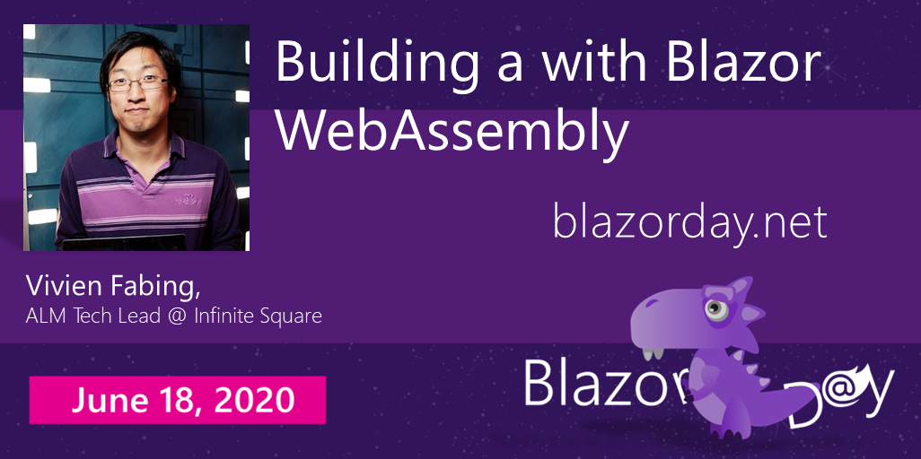


Thank you for attending
@vivien-fabing
@vivienfabing
blogs.infinitesquare.com/users/vfabing
www.vivienfabing.com

