Slide 1
Chris, Chloe & Vincent
Mostly air power - COP26 friendly team

Slide 2
What is Apache Airflow?
Open source platform to programmatically orchestrate workflows
Workflows as code

Slide 3

What’s the point?
What are its benefits?
Extensibility
Reliability
Scalable
Guaranteed SLA’s

Slide 4
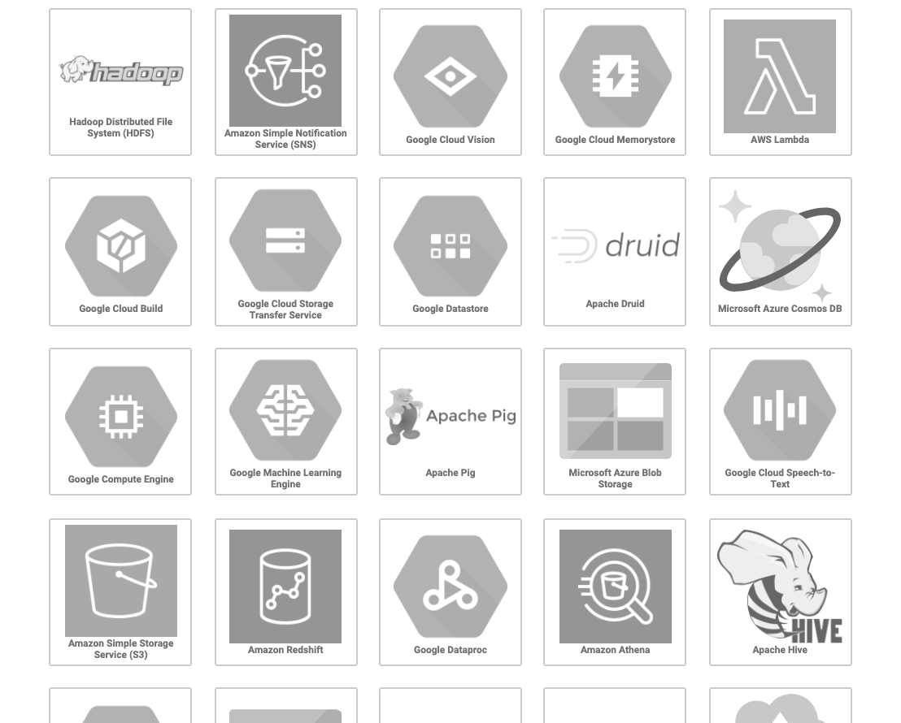
Integrations?
Many plugins

Slide 5

Concepts?
Dags/Pipelines ➡️ Operators ➡️ Executors
Core concepts:
Directed Acyclic Graph or DAG for Tasks
Operators packaging functionality
Administration or Configuration
Executors

Slide 6
What do we need to solve?
Exchange rates and currency look ups to a database
What would be the best way to populate the latest world currencies:
Download
Exchange Rates
Transform Data
Save to DB

Slide 7
DEMO

