Slide 1

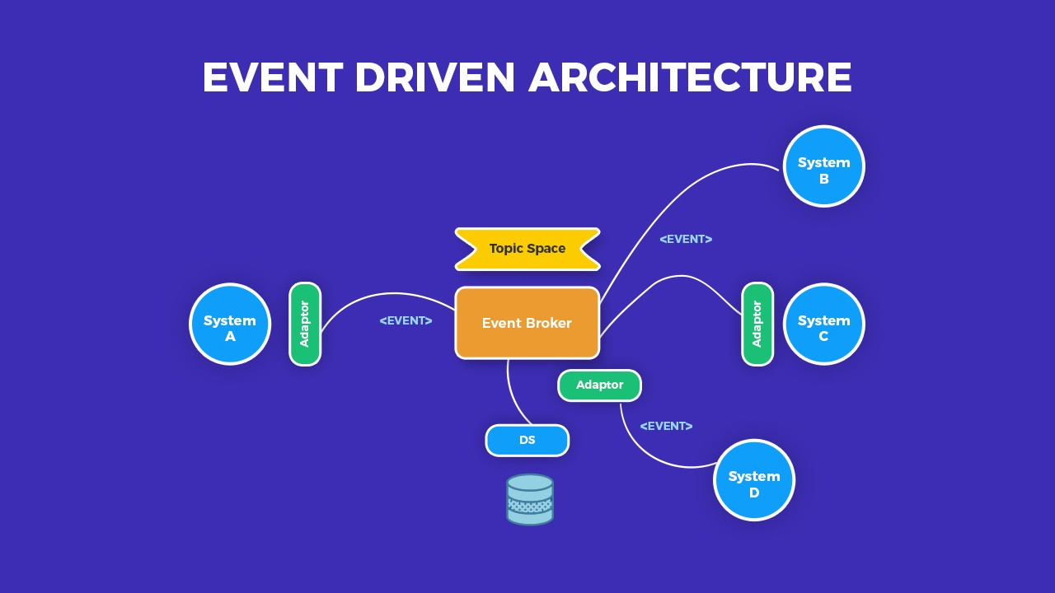
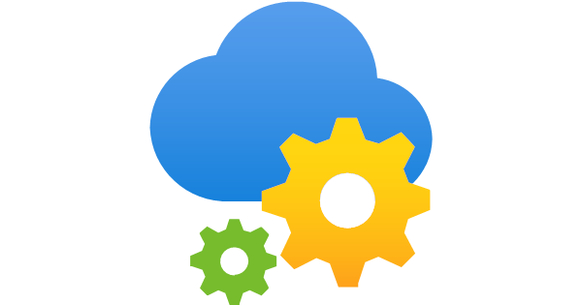
Spike on Implementing Event Driven Solutions
An Event-driven Architecture uses events to trigger and communicate between decoupled services and is common in modern applications built with microservices

Slide 2
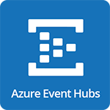
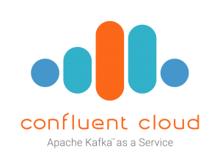
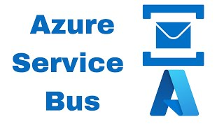

What needed to be understood?
ℹ️ For information
Azure Event Hub
Kafka and marketplace tools
Azure Service Bus
Masstransit.io
Notes:
Why Masstransit relevant in most of this?
Quick summary of what was good and what was bad about it
Why Kafka became an important topic?
Why Azure Event Hub is better and worse?
Difference between Streaming and Messaging?
Messaging Queues: Messages remain in the queue until they are consumed or until they expire based on some policy.
Streaming: Data in streaming platforms is often persisted for a specified period, allowing consumers to replay the data if required.

Slide 3
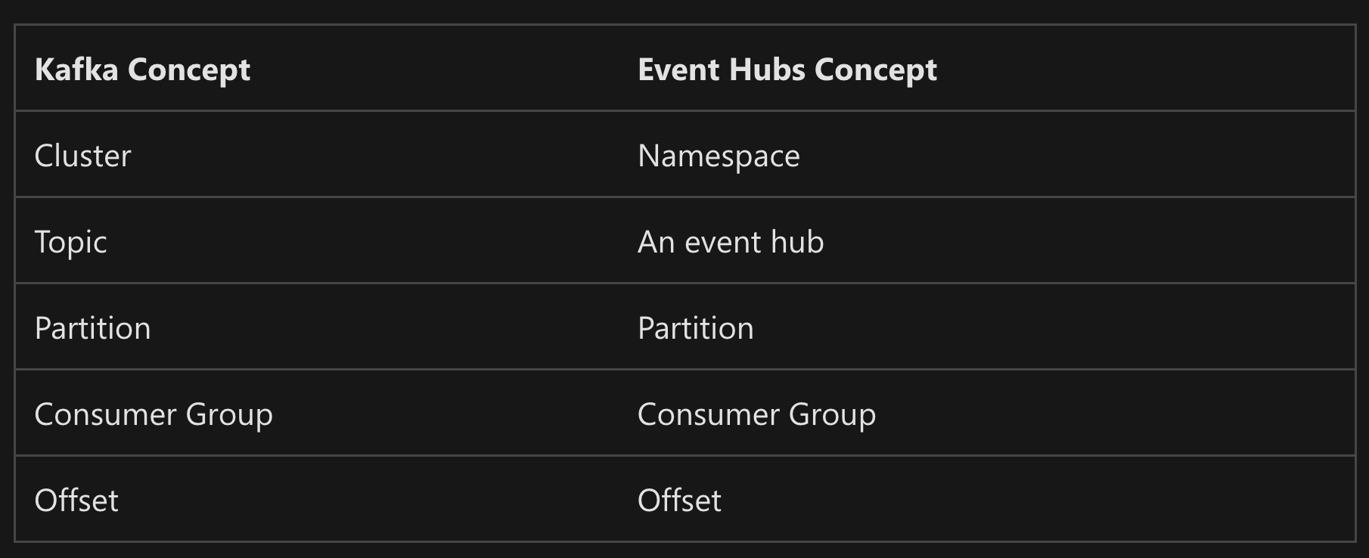
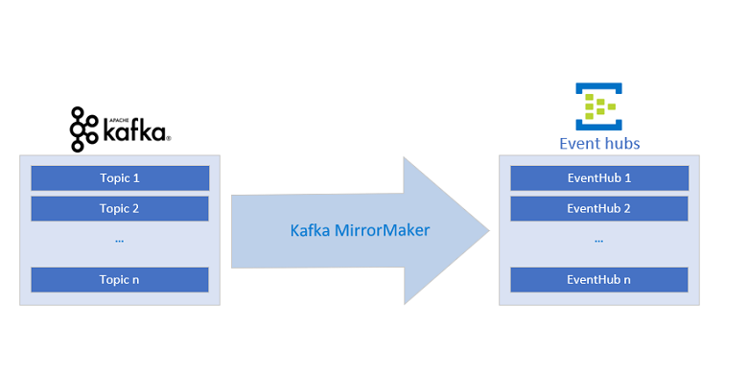
Kafka vs Event Hub
ℹ️ For information

Slide 4

Demo …

Slide 5
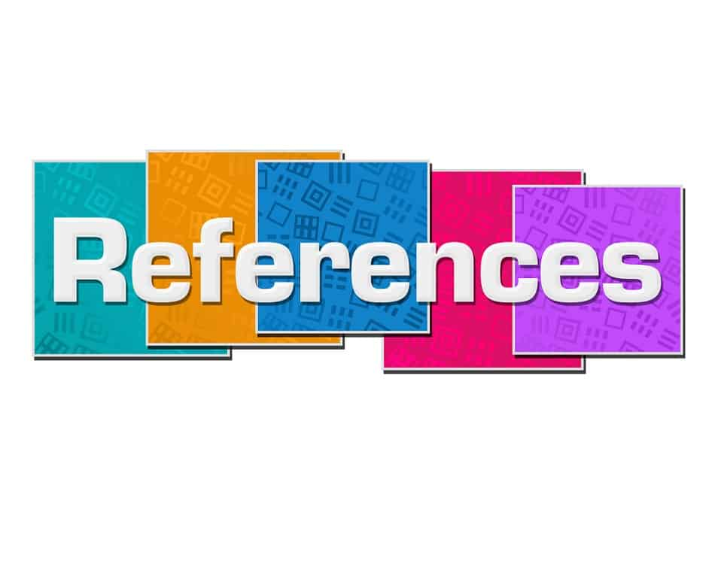
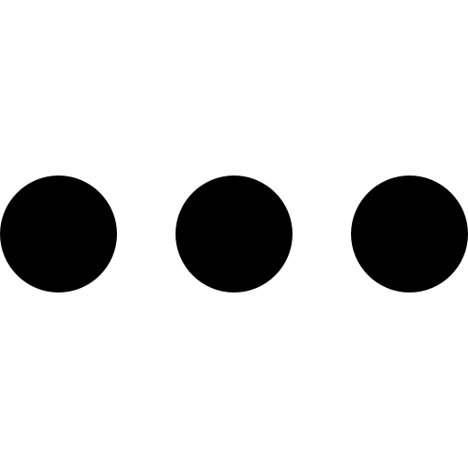
Learnings
Event-Driven Architectures Done Right, Apache Kafka
Azure Event Hub, Event Grid, and Service Bus - Made Simple
Event-Driven Architecture: Explained in 7 Minutes!
How to Build the Data Mesh Foundation: A Principled Approach
The Many Meanings of Event-Driven Architecture
Apache Kafka quick start

