Slide 1


Elasticsearch
Miriam, Chloe & Vincent
The elastiteam
Firebreak week, Oct 2021

Slide 2
What is Elasticsearch?
An open-source analytics and search engine, which stores data in a way which makes text-searches super fast

Slide 3
What’s the point?
What are its benefits?
Fast text searches
High availability
Scalable
Can interact via REST APIs
No schema needed
…
Why not just query a database?

Slide 4
How does it work?
Data ➡️ normalized & enriched ➡️ indexed
Two concepts:
The inverted index
Sharding

Slide 5
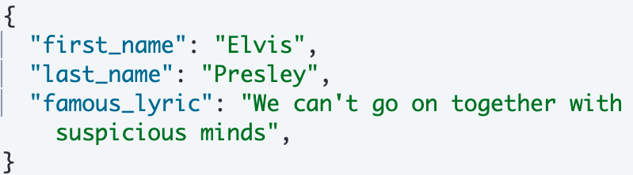
The inverted index
A piece of information (e.g. a record of a contact) is called a document.
Documents are grouped together into an index.

Slide 6
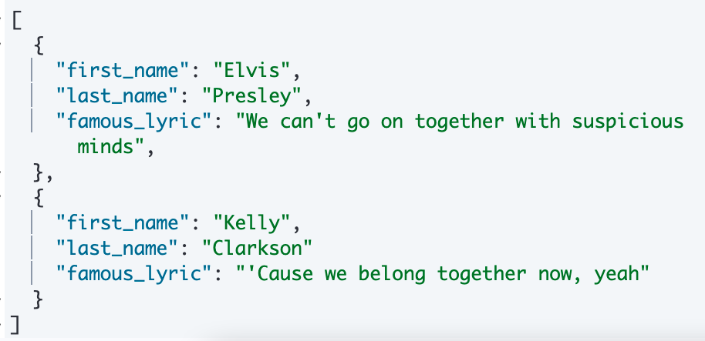
The inverted index
An inverted index consists of all of the unique terms that appear in any document covered by the index.

Slide 7
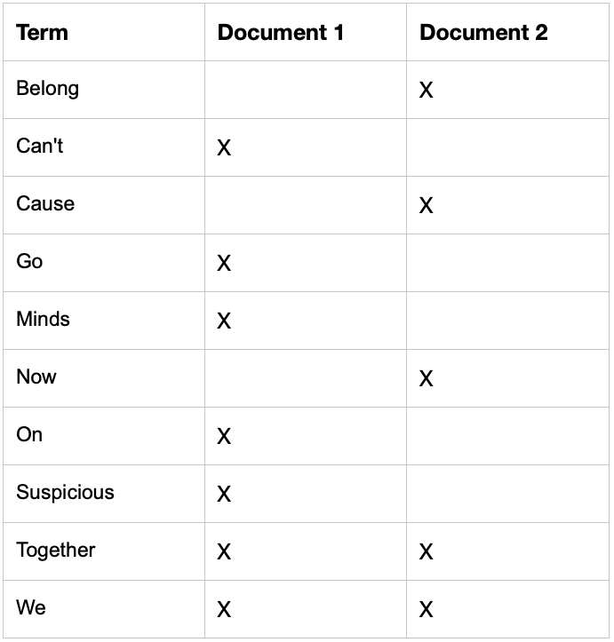
The inverted index

Slide 8
Sharding
Documents are grouped by type (e.g. musicians), these groups are called indices.
Elasticsearch will splits that index over multiple ‘nodes’ (servers) within a cluster (collection of servers).

Slide 9
Why split the index up?
Imagine you had a list of 100 names, and you need to find someone in that list.
What would be faster:
One person looking through the whole list to find the person?
Those 100 names being split up into 10 lists, with 10 people searching a list each?

Slide 10
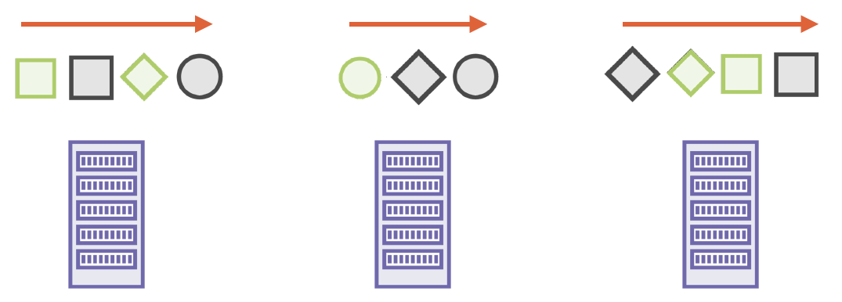

Slide 11
DEMO

