Slide 2

How it started
Relational database where designed to store data as structured schemas or tables
Only viable solution until the 2000’s
Web 2.0 boom started storing lots of unstructured data which could not map to table like structures
Data like key-value stores, documents, text, graphs, and wide columns formed the NoSQL databases

Slide 3
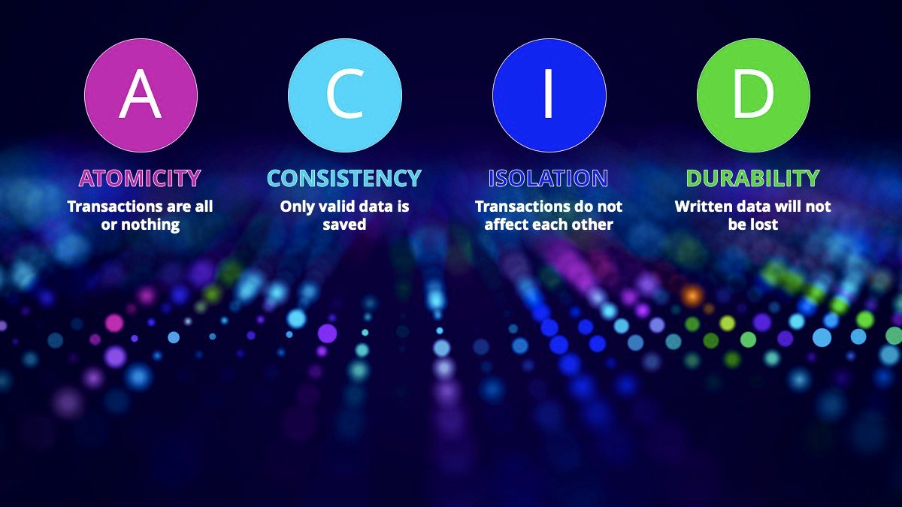
The architecture of SQL
These properties focus on the consistency and reliability of a transaction in a database

Slide 4
The architecture of NoSQL

Slide 5

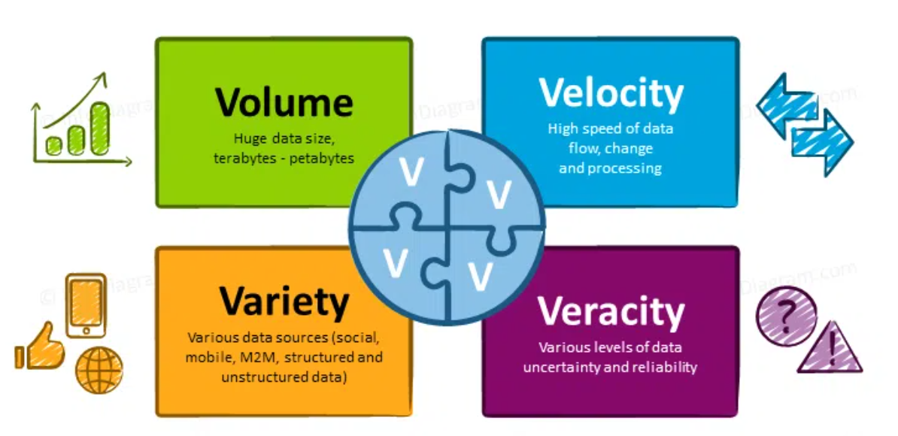

What’s does this mean?
Relational databases safeguard reliability of transactions
MongoDB ensures high availability of data

Slide 6
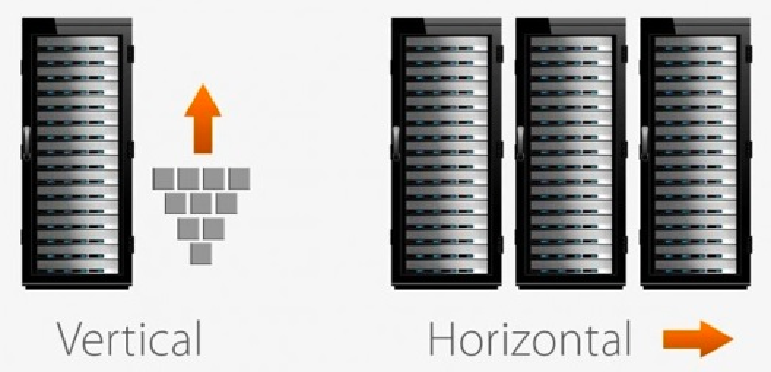
Scalability
SQL, in general, can only be scaled vertically by increasing memory, disk of the server
NoSQL support horizontal scaling or sharding

Slide 7
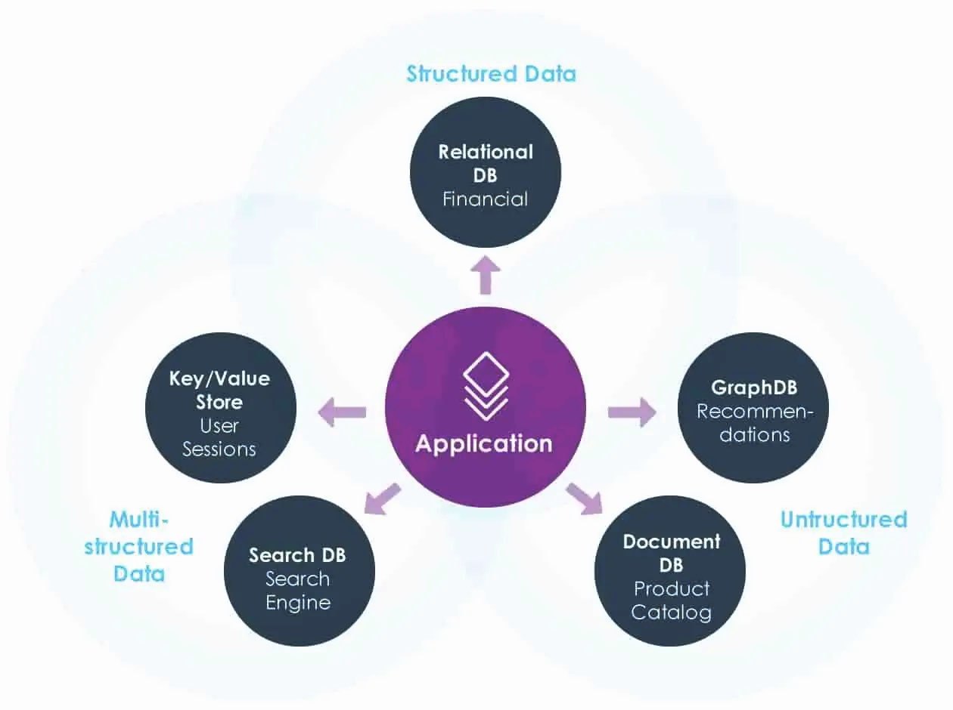
Schema
SQL has a predefined schema where data should comply
NoSQL can support different types of documents without any problem

Slide 8
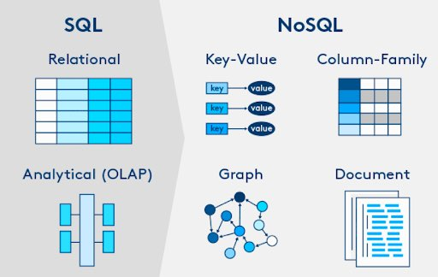
Querying and Analytics
SQL using ANSI SQL
NoSQL can support document querying but joins are limited, can be inefficient but can be compensated with connectors

Slide 9
What is the typical frontend stack?

Slide 10
DEMO

