Slide 1
Projeto 4 – Data Visualization
Beer production in the United States

Slide 2
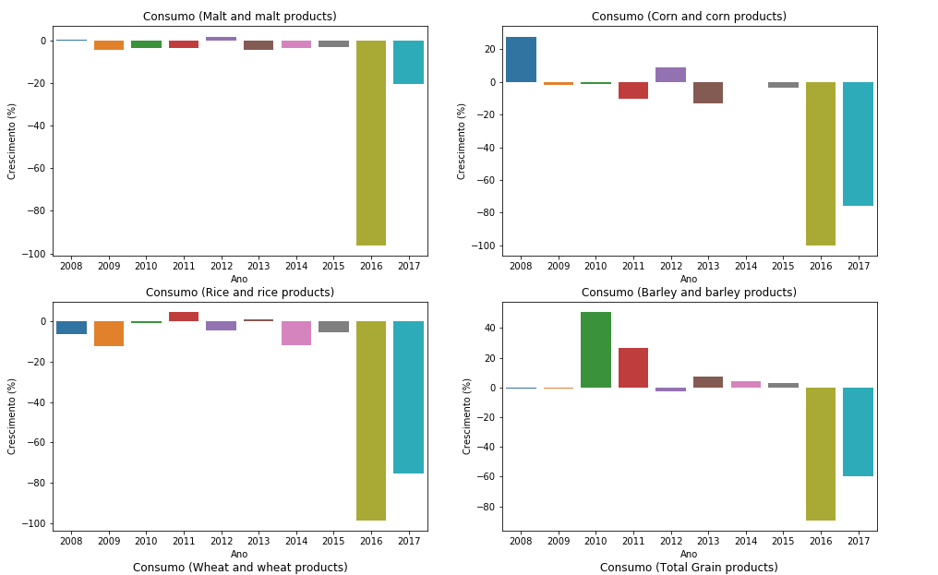
Raw material consumptions

Slide 3
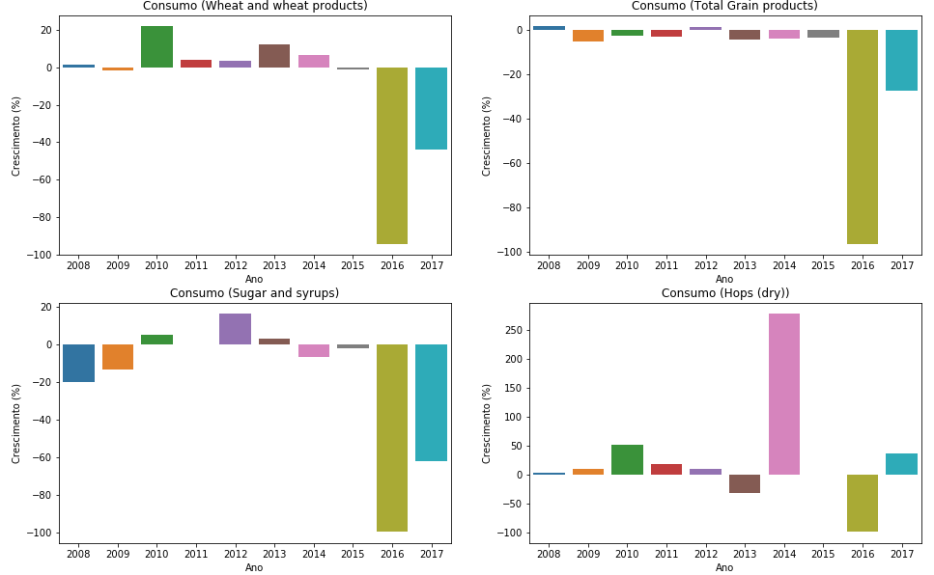
Raw material consumptions

Slide 4
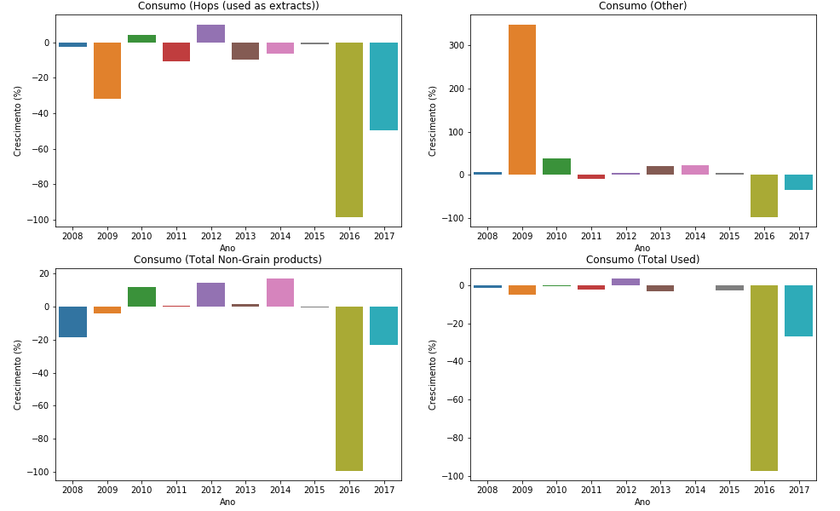
Raw material consumptions

Slide 5
Tableau: Production per state
https://public.tableau.com/profile/victor.farneze.de.camargo#!/vizhome/BeerProductionUnitedStates/Dashboard1?publish=yes
Tableau: Production per state over decade
https://public.tableau.com/profile/victor.farneze.de.camargo#!/vizhome/BeerProductionUnitedStatesoverdecade/Dash-DecadeProduction?publish=yes

Slide 6
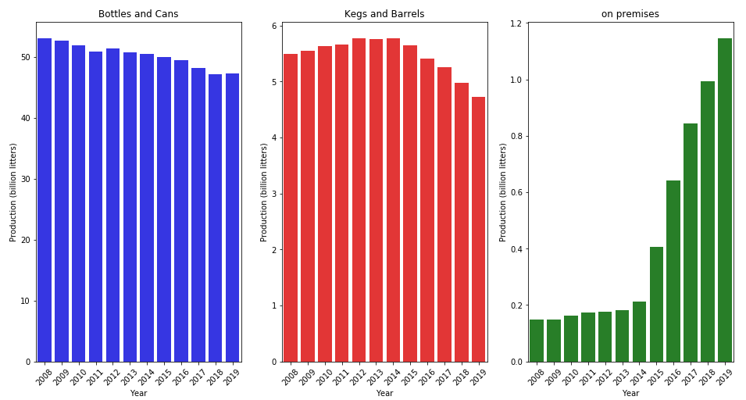
US beer production over the years

Slide 7
Final conclusions
Craft brewery/micro brewery production had a significant rise on past 5 years.
Brewing companies are producing more for consumption in bars, restaurants and pubs, while their production of cans, bottles and kegs are steadily decreasing.
New types of beer are coming to fashion.
Beer production is still on the rise but it is being diversified.

