Slide 1
CSE 803: Meal Recognition Project
Presentation by: Vince Fasburg, Josh Thomas, Bonnie Reiff

Slide 2
Overview
Problem
Methods
Foreground Detection
Color
Texture
Shape
Classification
Results

Slide 3
Problem

Slide 4
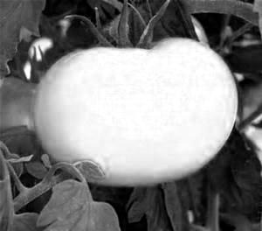
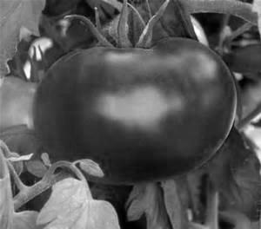
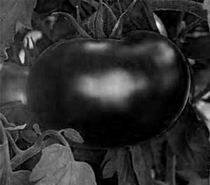
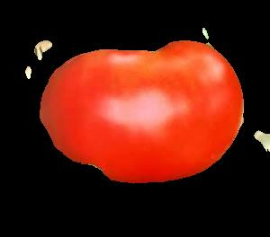
Methods: Foreground Detection
Use R, B, or G as gray image based on largest σ
Create intensity histogram H, and smooth
Threshold based on lowest trough in H
Region with larger μ_{rr} + μ_{cc} is background

Slide 5
Methods: Color
6 bit histogram from 2 MSBs of R, G, and B
Value of all 64 bins in feature vector
Alternative Method:
Histogram binned by I values from HSI image
Each pixel adds value (H * S) to histogram
Less weight to colors that are close to black or gray

Slide 6
Methods: Texture

Slide 7
Methods: Shape

Slide 8
Methods: Classification
Training
Find N-dimensional mean of each class
Testing
K-Means Clustering
Dist scaled by std dev of each dimension
Dist scaled to normalize dimension ranges
Manually tuned weights by feature
More weight to more important features

Slide 9
Results

Slide 10
Conclusions

Slide 11

Questions?

