Slide 1
CSE 803: Meal Recognition Project
Presentation by: Vince Fasburg, Bonnie Reiff, and Josh Thomas
December 7, 2015

Slide 2
Overview
Problem
Methods
Foreground Detection
Color
Texture
Shape
Classification
Image Database
Results
Discussion and Conclusions

Slide 3
Problem
Develop a software system to automatically recognize typical meals from images.
Salad
Pasta
Hotdog
French Fry
Burger
Apple
Banana
Broccoli
Pizza
Egg
Tomato
Rice
Strawberry
Cookie
Notes:
Three highlighted tasks:
Manual collection and labeling for the image databases (training and validation)
Identification and implementation of differentiating feature detection
Design and implementation of a classification system
Resulting system: (after training) outputs a class label (from the 14 on the slide) given an unlabeled input test image

Slide 4
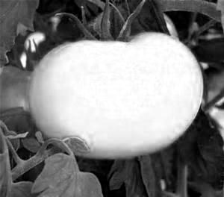
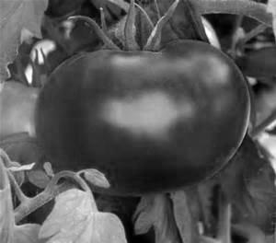
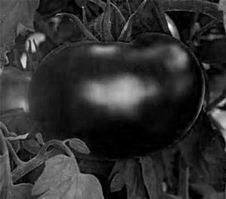
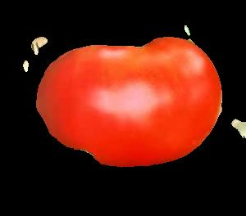
Methods: Foreground Detection
Use R, B, or G as gray image based on largest σ
Create intensity histogram H, and smooth
Threshold based on lowest trough in H
Region with larger μ_{rr} + μ_{cc} is background

Slide 5
Methods: Color
6 bit histogram from 2 MSBs of R, G, and B
Value of all 64 bins in feature vector
Alternative Method:
Histogram binned by I values from HSI image
Each pixel adds value (H * S) to histogram
Less weight to colors that are close to black or gray

Slide 6
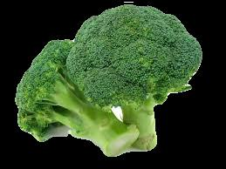
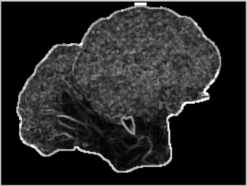
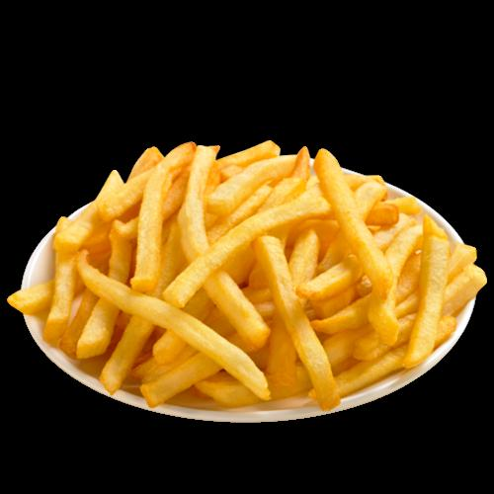
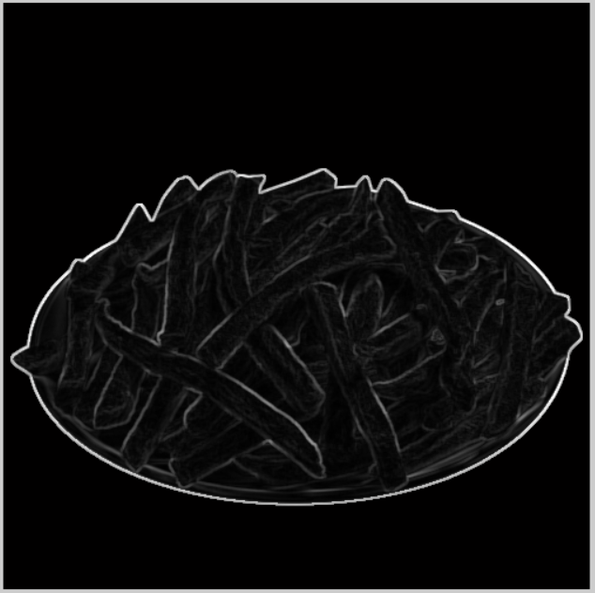

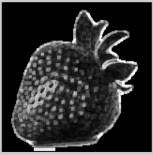
Methods: Texture
Input:
Foregrounded image
Foreground mask
Output:
Intensity per pixel in the food region of the image after application of Matlab’s range filter
Notes:
rangefilt function: each output cell contains the range value (maximum value – minimum value) of the 3x3 neighborhood around the corresponding pixel in the input image
(filter applied to a grayscale version of the foregrounded image)
Value returned for the broccoli image = 1721079 / 25095 = 68.5825
Value returned for the fries image = 2352384 / 1010810 = 23.2725
Value returned for the strawberry image = 952773 / 12306 = 77.4235
Note: this feature is affected by the illumination of the image (as seen in the strawberry picture)

Slide 7
Methods: Texture
Alternative Method: Law’s Texture Energy Measures
Produces 9 energy map features corresponding to the application of filters
Intensity per pixel in the food image region used as summarizing statistic for each map
Analyzed interclass and intraclass variation for all 9 features and selected the top 3
Experimental Result: insignificant difference from the original method
Notes:
Filters applied to the image are formed by convolving combinations of level, edge, spot, and ripple detector 1-dimensional vectors
Goal of the variation analysis: high interclass variation (high standard deviations of means) and low intraclass variation (low mean of standard deviations) for a feature among all classes
Previously explained method is more efficient and was thus chosen because Laws did not provide any advantage

Slide 8
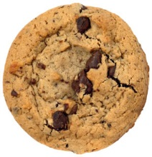

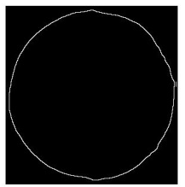
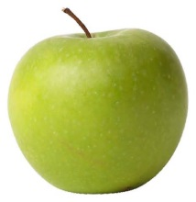

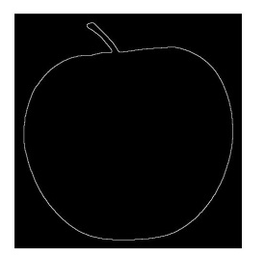
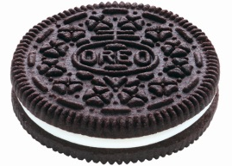
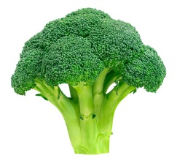

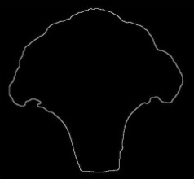
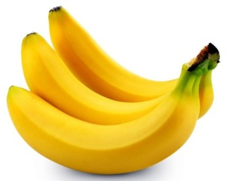
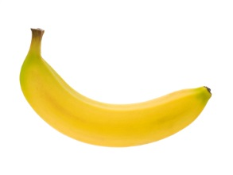

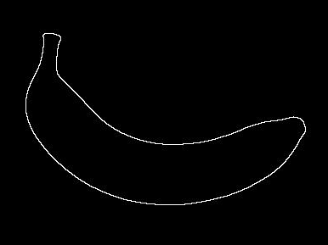
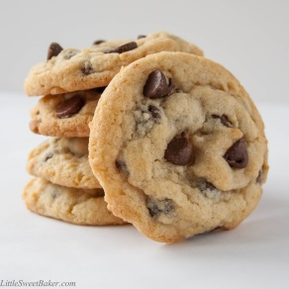
Methods: Shape
Circularity
Circularity
Border from erosion
Good for single objects
Sensitive to angle
89.7
17.7
6.4
Cookie on Angle
2.4
Multiple Objects

Slide 9


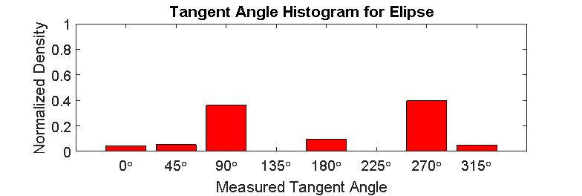
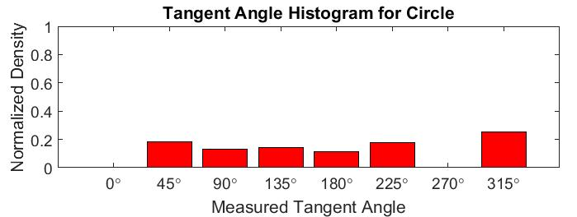
Methods: Shape
Alternative Method:
Tangent Angle Histograms
Made some classifications worse
Could be due to foreground/background segmentation

Slide 10
Methods: Classification
Training
Find N-dimensional mean of each class
Testing
K-Means Clustering
Dist scaled by std dev of each dimension
Dist scaled to normalize dimension ranges
Manually tuned weights by feature
More weight to more important features

Slide 11
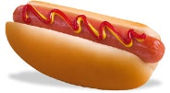
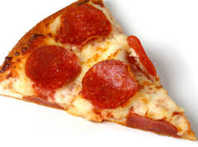
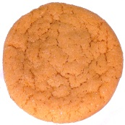


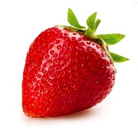
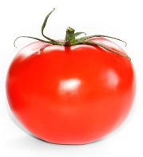
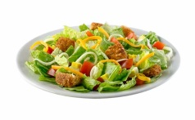
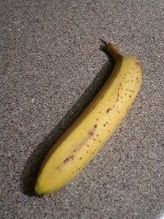
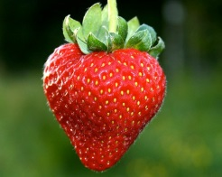
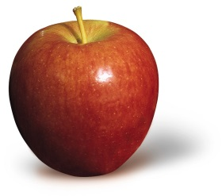
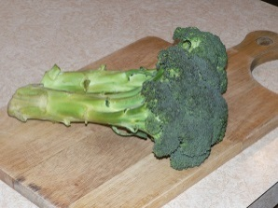
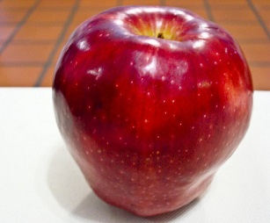
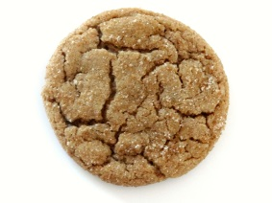
Image Database
Images from Google Image search and ImageNet
Training Images – Simple backgrounds to ensure features of objects were captured well
297 total training images
Testing Images – More complicated backgrounds, shadows, multiple objects, etc
82 total testing images
train_applegreen_4
train_pizza_7
train_banana_19

Slide 12
Results
Class | Accepted | Rejected | Average
apple | 40.91 | 83.68 | 62.30
banana | 30.77 | 87.66 | 59.21
burger | 36.36 | 83.26 | 59.81
frenchfry | 33.33 | 83.54 | 58.44
pizza | 60.87 | 81.93 | 71.40
pasta | - | - | -
hotdog | 31.25 | 86.12 | 58.69
strawberry | 60.00 | 88.38 | 74.19
tomato | 41.67 | 85.94 | 63.81
egg | 41.67 | 84.34 | 63.00
salad | 36.36 | 73.22 | 54.79
cookie | - | - | -
rice | 45.45 | 85.36 | 65.41
broccoli | 69.23 | 86.81 | 78.02
Total | 43.99 | 84.19 | 64.09

Slide 13
Limitations and Improvements
Performance of feature calculations limited by foreground calculations
Potential to improve the classification system:
Decision tree-like structure instead of using means and standard deviations of image classes from training
Addition of a reject class for images determined to not belong to any of the recognized classes
Notes:
Bullet #1: this is specifically in reference to the limited performance of the shape classifier based on the detected foreground

Slide 14
Conclusions
Interactions of various parts of the system need to be tested in addition to testing the parts themselves
Importance of the quality of the training and validation system
Teaching a computer what we understand from visual input is hard!
Notes:
Bullet #1: this refers to the fact that we found that a feature may do a good job classifying the images, but when combined with the other features may actually be detrimental to the performance of the system
Bullet #2: while implementing the feature calculations is important, the system also needs quality images in the database and needs a good structure for the classification system (spent more time than expected on how to combine the results of the features into a system that can actually recognize the food images)

Slide 15

Questions?

