Slide 1
CSE 803: Meal Recognition Project
Presentation by: Vince Fasburg, Josh Thomas, Bonnie Reiff

Slide 2
Overview
Problem
Methods
Foreground Detection
Color
Texture
Shape
Classification
Results

Slide 3
Problem

Slide 4
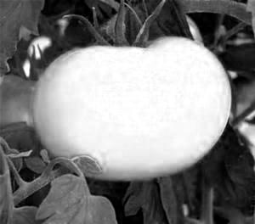
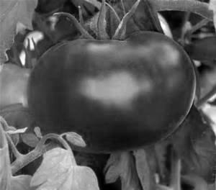
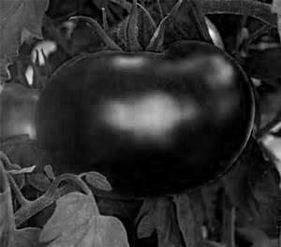
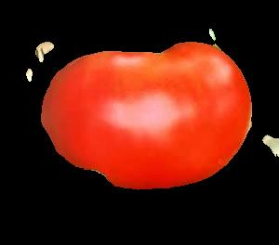
Methods: Foreground Detection
Use R, B, or G as gray image based on largest σ
Create intensity histogram H, and smooth
Threshold based on lowest trough in H
Region with larger μ_{rr} + μ_{cc} is background

Slide 5
Methods: Color

Slide 6
Methods: Texture

Slide 7
Methods: Shape

Slide 8
Methods: Classification

Slide 9
Results

Slide 10
Conclusions

Slide 11

Questions?

