Slide 1
CAPTCHA-Enabled HID Driver for Prevention of USB Keyboard and Mouse emulation
Presentation by: Vince Fasburg, Bonnie Reiff, and Josh Thomas

Slide 2
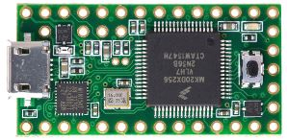
Overview
USB devices have become the standard for connecting devices, such as keyboard and mice, to computers. The security and protection of the computers that they are being connect to is a concern.
Attack Scenario:
An attacker disguises a small microcontroller (the Teensy) as a flash drive and leaves it in a public space to wait for someone to plug it into their computer.

Slide 3
Overview
Focus on the emulation of Human Interface Devices (HIDs), specifically a keyboard and mouse on a Linux OS.
Two phases of the project:
Create a suite of attacks on a Linux OS with the Teensy microcontroller which emulate a keyboard and mouse.
Prevent the attacks by making a modification to the USB-HID driver which disables key features of the device, then locks and grabs focus and displays a captcha GUI for verification.

Slide 4
Motivation
What are the existing defenses against HID emulation attacks?
What is the extent of attacks that can be performed using HID emulation?
Can a driver be designed for USB mice and keyboards to defend against HID emulation attacks?
How effective will the driver be in defending against the HID emulation attacks?
How will users react to the USB device verification?

Slide 5
Related work

Slide 6
Threat model

Slide 7
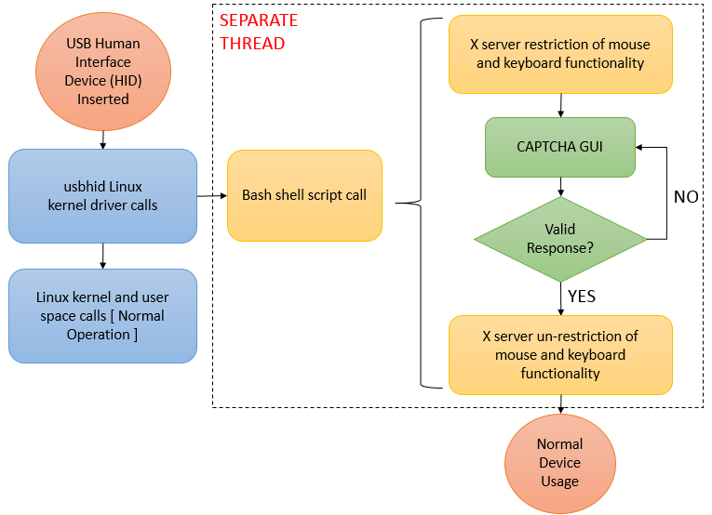
design

Slide 8
Teensy attacks

Slide 9
kernel

Slide 10
Bash script

Slide 11
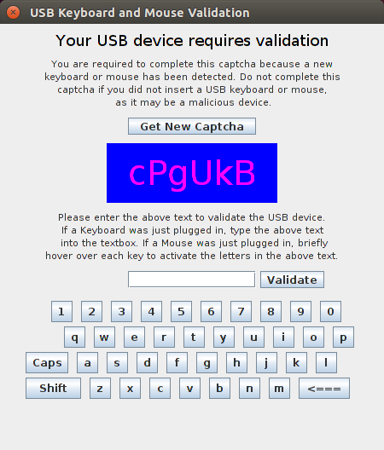
Captcha gui

Slide 12
Experimental results

Slide 13
Usability testing

Slide 14
Technical weaknesses

Slide 15
Future work

Slide 16
Questions?

Slide 17
Presentation Breakdown
Team Member | Presentation Sections
Vince Fasburg | Threat Model, Teensy Attacks, Bash Script, Demo Video
Bonnie Reiff | Design, Kernel, Technical Weaknesses, Future Work
Josh Thomas | Overview, Motivation, Related Work, Captcha GUI, Usability Testing

