Slide 1
Location Privacy Protection for Smartphone Users
Paper by: Kassem Fawaz and Kang G. Shin
Presentation by: Vince Fasburg, Bonnie Reiff, Josh Thomas
Notes:
Paper presented at the 2014 ACM SIGSAC Conference on Computer and Communications Security
(SIGSAC = Special Interest Group on Security, Audit, and Control)

Slide 2
Motivation
Research indicated users are concerned with location data collected by smartphone apps
Threat Model: the adversary…
Only accesses the user’s location via available application APIs
Will not attempt to hack or modify privacy controls on the operating system
Collected location data by malicious application poses the following privacy threats:
Real-time location tracking of user
User identification through frequently visited locations
User profiling even without identification
Notes:
78% of 180 survey respondents believe mobile phone location data collection can pose a privacy threat. 85 – 87% care who views their loc. info.
APIs that use the Android “Location” object. The standard mechanism for using location in Android apps
“Available application APIs” refers to the Android Location object, which is the only way most apps can view loc.
Carrier can use cell towers, these are not included.

Slide 3
Summary and Limitations of Prior Art
Practical Approaches
MockDroid: Allows complete disabling collection of location data
Koi & Cache: Require apps to use their APIs
Micinski: Coarsens all location data without regard to threat level or functionality
PlaceMask: Allows users to provide false location data. Can make apps unusable
Theoretical Approaches
All sited research focuses on protection against tracking threat only
Shown that profiling & identification may be possible even with “anonymized” location data only (cell tower based location)
Requires connection to anonymity server to provide anonymized location data
Requires many other users in the same location at the same time
Notes:
Anonymized data meant cell tower ping based only. 95% of actions could be linked to a specific individual in the anonymous database
Apps fall on continuum between poor usability and poor security.
Unrealistic assumptions cause many proposed solutions to be unworkable in real life.

Slide 4
Proposed Approach (1 of 2)
Design Principles: A Location Privacy Protection Tool should…
Allow access to user location only when the user expects location to be used
Allow access to user location no more granularity than is required for the location-based functionality
Prevent an anonymous app from identifying the user based on frequently visited locations
Prevent an app from profiling the user with collected location data
Prevent an app tracking the user continuously even when tracking is required for the functionality
Fit well into the existing mobile ecosystem
Function with minimal cost in usability and app functionality
Notes:
“Allow” principles relate to apps overreaching their location authority
“Prevent” principles relate to the 3 location privacy threats from before
Last 2 principles are practical concerns to ensure such a tool would be practical and likely to become widely used.

Slide 5
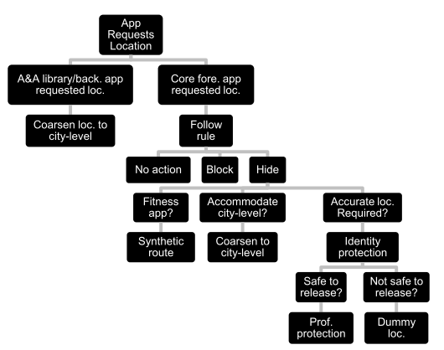
Proposed Approach (2 of 2)
Location Privacy Guardian (LP-Guardian) app uses rules to determine what location data is provided to individual apps
Notes:
A&A = Advertising & analytics
A & A or app running in background is automatically given only city-level location info.
Rule for foreground apps is selected by user.
“Follow rule” has 3 further options.
When accurate location is needed, LP-Guardian decides if info is safe to release (more in Bonnie’s slides)

Slide 6
Advantages over Prior Art
Protection from all 3 types of threats, and most types of app
Avoids various unrealistic assumptions
Require trusted infrastructure
Requires apps to conform to specific location API
Require other users at the same time and in the same place as user
Minimal interference with functionality
Allows most apps to provide full or only slightly reduced functionality
Applies different privacy rules to different apps
Balances need for functionality and privacy
Less than 10% energy overhead
Notes:
In most cases, LP-Guardian can achieve a good balance between functionality and security.

Slide 7
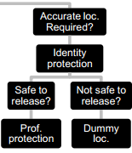



Technical Details: Design (1 of 2)
Identification Protection
Assumption is that there is a one-to-one mapping between a foreground application session and a visited location
Identification can be achieved via an anonymous histogram of city blocks visited given a database of background information
LP-Guardian releases the location as long as the histogram is reasonably close to that of another individual’s in the city
p_{min} ensures the user is indistinguishable from a theoretical set of users with a minimum probability of visiting the places in the user’s histogram
p_{min} can be tuned using census data
Can be a general value or set on a per-application basis
Notes:
Design details relate back to the diagram from the Proposed Approach slide of the presentation (slide 4)
Mention details that were discussed = the left half/automatic city-coarsened level of the diagram:
Background location access coarsened to city level → the rest of the information applies to foreground and persistent (perceptible applications) location access
Reasoning: analysis showed that only 3% of applications access the user’s location while running in the background
A&A library requests can be identified (shown via stack trace) and are sent city-coarsened information
Threat Model: the adversary has access to a mapping between a set of individuals and the probability distributions of visiting each block in the city → aims to match the anonymous mobility histogram to an individual in the database
Identification Protection Formula = Probability that the histogram belongs to a given individual (multinomial distribution)
N = # of user application sessions
Bl = set of city blocks in the 2D grid of the city = {bl₁, bl₂, …, }
c_{bli} = the number of times that bl_{i} is visited by the user out of the total N sessions
p_{i} = P(bl_{i}) = the probability of the user visiting block bl_{i}
“Reasonably close” estimation notes: *if the inequality is satisfied, a dummy location is released*
Assume that epsilon = 0.5
Between the two equations, y is replaced with p_{min} (min. probability) of visiting a block because LP-Guardian (client side) does not know other user’s histograms
Note: low p_{min} = strict privacy, high p_{min} = more relaxed privacy
If LP-Guardian determines that the same privacy level can be determined with a higher value of p_{min} , value will be relaxed (relies on census data that specifies the population for every city block)

Slide 8
Technical Details: Design
Technical Details: Design (2 of 2)
Profiling Protection: each time the user opens a location-polling application from a new place, he must decide whether to hide the location
Location anonymization makes the reported address indistinguishable from the actual location within a given radius by adding noise from a polar Laplacian distribution
Same anonymized location is always mapped to the same real location
Additional suggestion to use TOR application to anonymize IP address
Synthetic Route: for fitness tracking applications, LP-Guardian modifies the route information while retaining speed/distance information
Notes:
Noise value for LP-Guardian is 200m range

Slide 9
Technical Details: Design
Technical Details: Design (2 of 2)
Profiling Protection: each time the user opens a location-polling application from a new place, he must decide whether to hide the location
Given a user’s location (x, y) and anonymization radius r, noise pair (rad, θ) is computed as:
θ is drawn from the uniform distribution [0, 2π)
p is drawn from the uniform distribution [0, 1] and rad =
Same anonymized location is always mapped to the same real location
Additional suggestion to use TOR application to anonymize IP address
Synthetic Route: for fitness tracking applications, LP-Guardian modifies the route information while retaining speed/distance information
Notes:
Note: this slide only to be shown if more information on the polar Laplacian distribution is requested
Polar noise symbol explanation:
W₋₁ is the -1 branch of the Lambert W function and l is a privacy level (typically close to 1)
Noise value for LP-Guardian is 200m range

Slide 10
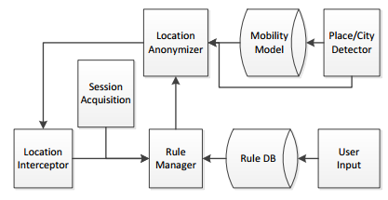
Technical Details: Architecture
Location Interceptor: diverts the application flow to LP-Guardian upon location access (blocks the app.) and returns the anonymized location
Rule Manager: rules are selected by user and cached for subsequent use
Global rules determine whether the location is safe to release
Per-place rules determine the coarseness of the released location
Place/City Detector: determines whether the location has been previously visited and maintains the “Mobility Model”
Location Anonymizer: uses the location sample, the application state, and the Rule Manager to create an anonymized location for the Interceptor
Notes:
Rule Manager:
Input: the application, the state of the application (foreground or background), the location sample, whether the application session is new or an ongoing session, and the place/city/block
Global rules: one per application (applies to foreground and background states)
Per-place rules: one per application-location combination
Place/City Detector:
Place = a cluster of locations within a radius of 100m and over a minimum duration of 5 minutes
Mobility Model = set of places the user has visited along with total visiting time of each place

Slide 11
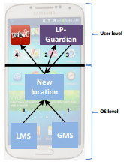
Technical Details: General Implementation
Implemented for Android 4.3 (Jelly Bean)
Applications requesting location access limited to Location API’s (i.e. no location from scanning nearby WiFi access points)
LP-Guardian modifies the location object before it reaches the application requesting the location
Modified Android Location class to contain a static context field that is populated whenever a context is created for the application
Treats the requesting application as a black box
LP-Guardian runs ever 750ms to reduce processing costs
Notes:
Diagram: LMS = Location Management Services, GMS = Google Play Services?
Alternative approach to implementation: modify each application’s location accessing interface
Disadvantages to this approach:
Requires repackaging the application, which changes its signature → may prevent updates and access to content that checks the signature
Users would need to download the applications from a different App Store
Continued “maintenance” required to keep up with the all released applications
Static context field addition allows:
Access to information about which application is requesting the location
Ability to communicate with the Operating System and other processes
Note of OS for smartphones: Android, Windows Phone, and Blackberry all use the permission model for applications versus. iOS which uses explicit user authentication for each access

Slide 12
Technical Details: User Interaction Specifics
Initial Application Use (bootstrapping)
User mobility data: the user ranks his or her top N visited locations with first LP-Guardian use so the application can assign probabilities of visitation
Anonymization rules set when a new application attempt to access a location
User can choose to hide his or her location or to allow the location to be passed to the application unmodified
Per-place Control Decisions (profiling protection)
Three options presented to user when LP-Guardian recognizes a new location: allow the location for only that session, allow the location permanently, or block the location
Per-session Control Decisions
Push notifications inform the user of anonymization within an application and allow disabling/re-enabling of the feature
Notes:
Introduction to the slides: Three instances of LP-Guardian use that require user interaction…
When a user chooses to hide his or her location, two options:
City-level coarsening
Note: p_{min} for identification protection defaults to 0.0005 = 30 minutes at a certain location each day for 40 days
Placement of prompts for controlling resource access obey the four main rules/objectives:
Safety – user prompt precedes every resource access
Frugality – user prompt is only displayed in the event of a resource access
Visibility – user prompt displayed only if the application in the foreground is attempting to access a resource
Non-repetitiveness – prompt never displayed when a more critical resource of the same type has been authorized (implied authorization)

Slide 13
Experimental Results
User Study
Delay Overhead
Battery Performance
Loss in App Functionality
Tracking

Slide 14
User Study
Started with study to determine users perceptions of location privacy
180 smartphone users surveyed…
78% believe apps accessing their location can pose a privacy threat
85% actually care who accesses their location information
52% have no problem with giving apps imprecise location information to protect privacy
18% object to giving apps imprecise location information
Notes:
Looking to see if there is a market for an app like LP-Guardian
70 from social network announcements, 110 from Amazon Mechanical Turk

Slide 15
USER study
User Study: Can the user accommodate reduced functionality from home or work for 6 types of apps?
Geo-search (Yelp):
Social Networking: Do they share location at or near home/work?
Notes:
82% indicate no problem sharing city level location for social networking

Slide 16
USER study
Messaging (WhatsApp): Do they share location at or near home/work?
Sports/Fitness:
Notes:
78% indicate no problem sharing city level location for messaging.

Slide 17
USER study
Gaming: Will the game experience change with location anonymization?
Weather: Over half indicated weather information would not change at city level
Notes:
Conclusion is that users generally won’t mind some loss in app location functionality at home/work

Slide 18
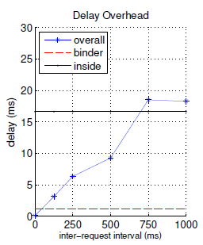
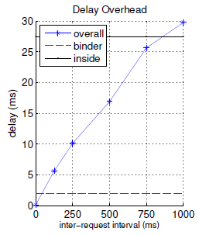
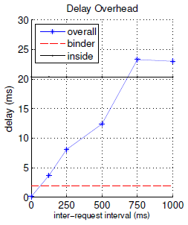
Delay Overhead
Delay Overhead
Delay between time the location is created and the time the modified location is delivered to the app.
Galaxy Nexus
Galaxy S3
Galaxy S4
Notes:
Looked at 40 location accessing apps and took average
Inside: anonymization delay for worst-case scenario
LP-Guardian temporarily caches location, the delay value increases with the increase of the inter-request interval.
Conclusion: LP-Guardian imposes a maximum delay of 30ms every 750ms which shouldn’t impact the app usability.

Slide 19
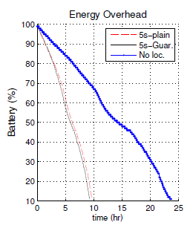
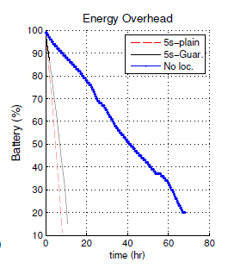
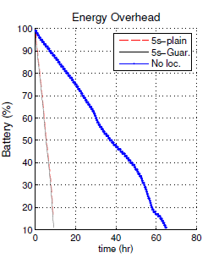
Battery Performance
Battery Performance
No significant drop in battery life with use of LP-Guardian
Galaxy Nexus
Galaxy S3
Galaxy S4
Notes:
Looked at 40 location accessing apps and took average

Slide 20
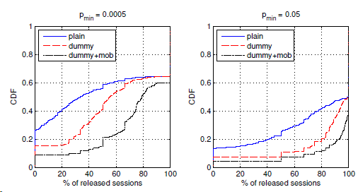
loss in app functionality
Relaxed privacy constraint enables releasing more of the user’s location
Adding dummy locations increases the number of released sessions
User with more diverse mobility pattern are naturally more protected
Number of unreleased sessions with potential loss in functionality is low
Most of the unreleased sessions are for home and work
Distribution of released sessions
Notes:
p_{min} of 0.05 is more relaxed
Cumulative Distribution Function: report the percentage of sessions in which app functionality is negatively affected
More than 60% of the sessions are released for more than 60% of the users in the more privacy-constraint scenario of p_{min} = 0.0005
Dummy: Adding dummy locations

Slide 21
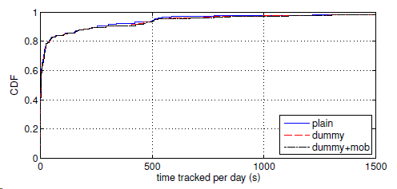
Evaluate Tracking Threat
All background location access is blocked, so we are only concerned with foreground location access
Look at time per day when an app receives accurate location updates
90% of apps have tracked time per day < 500sec/day (8 minutes)
Distribution of time tracked per day
Notes:
Tracking is not a big issue for normal apps. LP-Guardian handles special case such as fitness apps where location is accessed constantly and creates and artificial path.

Slide 22
Technical Weaknesses of Paper
Synthetic routes, used for fitness related apps, could potentially create an unrealistic path such as through buildings, water, steep elevation changes, etc.
Some apps also track elevation changes which would not be accurate with synthetic routes
Navigational apps are not handled by the current version of LP-Guardian.
City-Level Location would work for an app such as weather, but would be limited if used by a location specific search app where a user might be looking for the closest gas station, restaurant, store, etc. to their location.
Notes:
Synthetic routes: (S Health as an example)
Nav Apps: Offline navigation is a possibility (load map before leaving). However, this does not allow for real-time traffic updates.

Slide 23
Potential Future Work
Deploy LP-Guardian to more diverse participants with limited technical background for 6 months
Identify parts of the app where the privacy vs. usability balance can be improved
Make a similar app for iOS devices
Navigation Apps – Allow app to collect accurate location data, but prevent it from transmitting the data

Slide 24
Questions?

Slide 25
Presentation Breakdown
Team Member | Presentation Sections
Vince Fasburg | - Motivation - Summary and Limitations of Prior Art - Proposed Approach - Advantages of Proposed Approach over Prior Art
Bonnie Reiff | - Technical Details
Josh Thomas | - Experimental Results - Technical Weaknesses of the Paper - Potential Future Work

