Slide 1
CAPTCHA-Enabled HID Driver for Prevention of USB Keyboard and Mouse Emulation
Vince Fasburg, Bonnie Reiff, and Josh Thomas

Slide 2
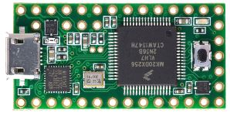
Overview
USB devices have become the standard for connecting devices, such as keyboard and mice, to computers. The security and protection of the computers that they are being connected to is a concern.
Attack Scenario
An attacker disguises a small microcontroller (the Teensy) as a flash drive and leaves it in a public space to wait for someone to plug it into their computer.

Slide 3
Overview
Focus on the emulation of Human Interface Devices (HIDs), specifically a keyboard and mouse on a Linux OS.
Two phases of the project:
Create a suite of attacks on a Linux OS using the Teensy microcontroller to emulate a keyboard and mouse.
Develop a defense against the attacks by making a modification to the usbhid driver that disables key features of the device, then locks and grabs system focus and displays a captcha GUI for validation that the device is human-controlled.

Slide 4
Motivation
What are the existing defenses against HID emulation attacks?
What is the extent of attacks that can be performed using HID emulation?
Can a driver be designed for USB mice and keyboards to defend against HID emulation attacks?
How effective will the driver be in defending against the HID emulation attacks?
How will users react to the USB device validation?

Slide 5
Related Work
S. Kamkar – “USBDriveby”
Using Teensy microcontroller to create a permanent connection to a remote server that is controller by the attacker.
K. Nohl and J. Lell – “BadUSB”
Describes how an emulated keyboard could steal the administrative password on a Linux OS.
Z. Wang and A. Stavrou
Proposes an extension to the USB driver.
Excludes “non-programmable devices” such as keyboards and mice.
A. Crenshaw – “Plug and Prey”
Use registry changes to prevent USB devices from being installed.
Will also prevent legitimate HIDs from being installed.
F. Barbhuiya
Authentication based on keystroke dynamics.
Would not work if attack is very short.
Notes:
1: Shows severity with which a system can be compromised.
2: Much less attention has been paid to authentication of USB HIDs
4: Speed of typing, relative times of presses and releases of the keys.

Slide 6
Threat model
Emulated HID with or without file storage
No combination HID+file storage systems known
Cannot emulate display
Attacker lacks physical or login access
Device plugged in by victim while logged in
Ubuntu 14.04 with standard tools
Notes:
Microcontrollers such as the Teensy are highly configurable, so display emulation or file storage may be possible.

Slide 7
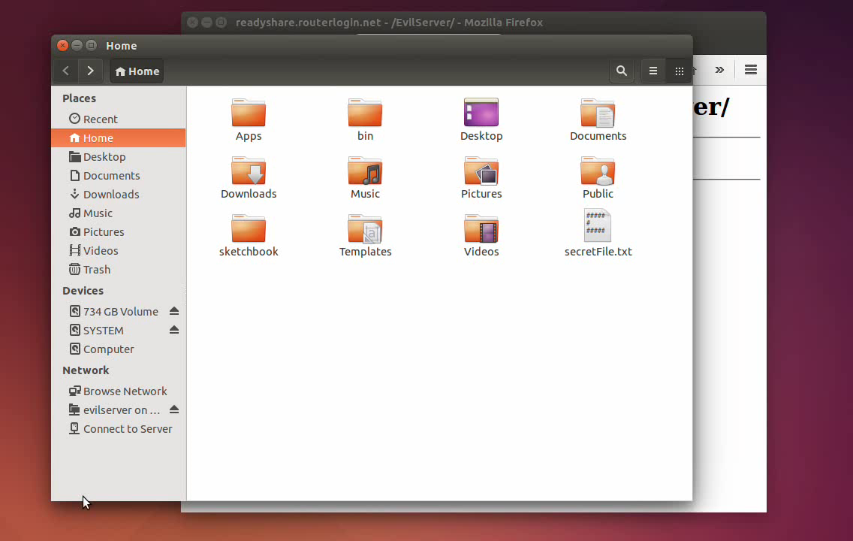
Teensy Attacks
What kinds of malicious actions can be performed with an emulated HID?
Steal secret files over an FTP server
Notes:
Set up a server in my house, can send files to it from anywhere

Slide 8
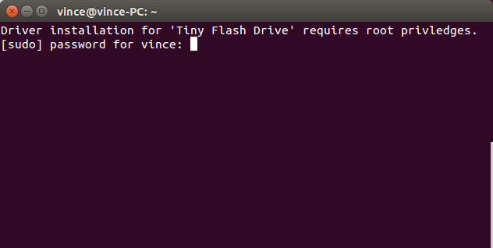
Teensy Attacks
What kinds of malicious actions can be performed with an emulated HID?
Steal Password
Notes:
The screen that shows up may fool people into thinking it is a system message, and type in password to download drivers.
A for loop is quickly written and cleared that waits for input and saves it to a file.
Now Teensy can do any command that requires root privledges (sudo can accept pw via pipe)

Slide 9
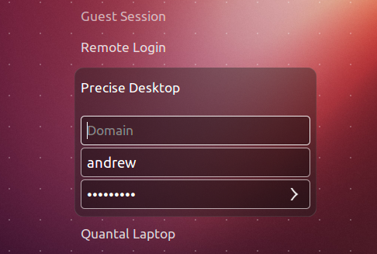
Teensy Attacks
What kinds of malicious actions can be performed with an emulated HID?
Add Fake User
Notes:
Run commands to disable the guest session and create a root user named “Guest Session”. Attacker can now login physically or remotely and do whatever he wants.

Slide 10
Teensy Attacks
What kinds of malicious actions can be performed with an emulated HID?
Delete Files
rm –rf *
Mouse Example
Open terminal without special keyboard keys
Notes:
Our captcha GUI works by disabling special keys, so this shows an example of why it is necessary to protect a mouse in addition to a keyboard.

Slide 11
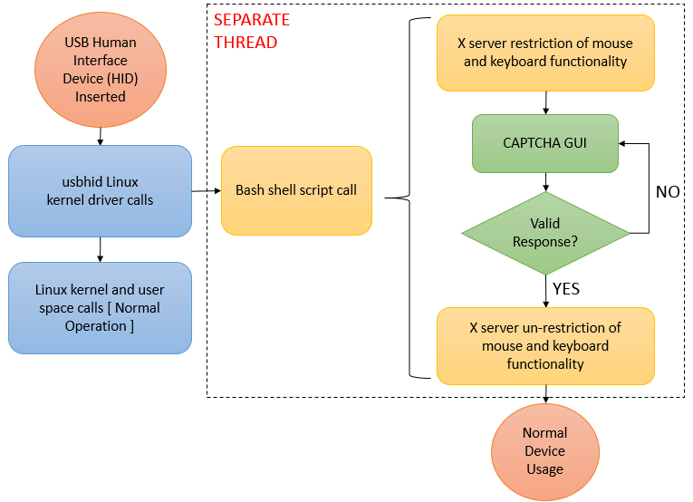
Design
= User Interactions
= System Actions
= Conditional
Notes:
Diagram Note: each color represents a different process
Design Notes:
SEPARATE THREAD: The system will not block on script execution due to the creation of a separate thread to run the shell commands
Restriction of keyboard and mouse functionality:
All mouse buttons are disabled
Only alphanumeric keys, the shift key, and the enter key allowed on the keyboard
CAPTCHA GUI
Causes the shell script process to block
Holds application focus and stays “on top” of other applications on screen

Slide 12
Kernel: Summary
Development OS: Ubuntu 14.04 LTS
Kernel Versions: 3.13.0-x
Source code for development from https://www.kernel.org
Source Version: 3.19.3
Driver modified: usbhid
Applies to all USB human interface devices
Notes:
Expanded Notes:
Kernel versions: 3.13.0-32 for initial development, 3.13.0-46 for final development and test (software update led to release patches)
Linux kernel source version 3.19.3 was the latest stable kernel version when development work began

Slide 13
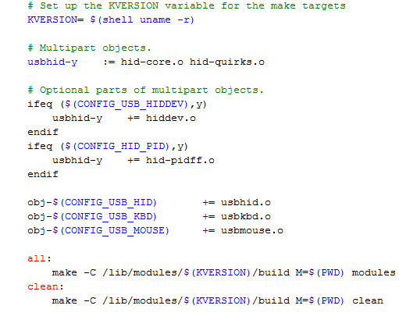
Kernel: Makefile Modification
Notes:
Red Boxes = new additions
Note: the Makefile also builds the usbkbd and usbmouse drivers – modification of these was outside the scope of the project but these drivers are important for the Future Work
Makefile target explanation:
KVERSION: the current kernel release
“-c”: the path to the kernel source
“M=<directory>”: provides the absolute path to the external module being built

Slide 14
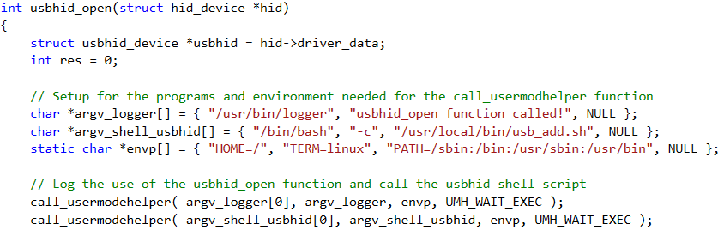
Kernel: Driver Modification
Generic function for all USB-HID devices found in hid-core.c
Environment parameters
Calls the Bash program to execute the shell script
Calls the system logger function
Notes:
Purpose of the calls to the user-space applications
Logger: verification that the function was running (output found in /var/log/syslog)
Bash program: control the USB-HID functionalities and execute the CAPTCHA program
call_usermodehelper function
Purpose: allows a user space application to be invoked from the kernel (prepares the process handle and executes the call)
Inputs:
The path to be the program to be executed
The null terminated list of program arguments, including the name of the program at the zeroth index
The null terminated list containing environment information
UMH_WAIT_EXEC to wait for the user space application to be invoked before continuing, UMH_WAIT_PROC to wait for the entire process (including the application running in user space) to complete, UMH_NO_WAIT to include no wait time

Slide 15
Bash Script
Restricts mouse and keyboard
Mouse clicking disabled
Only alphanumeric keys plus Shift and Enter
Calls captcha GUI
Contains mechanism to ensure that only one instance of the captcha GUI is running at any given time
Un-restricts devices when captcha is completed
Notes:
Keyboard and mouse restriction and un-restriction done via xmodmap utility (part of the overall X Window System / X Server)
Captcha must be completed to un-restrict devices because all other ways of exiting the program have been disabled

Slide 16
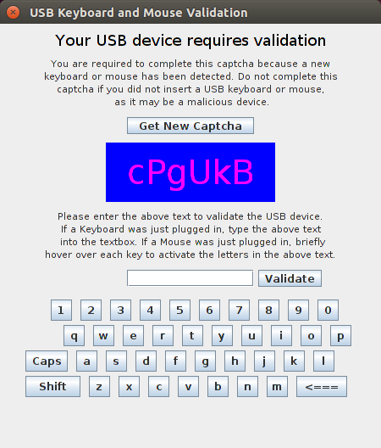
Captcha GUI
Created using Java Swing.
Captcha is non-web based to show proof of concept, future work would be to add this.
The GUI always stays on top of other windows and remains in focus.
The ‘X’ to close is disabled.
Two methods of validation:
Type directly in textbox - keyboard
Use hovering over keys on virtual keyboard - mouse

Slide 17
Usability Testing
Allowed external users to attempt to use the GUI while under observation.
Three main outcomes:
Users did not completely understand the idea behind hovering over the keys to validate the mouse.
Letters on the keys are too small / keys are too small.
Length of the directions was too long. Some did not read all the way through.

Slide 18
Experimental Results
USB Flash Drive
Purpose: ensure that driver modification only applies to human interface devices
Results:
Full functionality of built-in keyboard and mouse maintained
No appearance of the captcha GUI
USB Mouse and USB Keyboard
Purpose: verify the captcha program runs for expected human interface devices
Results: Keyboard and mouse functionalities restricted while the captcha program is active and restored after validation

Slide 19
Experimental Results (cont’d)
Teensy set to emulate USB-HID(s) with attack loaded
Purpose: test the effectiveness of the CAPTCHA-enabled driver in defending against HID emulation attacks
Results:
Mouse-based attack:
Unable to open terminal window and execute commands before the captcha GUI loads
Keyboard-based attacks:
Teensy has the ability to open a terminal window before the captcha GUI loads
Attacks unsuccessful in executing malicious commands
Notes:
Extra details of the test: Teensy set to emulate a keyboard, mouse, and joystick (all USB-HIDs)
Limitations of testing: no testing done for keyboard-based attack on the % of time that the terminal is spawned or the # of keystrokes entered into the terminal
Results inconsistent due to variables such as hardware performance, CPU usage, and delay/optimization of Teensy attack code

Slide 20
Technical Weaknesses
Weaknesses revealed via testing:
Delay in initial Bash script execution after the HID is inserted into the system
Driver is ineffective when the HID is inserted while the computer is suspended or powered off
Captcha GUI may be completed using any connected keyboard or mouse
Solution is ineffective against microcontrollers embedded inside of true HIDs
Notes:
Extra Notes: suggested improvements/corrections to these technical weakness are proposed in the next slide
Consequences of using any connected keyboard or mouse:
Users may complete the captcha for an emulated HID if they fail to heed warning about completing the validation for malicious devices
(Out of Scope)
Example: embed Teensy microcontroller with an attack loaded into a real keyboard
Scenario: user plugs in the keyboard with the embedded Teensy and completes the captcha GUI
Consequences: Teensy can begin executing attack commands after the captcha is completed by the human user

Slide 21
Future Work
Captcha Improvements
Use more advanced captcha characteristics or a professionally developed version
Driver Modification Improvements
Port restriction of HID functionalities and execution of the captcha program to the driver code (remove Bash script call)
Programmatically ensure that the captcha is completed by the device that triggered it
Driver Installation
Configure the Bash shell script to work for each system user
Notes:
Extra Notes
Driver Modification Improvements: Overall idea = port all user-space calls to the C driver code (kernel mode)
Structures:
Array identified in the usbkbd file that represents keyboard mapping
#defines identified for the usbmouse file that represent mouse button mappings
Modifications: use the input_report_key to ensure that the value of the key or button is not passed when hit/clicked if restricted
For bullet #2: system log shows that the system differentiates between each peripheral that is connected
Driver Installation:
Install the script for ever user OR dynamically configure the script based on the current user
Issue to overcome: Guest Session

Slide 22

Questions?

Slide 23
Presentation Breakdown
Team Member | Presentation Sections
Vince Fasburg | Threat Model, Teensy Attacks, Bash Script, Demo Video
Bonnie Reiff | Design, Kernel, Experimental Results, Technical Weaknesses, Future Work
Josh Thomas | Overview, Motivation, Related Work, Captcha GUI, Usability Testing

