Slide 1
CAPTCHA-Enabled HID Driver for Prevention of USB Keyboard and Mouse Emulation
Vince Fasburg, Bonnie Reiff, and Josh Thomas

Slide 2
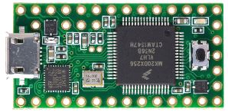
Overview
USB devices have become the standard for connecting devices, such as keyboard and mice, to computers. The security and protection of the computers that they are being connect to is a concern.
Attack Scenario
An attacker disguises a small microcontroller (the Teensy) as a flash drive and leaves it in a public space to wait for someone to plug it into their computer.

Slide 3
Overview
Focus on the emulation of Human Interface Devices (HIDs), specifically a keyboard and mouse on a Linux OS.
Two phases of the project:
Create a suite of attacks on a Linux OS with the Teensy microcontroller which emulate a keyboard and mouse.
Prevent the attacks by making a modification to the USB-HID driver which disables key features of the device, then locks and grabs focus and displays a captcha GUI for verification.

Slide 4
Motivation
What are the existing defenses against HID emulation attacks?
What is the extent of attacks that can be performed using HID emulation?
Can a driver be designed for USB mice and keyboards to defend against HID emulation attacks?
How effective will the driver be in defending against the HID emulation attacks?
How will users react to the USB device verification?

Slide 5
Related Work

Slide 6
Threat model
Emulated HID with or without file storage
No combination HID+file storage systems known
Cannot emulate display
Attacker lacks physical or login access
Device plugged in by victim while logged in
Ubuntu 14.04 with standard tools

Slide 7
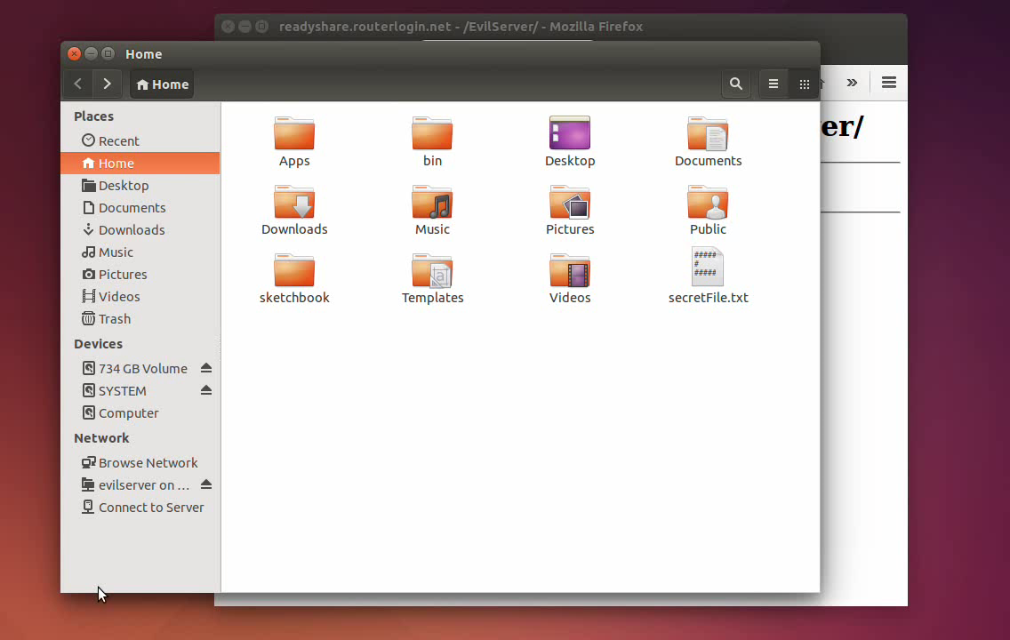
Teensy Attacks
What kinds of malicious actions can be performed with an emulated HID?
Steal secret files over an FTP server

Slide 8
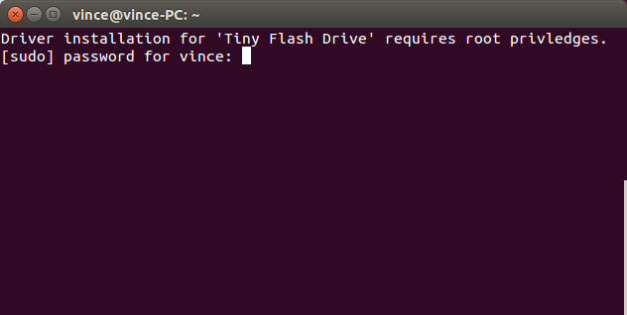
Teensy Attacks
What kinds of malicious actions can be performed with an emulated HID?
Steal Password

Slide 9
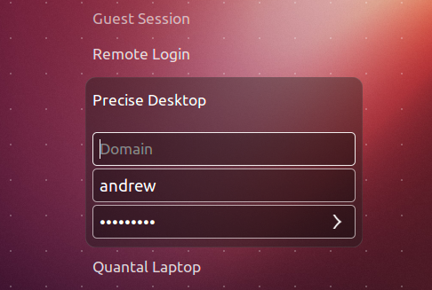
Teensy Attacks
What kinds of malicious actions can be performed with an emulated HID?
Steal Password

Slide 10
Teensy Attacks
What kinds of malicious actions can be performed with an emulated HID?
Delete Files
rm –rf *
Mouse Example
Open terminal without special keyboard keys

Slide 11
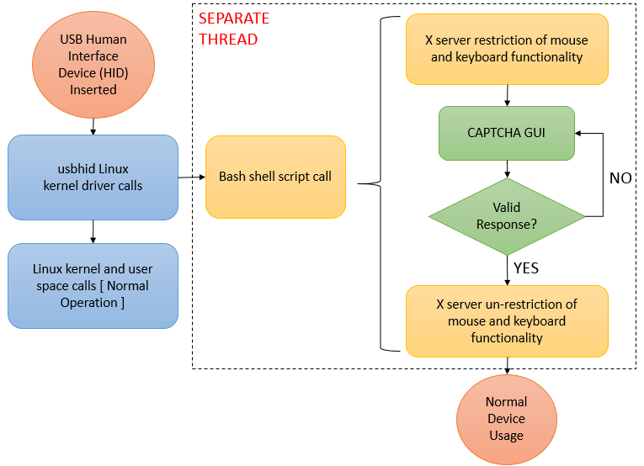
Design
= User Interactions
= System Actions
= Conditional
Notes:
Diagram Note: each color represents a different process
Design Notes:
The system will not block on script execution due to the creation of a separate thread to run the shell commands
Restriction of keyboard and mouse functionality:
All mouse buttons are disabled
Only alphanumeric keys, the shift key, and the enter key allowed on the keyboard
CAPTCHA GUI
Causes the shell script process to block
Holds application focus and stays “on top” of other applications on screen

Slide 12
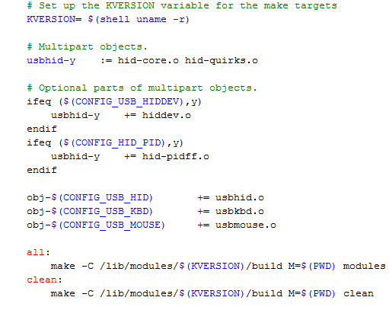
Kernel: Makefile Modification
Notes:
Red Boxes = new additions
Makefile target explanation:
KVERSION: the current kernel release
“-c”: the path to the kernel source
“M=<directory>”: provides the absolute path to the external module being built

Slide 13
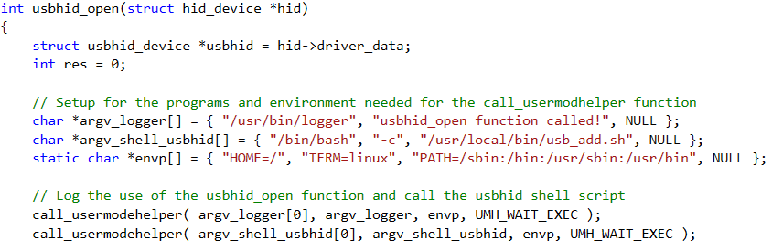
Kernel: Driver Modification
Generic function for all USB-HID devices found in hid-core.c
Calls the Bash program to execute the shell script
Calls the system logger function
Notes:
call_usermodehelper function
Purpose: allows a user space application to be invoked from the kernel (prepares the process handle and executes the call)
Inputs:
The path to be the program to be executed
The null terminated list of program arguments, including the name of the program at the zeroth index
The null terminated list containing environment information
UMH_WAIT_EXEC to wait for the user space application to be invoked before continuing, UMH_WAIT_PROC to wait for the entire process (including the application running in user space) to complete, UMH_NO_WAIT to include no wait time

Slide 14
Bash script
Called from usbhid kernel code
Restricts mouse and keyboard
No mouse clicks
Only alphanumeric keys plus Shift and Enter
Calls Captcha GUI
Un-restricts devices when Captcha is completed

Slide 15
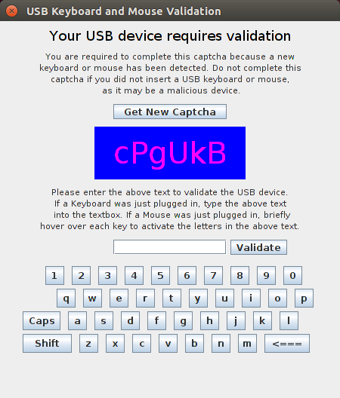
Captcha GUI
Created using Java Swing.
Captcha is non-web based to show proof of concept, future work would be to add this.
The GUI always stays on top of other windows and remains in focus.
The ‘X’ to close is disabled.
Two methods of validation:
Type directly in textbox - keyboard
Use virtual keyboard - mouse

Slide 16
Experimental results
Notes:
Mention that we didn’t do any testing on # of keystrokes entered or % of times teminal was spawned because there were too many variables for the measurements to be useful. Such as hardware performance, delay & optimization of Teensy code. Also it is an implementation specific problem.

Slide 17
Usability Testing
Allowed external users to attempt to use the GUI while under observation.
Three main outcomes:
Users did not completely understand the idea behind hovering over the keys to validate the mouse.
Letters on the keys are too small / keys are too small.
Length of the directions was too long. Some did not read all the way through.

Slide 18
Technical Weaknesses

Slide 19
Future Work

Slide 20

Questions?

Slide 21
Presentation Breakdown
Team Member | Presentation Sections
Vince Fasburg | Threat Model, Teensy Attacks, Bash Script, Demo Video
Bonnie Reiff | Design, Kernel, Experimental Results, Technical Weaknesses, Future Work
Josh Thomas | Overview, Motivation, Related Work, Captcha GUI, Usability Testing

