Slide 1
Location Privacy Protection for Smartphone Users
Paper by: Kassem Fawaz and Kang G. Shin
Presentation by: Vince Fasburg, Bonnie Reiff, Josh Thomas

Slide 2
Motivation
Research indicated users are concerned with location data collected by smartphone apps
Collected location data by malicious application poses the following privacy threats:
Real-time location tracking of user
User identification through frequently visited locations
User profiling even without identification
Threats indicate need for system to make following security improvements:
Only access location data when the user expects the app to do so
Only access location data with granularity necessary to perform intended function

Slide 3
Summary and Limitations of Prior Art
MockDroid
Allows user to disable apps using any location data
Very secure, but severely hinders functionality of many apps
Koi & Caché
These require other apps to use their APIs to provide secure location
Theoretical Approaches
All sited research focuses on protection against tracking threat only
Shown that profiling & identification may be possible even with “anonymized” location data only

Slide 4
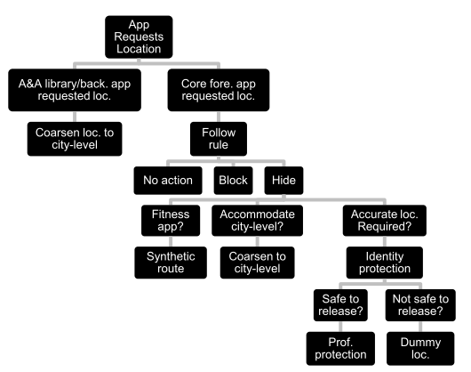
Proposed Approach (1 of 2)
Location Privacy Guardian (LP-Guardian) app uses rules to determine what location data is provided to individual apps
Notes:
A&A = Advertising & analytics
Rule for foreground apps is selected by user
Unclear how LP-guardian decides if info is safe to release???

Slide 5
Proposed Approach (2 of 2)
Design Principles: A Location Privacy Protection Tool should…
Allow access to user location only when the user expects location to be used
Allow access to user location no more granularity than is required for the location-based functionality
Prevent an anonymous app from identifying the user based on frequently visited locations
Prevent an app from profiling the user with collected location data
Prevent an app tracking the user continuously even when tracking is required for the functionality
Fit well into the existing mobile ecosystem
Function with minimal cost in usability and app functionality
Notes:
“Allow” principles relate to apps overreaching their location authority
“Prevent” principles relate to the 3 location privacy threats from before
Last 2 principles are practical concerns to ensure such a tool would be practical and likely to become widely used.

Slide 6
Advantages over Prior Art
Protection from all 3 types of threats, and most types of app
Avoids various unrealistic assumptions
Require trusted infrastructure
Requires apps to conform to specific location API
Require other users at the same time and in the same place as user
Minimal interference with functionality
Allows most apps to provide full or only slightly reduced functionality
Applies different privacy rules to different apps
Balances need for functionality and privacy
Less than 10% energy overhead

Slide 7
Technical Details

Slide 8
Experimental Results
Started with study to determine users perceptions of location privacy
180 smartphone users surveyed…
78% believe apps accessing their location can pose a privacy threat
85% actually care who accesses their location information
52% have no problem with giving apps imprecise location information to protect privacy
18% object to giving apps imprecise location information
Notes:
Looking to see if there is a market for an app like LP-Guardian
70 from social network announcements, 110 from amazon mechanical turk

Slide 9
Experimental Results
User Study: Can the user accommodate reduced functionality from home or work for 6 types of apps?
Geo-search (Yelp):
Social Networking: Do they share location at or near home/work?
Notes:
82% indicate no problem sharing city level location for social networking

Slide 10
Experimental Results
Messaging (WhatsAp): Do they share location at or near home/work?
Sports/Fitness:
Notes:
78% indicate no problem sharing city level location for messaging.

Slide 11
Experimental Results
Gaming: Will the game experience change with location anonymization
Weather: Over half indicated weather information would not change at city level
Notes:
Conclusion is that users generally won’t mind some loss in app location functionality at home/work

Slide 12
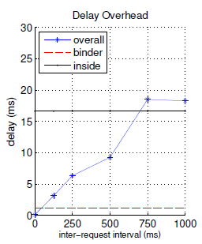
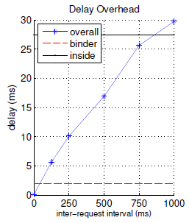
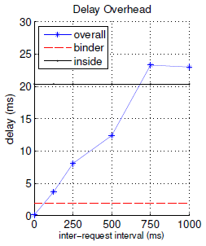
Experimental Results
Delay Overhead
Delay between time the location is created and the time the modified location is delivered to the app.
Galaxy Nexus
Galaxy S3
Galaxy S4
Notes:
Looked at 40 location accessing apps and took average
Inside: anonymization delay for worst-case scenario

Slide 13
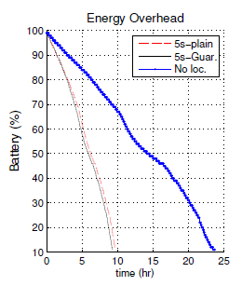
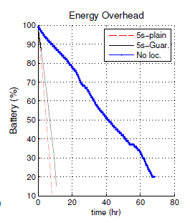
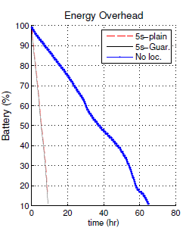
Experimental Results
Battery Performance
No significant drop in battery time with use of LP-Guardian
Galaxy Nexus
Galaxy S3
Galaxy S4
Notes:
Looked at 40 location accessing apps and took average

Slide 14
Experimental Results
Section 7.2??

Slide 15
Technical Weaknesses of Paper
Synthetic routes, used for fitness related apps, could potentially create an unrealistic path such as through buildings, water, steep elevation changes, etc.
Some apps also track elevation changes which would not be accurate with synthetic routes
Navigational apps are not handled by the current version of LP-Guardian.
City-Level Location would work for an app such as weather, but would be limited if used by a location specific search app where a user might be looking for the closest gas station, restaurant, store, etc to their location.
Notes:
Synthetic routes: (S Health as an example)
Nav Apps: Offline navigation is a possibility (load map before leaving). However, this does not allow for real-time traffic updates.

Slide 16
Potential Future Work
Deploy LP-Guardian to more diverse participants with limited technical background for 6 months
Identify parts of the app where the privacy vs. usability balance can be improved
Make a similar app for ios devices
Navigation Apps – Allow app to collect accurate location data, but prevent it from transmitting the data

