Slide 1
Location Privacy Protection for Smartphone Users
Paper by: Kassem Fawaz and Kang G. Shin
Presentation by: Vince Fasburg, Bonnie Reiff, Josh Thomas

Slide 2
Motivation
Research indicated users are concerned with location data collected by smartphone apps
Collected location data by malicious application poses the following privacy threats:
Real-time location tracking of user
User identification through frequently visited locations
User profiling even without identification
Threats indicate need for system to make following security improvements:
Only access location data when the user expects the app to do so
Only access location data with granularity necessary to perform intended function

Slide 3
Summary and Limitations of Prior Art
MockDroid
Allows user to disable apps using any location data
Very secure, but severely hinders functionality of many apps
Koi & Caché
These require other apps to use their APIs to provide secure location
Theoretical Approaches
All sited research focuses on protection against tracking threat only
Shown that profiling & identification may be possible even with “anonymized” location data only

Slide 4
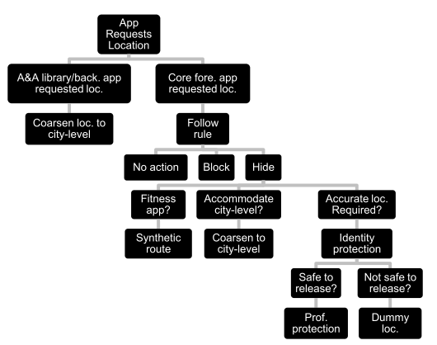
Proposed Approach
Location Privacy Guardian (LP-Guardian) app uses rules to determine what location data is provided to individual apps
Notes:
A&A = Advertising & analytics
Rule for foreground apps is selected by user
Unclear how LP-guardian decides if info is safe to release???

Slide 5
Advantages over Prior Art
Protection of all 3 threat types (tracking, identification, profiling)
Minimal interference with functionality

Slide 6
Technical Details

Slide 7
Experimental Results
Section 7.3 & motivation section @ beginning

Slide 8
Technical Weaknesses of Paper
Navigation Apps

Slide 9
Potential Future Work
Navigation Apps – Allow app to collect accurate location data, but prevent it from transmitting the data??

