Slide 1
Evolutionary Computation for Speech Enhancement
By: Vince Fasburg and Josh Thomas

Slide 2
Overview
Introduction
Background
Weiner Filter
Spectral Subtraction
Noise Gate
Evolutionary Strategy
Results
Conclusions

Slide 3
Introduction
Problem
Recover clean speech signal from audio corrupted by noise, such as road noise.
Approach
Combine several existing de-noising algorithms, using evolutionary strategies to tune parameters to recreate clean signal.

Slide 4
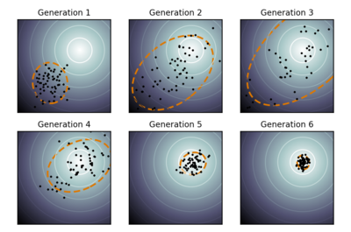
Background: CMA-ES
Real-valued parameters make up individuals
Random mutation from mean every gen
Mutation in direction of eigenvectors of covariance matrix
Notes:
Covariance matrix “learns” relationships between the variables.
Helps point mutation in the right n-dimensional direction, using these relationships.

Slide 5
Background: Spectral Subtraction
Basic Algorithm:
Subtract power spectrum of noise only from that of noisy signal X² = (Y² – N²)^{1/2}
Improvements:
Y values smoothed
Speech/Noise decision with hold times
Parameters: Noise Margin, Hang Over, Noise Smoothing Factor
Notes:
Version we’re using:
S.F. Boll (1979): "Suppression of acoustic noise in speech using spectral subtraction."IEEE Transactions on ASSP 27: 113–120
Needs piece of signal that is noise only
Noise Margin = threshold of difference between Y and N that will be considered noise
Hang Over = number of samples that will be considered noise once noise flag is set

Slide 6
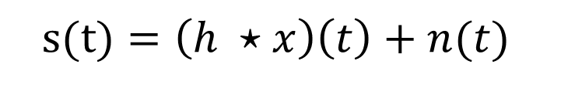
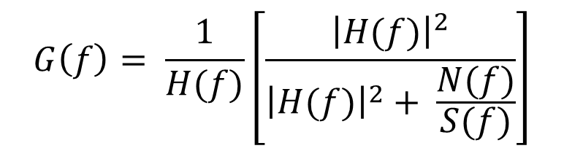
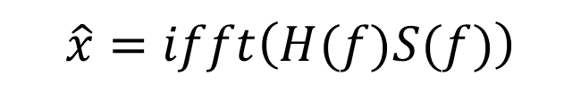
Background: Wiener Filter
Estimate SNR = S²/N, similarly to Spectral Sub
Use SNR to find best gains for FIR filter
Apply filter to eliminate noise
Parameters: SNR Smoothing Factor
$s(t)=\left(h ⋆x\right)\left(t\right)+n(t)$
$$G\left(f\right)= \frac{1}{H(f)}\left[\frac{{\left|H(f)\right|}^{2}}{{\left|H(f)\right|}^{2}+ \frac{N(f)}{S(f)}}\right]$$
$$\hat{x}=ifft\left(H(f)S(f)\right)$$
Notes:
Our Code adapted from Two-Step Noise Reduction version of WeinerNoiseReduction by Pascal Scalart (2009)
Y is power spectral density of noisy speech
N is power spectral density of noise-only portion of signal
H(f) is FFT of h(t). In this case h(t) ~= 1. For real system h(t) would have to do with acoustics of the car

Slide 7
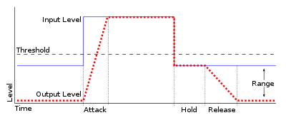
Background: Noise Gate
Parameters: Threshold, Attack, Release

Slide 8
Evolutionary Strategy
(μ, λ) CMA-ES with weighted recombination
μ = 6,12,24 parents, λ = 12,24,48 offspring
Each offspring contains 8 parameters
G_{w}
Wiener(α)
₊
Gate(T,A/R)
G_{s}
SpecSub(N,H,L)
Notes:
Weighted recombination = best individuals are given higher weight when computing the new distribution mean

Slide 9
Results

Slide 10
Conclusions

Slide 11
Questions?

