Slide 1

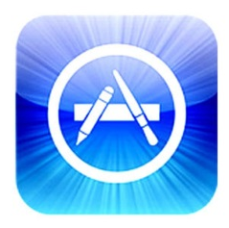

How to be a Successful App Developer: Lessons from the Simulation of an App Ecosystem
GECCO 2012
Paper by: Soo Ling Lim, Peter J. Bentley
Presentation by: Vince Fasburg and Josh Thomas

Slide 2
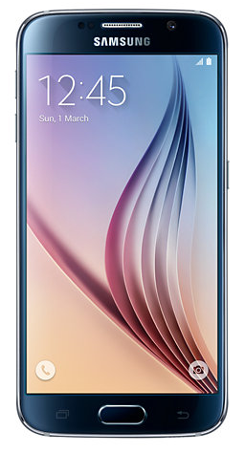
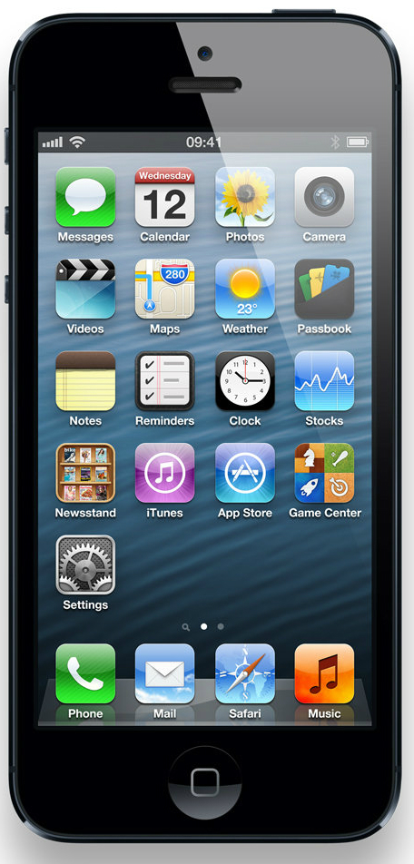
Overview
Previous Work
Problem
Model
Apps
Developers
Users
Algorithm
Results
Limitations
Conclusions

Slide 3
Previous Work
There has been little work in mobile app ecosystem modeling, but a lot of related work in ecosystem modeling.
Garg and Telang – strategy to infer the sales based on ranking
Bohmer – developed app to collect mobile app usage data
Holland – agent based models to model complex systems by the interaction of autonomous “agents”
Notes:
Garg and Telang – developed strategies to infer the current sales of an app based on it ranking in the app store.
- no certainty a new app will appear ranked
Bohmer – developed app to collect app usage data.
- Average app session time is less than a minute
- People use news apps in the morning, games at night, and communication apps during the day
- Informative, but only studies what is already out there
Holland – Echo: ecosystem model where evolving agents are placed in a resource limited environment
Study the interaction between organisims

Slide 4
Problem
App developers are always competing with each other to get more downloads of their apps.
What strategy should app developers use to be successful?
Notes:
A mobile app ecosystem was developed to model the creation and downloading of mobile apps simulate Apple’s iOS and investigate common developer strategies.
Evaluate in terms of downloads received, app diversity, and adoption rate.

Slide 5

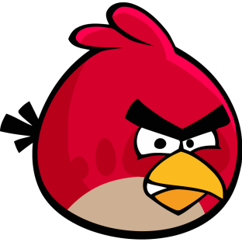
Why do we care?
It pays to be a successful app developer
Angry Birds revenue of $100 Million in 2011
Total revenue projected to reach $77 Billion by 2017

Slide 6



The Model
App Store
App Developers
App Users
Notes:
Coevolving systems of apps, developers, and users
Developer agents build and upload apps to the app store
User agents browse the store and download the apps

Slide 7
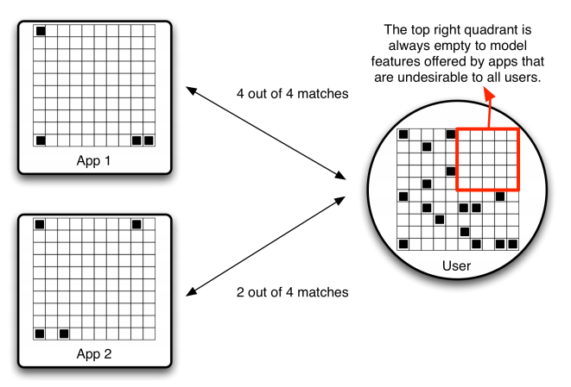
The Model: Apps
Represented by 10x10 binary grid of “features”
Features occupying spaces on the grid near each other represent similar features
Feature grid is filled depending on the strategy used by the app developer
Notes:
Innovator: All cells filled based on random probability of being filled
Milker: Copies features from previous app with random mutation
Optimizer: Copies features from own best app with random mutation
CopyCat: App randomly selected from top charts and copied with random mutation

Slide 8
The Model: Developers
Developers develop apps at regular intervals, using one of four strategies. SOME can change strategies throughout simulation
Innovator: Creates new, totally different apps each time
Milker: Produces apps that are a variation of their most recent app
Optimizer: Develops apps that are a variation of their best app to date
Copycat: Duplicates current best selling apps, with minor variations
Notes:
Variables:
Development duration – random value for days to build an app
Probability to become inactive – to model hobbyists and tendency to stop building apps
Innovator: Innovative Devloper to create random features each time
Milker: “milk” a single app idea repeatedly
Optimizer: improve on the best app
Copycat: Less creative
Flexible: Some are “flexible” meaning there is a 1% chance that after any given app is released, it will change it’s style. Later we will see what happens if everyone is flexible.

Slide 9
The Model: Users
10x10 grid representing desired features
All users have same blank 5x5 block of unwanted features
User downloads apps at regular intervals
All apps that include only desired features are downloaded at each interval
User population increases over time governed by sigmoid growth function
Notes:
Unwanted features – difficult to use interface or malicious program

Slide 10


The Model: Users

Slide 11
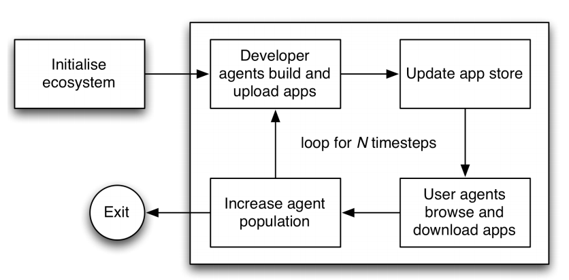
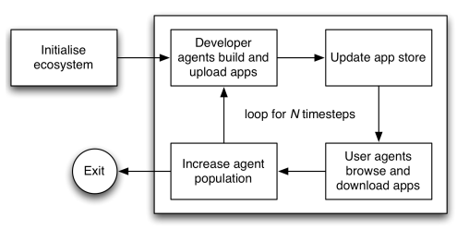
Algorithm
Notes:
Initialize: Creates initial number of apps from random developers
Dev Build Apps: For each active dev, daysTaken++ if daysTaken > devDuration app is uploaded to Store
App Store: New Apps Chart and Top Apps Chart is updated
User Agents: For each user, daysElapsed++ if daysElapsed > daysBtwBrowse user looks at store
Increase Population: Increases devs and users

Slide 12
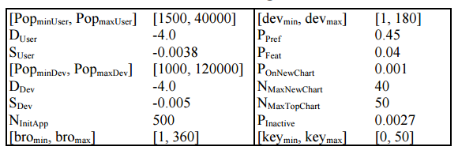
Algorithm
Initial parameters set up to mimic iOS app store in July 2008, simulated to June 2011

Slide 13
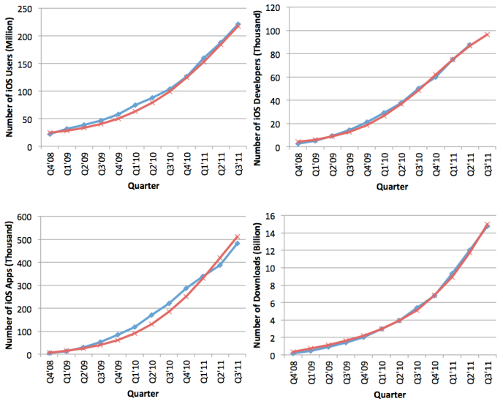
Algorithm

Slide 14
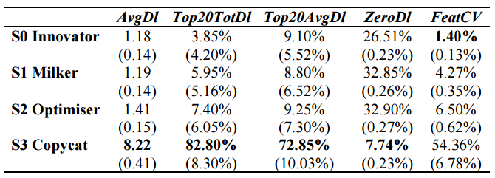
Results
Which developer strategy enables individual developers to be most successful?
What is the diversity of apps produced by each strategy?
Notes:
Diversity measured by a coefficient of feature variation, based on the mean and standard deviation of values from the feature grid.
AvgDl: total number of downloads / total number of apps
Top20TotDl: Rank top 20 based on total number of downloads, % proportion belonging to each strategy
Top20AvgDl: Rank top 20 based on average number of downloads, % proportion belonging to each strategy
ZeroDl: Proportion of devs who received no downloads for any apps so far.
FeatCV: Measure app coverage of features that are desired by users. FeatCV = stddev/mean. Lower means more even coverage of desired features.
Good strategy has low FeatCV
Mean preference for user population is evenly distributed
Indicates all the apps have features that cover the desired region in feature matrix

Slide 15
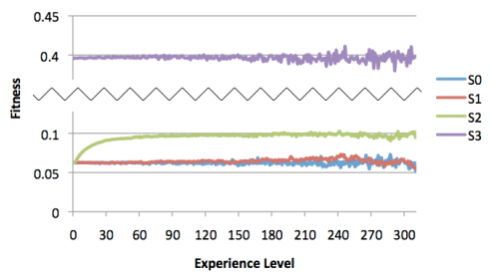
Results
Which strategy enables the developer to improve as they develop more apps?
Optimizer – continuously improving upon itself
Similar to (1+λ) Evolutionary Strategy
Innovator
Milker
Optimizer
CopyCat
Notes:
Measure fitness of each strategy as developers gain more experience in app development
Survey users if they would download the app
Fitness = avg download / NumUsers
S0: Innovator
S1: Milker
S2: Optimizer
S3: CopyCat

Slide 16
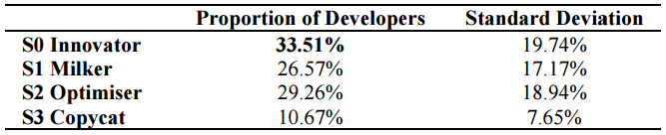

Results
When strategies compete, how often is each strategy chosen by developers?
Copycat is least often chosen, others vary widely by individual run
Notes:
Fitness is for a strategy. AvgDl is number of downloads for all of strategy’s apps, divided by number of that strategy’s apps.

Slide 17
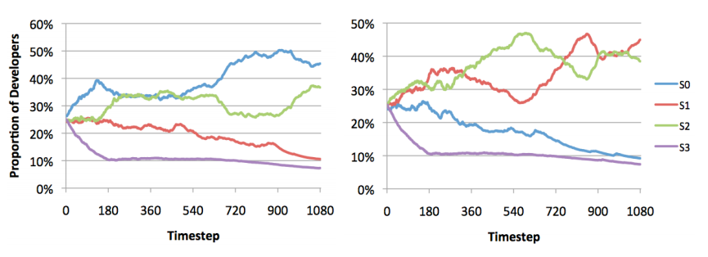
Results
Innovator
Milker
Optimizer
CopyCat
Notes:
Fitness is for a strategy. AvgDl is number of downloads for all of strategy’s apps, divided by number of that strategy’s apps.

Slide 18
Results
What is the diversity of apps produced?
FeatureCV much lower when developers can change strategies (2.33% vs 6.28%)
Apps evenly cover user preferences when developers are flexible
Without all flexible developers, there were some user preferences that were not met by a single app!
Notes:
Between fixed & flexible strategies

Slide 19
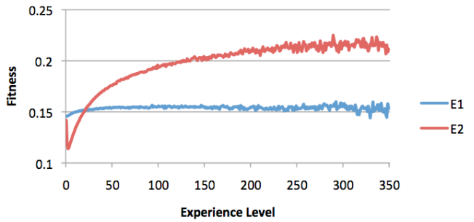
Results
Is this ecosystem able to improve its performance in the long term?
E1 = Fixed Strategies E2 = Flexible Strategies
Notes:
Some user preferences were not met by a single app when the whole developer population was not flexible

Slide 20
Limitations
No reasons for choice of developer strategies
Overly simplistic models for user downloads
Wanted vs unwanted features
Feature closeness to desired features
App popularity
Currently owned apps
Lack of evidence that results predict reality
No mention of how strategies are selected
Notes:
Including some random elements in user and developer behaviors would be interesting. Should have tried to assess validity of results based on empirical data.
Flexible strategies have a 1% chance of changing strategy, but it is not mentioned how selection pressure was applied to make strategies appear in uneven proportions.
Paper says that nearby cells are similar features, but it is not clear whether this is used when determining a user’s preference for an app.
More realistic download model would consider apps a user already has, and number of features a user wants

Slide 21
Conclusions
Copycat is most lucrative for developers
This only works when a minority of developers follow copycat strategy
Good apps needed from other developers to be copied
App diversity and fitness over time is improved by making developer strategies flexible
More work needed in comparing results to real world and adjusting models accordingly

Slide 22

Questions?

