Slide 1
Evolutionary Computation for Speech Enhancement
By: Vince Fasburg and Josh Thomas

Slide 2
Overview
Introduction
Background
CMA-ES
Weiner Filter
Spectral Subtraction
Noise Gate
Evolutionary Strategy
Results
Conclusions
Future Work

Slide 3
Introduction
Problem
Recover clean speech signal from audio corrupted by noise, such as road noise.
Approach
Combine several existing de-noising algorithms, using evolutionary strategies to tune parameters to recreate clean signal.
Notes:
Lots of applications for cars
Cell phone calls
Voice recognition

Slide 4
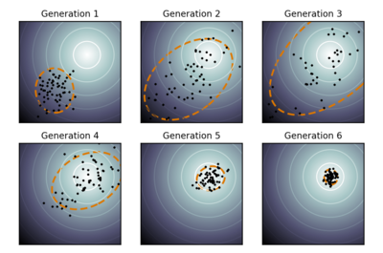
Background: CMA-ES
Real-valued parameters make up individuals
Random mutation from mean every gen
Mutation in direction of eigenvectors of covariance matrix
Notes:
Covariance Matrix Adaptation – Evolutionary strategies
Covariance matrix “learns” relationships between the variables.
Helps point mutation in the right n-dimensional direction, using these relationships.

Slide 5
Background: Spectral Subtraction
Basic Algorithm:
Subtract power spectrum of noise only from that of noisy signal X = (Y² – N²)^{1/2}
Improvements:
Y values smoothed
Speech/Noise decision with hold times
Parameters: Noise Margin, Hang Over, Smoothing Factor
Notes:
Fourier domain – results in energy values for different frequency bins
Noise is random in time domain, but roughly static in frequency domain
Version we’re using:
S.F. Boll (1979): "Suppression of acoustic noise in speech using spectral subtraction."IEEE Transactions on ASSP 27: 113–120
Needs piece of signal that is noise only
Noise Margin = threshold of difference between Y and N that will be considered noise
Hang Over = number of samples that will be considered noise once noise flag is set

Slide 6
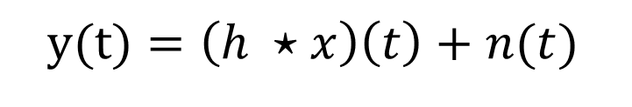
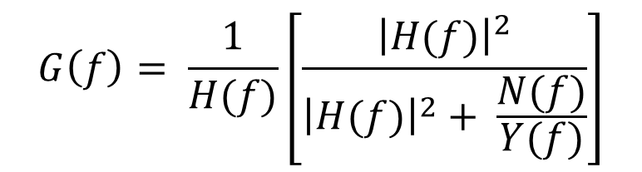
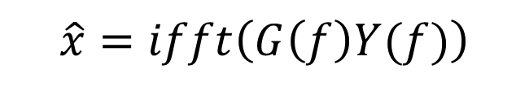
Background: Wiener Filter
Estimate SNR = Y(f)/N(f)
Use SNR to find best gains for FIR filter
Apply filter to eliminate noise
Parameters: SNR Smoothing Factor
$y(t)=\left(h ⋆x\right)\left(t\right)+n(t)$
$$G\left(f\right)= \frac{1}{H(f)}\left[\frac{{\left|H(f)\right|}^{2}}{{\left|H(f)\right|}^{2}+ \frac{N(f)}{Y(f)}}\right]$$
$$\hat{x}=ifft\left(G\left(f\right)Y(f)\right)$$
Notes:
Our Code adapted from Two-Step Noise Reduction version of WeinerNoiseReduction by Pascal Scalart (2009)
y(t) is what we can hear (nosiy speech)
x(t) is the unknown clean speech that
n(t) is additive noise
h(t) is the Linear Time Invariant system applied to x (in this case, the car)
Y is power spectral density of noisy speech
N is power spectral density of noise-only portion of signal
H(f) is FFT of h(t). In this case h(t) ~= 1. For real system h(t) would have to do with acoustics of the car

Slide 7
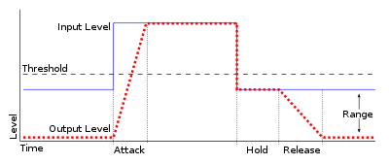
Background: Noise Gate
Parameters: Threshold, Attack, Release
Notes:
When above threshold, does nothing
When below threshold, attenuates
We made hold = 0 and attack = release to simplify

Slide 8
Evolutionary Strategy
(μ, λ) CMA-ES with weighted recombination
μ = 6,12,24 parents, λ = 12,24,48 offspring
Each offspring contains 8 parameters
G_{w}
Wiener(α)
₊
Gate(T,A/R)
G_{s}
SpecSub(N,H,L)
Notes:
Weighted recombination = best individuals are given higher weight when computing the new distribution mean

Slide 9
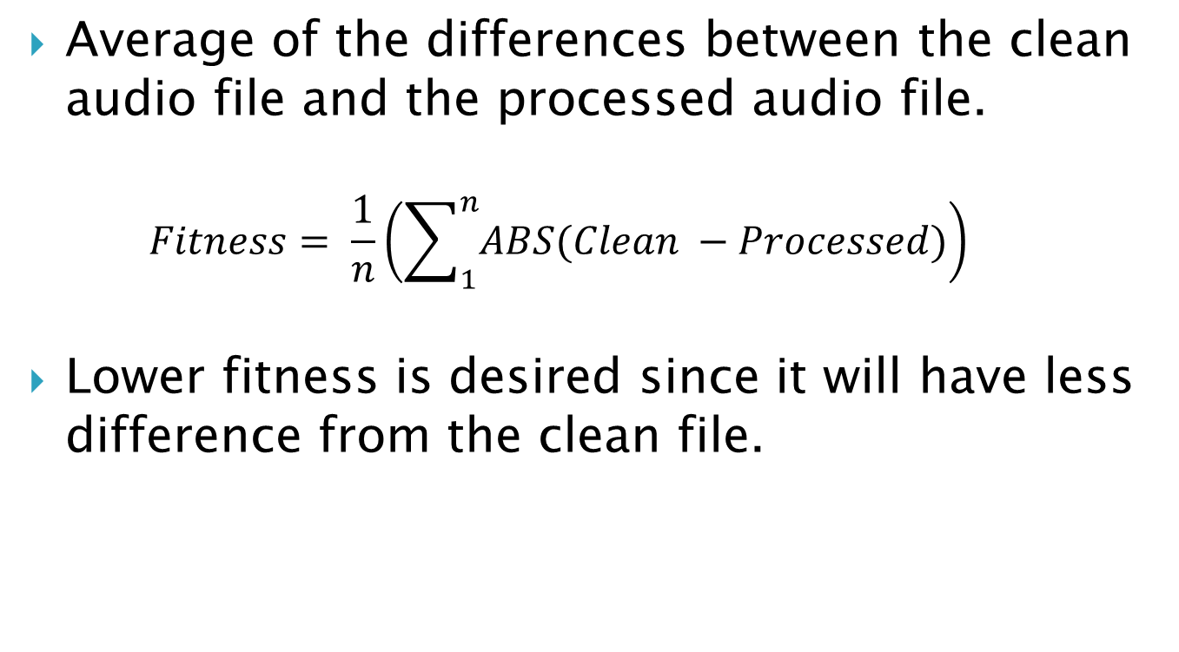
Fitness Function
Average of the differences between the clean audio file and the processed audio file.
$$Fitness= \frac{1}{n}\left(\sum_{1}^{n}{ABS(Clean −Processed)}\right)$$
Lower fitness is desired since it will have less difference from the clean file.

Slide 10
Evolutionary Strategy
Each parameter scaled differently from [0,1]
Parameter | Min | Max | “Expert” Value
Wiener Smoothing | 0 | 2 | 0.98
Wiener Gain | -2 | 2 | N/A
Spec Sub Gain | -2 | 2 | N/A
Noise Margin | 0 | 20 | 8
Noise Length | 0 | 20 | 18
Hangover | 0 | 20 | 3
Threshold | 0 | 0.25 | N/A
Attack/Release | 0 | 10 | N/A
Notes:
Not a black box problem
ES saw parameters cut off at 0 and 1
Scales were applied during fitness function
Note params are given wider than usual space as to not make too many assumptions

Slide 11
Results
Three different run configurations
1: Offspring of 12
2: Offspring of 24
3: Offspring of 48
50 runs per configuration
300 Generations per run

Slide 12
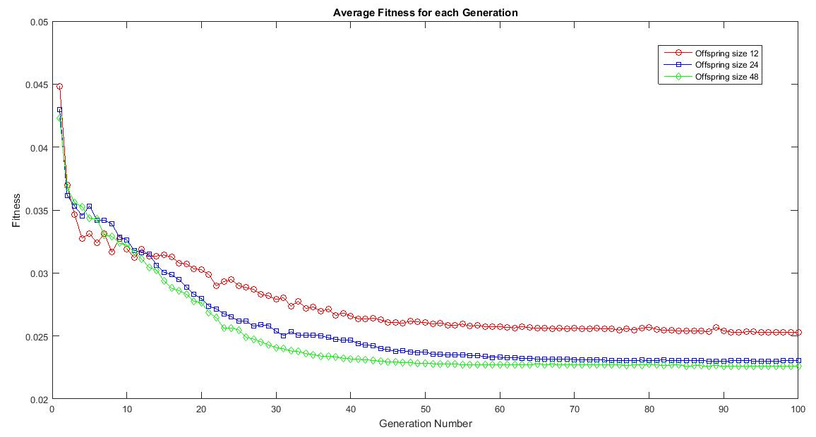
Results
Notes:
Shows average fitness at each generation for each configuration type.
Only first 100 generations are shown since lines become steady after 100
Offspring of 48 also arrives at a better overall fitness

Slide 13
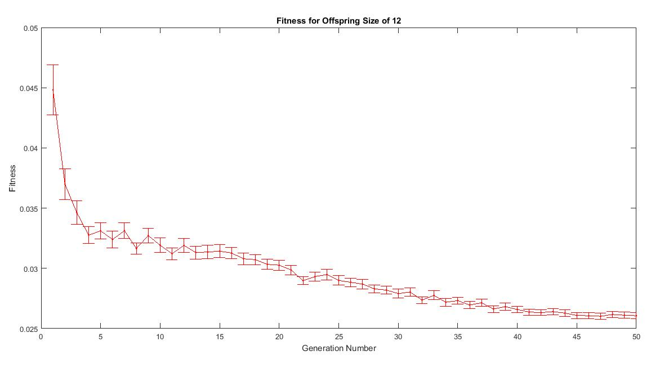
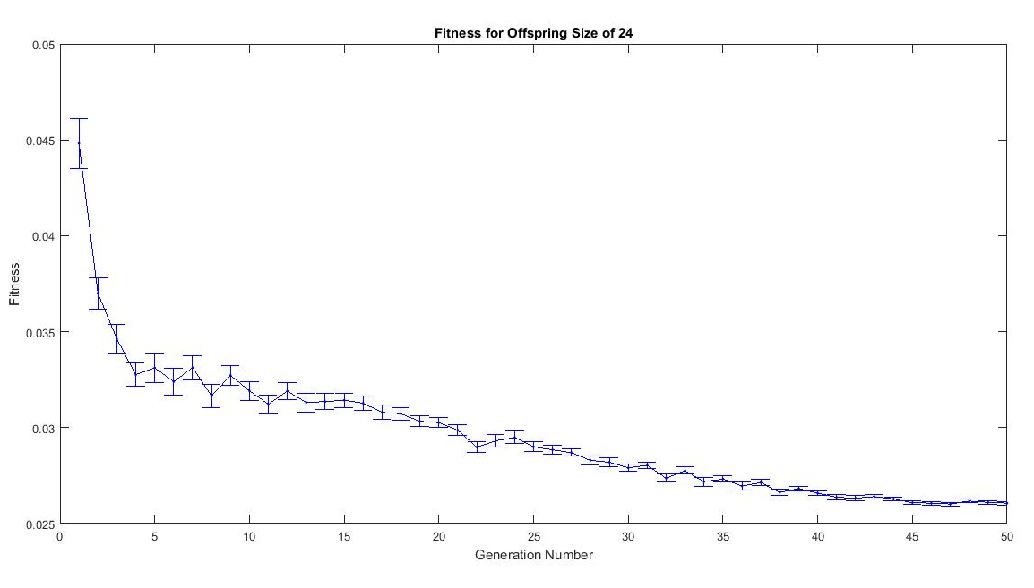
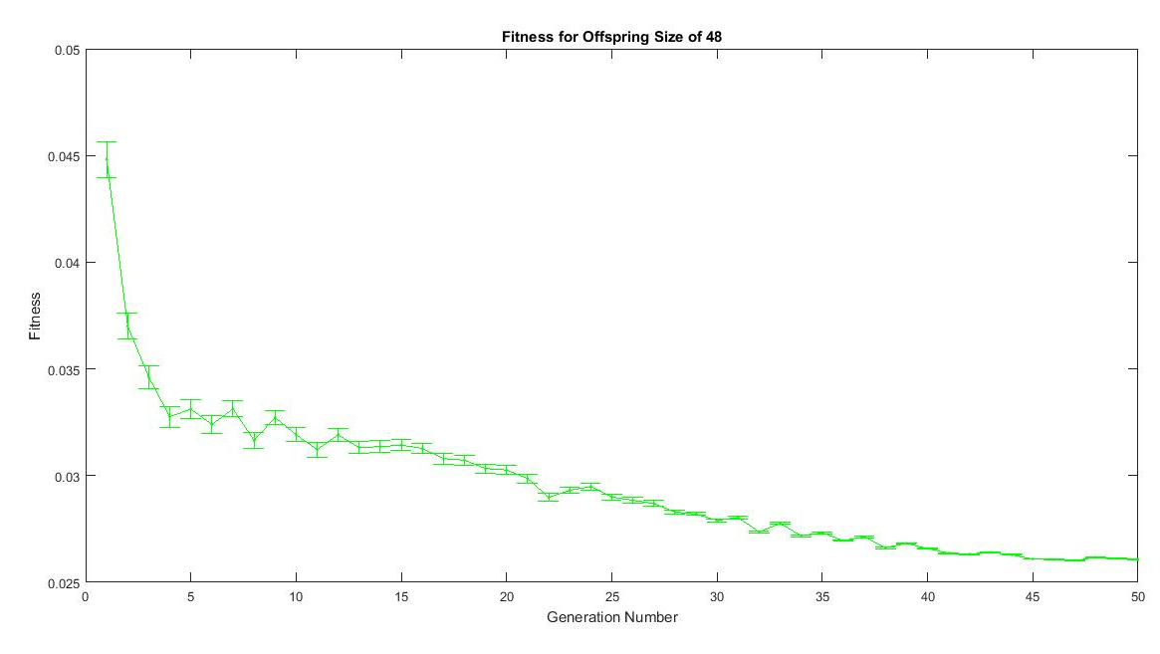
Results
Notes:
Shows same average as previous slide, but with error bars showing the 95% confidence interval.
Overall error bars are pretty small
In all three cases, error bars get smaller as the number of generations increases.
This is because the population is becoming less diverse.

Slide 14
Results
 | Expert Results | Expert Results | Best Pop 12 | Best Pop 24 | Best Pop 48
Wiener Gain | 1 | 0 | 1.10 | 0.97 | 1.10
Wiener Smoothing | 0.98 | - | 0.95 | 0.96 | 0.95
Spec Sub Gain | 0 | 1 | 0.41 | 0.45 | 0.41
Noise Length | - | 20 | 13.65 | 18.92 | 0.69
Noise Margin | - | 8 | 18.23 | 0.78 | 15.35
Hang Over | - | 3 | 9.33 | 0.58 | 18.16
Threshold | - | - | 0.03 | 0.03 | 0.03
Attack/Release | - | - | 1.25 | 0.96 | 1.25
Fitness | 0.0301 | 0.0316 | 0.0225 | 0.0223 | 0.0225
Notes:
Expert only used one or the other at a time, because this is realistic scenario, plus the scale would be difficult to get exactly right, thus the fitness would be worse (since it is a raw subtraction)
Wiener is better

Slide 15
Results
Running the best results with only
the Wiener Filter
 | Expert Results | Best Results
Wiener Gain | 1 | 1
Wiener Smoothing | 0.98 | 0.96
Spec Sub Gain | 0 | 0
Fitness | 0.0301 | 0.0270

Slide 16
Results
Running the best results with only
Spectral Subtraction
 | Expert Results | Best Results
Wiener Gain | 0 | 0
Spec Sub Gain | 1 | 1
Noise Length | 20 | 18.92
Noise Margin | 8 | 0.78
Hang Over | 3 | 0.58
Fitness | 0.0316 | 0.0354

Slide 17


Results
Clean File
Dirty File
Processed File

Slide 18
Conclusions
Improve upon the expert results with ES
Difficult to compare to expert results
Fitness is improved from expert results
Computation time of EC may not be worth it
Wiener Filter is better than Spectral Subtraction at reducing noise
Notes:
Weiner is better
We can improve, but with the computation time the gain isn't that great

Slide 19
Future Work
New fitness function
Tuned to human hearing
For computer interpretation
Evolve different combinations of de-noising algorithms alongside parameters
Genetic programming
Variety of audio samples
Different voices
Different noise situations

Slide 20
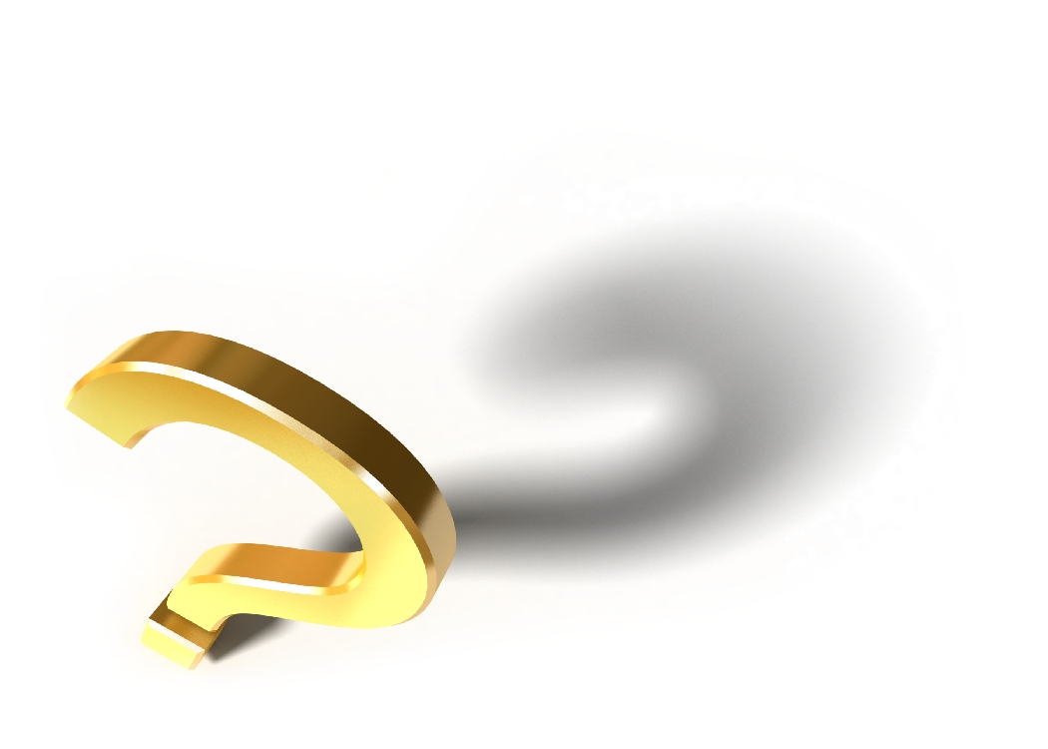
Questions?

