Slide 1
How to be a Successful App Developer: Lessons from the Simulation of an App Ecosystem
Paper by: Soo Ling Lim, Peter J. Bentley
Presentation by: Vince Fasburg and Josh Thomas

Slide 2
Background
Agent-Based Models model complex systems by the interaction of autonomous “agents”
Models used to predict emergent behaviors

Slide 3



The Model
App Store
App Developers
App Users

Slide 4
The Model: Developers
Developers develop apps at regular intervals, using one of four strategies. SOME can change strategies throughout simulation
Innovator: Creates new, totally different apps each time
Milker: Produces apps that are a variation of their most recent app
Optimizer: Develops apps that are a variation of their best app to date
Copycat: Duplicates current best selling apps, with minor variations
Notes:
Some are “flexible” meaning there is a 1% chance that after any given app is released, it will change it’s style. Later we will see what happens if everyone is flexible.

Slide 5
The Model: Applications
Represented by 10x10 binary grid of “features”
Features occupying adjacent spaces on the grid represent similar features

Slide 6
The Model: Users
10x10 grid representing desired features
All users have same 5x5 block of unwanted features
User downloads apps at regular intervals
All apps that include only desired features are downloaded at each interval
User population increases over time governed by sigmoid growth function

Slide 7
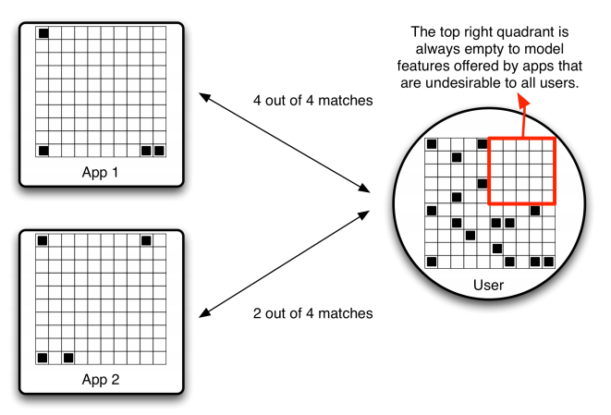
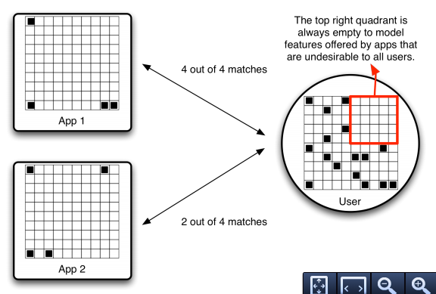


The Model: Users

Slide 8
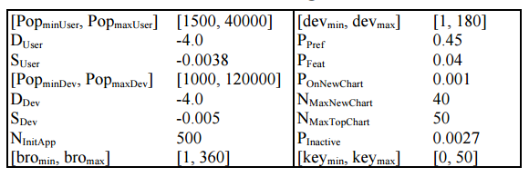
Algorithm
Initial parameters set up to mimic iOS app store in July 2008, simulated to June 2011

Slide 9
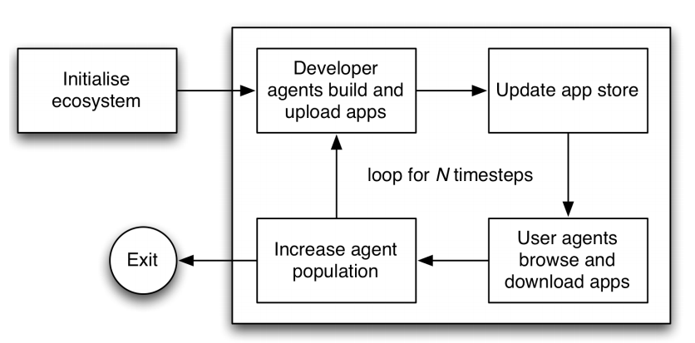
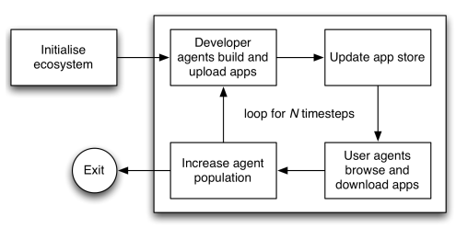
Algorithm

Slide 10
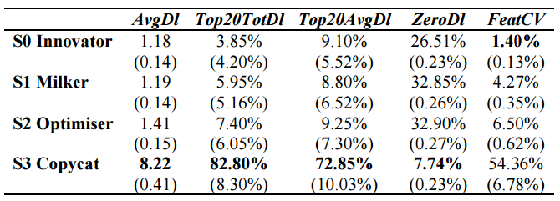
Results
Which developer strategy enables individual developers to be most successful?
What is the diversity of apps produced by each strategy?
Notes:
Diversity measured by a coefficient of feature variation, based on the mean and standard deviation of values from the feature grid.

Slide 11
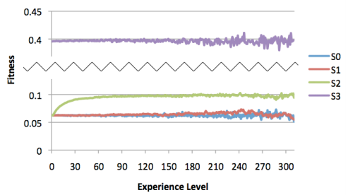
Results
Which strategy enables the developer to improve as they develop more apps?
Optimizer – continuously improving upon itself
Similar to (1+λ) Evolutionary Strategy

Slide 12
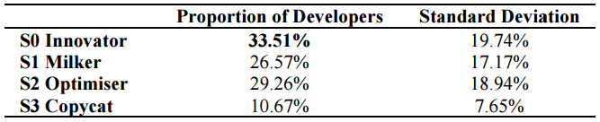
Results
When strategies compete, how often is each strategy chosen by developers?
Copycat is least often chosen, others vary widely by individual run

Slide 13
Results
What is the diversity of apps produced?
FeatureCV much higher when developers can change strategies (6.28% vs 2.33%)
Apps evenly cover user preferences when developers are flexible
Without all flexible developers, there were some user preferences that were not met by a single app!

Slide 14
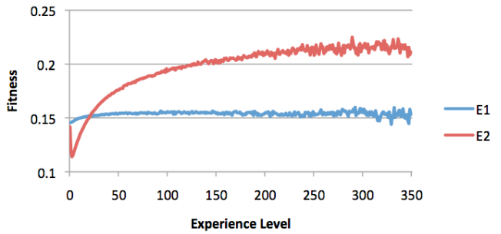
Results
Is this ecosystem able to improve its performance in the long term?
E1 = Fixed Strategies E2 = Flexible Strategies
Notes:
Some user preferences were not met by a single app when the whole developer poulation was not flexible

Slide 15
Limitations
No reasons provided for choice of developer strategies
Overly simplistic models for:
User preferences
User download patterns
Number of developers
Developer app creations times
Lack of evidence that results predict real world
Notes:
Including some random elements in user and developer behaviors would be interesting. Should have tried to assess validity of results based on empirical data.

Slide 16
Conclusions
Copycat is most lucrative for developers
This only works when a minority of developers follow copycat strategy
Good apps needed from other developers to be copied
App diversity and fitness over time is improved by making developer strategies flexible
More work needed comparing results to real world and adjusting models accordingly

Slide 17
Questions?

