Slide 1
TERMINOLOGY
Link
A component forming a part of a chain; generally rigid with provision at each end for connection to two other links
Mechanism
A combination of rigid bodies (links) connected by kinematic pairs.
Kinematic pair
A joint which is formed by the contact between two bodies and allows relative motion between them.
Machine
A collection of mechanisms which transmit force from the source of power to the resistance to be overcome
Kinematics
A branch of dynamics dealing with motion in time and space but disregarding mass and forces
Kinetics
A branch of physics that deals with the relation of force and changes of motion
Dynamics
A branch of mechanics that deals with matter (mass) in motion and the forces that produce or change such motion. Mechanics deals with force and energy in their relation to the material bodies.

Slide 2
KINEMATIC PAIR
A mechanism is defined as a combination of rigid bodies connected by kinematic pairs.
A kinematic pair is a joint which is formed by the contact between two bodies and allows relative motion between them.
The contact element on a body, which joins to form a kinematic pair, is called pairing element.

Slide 3
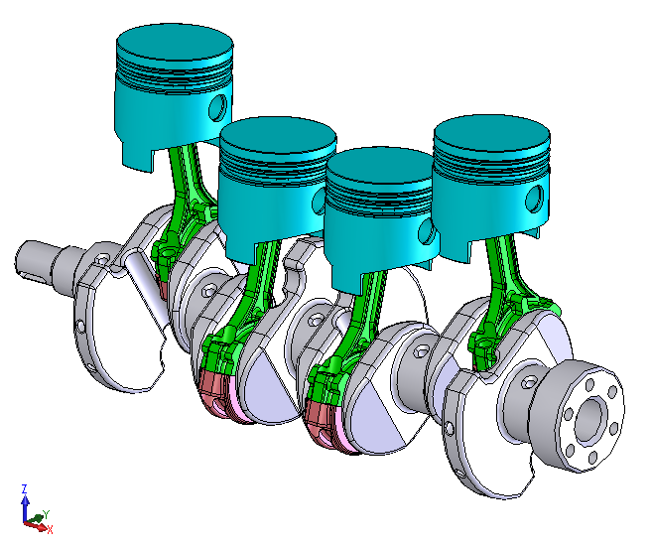
KINEMATIC PAIR
Each link in the slider-crank mechanism shown here has two pairing elements.

Slide 4
LOWER KINEMATIC PAIRS
Surface contact pairs are lower pairs.
The commonly used lower pairs include
  (1) Revolute Pair
  (2) Prismatic Pair
  (3) Screw Pair
  (4) Cylindrical Pair
  (5) Spherical Pair
  (6) Planar Pair

Slide 5
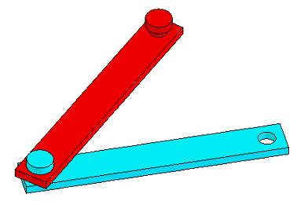
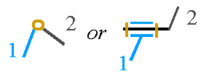
REVOLUTE PAIR (PIN JOINT)
revolute.SLDASM
Degrees of freedom: 1
Symbol: R
Relative motion: Circular

Slide 6
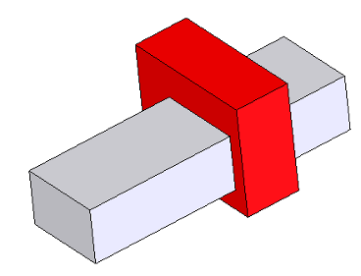
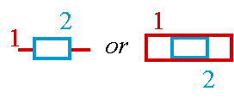
PRISMATIC PAIR (SLIDER JOINT)
prismatic.SLDASM
Degrees of freedom: 1
Symbol: P
Relative motion: linear

Slide 7
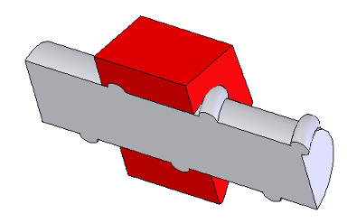

SCREW PAIR (HELICAL PAIR)
screw.SLDASM
Degrees of freedom: 1
Symbol: H
Relative motion: Helical

Slide 8
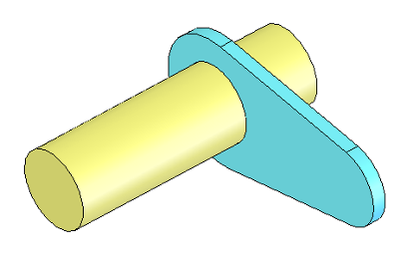
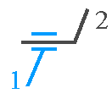
CYLINDRICAL PAIR
cylidrical.SLDASM
Degrees of freedom: 2
Symbol: C
Relative motion: Cylindrical

Slide 9
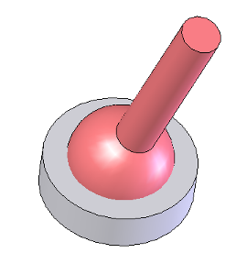

SPHERICAL PAIR (GLOBULAR PAIR)
spherical.SLDASM
Degrees of freedom: 3
Symbol: S
Relative motion: Spherical

Slide 10
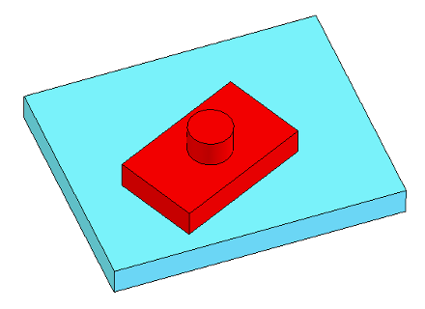

PLANAR PAIR (FLAT PAIR)
planar.SLDASM
Degrees of freedom: 3
Symbol: F
Relative motion: Planar

Slide 11
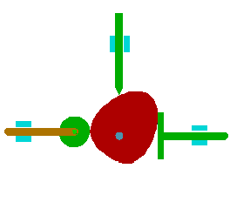
HIGHER KINEMATIC PAIRS
Higher pairs (joints) have either a line contact or a point contact.
Higher pairs exist in cam mechanisms, gear trains, ball and roller bearings and roll-slide joints, etc.
For planar motion, both line contact higher pairs and point contact higher pairs have two degrees-of-freedom.
The only constraint at the contact point is along the common normal.
A pin-in-slot joint (rolling contact with sliding) is also a higher pair with a line contact between the pin and the slot.

Slide 12
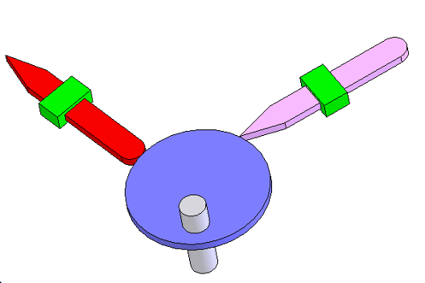
HIGHER KINEMATIC PAIRS
higher.SLDASM

Slide 13
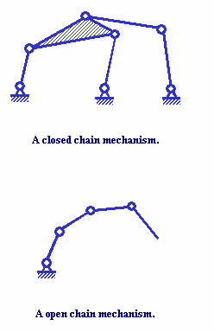
KINEMATIC CHAIN
A kinematic chain is an assemblage of links by pairs. When one link of a kinematic chain is held fixed, the chain is said to form a mechanism. The fixed link is called the ground link or frame.
A closed chain is a consecutive set of links in which the last link is connected to the first. All links have at least two pair elements. There are single loop closed chains and multi-loop closed chains.
An open chain is the one in which the last link is not connected to the first link. At least one link has a single pair element.
A closed chain mechanism.
An open chain mechanism.

Slide 14
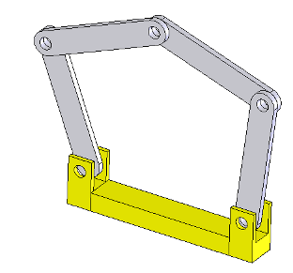
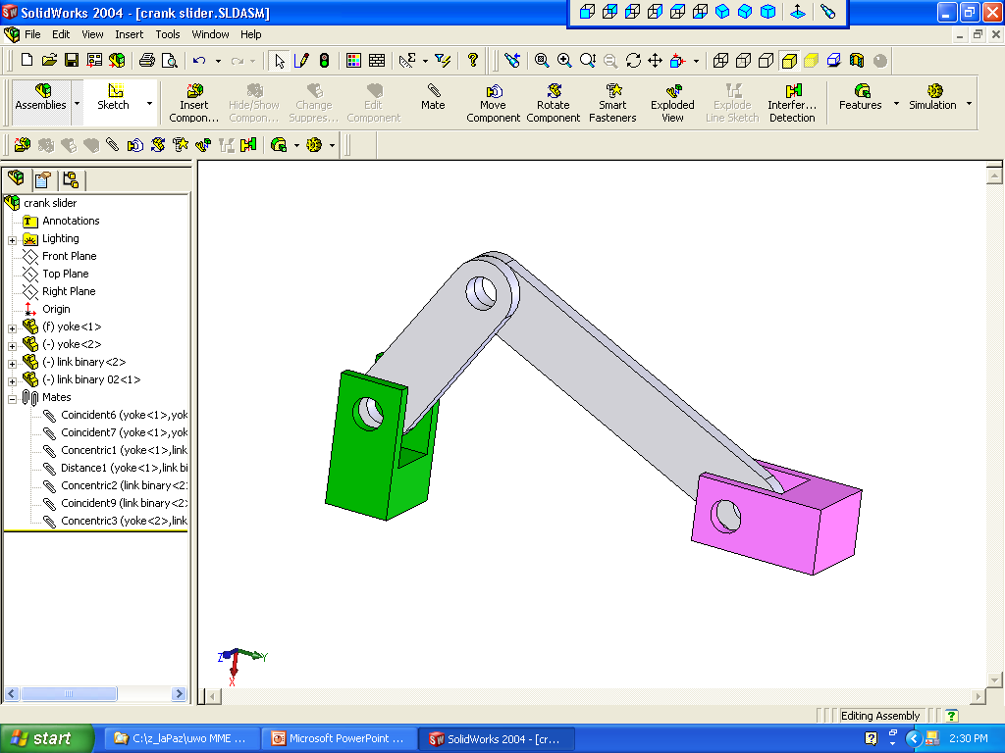
KINEMATIC CHAIN CLOSED
Ground
5 bar linkage.SLDASM
Slider-crank

Slide 15
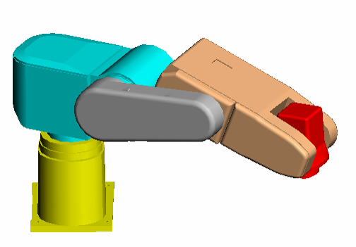
KINEMATIC CHAIN OPEN
Ground
fanuc robot.SLDASM

Slide 16
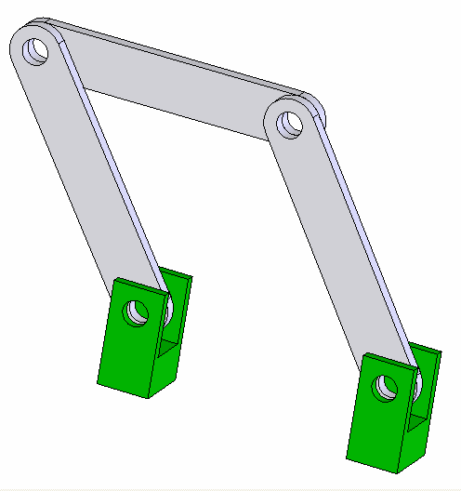
PLANAR FOUR BAR MECHANISM
A four-bar mechanism is composed of four links (including the ground link) and four kinematic pairs.
Planar four bar mechanisms are the simplest closed-chains such as crank-rocker and slider-crank mechanisms.
A dyad is a combination of two links connected by a joint. A four-bar mechanism is composed of two dyads.
Many planar mechanisms can be viewed as a combination of a four-bar mechanism with one or more dyads.
Crank-rocker

Slide 17
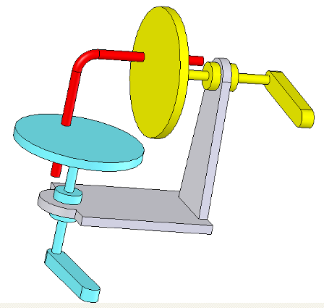
SPATIAL MECHANISM
A spatial mechanism is one in which one or more links do not move in planar motion.
In the RCCR mechanism shown here, the input (blue disk) and the output (yellow disk) move in different planes that are not parallel to each other.
The coupler link has three dimensional spatial motion and does not move parallel to a single plane Therefore, the mechanism is defined as a spatial mechanism.
C
cylindrical
C
cylindrical
R
revolute
R
revolute
spatial.SLDASM

Slide 18
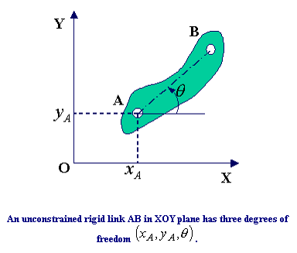
DEGREES OF FREEDOM
The degrees of freedom of a mechanical system is the number of independent inputs required to determine the position of all links of the mechanism.

Slide 19
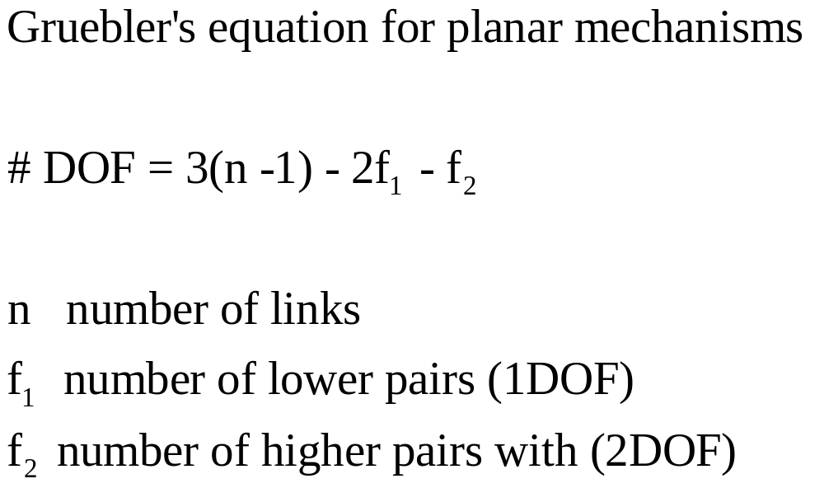
DEGREES OF FREEDOM OF A PLANAR MECHANISM
A planar mechanism containing n links (including the ground link) has 3(n-1) degrees of freedom before they are connected by pairs.
A lower pair has the effect of providing two constraints between the connected links. Therefore, f₁ lower pairs will remove 2f₁ degrees of freedom from the system.
A higher pair provides one constraint. So, f₂ higher pairs will remove f₂ degrees of freedom from the system.

Slide 20
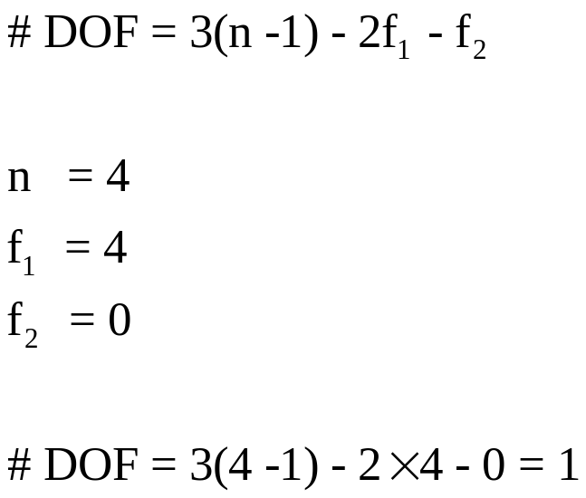
DEGREES OF FREEDOM: 4 BAR LINKAGE
4 bar linkage.SLDASM

Slide 21
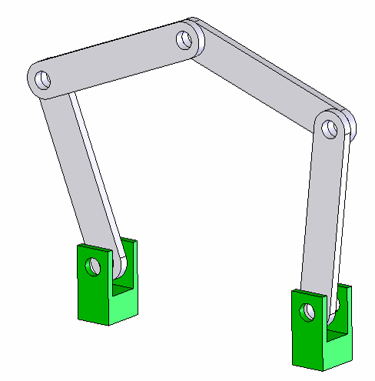
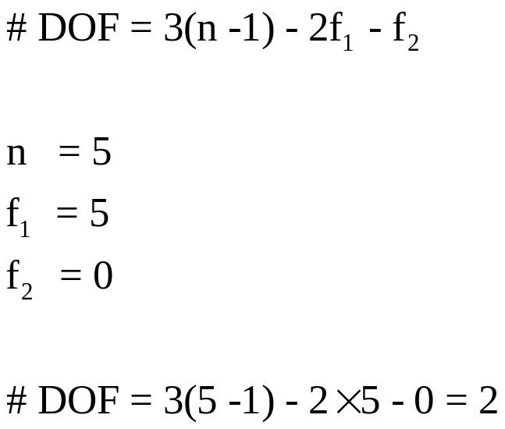
DEGREES OF FREEDOM: 5 BAR LINKAGE
5 bar linkage.SLDASM

Slide 22
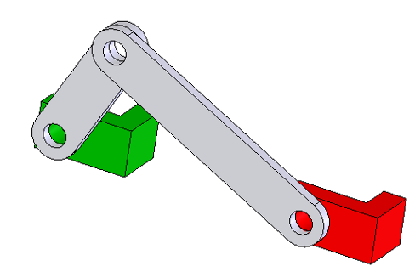
DEGREES OF FREEDOM: CRANK AND SLIDER
crank mechanism.SLDASM

Slide 23
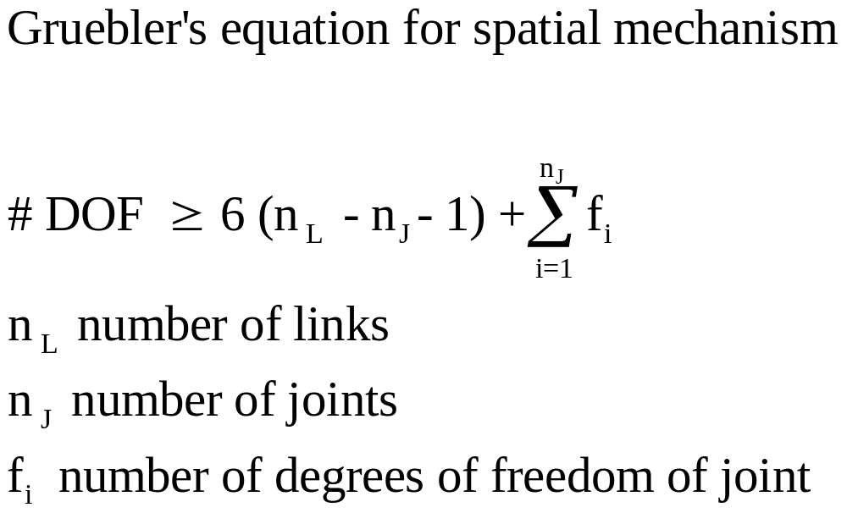
DEGREES OF FREEDOM OF A SPATIAL MECHANISM

Slide 24
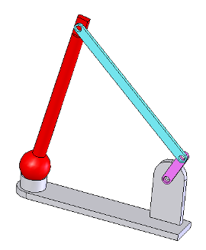
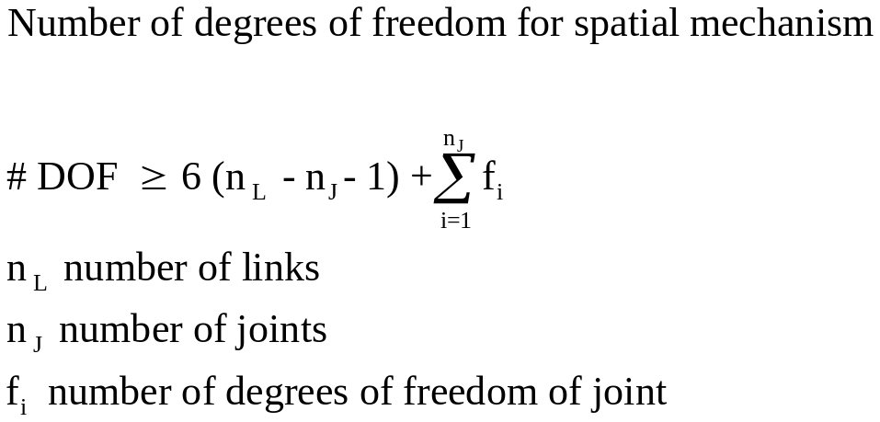
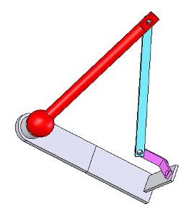
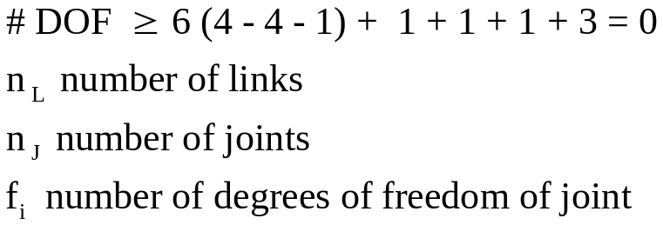
DEGREES OF FREEDOM OF A SPATIAL MECHANISM
ball joint.SLDASM
ball joint 01.SLDASM

Slide 25
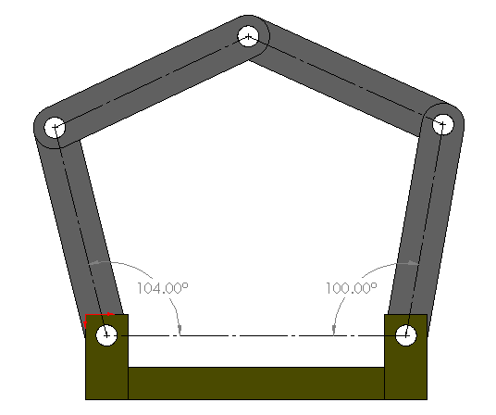
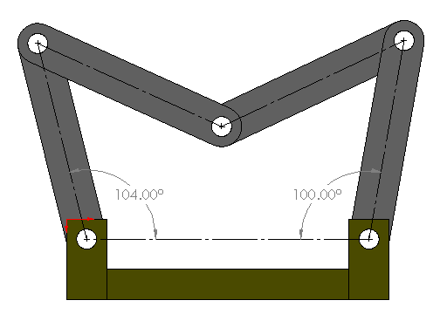
DEGREES OF FREEDOM: 5 BAR LINKAGE
TWO CIRCUITS ARE POSSIBLE
5 bar linkage.SLDASM

Slide 26
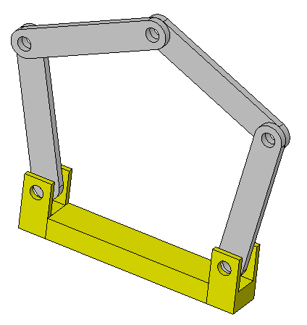
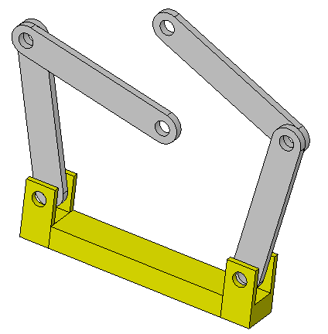
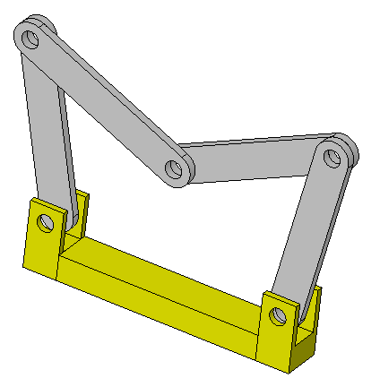
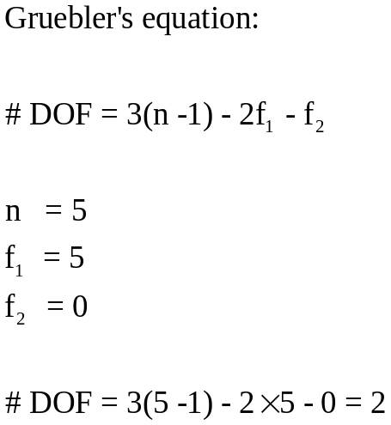
TWO CIRCUITS ARE POSSIBLE
5 bar linkage.SLDASM
CIRCUIT 1
DISASSEMBLY
CIRCUIT 2
If after specifying two independent variables defining the linkage position (here the angular position of two links connected to ground) the number of possible positions of remaining links are finite, the number of degrees of freedom is equal 2

Slide 27
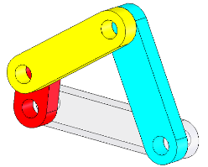
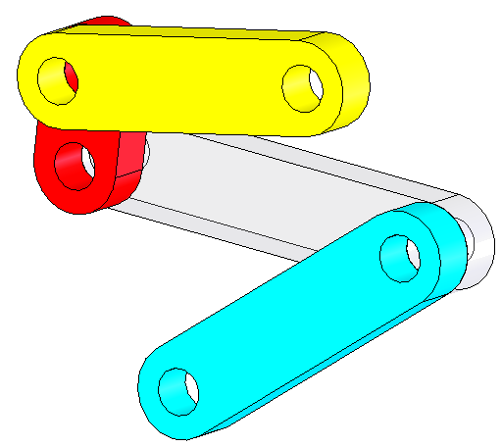
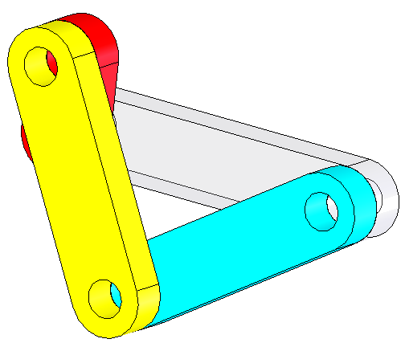
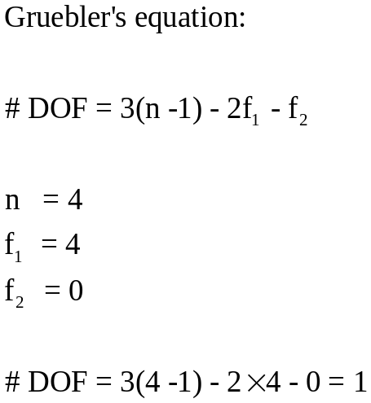
TWO CIRCUITS ARE POSSIBLE BUT DISASEMBLY IS REQUIRED TO MOVE FROM ONE CIRCUIT TO THE OTHER
CIRCUIT 1
DISASSEMBLY
CIRCUIT 2
crank rocker.SLDASM
If after specifying one independent variable to define the linkage position (here the angular position of the red link) the number of possible positions of remaining links are finite, the number of degrees of freedom is equal 1

Slide 28

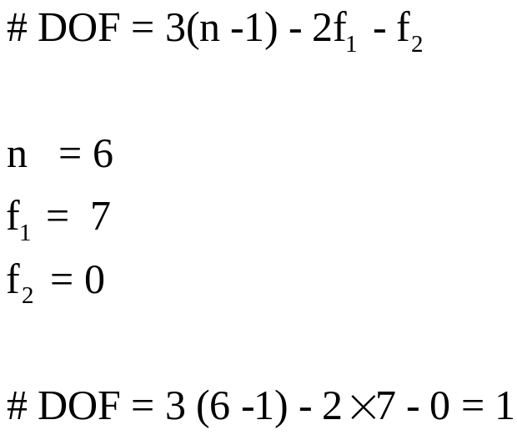
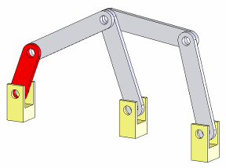
SUPERIMPOSED JOINT
When three links are joined by a single pin, two pairs must be counted.
When n links are joined by a single pin, (n-1) pairs must be counted.
Two pin joints here
6 bar linkage.SLDASM

Slide 29
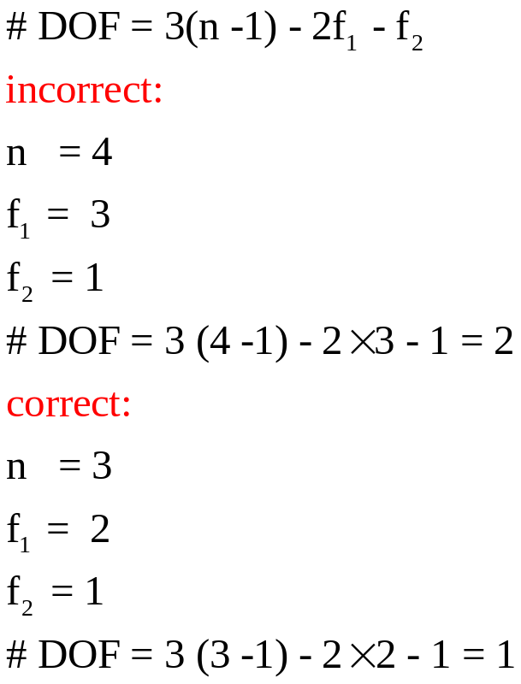
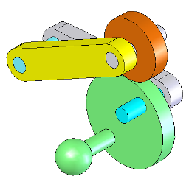
REDUNDANT DEGREE OF FREEDOM
There are instances when Gruebler’s formula predicts a seemingly excessive number of degrees of freedom. This may involve a passive or redundant degree of freedom.
The redundant degrees of freedom does not influence the overall motion of the mechanism.
The rotation of the roller about its own axis is a redundant degree of freedom and it does not affect the motion of the output follower.
Redundant degree of freedom between arm and roller
cam and follower.SLDASM

Slide 30
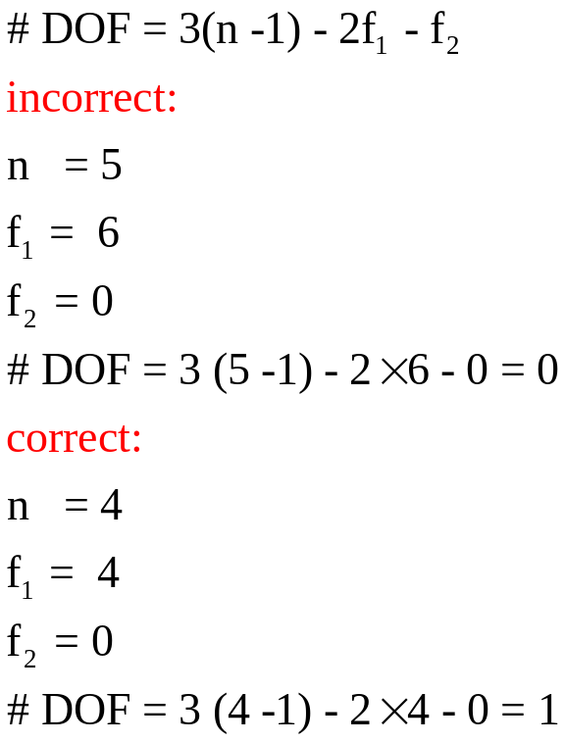
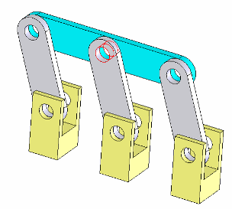
REDUNDANT CONSTRAINT
There are mechanisms whose computed degrees of freedom may be zero or negative. They can, nevertheless, move due to special proportion, for example, the five-bar linkage.
Because of the parallel configuration, the linkage can move. This is called overconstrained linkage, in which one of the two couplers provides a redundant constraint.
Remove the link which provides redundant constraint in calculating the degrees of freedom.
5 bar linkage overconstrained.SLDASM

Slide 31
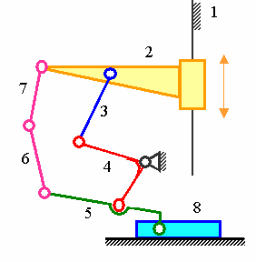
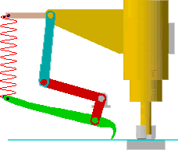
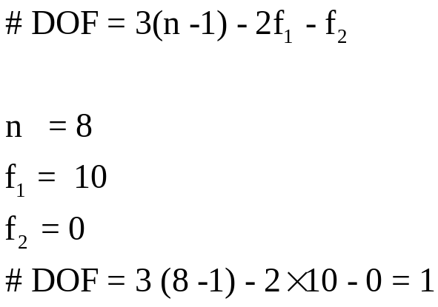
SPRING CONNECTIONS
The spring in a mechanism can be replaced by a dyad.
The punch mechanism shown has one degree of freedom.
The input is the slider. The motion of the green link is controlled not only by the red link but also by the spring force and the contact force between the pawl and the part being punched.
Slider

Slide 32
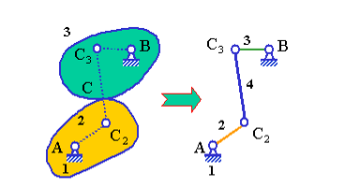
EQUIVALENT LINKAGE
For the purpose of kinematic analysis, a planar higher-pair mechanism can be replaced by an equivalent lower-pair mechanism based on instantaneous velocity equivalence.
Each higher pair is replaced by two lower pairs and a link.
The degrees of freedom of the equivalent mechanism is the same as the original mechanism.
The instantaneous velocity and acceleration relationships between links 2 and 3 of the original and the lower-pair equivalent mechanism are the same.
The equivalence is instantaneous. Because the positions the center of curvature changes as the mechnism moves, different mechanism position will generate a different equivalent linkage.
The higher mechanism (left) and its equivalent linkages (right), in which C2 and C3 are centers of curvature of contact curves on part 2 and part 3 at point C respectively

Slide 33
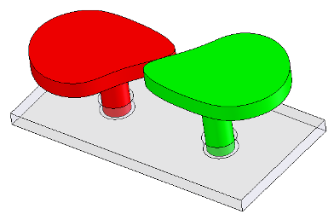

EQUIVALENT LINKAGE
two cams concept.SLDASM
=

Slide 34


EQUIVALENT LINKAGE
two cams.SLDASM

Slide 35



GRASHOF MECHANISM
If one link can perform full rotation relative to another link of four bar linkage (we may also say “if there is to be continuous motion”) the sum of the length of the shortest and the longest link must not be larger than the sum of the lengths of the two other links.
If the above condition is satisfied the four bar link is called Grashof mechanism.
L2
L3
Here:
L1
L0

Slide 36


GRASHOF MECHANISM: CRANK ROCKER
1 L2 - L1 < L0 + L3
2 L3 < L2 - L1 + L0
3 L0 < L2 – L1 +L3
4 L1 + L2 < L0 +L3
5 L3 < L1 + L2 + L0
6 L0 < L1 + L2 + L3
2 + 3 >>> L1 < L2
2 + 4 >>> L1 < L0
3 + 4 >>> L1 < L3
L1 = L min
Crank is the shortest link

Slide 37

GRASHOF MECHANISM: CRANK ROCKER
Crank is the shortest link
coupler
Driven link
crank
crank rocker.SLDASM
ground
Input (crank) rotates, output crank (driven link) oscillates

Slide 38

GRASHOF MECHANISM: DRAG LINK
Fixed link is the shortest link
coupler
Driven link
crank
ground
drag link.SLDASM
Input (crank) rotates, output crank also rotates

Slide 39

GRASHOF MECHANISM: DOUBLE ROCKER
Coupler is the shortest link
coupler
Driven link
crank
double rocker.SLDASM
ground
Input (crank) and output crank both oscillate

Slide 40
KINEMATIC INVERSIONS
The process of choosing different links of a kinematic chain for the frame is known as kinematic inversions.
The relative motions between the various links are not altered but their absolute motions may be change drastically.
By fixing different links three different types of four-bar mechanisms are derived from the original four-bar mechanism. These are crank-rocker, double-crank (or drag-link) and double-rocker mechanisms. The crank is the link which can rotate complete 360 degrees.

Slide 41


KINEMATIC INVERSIONS
Crank rocker
CRANK
Drag link
Double rocker
CRANK
CRANK
GROUND
GROUND
GROUND
GROUND
CRANK
By fixing different links three different types of four-bar mechanisms are derived from the original four-bar mechanism. These are crank-rocker, double-crank (or drag-link) and double-rocker mechanisms.
The crank is the link which can rotate complete 360 degrees.

Slide 42


GRASHOF MECHANISM: CHANGE POINT
coupler
Driven link
crank
change point.SLDASM
ground

Slide 43



GRASHOF MECHANISM: CHANGE POINT

Slide 44



TRANSMISSION ANGLE – 4 bar linkage
coupler
crank
Driven link
Maximum transmission angle
ground
transmission angle.SLDASM
Recommended transmission angle
(angle between coupler centerline and the driven crank centerline)
40⁰ < TA < 140⁰
Minimum transmission angle

Slide 45

TRANSMISSION ANGLE – crank slider
Maximum transmission angle
crank mechanism.SLDASM
Recommended transmission angle
-40⁰ < TA < 40⁰

Slide 46


WATT SIX-BAR LINKAGES
These type of kinematic chains have four binary links and two ternary links.
A single degree of freedom chain has all lower-pair (pins or sliders) single degree of fredom joints.
In Watt-type six link chain, the two ternary links are directly connected to each other. Figure shows the two distinct ways in which two ternaries and four binary can be arranged.

Slide 47


STEPHENSON SIX-BAR LINKAGES
In Stephenson chains, the two ternary links are separated by a binary link.
Like the Watt-chain, all Stephenson chains have single degree of freedom.
Both Watt and Stephenson chains have two loops.

Slide 48

  QUICK RETURN MECHANISM
crank mechanism with offset.SLDASM

Slide 49

  QUICK RETURN MECHANISM
quick return.SLDASM

