Slide 1
Running and pressing by position
FIFA World Cup 2026 / Objective 1 / Maximus Turner
Running distance per 90 minutes
Direct pressures as a share of all pressures
Midfielders and forwards in the captured eligible records
Validated joins and fixed random samples
Python preparation, statistics and visualisations
For both: H0 equal group means / H1 different means
Two-sided independent t-tests, alpha = 0.05
CDU HIT140 / Maximus Turner
01
Notes:
[Show CDU student ID, then begin.]
I'm Maximus Turner. My two questions compare midfielders and forwards: how far they run per ninety minutes, and what share of their defensive pressures directly challenges the ball carrier.
The analysis joins FIFA player tables using player, team and position. A source check recovered 281 missing minutes records. Missing statistics stayed missing. Python performs the preparation, sampling, calculations and charts. For both questions, the null hypothesis is equal group means, tested against a two-sided alternative at five percent significance.
Source: FIFA player statistics and glossary, https://www.fifa.com/en/tournaments/mens/worldcup/canadamexicousa2026/statistics/player-statistics. Original snapshots 31 August 2026; minutes supplement 10 September 2026. Analysis outputs generated in Python. See docs/max_analysis_notes.md for complete methods and source limitations.
AI assistance: OpenAI Codex assisted with code, analysis review and slide/script drafting. Student must review, adapt and complete the official declaration.

Slide 2
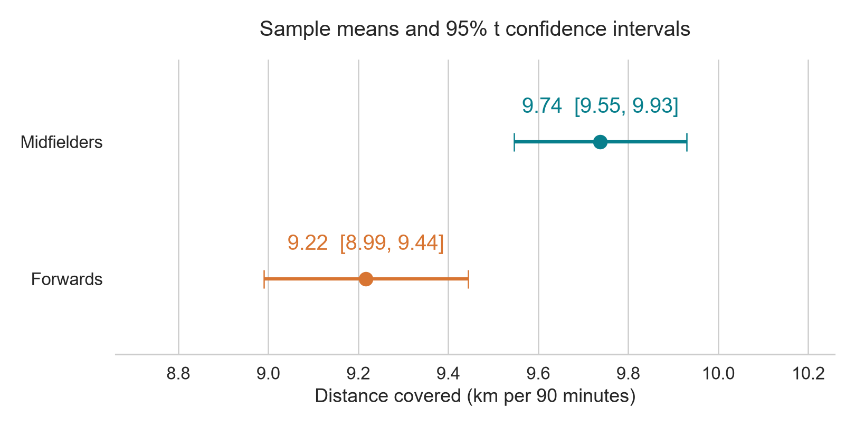
Midfielders ran 0.52 km farther per 90
At least 180 minutes / Random sample of 30 per position
Difference: 0.521 km/90
95% CI
0.224 to 0.818 km/90
t = 3.589, df = 29
p = 0.001206
Reject H0 at 5%
Distance / minutes × 90 Eligible frame: 57 MF, 91 FW
CDU HIT140 / Maximus Turner
02
Notes:
For running, players needed at least 180 minutes and recorded distance. Distance divided by minutes, multiplied by ninety, makes playing duration comparable. The random samples contain thirty players per position, using fixed seeds.
Midfielders averaged 9.74 kilometres per ninety, compared with 9.22 for forwards. The chart shows each mean and its ninety-five percent confidence interval. The estimated difference is 0.52 kilometres, with a difference interval from 0.22 to 0.82.
The course two-sample test gives t equal to 3.59, with 29 degrees of freedom, and p equal to 0.0012. We reject the null hypothesis.
Source: FIFA player statistics and glossary, https://www.fifa.com/en/tournaments/mens/worldcup/canadamexicousa2026/statistics/player-statistics. Original snapshots 31 August 2026; minutes supplement 10 September 2026. Analysis outputs generated in Python. See docs/max_analysis_notes.md for complete methods and source limitations.
Group SD: MF 0.513, FW 0.608 km/90. Means/CI figure is a Python image to meet the assessment visualisation rule. Numerical data remain in outputs/task1_running_descriptive_and_ci.csv. Primary test uses conservative course df, Welch sensitivity p=0.000696.

Slide 3
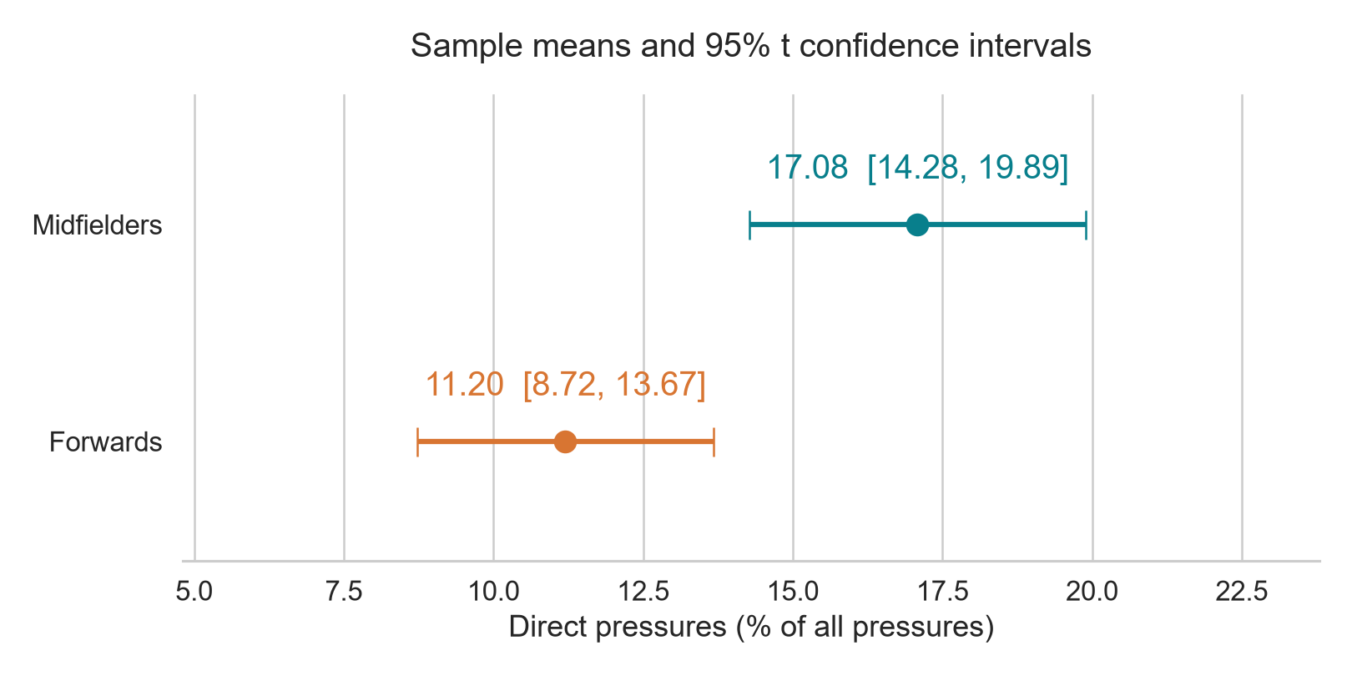
Direct-pressure share was higher for midfielders
At least 90 minutes and positive pressures / 40 per position
Difference: 5.885 points
95% CI
2.141 to 9.628 points
t = 3.179, df = 39
p = 0.002888
Reject H0 at 5%
100 × direct pressures / all pressures Eligible frame: 71 MF, 49 FW
CDU HIT140 / Maximus Turner
03
Notes:
The less obvious question concerns pressing composition. For each player, direct pressures divided by all pressures, multiplied by one hundred, gives a percentage. It describes pressing style, not success.
Players needed at least ninety minutes and positive recorded pressures. Forty players were sampled per position. Midfielders averaged 17.08 percent, compared with 11.20 percent for forwards. The difference is 5.88 percentage points, with a ninety-five percent interval from 2.14 to 9.63.
The test gives t equal to 3.18, with 39 degrees of freedom, and p equal to 0.0029. Again, we reject the null.
Source: FIFA player statistics and glossary, https://www.fifa.com/en/tournaments/mens/worldcup/canadamexicousa2026/statistics/player-statistics. Original snapshots 31 August 2026; minutes supplement 10 September 2026. Analysis outputs generated in Python. See docs/max_analysis_notes.md for complete methods and source limitations.
The mean is an unweighted average of player percentages, not a pooled event ratio or success rate. Group SD: MF 8.780, FW 7.742 percentage points. Numerical data: outputs/task2_pressing_descriptive_and_ci.csv. Welch sensitivity p=0.002128.

Slide 4
Interpretation and lessons learned
Both differences are statistically significant under the course model
Incomplete joins change the sample
281 recovered minute records improved coverage.
The captured tables still limit generalisation.
Denominators change the question
Running measures workload. Direct-pressure share describes style.
Small p-values need context
Exploratory selection, skewed pressing data and shared team tactics
limit the inference. Position does not establish causation.
CDU HIT140 / Maximus Turner
04
Notes:
These findings are exploratory. The second question was selected after inspecting alternatives. Partial source coverage limits generalisation, and shared team tactics may weaken independence. Pressing is right-skewed, and plausible outliers were retained. Larger samples help, but do not remove these limitations.
My main lessons are that incomplete joins change the sample, denominators change a question's meaning, and a small p-value needs context. These samples suggest midfielders run farther and apply a larger share of pressures directly. They do not establish that playing position causes either difference.
[If another presenter follows, replace the final sentence or shorten the conclusion to add: "I'll now hand over for the next analysis." Keep total time under three minutes.]
Source: FIFA player statistics and glossary, https://www.fifa.com/en/tournaments/mens/worldcup/canadamexicousa2026/statistics/player-statistics. Original snapshots 31 August 2026; minutes supplement 10 September 2026. Analysis outputs generated in Python. See docs/max_analysis_notes.md for complete methods and source limitations.
This concludes the narrated segment. Do not narrate appendix slides within the three-minute recording. Adapt handoff to the combined presentation.

Slide 5
Reference: sampling and inference
Optional technical reference, outside the narrated segment
State and plan
Each task compares two eligible-group means. Players are the units.
Sample without replacement: MF seed 2026, FW seed 2027.
Solve
t = (mean MF − mean FW) / sqrt(s² MF / n MF + s² FW / n FW)
Course df = min(n MF − 1, n FW − 1)
Mean CI = mean ± t critical × s / sqrt(n)
Large sampling fractions and team dependence make inference approximate.
Welch sensitivity retains both decisions. All nominal tests are exploratory.
CDU HIT140 / Maximus Turner
05
Notes:
Source: FIFA player statistics and glossary, https://www.fifa.com/en/tournaments/mens/worldcup/canadamexicousa2026/statistics/player-statistics. Original snapshots 31 August 2026; minutes supplement 10 September 2026. Analysis outputs generated in Python. See docs/max_analysis_notes.md for complete methods and source limitations.
Course references: CDU HIT140 Week 2 descriptive statistics; Week 3 sampling and confidence intervals; Week 4 hypothesis testing and conservative df; Week 5 data preparation; Weeks 6-7 EDA and communication. Week 8 regression is outside Objective 1. Full notes and test outputs provide numerical detail.

Slide 6
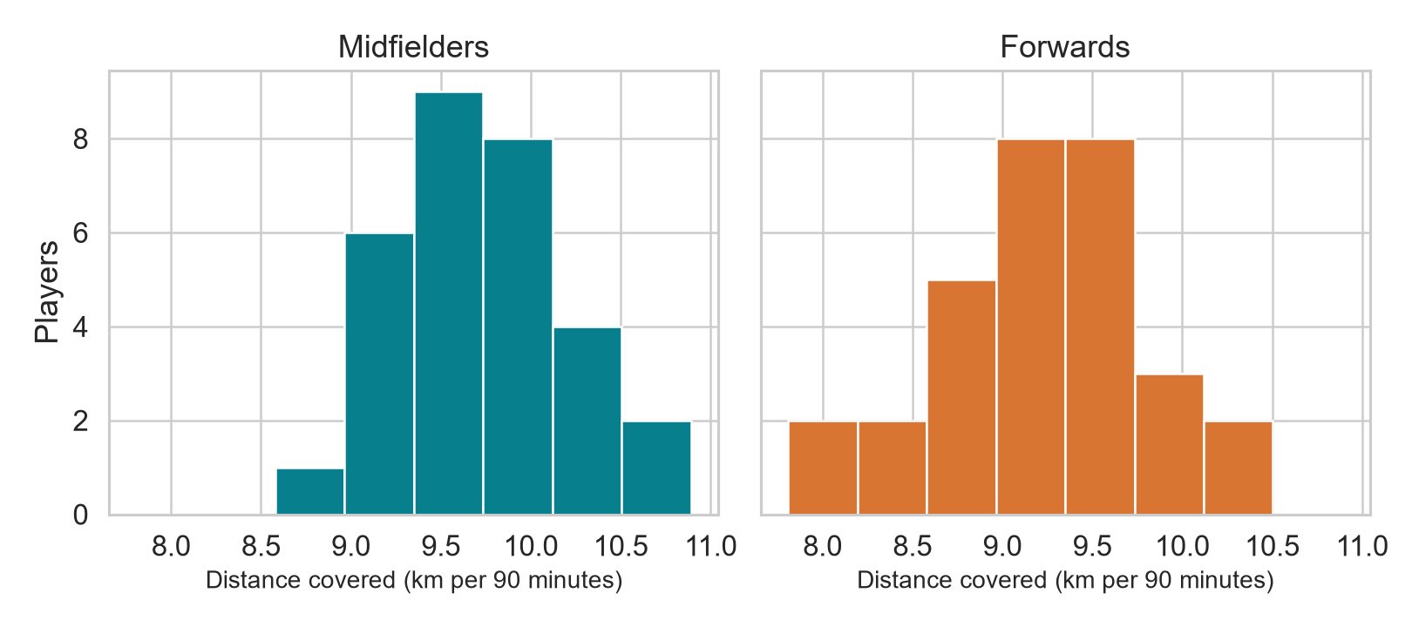
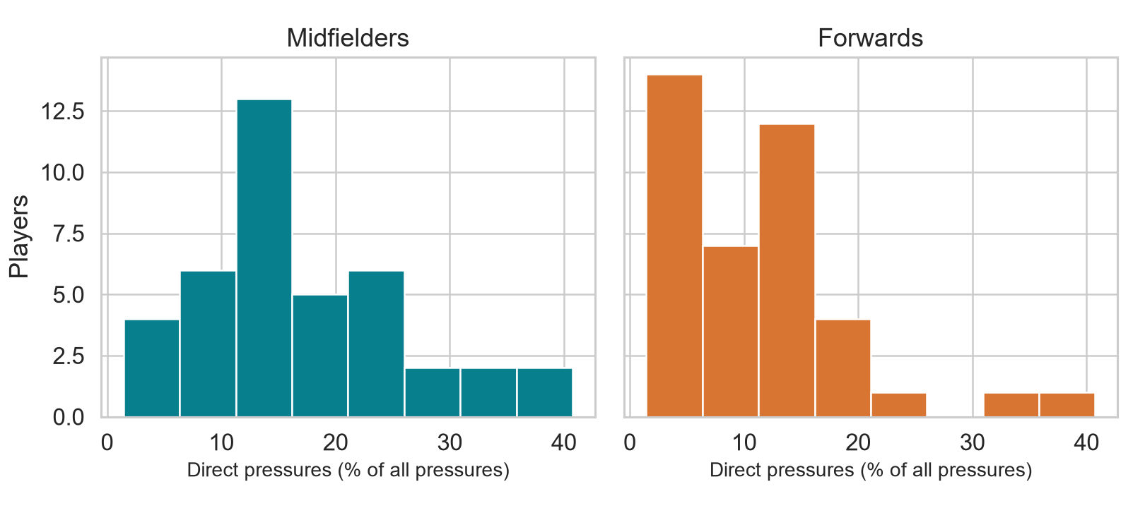
Reference: distributions and source limits
Optional technical reference, outside the narrated segment
Running: 1 IQR outlier, retained
Pressing: 2 per group, retained
Physical: 350/350 records matched minutes
Defending: 294/350 matched, 56 with unknown eligibility
CDU HIT140 / Maximus Turner
06
Notes:
Source: FIFA player statistics and glossary, https://www.fifa.com/en/tournaments/mens/worldcup/canadamexicousa2026/statistics/player-statistics. Original snapshots 31 August 2026; minutes supplement 10 September 2026. Analysis outputs generated in Python. See docs/max_analysis_notes.md for complete methods and source limitations.
Running skewness MF 0.126, FW -0.391. Pressing skewness MF 0.953, FW 1.625. No normality claim is made for pressing. The CLT supports approximate mean inference with n=40 but does not remove clustering or selection bias. Physical leaderboard capture was partial and sorted by top speed. Zero-denominator and missing-metric cases are excluded rather than imputed.

