Slide 1

TestBenchmark1 List<int>[100000]

Slide 2

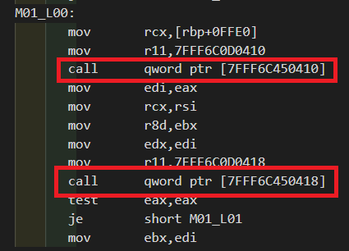
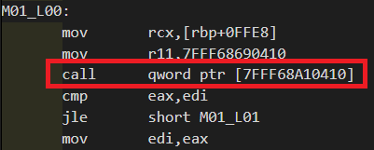
TestBenchmark2 List<int>[100000]

Slide 3


TestBenchmark3 List<int>[100000]
TestBenchmark3 List<Account>[100000]

Slide 4



TestBenchmark4 List<int>[100000]
TestBenchmark4 List<Account>[100000]
Increment:

Slide 5
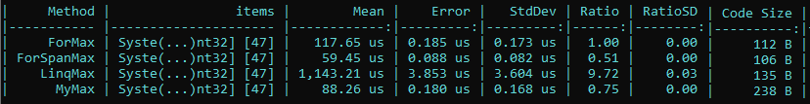
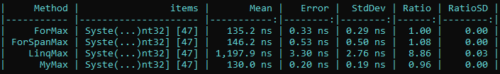
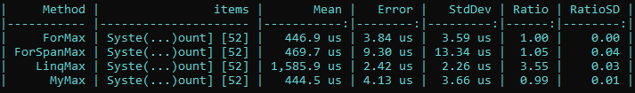
TestBenchmark5 List<int>[100000]
TestBenchmark5 List<int>[100]
TestBenchmark5 List<Account>[100000]

Slide 6
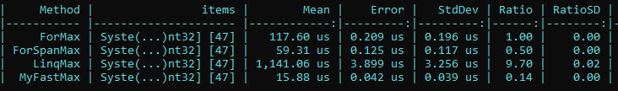
TestBenchmark5 Intrinsics List<int>[100000]

