Slide 1

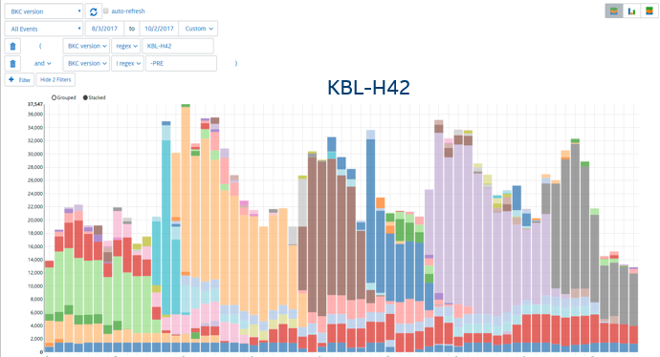


Lantern Rock on Hybrid-Cloud
12114-Lantern Rock - SD Elements (intel.com)
Intel Cloud/PaaS
databases
ASPN
ASPN
https://analytics.intel.com
portal
batch
Internal
ASPN
ASPN
SDLe
App
App
LRIO
https://us-west-2.sthree.intel.com/...
s3rproxy
SQS
ASPN
ASPN
LR SDK
LR SDK
https://c.telemetry.intel.com
S3
Telemetry
Local Stores
collector
https://telemetry.intel.com
collector
archives
logs
collector
SDLe
SDLe
client devices
policy
policies
External
policy
SDLe
collector
attachments
rejects
collector
SDLe
collector
SDLe
https://telemetry.intel.com
App
App
LRIO
https://c.telemetry.intel.com
LR SDK
LR SDK
https://s3-us-west-2.amazonaws.com/...
Telemetry
Local Stores
client devices
AWS Cloud/IaaS
SDLE Project - Lantern Rock SDK (intel.com)
SDLe
ASPN
12114-Lantern Rock
SDLE Project - Telemetry Collector Service (intel.com)
SDLe
17576-Object Store Reverse Proxy)
SDLE Project - Lantern Rock Policy Service (intel.com)
ASPN
SDLe

Slide 2

Lantern Rock Architecture for SDLe
External
AWS
Cloud
Intel
Cloud
Internal
Collector
service
Batch
Telemetry
(https)
S3
Application
AWS SDK
(https)
SQS
AWS SDK
(https/proxy)
Telemetry
Local Store
Uploader
LRIO.exe
(scheduled task)
Attachment file
(S3 pre-signed url/https)
SQL/TLS
LR SDK
(DLL)
Telemetry
(File write)
Telemetry
(File read)
DB
Cluster
Policy
service
Policy File
(https)
AWS SDK
(https)
S3
SQL/TLS
Client Device
Portal
service
LR
Portal
https
out-of-scope

Slide 3
SDK API
Simple API*
Initialize(app_version, tid, ... )
BeginSession()
RecordEvent(name, count, sum, optional segment_kv[])
AttachFile(name, filepath, optional segment_kv[])
EndSession()
Flush()
Deinitalize()
Upload(tid,options)
Each session is captured in temporary storage on disk and uploaded in bulk with other sessions.
Telemetry data is uploaded to the REST endpoint over HTTPS. Steps are taken to ensure the data is uploaded to a known endpoint. Much more than a wrapper around a REST API
Policy controls aging, upload attempts, max cache size, endpoints, security, etc.

Slide 4
Data recording flow
Application
LR SDK
Initialize
IO Thread
CreateThread
BeginSession
QueueIO
CreateFile
Telemetry files
Attachment files
RecordEvent
QueueIO
AttachFile
WriteFile
QueueIO
WriteFile
EndSession
QueueIO
Flush
CloseFile
Deinitialize
FlushIO
Flush
CloseFile
data store
Join
Destroy

Slide 5
Policy download flow
Uploader
Policy
service
AWS S3
LR Admin
provision
policy
S3 sync
(https/proxy)
S3 cp
(https)
S3
policy
bucket
cached
policy files
start
up
S3 sync
(https)
policy
file
read
check
validity
write
expired
https get (/telemetry-policy/<tid>)
(telemetry.intel.com)
Client
Cloud
Internal

Slide 6
Telemetry upload flow
Policy
service
Collector
service
uploader
AWS S3
policy
file
read
https get
(telemetry.intel.com)
telemetry
report files
aggregate
https post (/v2/collector)
(c.telemetry.intel.com)
attachment
metadata
read
https post (/v3/attach)
(c.telemetry.intel.com)
https request
pre-signed url
attachment
file
pre-signed url
fetch
https post (pre-signed url)
(s3-us-west-2.amazonaws.com)
data store
Client
Cloud

Slide 7

Collector connection establishment flow
Collector
service
(c.telemetry.intel.com)
uploader
policy
file
read (collector url)
(trusted cert hash)
initiate TLS connection
server cert info
check cert hash
mismatch
terminate TLS connection
match
complete TLS connection
Client
Cloud

Slide 8
Telemetry payload message digest verification flow
Collector
service
(c.telemetry.intel.com)
uploader
AWS S3
telemetry
files
read
aggregate
generate
payload
digest
https post
(digest in header)
payload
digest
good
http 200
S3
S3 write
(https)
http 400
payload
digest
bad
Client
Cloud

Slide 9
Portal User Data Access Flow
Intel
User
Portal
service
Azure
SSO
DbaaS
APIs
Hub
DB
App
DB
https get
(get hub db connection info)
sql/tls
(establish connection to hub db)
https://analytics.intel.com
https://login.microsoftonline.com/...
(authn user request)
https post
(SAML response)
sql/tls
(authz user: john.smith@intel.com)
sql/tls
(app db name)
https get
(get app db connection info)
sql/tls
(establish connection to app db)
sql/tls
(send queries to app db)

Slide 10
Portal Programmatic Data Access Flow
Intel
User
Intel
Tool
Portal
service
DbaaS
APIs
Hub
DB
App
DB
https get
(get hub db connection info)
sql/tls
(establish connection to hub db)
request LR admin for token to query app data
sql/tls
(generate token and save to hub db)
return token to user
https get
(query with token/appid)
sql/tls
(authz request: token/appid)
sql/tls
(app db name)
https get
(get app db connection info)
sql/tls
(establish connection to app db)
sql/tls
(send query to app db)

Slide 11
backup

Slide 12
Lantern Rock SDKs
ver 3.0
ver 2.2
C# wrapper
python wrapper
Native C/C++ codebase
.NET standard library codebase
Windows
Linux
MacOS
Windows
Linux
MacOS

Slide 13
Hybrid-Cloud Infrastructure
Intel Cloud/PaaS
databases
https://analytics.intel.com
portal
batch
App
App
LRIO
https://us-west-2.sthree.intel.com/...
s3rproxy
SQS
Internal
LR SDK
LR SDK
https://c.telemetry.intel.com
S3
Telemetry
Local Stores
collector
https://telemetry.intel.com
collector
archives
logs
collector
client devices
policy
policies
policy
collector
attachments
rejects
collector
collector
https://telemetry.intel.com
App
App
LRIO
https://c.telemetry.intel.com
External
LR SDK
LR SDK
https://s3-us-west-2.amazonaws.com/...
Telemetry
Local Stores
AWS Cloud/IaaS
client devices
Lantern Rock Cloud Instances

Slide 14
Lantern Rock on Hybrid-Cloud
12114-Lantern Rock - SD Elements (intel.com)
Intel Cloud/PaaS
databases
ASPN
ASPN
https://analytics.intel.com
portal
batch
Internal
ASPN
ASPN
SDLe
App
App
LRIO
https://us-west-2.sthree.intel.com/...
s3rproxy
SQS
ASPN
ASPN
LR SDK
LR SDK
https://c.telemetry.intel.com
S3
Telemetry
Local Stores
collector
https://telemetry.intel.com
collector
archives
logs
collector
SDLe
SDLe
client devices
policy
policies
External
policy
SDLe
collector
attachments
rejects
collector
SDLe
collector
SDLe
https://telemetry.intel.com
App
App
LRIO
https://c.telemetry.intel.com
LR SDK
LR SDK
https://s3-us-west-2.amazonaws.com/...
Telemetry
Local Stores
client devices
AWS Cloud/IaaS
SDLE Project - Lantern Rock SDK (intel.com)
SDLe
ASPN
12114-Lantern Rock
SDLE Project - Telemetry Collector Service (intel.com)
SDLe
17576-Object Store Reverse Proxy)
SDLE Project - Lantern Rock Policy Service (intel.com)
ASPN
SDLe

Slide 15
ITS Data Support
Intel Cloud
(OR-INT)
db-hub
portal
(FM-HTZ)
dbs
dbs
s3rproxy
batch
batch
collector
ITS-Data
Client
IC-Data
Client
collector
Q
Q
Internal
policy
S3
S3
External
policy
IC-Data
Client
collector
collector
ITS-Data Client
AWS Cloud

Slide 16



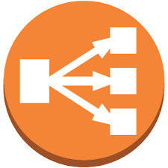






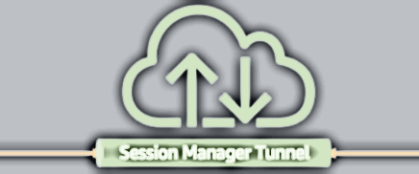

10.0.0.0/16
destination | target
10.0.0.0/16 | local
0.0.0.0/0 | igw-id
destination | target
10.0.0.0/16 | local
pl-id for S3 | vpce-id
public subnet
private subnet
S3 service
sg-elb
deploy
logs
Internet
gateway
sg-collector
EC2
https/443
(ACLs)
Client
https
443
https/443
Collector
VPC gateway
endpoint
archive
attachment
router
ELB
SSM agent
c.telemetry.intel.com
https/443
sg-ssm
https/443
VPC interface
endpoints for SSM
Internet
10.0.x.0/24
10.0.y.0/24
SSM service
Availability zone

Slide 17
10.0.0.0/16
destination | target
10.0.0.0/16 | local
0.0.0.0/0 | igw-id
destination | target
10.0.0.0/16 | local
pl-id for S3 | vpce-id
public subnet
private subnet
S3 service
sg-elb
deploy
logs
Internet
gateway
sg-collector
EC2
https/443
(ACLs)
Client
https
443
https/443
Policy
VPC gateway
endpoint
policy
router
ELB
SSM agent
telemetry.intel.com
https/443
sg-ssm
https/443
VPC interface
endpoints for SSM
Internet
10.0.x.0/24
10.0.y.0/24
SSM service
Availability zone

Slide 18
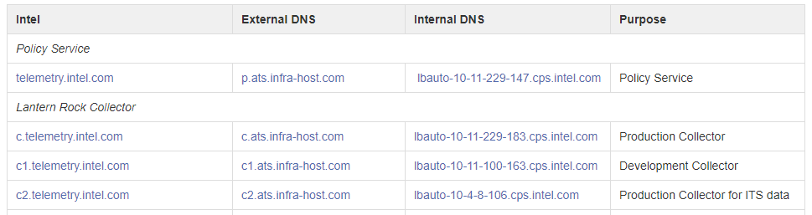
Split DNS
Domain name resolved based on the client location
External DNS resolved thru infra-host.com and managed in AWS Route 53
Some entries have an alternate entry for internal resolution that routes to internal deployment.

Slide 19
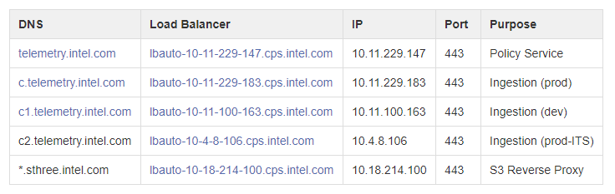
Internal Firewall Whitelisting

Slide 20

Analytics
https://wiki.ith.intel.com/display/lr/Analytics
Telemetry data is available via analytics.intel.com, REST API (FlexQ), SQL or Raw; with increasingly higher barrier of entry.
Recommended: PowerBI + FlexQ
analytics.intel.com
REST / FlexQ
SQL
Raw/S3

Slide 21
App
A
A
portal
App
B
batch
B
S3
Q
batch
batch
App
C
C
collector
Q
batch
S3
IDSA
batch
IDSA
App
IDSA

Slide 22
Telemetry Data
https://wiki.ith.intel.com/display/lr/Telemetry
Default Telemetry Data
Device ID & User ID (persistent anonymous/random GUIDs)**
Application Version & ‘bitness’ (32/64)
OS Name, Version & ‘bitness’ (32/64)
BIOS Version
BKC
Language-Locale
Manufacturer & SKU
CPU Brand String, Model/Family/Stepping
Memory (MB)
Primary Display Resolution
The reporting IP addressed is used to capture the Region/Country and Origin (Internal/External to proxy)
We derive user retention, loyalty, session duration, frequency & activity + context from this data
Custom events can be collected via the RecordEvent API.
** SDK supports a mode of operation that zero’s the Device/User ID

Slide 23
App Telemetry Data
https://wiki.ith.intel.com/display/lr/Telemetry
RecordEvent(..)
AttachFile(..)
{
"t": "evt", "n": "EventName", "c": 1, "s": 0.0, "ts": 1394238341,
"d": { // dictionary
"key1": "value1",
"key2": "value2"
}
}
{
"t": “atc", "n": “AttachmentName", “_p": file_path, “sz": 2048, “g": “895b73fa-1946-4032-9fbb-25d891fb1a2b”, "ts": 1394238341,
"d": { // dictionary
"key1": "value1",
"key2": "value2"
}
}

Slide 24
Telemetry Store Disk Layout
IAS2_API ias_error_t Initialize(
ias_handle_t* sdk_handle,
const wchar_t* app_name,
const wchar_t* app_version,
const wchar_t* telemetry_id,
const wchar_t* options,
const wchar_t* store_folder);
%ProgramData%
/Intel Telemetry
policy optional
/<app> AppName from Initialize
policy optional
did device id guid
%LocalAppData% override w/ store_folder in Initialize
/Intel Telemetry
policy optional
/<app> AppName from Initialize
policy optional
uid user id guid
/<telemetry id> from Initialize; provisioned by LR team
policy fetched from cloud
s-timestamp.json session file (temp storage)
r-timestamp.json report file (aggregated sessions)
p-timestamp.json post file (aggregated reports)
a-timestamp.json attach file (attachment metadata)
Notes:
I 08:49:27.0565612 P03484 T08876 SDK Build Version engineering
V 08:49:27.0566309 P03484 T08876 sharedfolder: C:\ProgramData\Intel Telemetry\test
V 08:49:27.0566518 P03484 T08876 storefolder: C:\Users\jboelter.AMR\AppData\Local\Intel Telemetry\test
V 08:49:27.0566688 P03484 T08876 store_path_did: C:\ProgramData\Intel Telemetry\test\did
V 08:49:27.0566861 P03484 T08876 store_path_uid_: C:\Users\jboelter.AMR\AppData\Local\Intel Telemetry\test\uid
V 08:49:27.0567191 P03484 T08876 store_path_policy_tid_: C:\Users\jboelter.AMR\AppData\Local\Intel Telemetry\test\00000000-0000-0000-0000-000000000000\policy
V 08:49:27.0567364 P03484 T08876 store_path_policy_app_: C:\Users\jboelter.AMR\AppData\Local\Intel Telemetry\test\policy
V 08:49:27.0567622 P03484 T08876 store_path_policy_device_tid_: C:\ProgramData\Intel Telemetry\test\00000000-0000-0000-0000-000000000000\policy
V 08:49:27.0567807 P03484 T08876 store_path_policy_device_app_: C:\ProgramData\Intel Telemetry\test\policy
V 08:49:27.0568097 P03484 T08876 store_path_policy_device_: C:\ProgramData\Intel Telemetry\policy
V 08:49:27.0568306 P03484 T08876 store_path_sessions_: C:\Users\jboelter.AMR\AppData\Local\Intel Telemetry\test\00000000-0000-0000-0000-000000000000
V 08:49:27.0568507 P03484 T08876 store_path_reports_: C:\Users\jboelter.AMR\AppData\Local\Intel Telemetry\test\00000000-0000-0000-0000-000000000000
V 08:49:27.0602243 P03484 T08876 checking for non-zero guid
V 08:49:27.0602345 P03484 T08876 checking for non-zero guid
V 08:49:27.0614482 P03484 T08876 checking for non-zero guid
V 08:49:27.0614578 P03484 T08876 checking for non-zero guid
V 08:49:27.0615229 P03484 T08876 >>> ias_policy::load
V 08:49:27.0620970 P03484 T08876 >>> ias_policy::load
V 08:49:27.0621038 P03484 T08876 >>> ias_policy_factory::parse_version
V 08:49:27.0621530 P03484 T08876 <<< ias_policy_factory::parse_version
V 08:49:27.0621590 P03484 T08876 >>> ias_policy::parse_authorities
V 08:49:27.0621756 P03484 T08876 policy: authorities is not an object
V 08:49:27.0621908 P03484 T08876 <<< ias_policy::parse_authorities
V 08:49:27.0623303 P03484 T08876 policy: policy 0 v1 data authority is not a string
V 08:49:27.0623367 P03484 T08876 policy: policy 0 v1 data resource is not a string
V 08:49:27.0624160 P03484 T08876 <<< ias_policy::load
V 08:49:27.0624821 P03484 T08876 <<< ias_policy::load
V 08:49:27.0631798 P03484 T08876 no policy file at C:\Users\jboelter.AMR\AppData\Local\Intel Telemetry\test\00000000-0000-0000-0000-000000000000\policy
V 08:49:27.0635826 P03484 T08876 no policy file at C:\Users\jboelter.AMR\AppData\Local\Intel Telemetry\test\policy
V 08:49:27.0640689 P03484 T08876 no policy file at C:\ProgramData\Intel Telemetry\test\00000000-0000-0000-0000-000000000000\policy
V 08:49:27.0643496 P03484 T08876 no policy file at C:\ProgramData\Intel Telemetry\test\policy
V 08:49:27.0646041 P03484 T08876 no policy file at C:\ProgramData\Intel Telemetry\policy
I 08:49:27.0647460 P03484 T08876 effective policy
authorities:
<<empty>>
retention:
max_cache: 1
max_age: 90
backoff: 1
endpoint:
<<empty>>

Slide 25
What you get
Easy to integrate Telemetry SDK Simple API to quickly and easily collect baseline data; easy to extend to complex data collection needs.
Robust data collection SDK -> Cloud is secure and robust; data is persisted in raw form bounded by retention policy.
Analytics dashboard Baseline set of “Charts and Graphs” providing data insights and trends.
Raw data access Export the raw data for your own custom analysis or run map/reduce jobs on it.
Policy Controls caching, retries, security, see Policy Features.

Slide 26
te•lem•e•try (təˈlɛm ɪ tri)
n. the automated transmission and measurement of data from a distant source
an•a•lyt•ics (ˌæn lˈɪt ɪks)
n. the science of logical analysis

Slide 27
Network Connectivity Requirements
Lantern Rock cloud services are hosted on internally (iCloud) and externally (AWS). Systems on the Intel intranet can access the endpoints below without requiring a proxy (DNS lookup points to internal resources). Systems outside Intel use the same endpoints, but resolve to AWS hosted services.
Access is working if you can fetch these documents:
https://c.telemetry.intel.com/health You will see ok - #; e.g. “ok – 259463”
https://telemetry.intel.com/telemetry-policy/00000000-1111-2222-3333-444444444444/policy.json
https://sthree.intel.com/telemetry-policy/00000000-1111-2222-3333-444444444444/policy.json

Slide 28
SDK Design Guiding Principles
Simple & Transparent - Fire and forget API model that stays out of the way.
Store & Forward - Each API call stores a snippet of data to disk in (human readable json form). During upload the snippets are collected across all complete sessions and uploaded in one PUT. Intelligent handling of crashes, API abuse, etc.
Network IO- Policy fetch and telemetry upload are in a separate executable that is executed periodically (scheduled task).
Policy - Controls caching, retries, security, see Policy Features.

Slide 29
Technology Stack
Client (Windows)
SDK Redistributables
SDK .DLL + Pinvoke (.NET)
Consent UI + Control Panel (translated 34 languages)
C++, (VS 2013 Update 4)
Casablana REST library
JsonCPP library
C# PInvoke layer (3.5 or 4.5)
Wix for installer (MSI + MSM)
Cloud
Browser
JavaScript, AngularJS, Bootstrap CSS
Charting with D3/NVD3/Angular-NVD3
Misc libraries (e.g. lodash)
Backend
Amazon AWS for all hosting
EC2, ELB, ASG, S3, SQS, VPC, PostgreSQL
Automated deployment
Go Language

Slide 30
Distribution Model (Windows)
Your Application Installer
Your app includes intel-ias2.dll in your local directory
32 bit and/or 64 bit
static build is recommended (no dynamic CRT dependency for install)
Your app includes Intel.Ias2-X.5.dll if using C#
Your app integrates w/ the merge module (LanternRock.msm)
Installs the Scheduled Task to upload telemetry (runs lrio.exe)
Merge Module correctly reference counts the scheduled task when multiple products deploy w/ Lantern Rock
The newest lrio.exe will be installed; always major rev backward compatible.

Slide 31
Distribution Dependencies
Native
Implemented in C++. Compiled with VS2013 and distributed as a DLL. Binary is statically linked to the CRT. Upload component provided by an installer/merge module and runs as a scheduled task.
.NET
Implemented as a PInvoke layer on top of the native DLL. Distributed as ‘Any CPU’ with automatic selection/loading of the 32/64 bit library.
Android
Implemented in Java as a library

Slide 32
Telemetry Example
https://wiki.ith.intel.com/display/lr/Telemetry
RecordEvent(..) produces a snippet of data
{
"t": "evt", "n": "EventName", "c": 1, "s": 0, "ts": 1394238341,
"d": { // dictionary
"key1": "value1",
"key2": "value2"
}
}
StructType([
StructField('ts', TimestampType(), True), // timestamp; UTC
StructField('type', StringType(), True), // event, session, attachment
StructField('name', StringType(), True), // event name
StructField('dimension', MapType(StringType(), StringType(), True)), // key=value strings
StructField('metric', MapType(StringType(), DoubleType(), True)) // key=value integers
])

Slide 33
Debugging
ETW
The SDK is instrumented with ETW (Event Tracing for Windows) output using ETWWriteString(…). The trace.exe tool is included in the distribution. You may also use logman or setup ETW collectors on Windows.
The SDK uses GUID {8278A894-5875-4907-B3ED-FB3AC5F6FF6C}.
The uploader uses GUID {2EA5F16B-E281-4179-868B-77F8884A93F8}
As an aside, this is an awesome way to leave tracing in your code – we’ve been using this technique (and library) in various projects for 10+ years. The library supports C++ and .NET on Windows.
Notes:
Isn’t that like printf(…)? Yes…. and it’s awesome.

Slide 34
Event Telemetry RecordEvent API
RecordEvent(name, count, sum)
Captures a named event at a point in time. The event is time-stamped at the time of call. The caller specifies the count >= 1 and optionally may specify a sum.
Example: RecordEvent( “VideoViewed”, 1, 20.7) // record that a video was viewed for 20.7 seconds
RecordEvent(name, count, sum, segment_kv)
Same as above, but with an array of segmentation key/value pairs associated with the event. These key/value pairs can be used during analysis to filter data.
Example: RecordEvent( “VideoViewed”, 1, 20.7, {{“VideoId”, “sample”}, {“Resolution”, “1080p”}} ) // record that the sample video was viewed at 1080p for 20.7 seconds

Slide 35
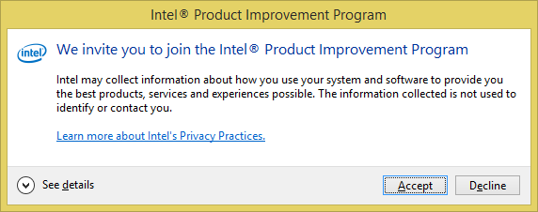
Have you interacted with a dialog like this? We build the solution to make telemetry possible.

Slide 36
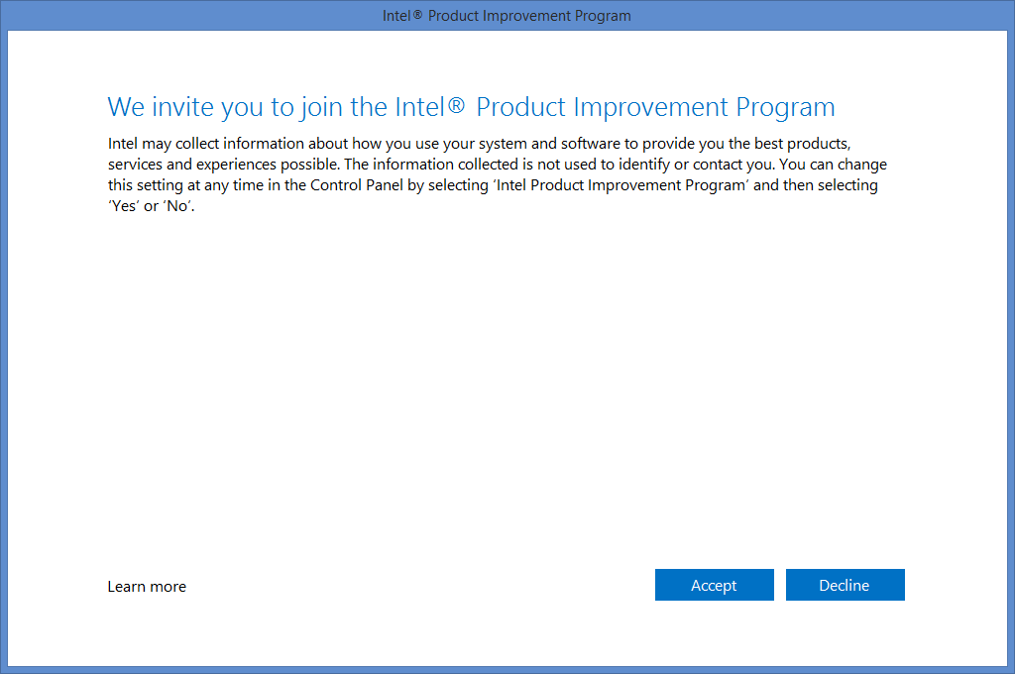
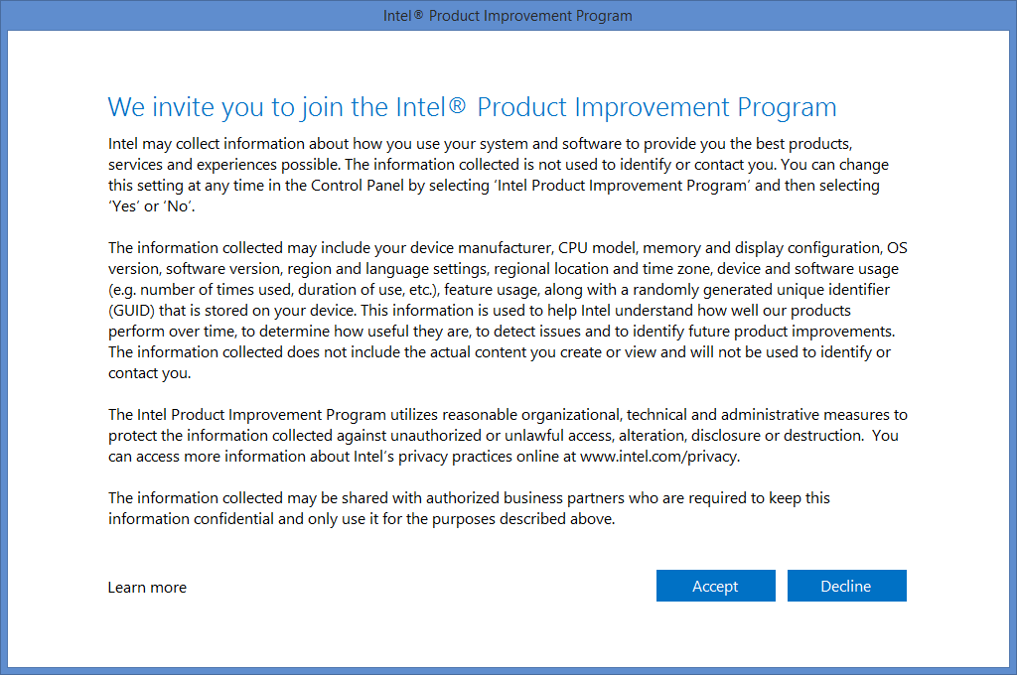
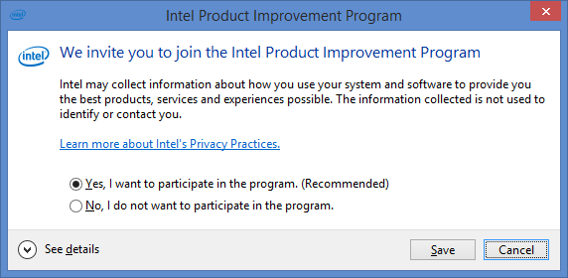
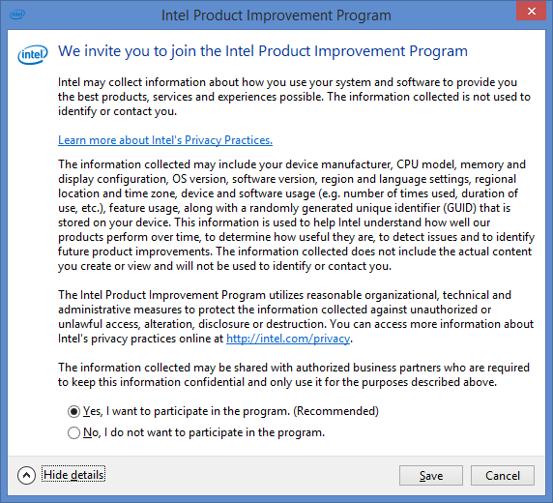
Consent Dialogs

Slide 37
Application Telemetry In Practice
Insights & Actions Taken
RealSense cut the Emotion API; the Voice API and Java were lowered in priority (lack of use).
SDS Telemetry monitors active/idle time; extending to identify outdated BKC usage and misconfigured systems.
WiDi identified 250+ Manf/Model/FW adapter combinations (so far); investigating certification impact. What % are certified?
Unite extending telemetry to measure feature usage/adoption to drive future product plans.
Intel Technology Access actively monitoring new releases for health.
XTU focusing on OS/Configs based on actual usage.
CCG/IEG
WiDi 4/5/6 *
WiDi Compatibility Tool *
Intel Extreme Tuning Utility *
SDS Telemetry *
Misc internal tools
CCG/BCP
Intel Unite *
Small Business Advantage *
Intel Authenticate *
iCDG
Wireless Docking *
SSG
Intel Technology Access*
RealSense SDK & Middleware*
Mobile Platform Monitor (MPM)
INDE development tools
VPG
Miracast User Mode Driver*
Graphics Control Panel
* Shipping Today
How loyal are our users?
How many users abandon the product? Why?
How frequently is feature X used? (and should I keep it)
Are we localizing the product for the right markets?
Are we tailoring products for the right markets?
Are we marketing to the right markets? Does it work?
What Manufacturer/SKUs are most popular?
Where do our products actually ship and get used?
Do the system configurations match arch. expectations?
Are products meeting key performance indicators?
How are our KPIs holding up in real world usage scenarios?
How often does feature/product X fail?
Do users successfully navigate multi-step UX flows?
How quickly are users adopting new versions (OS, App, Updates)?
Lantern Rock supports both real-world measurement and longitudinal studies

Slide 38
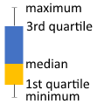
# of WiDi Sessions
# of Unique Users

Slide 39
Consumer WiDi/Miracast Analytics**
How many Miracast sessions are established per day/month/year?
How long is the typical Miracast session?
How many users are regularly/actively using Miracast? (user loyalty/retention)
How many users have used Miracast in the last N days/months/…?
How many sessions does a user establish per day/week/month/…?
What time of day/week is a typical session? (weekday/weekend day/night)
What version(s) of Windows are most popular?
What CPU/Manufacturer/SKU combinations are most popular?
What language/locale is most popular?
What geos are most popular?
** Analytics is capable of measuring data from the user base that has consented, has network connectivity to report telemetry and has not chosen to opt out.

Slide 40
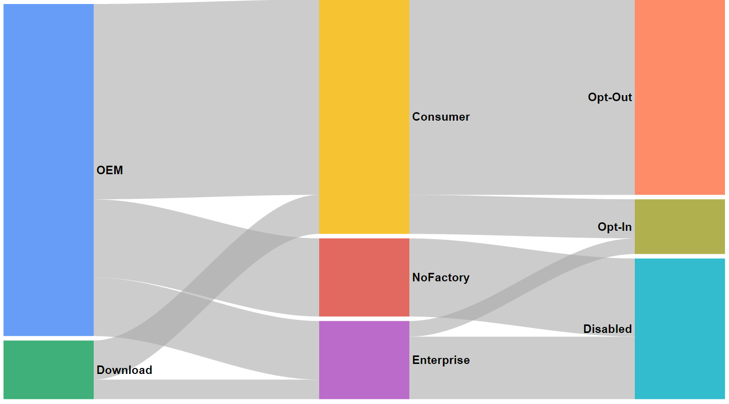
OEM Design Wins (ship w/ telemetry enabled)
Factory Install
10 – 25% consumer opt-in
The population
we may collect telemetry from.
OEM’s may disable telemetry
Direct Downloads (telemetry enabled)
Large Enterprises may disable during reimaging
Notes:
For most products, the path to telemetry goes through the OEM and Consumer.

Slide 41
Enterprise Readiness
Provide multiple opportunities to opt-in/out of telemetry at factory install, user/enterprise install or via deferred UI interaction.
Enterprise
Enable/Disable telemetry through installer flags during re-imaging [Intel or OEM supplied]
Disable telemetry through Enterprise Management Systems (SMS, Tivoli, GP, …) [need to document and publish]
Optionally Provision an ‘Enterprise ID’ (provided by Intel) to identify data from an enterprise customer
Lantern Rock (telemetry solution) comprehends Enterprise ability to proxy/inspect data
End-User
Gain consent during interactive install via EULA (end-user direct/upgrade scenarios)
Gain consent during first execution
Notes:
UI grayed out when IT controls opt-in/out.
UI hidden when disabled.

Slide 42
Policy Features
A policy document provides for tuning of telemetry data collection policy, survivability and security.
Name | Default | Purpose
policy_expiration | 30 | Days until the policy should be refreshed
telemetry_max_cache | 10 | Max size of stored telemetry data in megabytes
session_max_age | 90 | Days to keep a session until it is discarded if it cannot be uploaded
session_min_upload_backoff | 3 | Days to wait between upload attempts of a session
auth | see policy | Contains the details necessary to securely upload to Intel including protocol, host, fragment and whitelist
data | see policy | Contains the details necessary to securely upload to Intel including protocol, host, fragment and whitelist
filters (future) | None | Ability to filter out malformed event data after ship.
https://s3.amazonaws.com/telemetry-policy/policy.json

Slide 43
Consent Dialogs

Slide 44
FAQ
What about privacy?
We have a privacy plan/policy in place for the SDK that covers the default data. However, you must engage with the privacy office to determine any special requirements for your application. For example: any additional data you collect via the RecordEvent API.
How is this useful?
Collecting telemetry allows you to gain insights across the installed base of your application. This is specifically targeted at telemetry you can capture about your application behavior and usage patterns.
Who owns the data? Telemetry data is sent to Intel managed servers for internal use.
What does the policy provide?
A policy provides the ability to manage survivability (hosts changing, ssl certs changing), security and control telemetry behavior (see the slide on Policy).
How are timestamps recorded? All timestamps are captured in epoch time normalized to UTC time.
What about opt-in vs opt-out?
The outcome of your privacy review will determine if you need user opt-in or opt-out at launch.

Slide 45


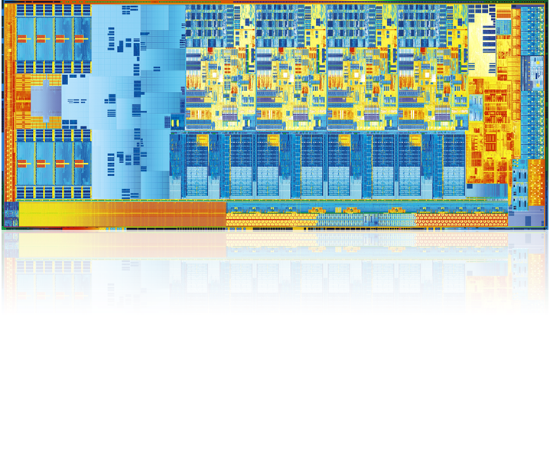






Collection Systems Across Intel
SW Opt Targets
UX Personalization
UX
Telemetry
Intel
Analytics for UX
Usages
e.g. one-off studies
Workflows
New Experiences
100’s to 1,000’s
UX Evaluation
TMG QnR
Intel Systems
System
Telemetry
e.g. DCA
Recommendation
Intel / Partner
Analytics for Business
TMG QnR
IA/OEM Planners
Instrumented Intel Applications
10s of Millions scaling up
Potentially 100’s Millions
Desktop Apps
App/Feature Usage
e.g. Lantern Rock,
Phone Home
Mobile Apps
Telemetry SDK
Intel
Analytics for Apps
App Performance
Web Apps
User Retention
10s to 100’s of Millions
Notes:
Quality Hill = Lantern Rock + DCA
AppMon (ux/small scale)
DCA (system)
PhoneHome (DPD Apps; SSG)
Lantern Rock (Generic Software Telemetry, CCG)

