Slide 1
AdmitSee Analytics
Mike Yung

Slide 2


Context
Part I: The Model
Can we build a model that predicts a student’s chances* of being admitted into college?
Part II: The Essay
What insights can we glean from a student’s admission essay?
*There are some resources that ‘calculate’ your chances based on your GPA, SAT, and demographics, but none (at least publicly available) that take into account detailed factors such as specific extracurriculars, academic trajectory, the Common App essay etc.

Slide 3
Part 1: The Model
Can we build a model that predicts a student’s chances of being admitted into college?

Slide 4

Building an Ensemble Model
Model Pipeline
Inputs
Modeling
Probabilities
Prediction
Feature
Engineering
Non-Essay Features
(GPA, SAT,
Demographics,
Extra-curriculars, etc.)
m1_prob
Accepted
/
Rejected
Final
Predictions
Essay Features
(Latent Topics,
Word Sophistication)
m2_prob
TFIDF --> NMF
Grid Search

Slide 5
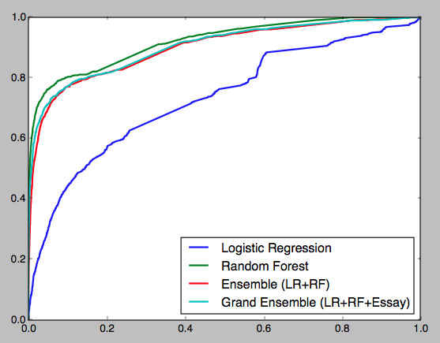
Evaluating the Model
Train Set
Random Forest overfits
Target Metric: Precision
Logistic Regression underfits
Grand Ensemble
Random Forest
Ensemble
Accuracy | 92.4 | 91.2 | 94.2
Precision | 93.1 | 91.2 | 90.1
Recall | 45.7 | 37.2 | 63.3

Slide 6

Evaluating the Model
Train Set
Random Forest overfits
Target Metric: Precision
Logistic Regression underfits
Grand Ensemble
Random Forest
Ensemble
Accuracy | 92.4 | 91.2 | 94.2
Precision | 93.1 | 91.2 | 90.1
Recall | 45.7 | 37.2 | 63.3

Slide 7
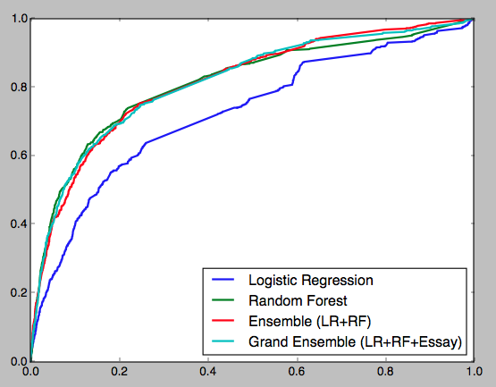
Evaluating the Model
Test Set
Target Metric: Precision
Grand Ensemble
Random Forest
Ensemble
Accuracy | 88.1 | 87.8 | 88.0
Precision | 62.8 | 61.9 | 57.7
Recall | 25.4 | 21.6 | 37.1

Slide 8
Interpreting the Model
Logistic Regression Coefficients
Variable | e^{Coefficient}
Leader | 2.26
Student Gov | 1.69
Varsity Sport | 1.58
Sports Captain | 1.29
Award | 1.22
Community Service | 1.21
SAT Score | 1.0003
SAT Times Taken | 0.39
How to Interpret
If you aren’t already in a leadership position, taking one will more than double your odds of being admitted
If you gain an additional 100 points on your SAT, you increase your odds of being admitted by 3%
If you take the SATs one more time, you reduce your odds of being admitted by 61%
*Note: this is only a subset of all variables used in the model
Notes:
Give example of how it can be used in AdmitSee’s site
If you increase your SAT score by 100 points, you improve your odds by 2x
Caveat: model assumes the incremental effect of SAT score on prob is same
In reality, it’s not. Going from 1800 to 1900 will prob have a lesser effect than 2200 to 2300

Slide 9
Part 2: The Essay
What insights can we glean from a student’s admission essay?

Slide 10
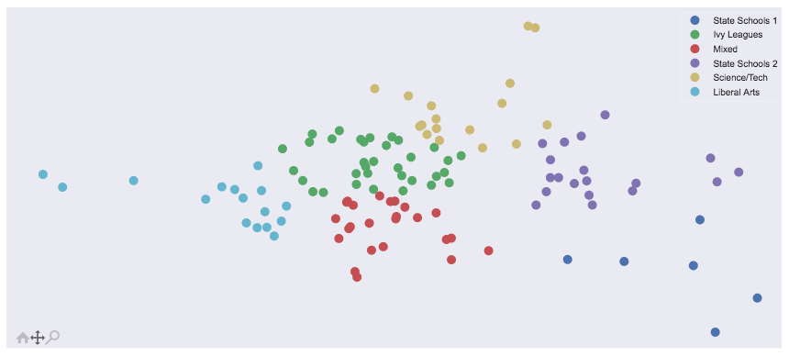
A 2-D Representation of College Essays
Step | Vectorize Text | Topic Modeling | Visualize in 2D | Clustering
Method | TF-IDF | NMF | PCA | K-Means
Scientific Focus
Personality
Driven
Career
Driven
Cultural Focus
*Each point represents a college/university

Slide 11
A 2-D Representation of College Essays
Cluster #1: Colleges with STEM Focus
Scientific Focus
Purdue
CalTech
CMU
MIT
Personality
Driven
Career
Driven
Cultural Focus
*Each point represents a college/university

Slide 12
A 2-D Representation of College Essays
Cluster #2: State Schools, Large Institutions
Scientific Focus
Arizona
State
Michigan
State
Personality
Driven
Career
Driven
Cal State
LB
Cultural Focus
SD State
*Each point represents a college/university

Slide 13
A 2-D Representation of College Essays
Cluster #3: Liberal Arts Schools
Scientific Focus
Bowdoin
Skidmore
Personality
Driven
Career
Driven
Middlebury
Wellesley
Amherst
Cultural Focus
*Each point represents a college/university

Slide 14
A 2-D Representation of College Essays
Cluster #4: A Mixed Bag
Scientific Focus
Personality
Driven
Career
Driven
Cultural Focus
*Each point represents a college/university

Slide 15
A 2-D Representation of College Essays
Cluster #5: Ivy League
Scientific Focus
Personality
Driven
Career
Driven
Cultural Focus
*Each point represents a college/university

Slide 16
Final Thoughts & Caveats
Similar Essay Recommender
INPUT: your essay
OUTPUT: 3 most ‘similar’ essays and their profiles
Currently being deployed by AdmitSee into its product
Limitation of data
Only enough to model ‘top school’ admittance
Can predict on a school-level with more data
Further NLP exploration
N-gram (bigrams, trigrams, etc.)
PoS tagging

