Slide 1
AdmitSee Analytics
Mike Yung

Slide 2
Context
2 Questions:
Can we predict a student’s chances of being admitted based on both conventional model factors and their admission essay?
What insights can we glean from a student’s admission essay?

Slide 3
Part 1: The Model
Can we predict a student’s chances of being admitted better than the existing prediction tools?

Slide 4
Building the Model
The Pipeline
Raw Features
Modeling
Probabilities
Prediction
Feature
Engineering
Non-Essay Features
(GPA, SAT,
Demographics,)
m1_prob
Accepted
/
Rejected
Final
Predictions
Essay Features
(Latent Topics,
Word Sophistication)
m2_prob
TFIDF --> NMF

Slide 5
Evaluating the Model

Slide 6
Interpreting the Model

Slide 7
Part 2: The Essay
What insights can we glean from a student’s admission essay?

Slide 8
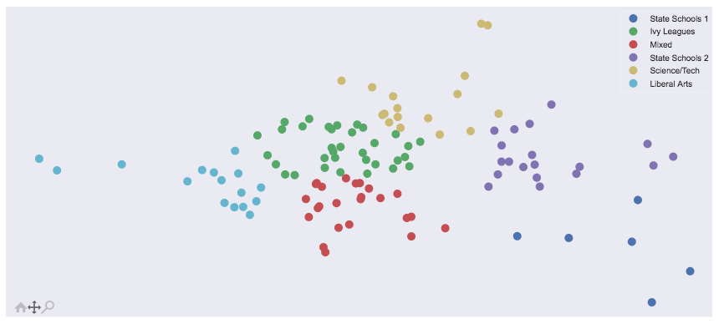
The Landscape of Colleges vs. Essay Topics

Slide 9
Tool:
Word

Slide 10
Caveats
Does not tell you what to write about
Limited data -> only enough to model ‘top schools’
With more data, can predict on a school level
Doc2Vec
N-gram (bigrams, trigrams, etc.)

