Slide 1
AdmitSee Analytics
Mike Yung

Slide 2
Context
2 Questions:
Can we predict a student’s chances of being admitted based on both conventional model factors and their admission essay?
What insights can we glean from a student’s admission essay?

Slide 3
Part 1: The Model
Can we predict a student’s chances of being admitted better than the existing prediction tools?

Slide 4
Building the Model
The Pipeline
Raw Features
Modeling
Probabilities
Prediction
Feature
Engineering
Non-Essay Features
(GPA, SAT,
Demographics,)
m1_prob
Accepted
/
Rejected
Final
Predictions
Essay Features
(Latent Topics,
Word Sophistication)
m2_prob
TFIDF --> NMF

Slide 5
Evaluating the Model

Slide 6
Interpreting the Model

Slide 7
Part 2: The Essay
What insights can we glean from a student’s admission essay?

Slide 8
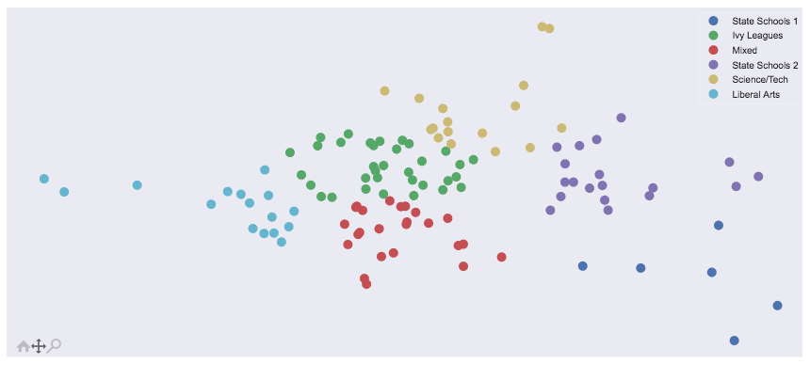
The Landscape of Colleges vs. Essay Topics
Scientific Focus
Purdue
CalTech
CMU
MIT
Personality
Driven
Career
Driven
Cultural Focus

Slide 9
The Landscape of Colleges vs. Essay Topics
Scientific Focus
Arizona
State
Michigan
State
Personality
Driven
Career
Driven
Cal State
LB
Cultural Focus
SD State

Slide 10
The Landscape of Colleges vs. Essay Topics
Scientific Focus
Bowdoin
Skidmore
Personality
Driven
Career
Driven
Middlebury
Wellesley
Amherst
Cultural Focus

Slide 11
The Landscape of Colleges vs. Essay Topics
Scientific Focus
Personality
Driven
Career
Driven
Cultural Focus

Slide 12
The Landscape of Colleges vs. Essay Topics
Scientific Focus
Personality
Driven
Career
Driven
Cultural Focus

Slide 13
Tool:
Word

Slide 14
Caveats
Does not tell you what to write about
Limited data -> only enough to model ‘top schools’
With more data, can predict on a school level
Doc2Vec
N-gram (bigrams, trigrams, etc.)

