Slide 1



AdmitSee Analytics
Mike Yung
mikeyung
yungmsh
yungmsh
Notes:
Hi everyone, my name is Mike Yung.
For my project, I was fortunate to partner with AdmitSee, a college application resource where prospective students can browse the profiles and essays of real students that have been accepted into colleges.

Slide 2


Context
The Model
Can we build a model that predicts a student’s chances* of being admitted into college?
The Essay
What insights can we glean from the Common App essay?
*There are some resources that ‘calculate’ your chances based on your GPA, SAT, and demographics, but none (at least publicly available) that take into account detailed factors such as specific extracurriculars, academic trajectory, the Common App essay etc.
Notes:
With the rich and unique dataset that AdmitSee has, I set out to explore two things:
First, to build a model that predicts a student’s chances of being admitted into college.
- Learn about what factors affect admission chances.
Second, to see what insights can we glean from the Common App essay, both on an individual and an aggregate level?

Slide 3

Building an Ensemble Model
Model Pipeline
Inputs
Modeling
Probabilities
Prediction
Feature
Engineering
Non-Essay Features
(GPA, SAT,
Demographics,
Extra-curriculars, etc.)
m1_prob
Accepted
/
Rejected
Final
Predictions
Essay Features
(Word Sophistication,
Latent Topics)
m2_prob
TFIDF --> NMF
Grid Search
Notes:
This is a simplified visual representation of the model pipeline
Basically, we start with a bunch of inputs, or features.
Most are non-essay related (like GPA, SAT, demographics, extracurriculars, academic trajectory, sports, etc.)
We then feature-engineer these raw inputs to get the features we want in the model.
Out of this feature engineering step, we also get a handful of essay features:
In a nutshell, we vectorize the essays and apply dimensionality reduction to uncover “latent topics” – we’ll touch on that in more depth later.

Slide 4
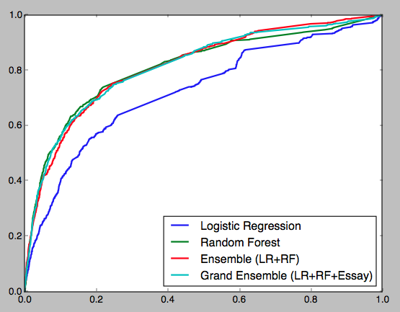

Evaluating the Model
ROC Curve (Test)
Test Set
Target Metric: Precision
Grand Ensemble
Random Forest
True Positive Rate
Ensemble
Accuracy | 88.1 | 87.8 | 88.0
Precision | 62.8 | 61.9 | 57.7
Recall | 25.4 | 21.6 | 37.1
False Positive Rate
Notes:
To evaluate the model, I spoke with AdmitSee and we agreed that optimizing Precision is best for them, since models with high-precision tend to under-estimate probabilities, which aligns with their goal of encouraging students to use the product even if they are star students.
While the visual difference between three models is minimal, the Grand Ensemble, which takes into account essay features, scores a full pp higher than basic Ensemble.
###
AUC is the probability that we will rank a randomly chosen positive data point higher than a randomly chosen negative one.

Slide 5
Interpreting the Model
Logistic Regression Model
Variable | e^{Coefficient}
Leader | 2.26
Student Gov | 1.69
Varsity Sport | 1.58
Sports Captain | 1.29
Award | 1.22
Community Service | 1.21
SAT Score | 1.0003
SAT Times Taken | 0.39
How to Interpret?
If you aren’t already in a leadership position, taking one will more than double your odds of being admitted
*Note: this is only a subset of all variables used in the model
Notes:
Now, optimizing for accuracy/precision is great, you lose interpretability with ensemble models.
However, by taking the exponents of the coefficients in our LR model, we can see how each variable affects the admissions outcome.
e.g.
If you increase your SAT score by 100 points, you improve your odds by 2x
Caveat: model assumes the incremental effect of SAT score on prob is same
In reality, it’s not. Going from 1800 to 1900 will prob have a lesser effect than 2200 to 2300

Slide 6
What’s in an Essay?
Topic Distribution of a Sample Essay
mother, father, family, parent, sister, ...
Family
Career
Music/Arts
work, success, career, educate, community,...
music, play, piano, perform, theater, ...
25%
50%
Sports
75%
Science
100%
research, science, technology, math,...
team, game, coach, player, season, ...
Personal Story
Culture
feel, think, friend, love, life, moment, ...
culture, world, language, travel, chinese, ...
Notes:
Now I want to switch gears and dive deep into the essay portion.
After vectorizing the essays (text -> sp matrix), I used NMF to reduce the dimensionality from 16,000 to 7 dimensions.
Those 7 dimensions are these 7 topics here, and the text that surrounds the topic labels are the top words for each ‘topic’. You can see that the topics fit quite nicely, with both strong association within topics, as well as pretty strong separation between topics.
So what’s the use case?
You can basically pass it any essay and it’ll tell us how strongly associated the essay with each ‘topic’ – in a sense giving us a topic distribution of an essay.
I also built a essay recommender tool trh
In this example, the essay talks mostly about sport and family, with a personal story touch to it.
(more than happy to give a live demo with a real essay afterwards).

Slide 7
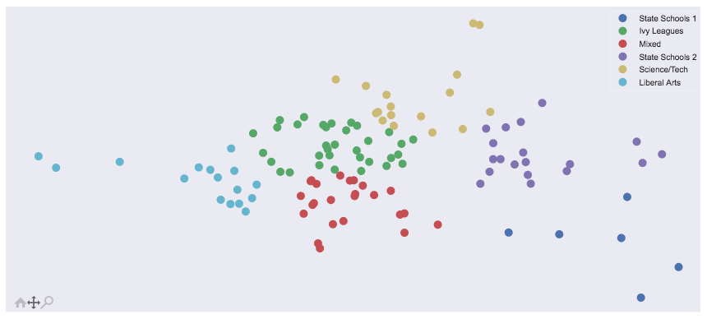
A 2-D Representation of College Essays
Step | Vectorize Text | Topic Modeling | Visualize in 2D | Clustering
Method | TF-IDF | NMF | PCA | K-Means
Scientific Focus
Personality
Driven
Career
Driven
Cultural Focus
*Each point represents a college/university

Slide 8
A 2-D Representation of College Essays
Step | Vectorize Text | Topic Modeling | Visualize in 2D | Clustering
Method | TF-IDF | NMF | PCA | K-Means
Scientific Focus
Purdue
CalTech
CMU
MIT
Arizona
State
Bowdoin
Skidmore
Michigan
State
Personality
Driven
Career
Driven
Middlebury
Wellesley
Amherst
Cal State
LB
Cultural Focus
SD State
*Each point represents a college/university

Slide 9
A 2-D Representation of College Essays
Step | Vectorize Text | Topic Modeling | Visualize in 2D | Clustering
Method | TF-IDF | NMF | PCA | K-Means
Scientific Focus
STEM
Ivy League
Personality
Driven
Career
Driven
Liberal Arts
State Schools
Mixed
Cultural Focus
*Each point represents a college/university

Slide 10
Final Thoughts
Limitation of data
Only enough to model ‘top school’ admittance
With more data:
School-level model
Graduate school model
Further NLP exploration
N-gram (bigrams, trigrams, etc.)
PoS tagging
Latent Dirichlet Allocation (LDA)

Slide 11


Thank You
Did You Know?
If you gain an additional 100 points on your SAT, you can increase your odds of being admitted by 3%
If you take the SATs one more time, you can reduce your odds of being admitted by 61%

Slide 12
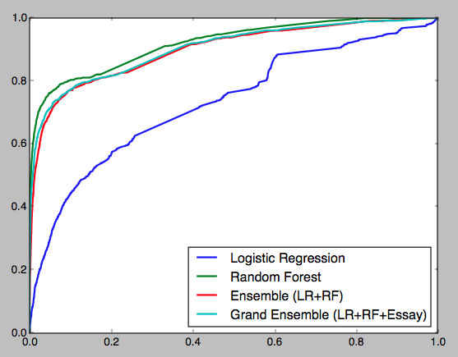
Appendix 1: ROC Curve for Train Set
ROC Curve (Train)
Train Set
Random Forest overfits
Target Metric: Precision
Logistic Regression underfits
Grand Ensemble
Random Forest
True Positive Rate
Ensemble
Accuracy | 92.4 | 91.2 | 94.2
Precision | 93.1 | 91.2 | 90.1
Recall | 45.7 | 37.2 | 63.3
False Positive Rate
Notes:
To evaluate the model, I spoke with AdmitSee and we agreed that optimizing Precision is best for them, since models with high-precision tend to under-estimate probabilities, and one of their goals is to encourage students to use the product even if they are star students.
Looking at the ROC curve on the train set, we can see that there is some overfitting w the RF model, and some underfitting w the LR model.
While the visual difference between the ensemble models is minimal, the Grand Ensemble, which takes into account essay features, is 2% higher than the basic Ensemble on precision.

Slide 13
Appendix 2: NMF Visualized
Step | Vectorize Text | Topic Modeling | Analyze
Method | TF-IDF | NMF (Fit) | NMF (Transform)
Visualization of NMF
Words
Topics
≈
Words
x
Topics
Essays
Essays
Semantic Reference
(Word vs. Topic)
Old Matrix
(Word vs. Essay)
New Matrix
(Topic vs. Essay)
Notes:
To look at essay trends on the aggregate level, we first need to analyze them at an individual level.
I applied a TF-IDF vectorizer to vectorize all the essays into a sparse matrix, then used non-negative matrix factorization (NMF) to get two new matrices: one long (our new matrix with reduced dimensionality) and one fat (that provides info on the key words for each ‘topic’).
Let’s now take a closer took at the fat matrix to see the specific topics.
### By examining this fat matrix, we can identify which words are most represented for each of the 7 dimensions, in a way uncovering the ‘latent topics’ of our essay corpus.

Slide 14
Appendix 3: NMF Semantic Reference Table
Step | Vectorize Text | Topic Modeling | Analyze
Method | TF-IDF | NMF (Fit) | NMF (Transform)
Non-Negative Matrix Factorization
Words
mother | father | family | parent | sister | ….
music | play | piano | perform | theater | …
culture | world | language | travel | american | …
team | game | coach | player | season | …
 |  |  |  |  | …
research | science | computer | technology | math | …
work | education | career | success | community | …
Family
Music/Arts
Culture
Sports
Personal/Story
Science
Career
Topics
Semantic Reference
(Word vs. Topic)
Notes:
This table shows just the top words for each ‘topic’, and you can see that the topics fit quite nicely in place, with both strong association within topics, as well as pretty strong separation between topics.

