Slide 1
ERA2-PPTX-MARKER
Office 2007–2013 baseline presentation

Slide 2
Baseline content
BULLET-ONE
BULLET-TWO
BULLET-THREE

Slide 3
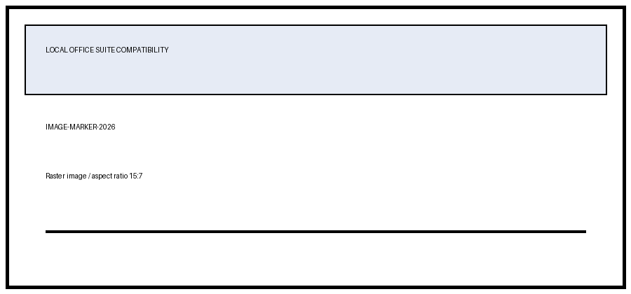
Image and table
PPT-T11 | PPT-T12 | PPT-T13
PPT-T21 | PPT-T22 | PPT-T23
PPT-T31 | PPT-T32 | PPT-T33

