Slide 1
ERA3-PPTX-MARKER
Modern Microsoft 365 feature fixture
Notes:
MODERN-NOTES-MARKER

Slide 2
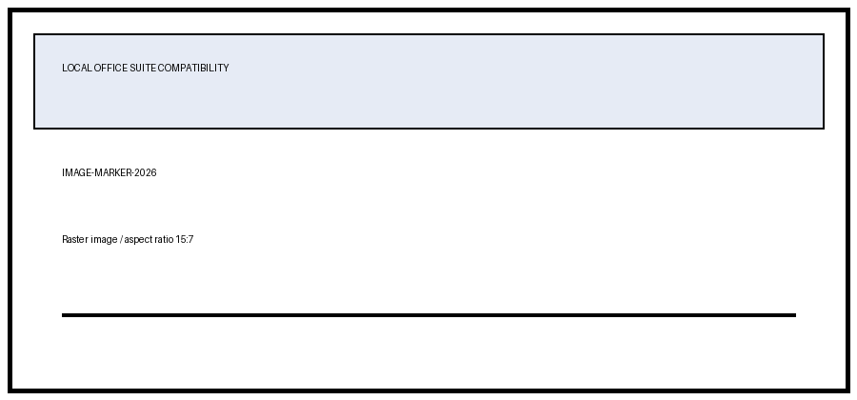
Modern objects
GROUP-A
GROUP-B

Slide 3
Table and notes
MODERN-TABLE-1-1 | MODERN-TABLE-1-2 | MODERN-TABLE-1-3 | MODERN-TABLE-1-4
MODERN-TABLE-2-1 | MODERN-TABLE-2-2 | MODERN-TABLE-2-3 | MODERN-TABLE-2-4
MODERN-TABLE-3-1 | MODERN-TABLE-3-2 | MODERN-TABLE-3-3 | MODERN-TABLE-3-4
Notes:
MODERN-NOTES-SECOND-SLIDE

