Slide 1
COVID-19 DATA ANALYSIS AND PREDICTION
Anuj Kulkarni
Vivek Gupta

Slide 2
MOTIVATION
COVID-19 is a serious pandemic affecting the whole world
Visualizing this data and predicting the positive and death cases count in a region would help implement precautionary measures for government

Slide 3
DATA ASSEMBLY/ MANAGEMENT
DATA SOURCES:
The New York Times
European Centre for Disease Prevention and Control
Public Health Agency of Canada

Slide 4
DATA ASSEMBLY/ MANAGEMENT
Operations Performed:
Gather data from multiple sources
Clean the data - remove unimportant entries / rows with null values
Handle missing values - dates whose entries were not present
COVID-19 data related operations such as handling date format of different sources
Merge the cleaned sources to a standard format
Final columns in the merged dataset: CONTINENT_NAME, COUNTRY_ALPHA3_CODE, COUNTRY_SHORT_NAME, COUNTY_FIPS_NUMBER, COUNTY_NAME, DATASOURCE_NAME, PEOPLE_DEATH_COUNT, PEOPLE_DEATH_NEW_COUNT, PEOPLE_POSITIVE_CASES_COUNT, PEOPLE_POSITIVE_NEW_CASES_COUNT, PROVINCE_STATE_NAME and REPORT_DATE

Slide 5
DATA MINING
Data mining can be described as a process used to extract usable data from a larger set of any raw data.
It involves discovering patterns in huge data sets that involves methods at the intersection of machine learning, statistics, and database systems.
A real world data mining task is defined by an automatic analysis of large data to discover unknown interesting patterns such as cluster analysis, anomaly detection or association rule mining which can be further used for machine learning or predictive analysis.

Slide 6
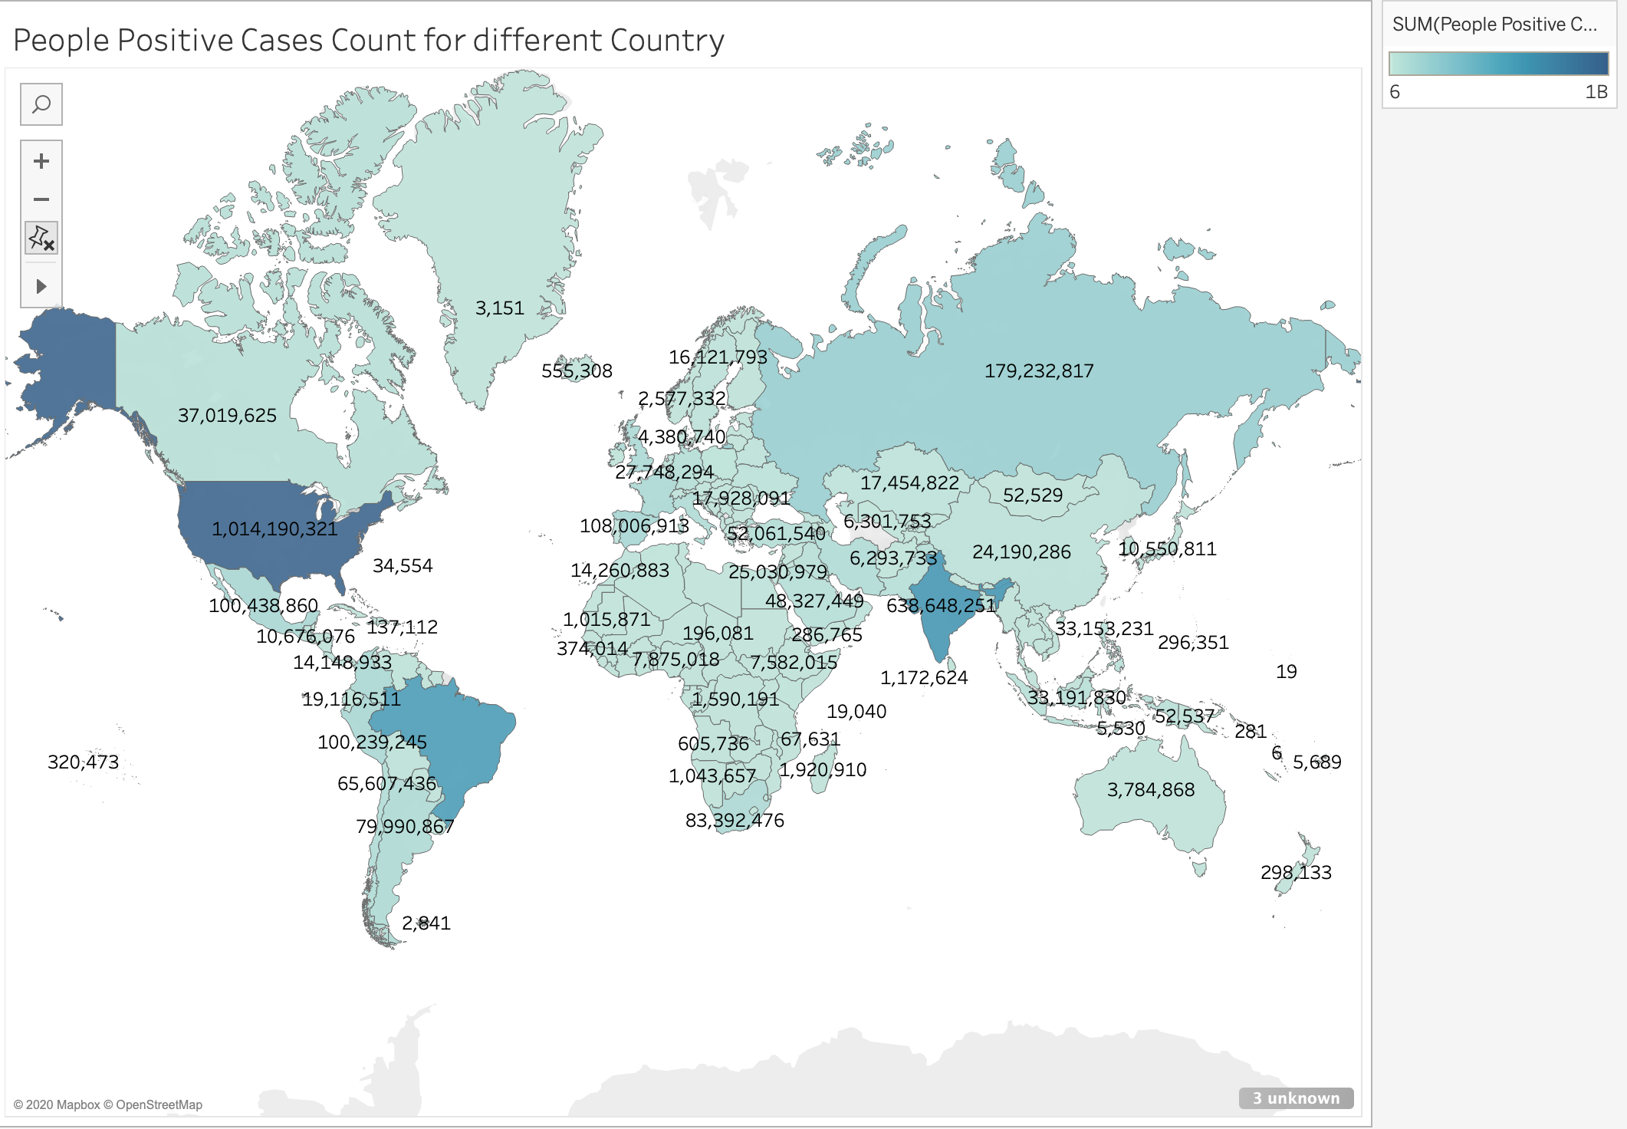
DATA MINING
VISUALIZATION OF POSITIVE CASES
FOR DIFFERENT COUNTRIES

Slide 7
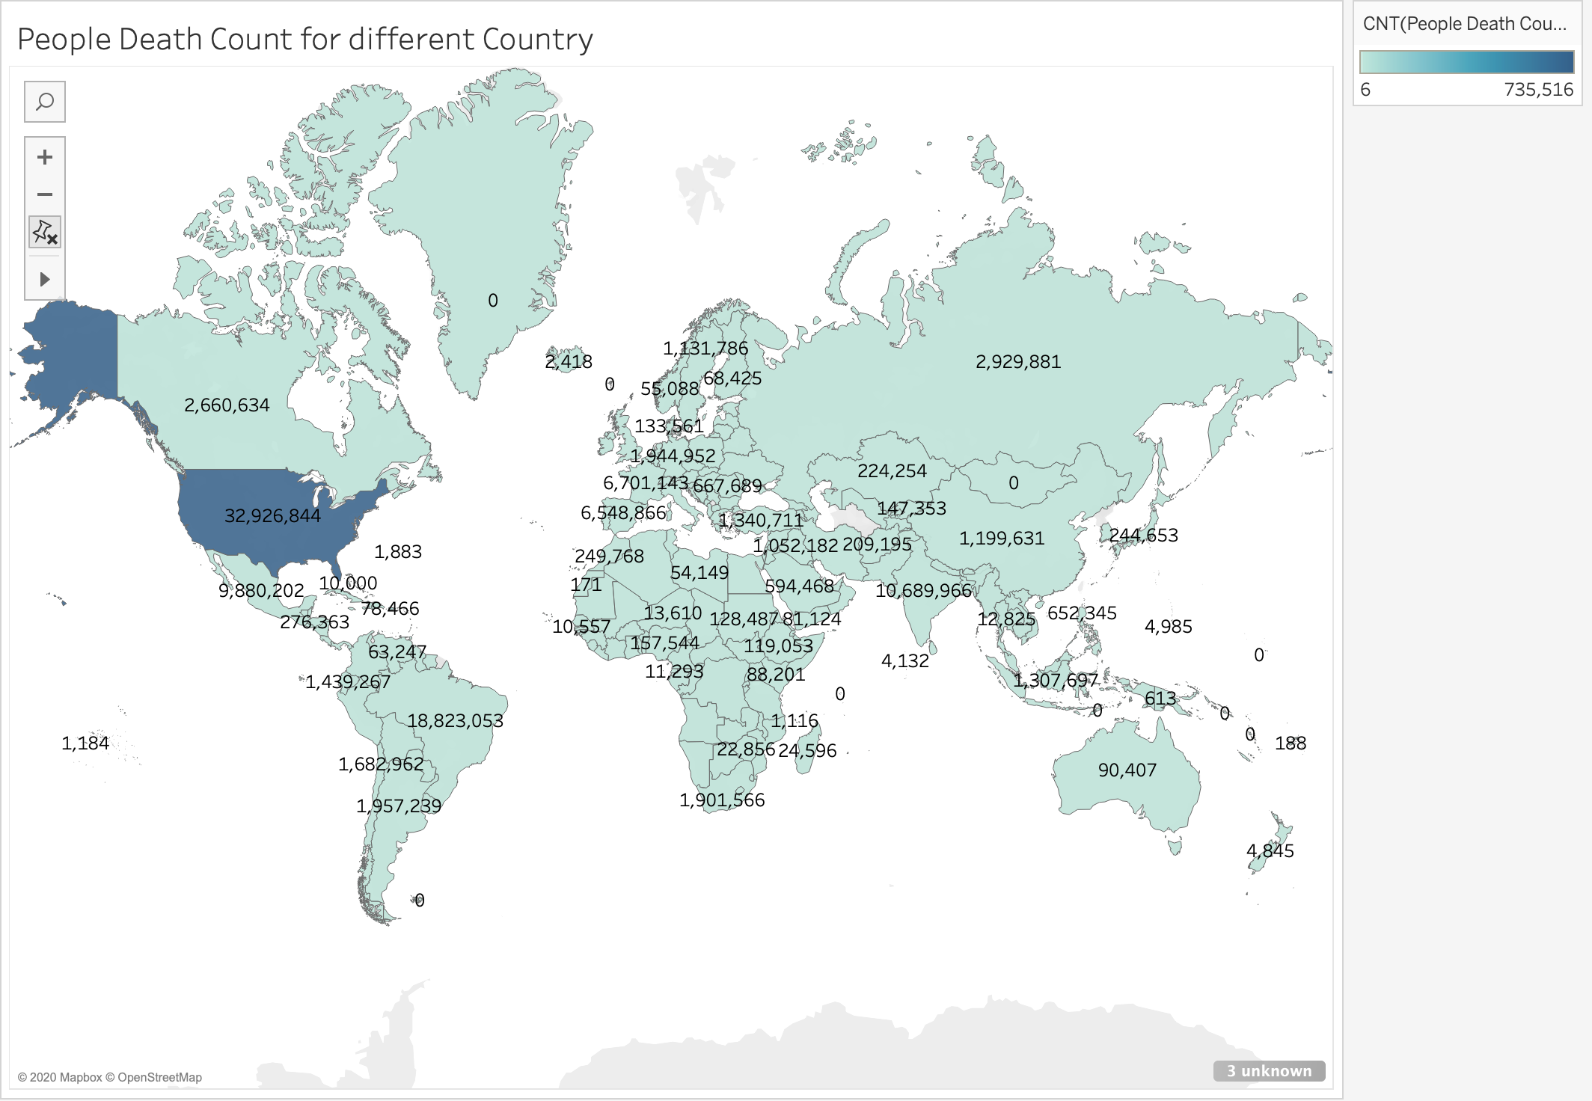
DATA MINING
VISUALIZATION OF DEATH CASES
FOR DIFFERENT COUNTRIES

Slide 8
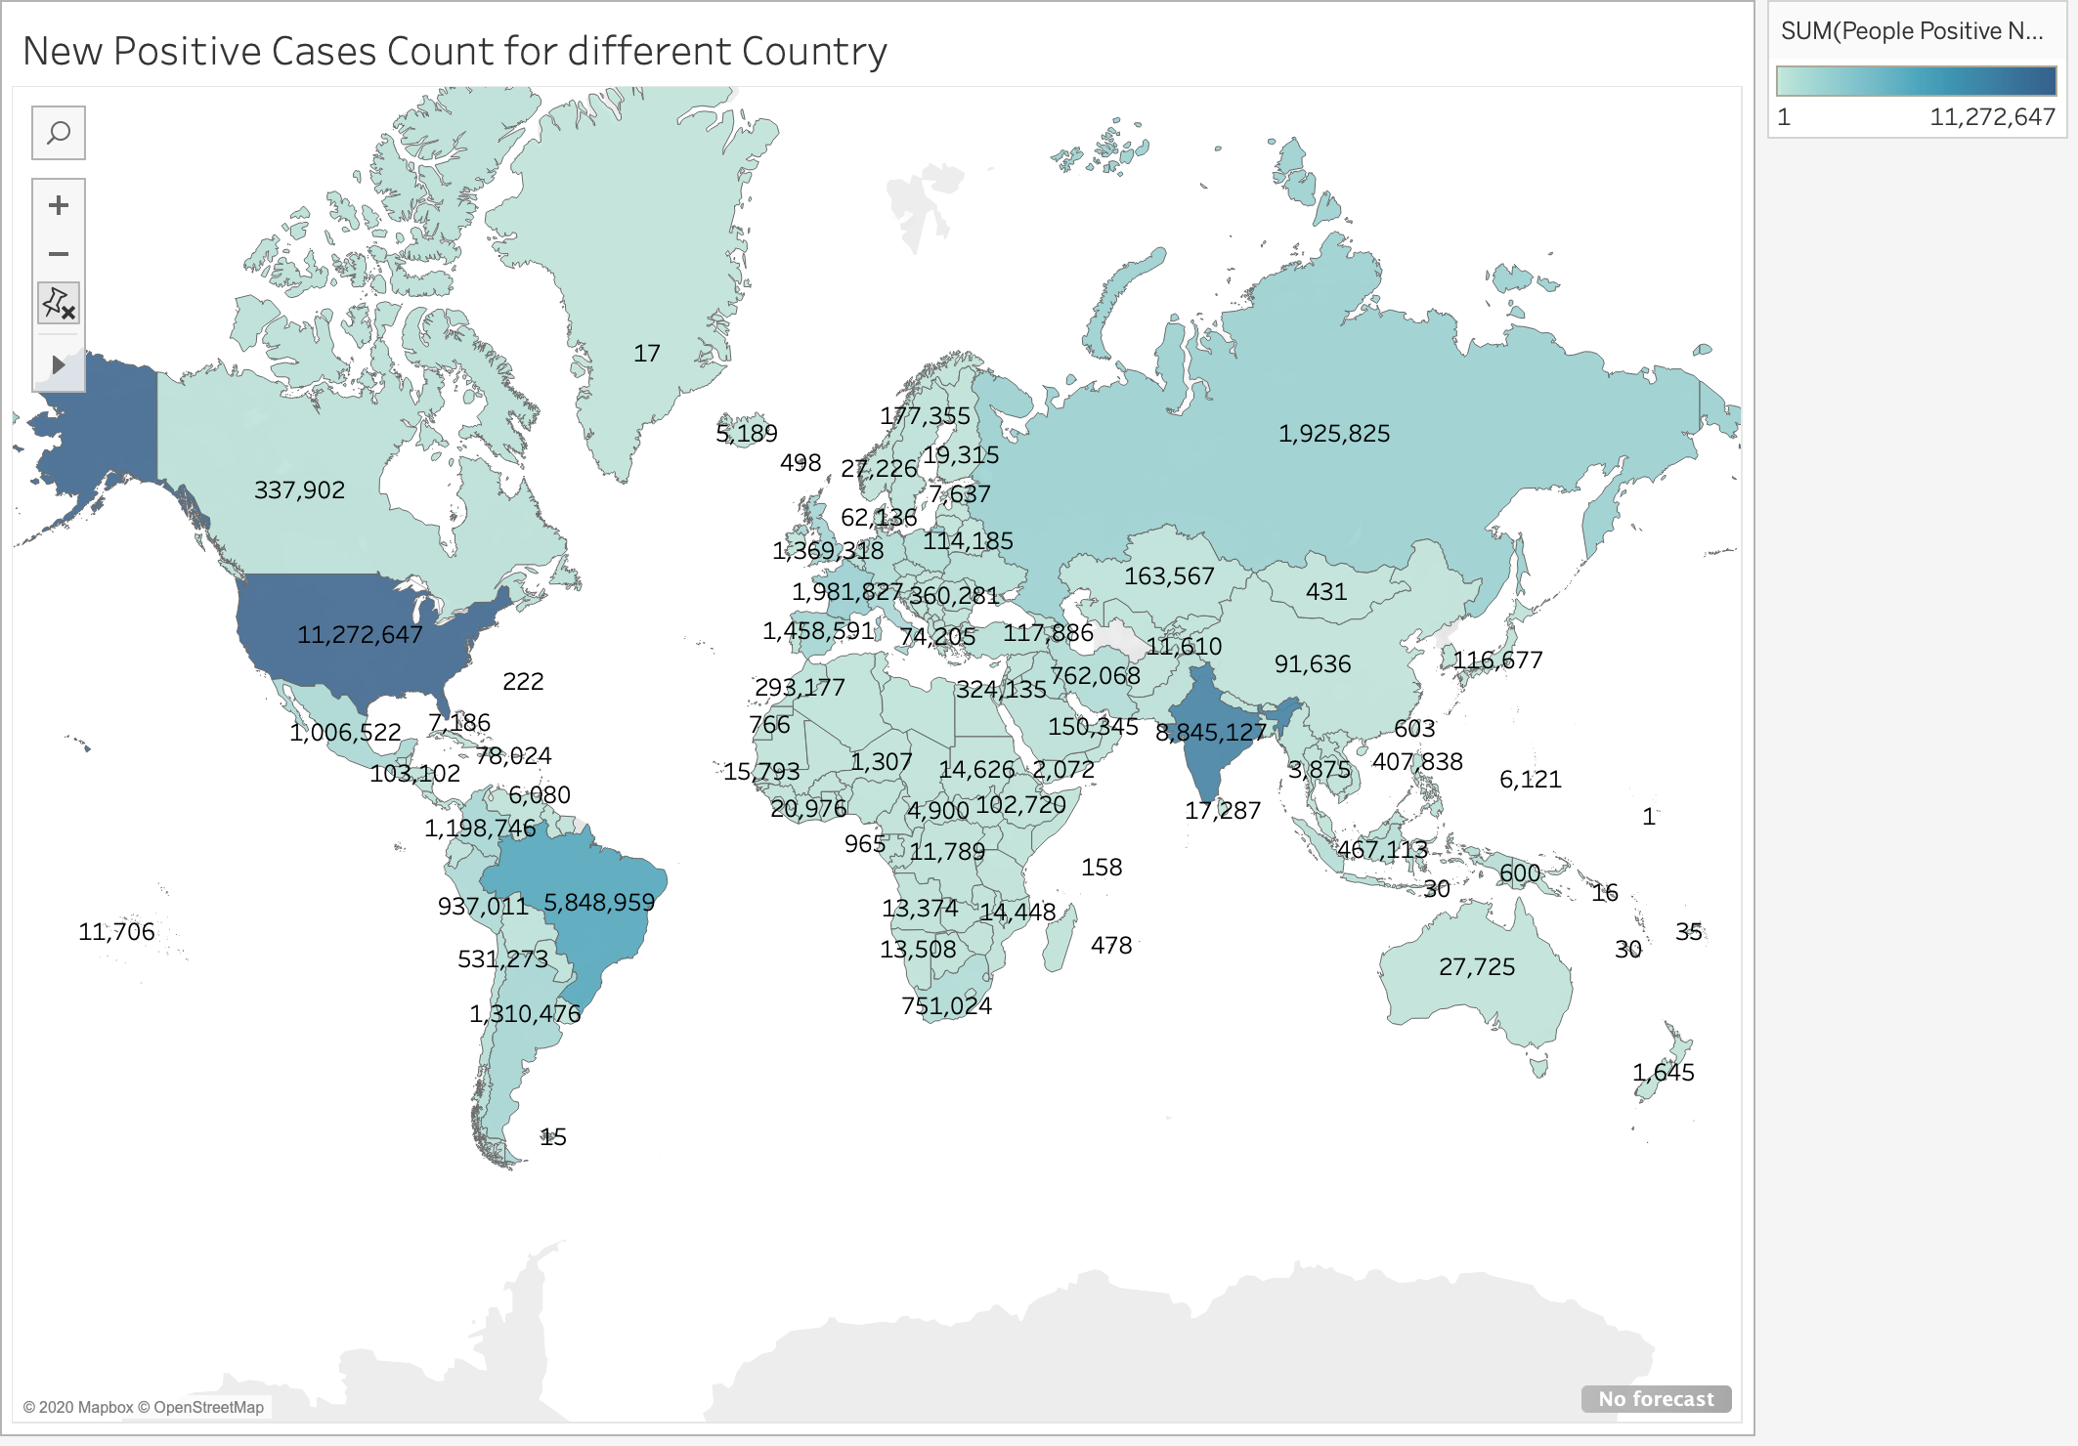
DATA MINING
VISUALIZATION OF DAILY POSITIVE CASES FOR DIFFERENT COUNTRIES

Slide 9
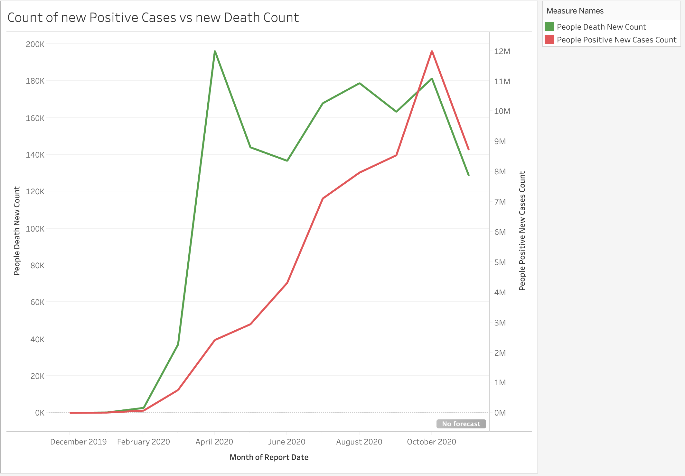
DATA MINING
PAIRWISE COMPARISON OF PEOPLE_DEATH_NEW_COUNT and PEOPLE_POSITIVE_NEW_CASES_COUNT with REPORT_DATE

Slide 10
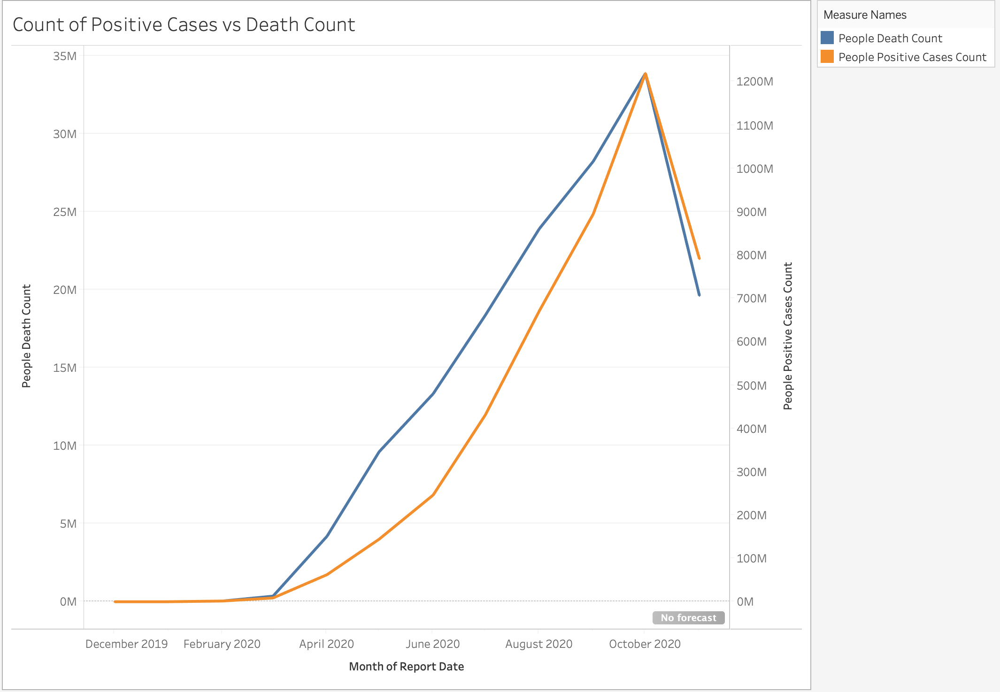
DATA MINING
PAIRWISE COMPARISON OF PEOPLE_DEATH_COUNT and PEOPLE_POSITIVE_CASES_COUNT
with REPORT DATE

Slide 11
DATA MINING
ALGORITHMS
SARIMA
DECISION TREE

Slide 12
DATA MINING
Autoregressive integrated moving average model(ARIMA) is a forecasting algorithm that uses the time series’s past values to predict future values.
Seasonal Autoregressive integrated moving average model(SARIMA) is a modification of ARIMA that explicitly supports univariate time series data with a seasonal component.
It adds three new hyperparameters to specify the autoregression (AR), differencing (I) and moving average (MA) for the seasonal component of the series, as well as an additional parameter for the period of the seasonality.
SARIMA

Slide 13
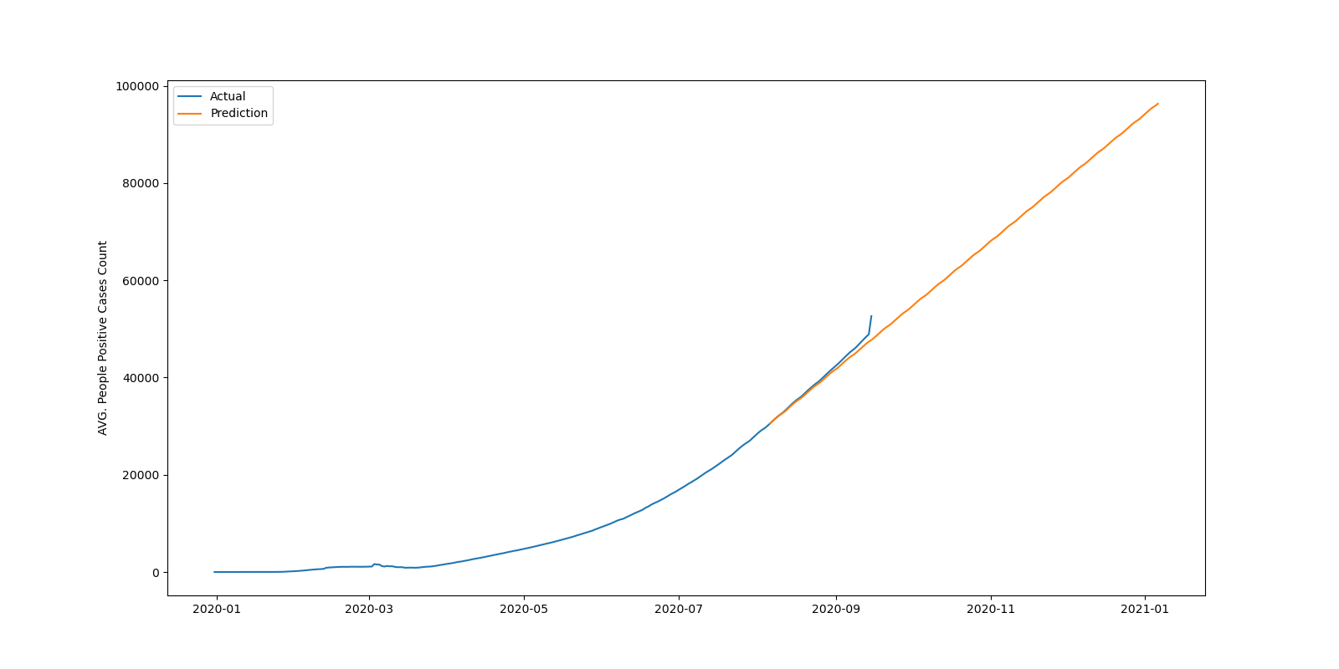
DATA MINING
SARIMA: RESULTS
[Prediction for next 3 months]

Slide 14
DATA MINING
A regression model is built by the Decision tree in a tree structure by breaking down a large data-set into smaller subsets while increasing and developing a linked decision tree.
The result is a decision tree with decision nodes and leaf nodes which represent the tested attribute.
GridSearchCV is a hyper-parameter tuner for an estimator such as decision tree.
It implements a fit and score method which is optimized by cross-validated grid-search over a parameter grid.
DECISION TREE

Slide 15
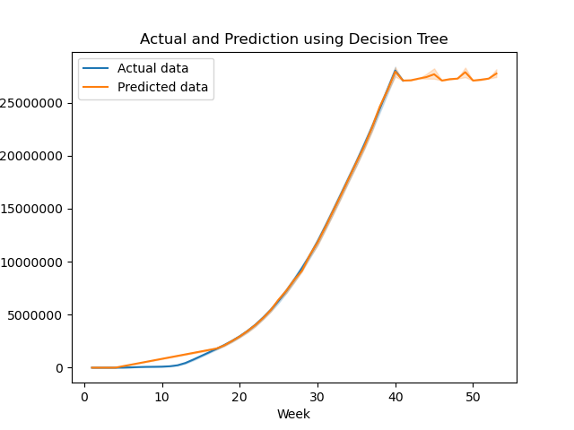
DATA MINING
DECISION TREE: RESULTS
[Prediction for next 12 weeks]

Slide 16
CHALLENGES AND LESSONS LEARNED
Understanding the data sources
Deciding the final set of attributes from three data sources
Filling missing date values

Slide 17
CONCLUSION
Gathered data from three sources
Cleaned, added missing values and merged the data
Visualized three attributes and performed two pairwise comparison of attributes
Used SARIMA algorithm to forecast the positive cases for next four months
Used DECISION TREE algorithms to forecast the positive cases for next 12 weeks

Slide 18
FUTURE WORK
Automated script to update the database on a daily basis
Planning to make a GUI that would allow us to present a collaborative report of the dataset and help us visualize as we want (reports on daily basis, country wise, continent wise etc.)

